Slide 1
HNDIT 4012 Software Engineering
Quality Management

Slide 2
Topics Covered
Software Quality
Software Standards
Reviews and Inspections
Quality Management in Agile Development
Software Measurement

Slide 3
What is Software Quality Management?
Software Quality Management (SQM) refers to activities that ensure software meets-
  Customer requirements
  Organizational standards
  Reliability expectations
  Maintainability requirements

Slide 4
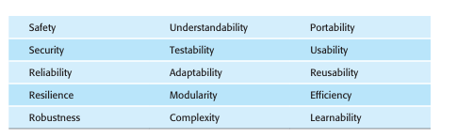
Software Quality Attribute

Slide 5
Quality Management Activities
Quality Planning
Quality Assurance
Quality Control

Slide 6
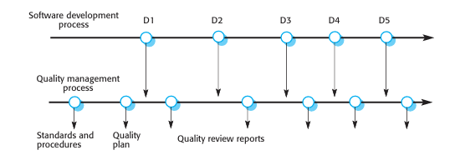
Software Quality Process

Slide 7
Quality Planning
Product description
Quality goals
Review procedures
Testing strategy
Standards to be followed

Slide 8
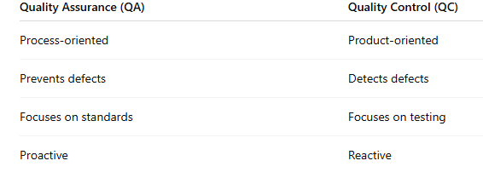
Quality Assurance vs Quality Control

Slide 9
Software Standards
Software standards are documented best practices that support quality assurance.
Purpose
  Improve consistency
  Improve communication
  Reduce errors
  Support maintainability

Slide 10
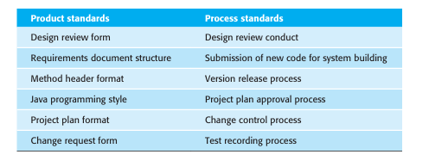
Types of Standards

Slide 11
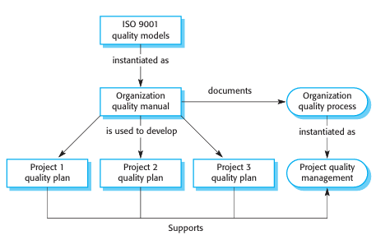
ISO 9001 and Quality Management
Organizational quality procedures.
Compliance with defined processes.
Documentation of quality activities.

Slide 12
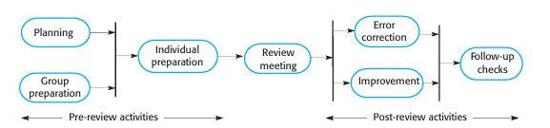
Software Reviews
Team members examine documents or code.
Quality standards are checked.
Findings are recorded.
Defect reports

Slide 13
Software Inspection
A peer-review process where developers systematically examine source code to identify defects.
  Logical errors
  Missing functionality
  Coding standard violations
  Design inconsistencies

Slide 14
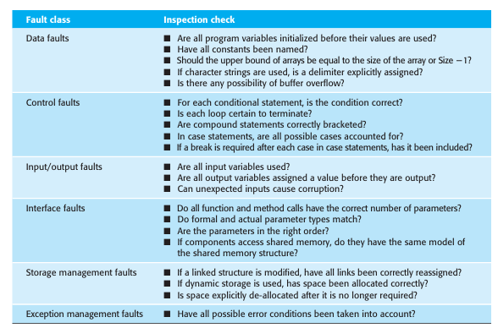
Inspection Checklists

Slide 15
Quality Management and Agile Development
Refactoring
Test-Driven Development (TDD)
Continuous Testing
Team Responsibility

Slide 16
Quality Culture in Agile Teams
Traditional Approach-
  Dedicated QA teams
Agile Approach-
  Quality is built into development activities.
  Team members work together to improve quality.

Slide 17
Software Measurement
Software measurement involves collecting quantitative data about
  Product Metrics
  Process Metrics

Slide 18
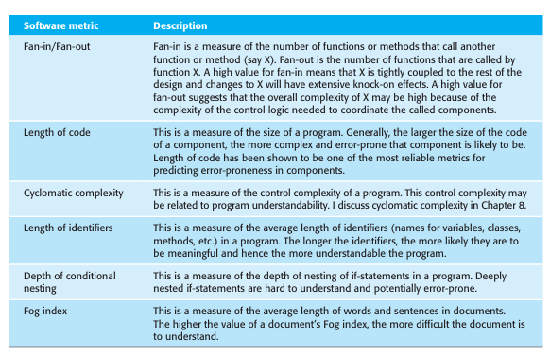
Product Metrics

Slide 19
Process Metrics
Measure software processes.
Examples-
  Defects discovered
  Review effectiveness
  Development effort

Slide 20
Summary
Software Quality Management
Quality Techniques
Agile Quality Managemen
Software Measurement

