Slide 1
HNDIT 4012 Software Engineering
Configuration Management

Slide 2
Learning Outcome
Define Configuration Management (CM)
Explain why Configuration Management is important
Describe the four Configuration Management activities
Explain Version Management
Explain System Building
Explain Change Management
Explain Release Management

Slide 3
What is Configuration Management?
Configuration Management (CM) is the collection of policies, processes and tools used to manage changing software systems

Slide 4
Why is Configuration Management Needed?
Bugs are fixed
New features are added
Customer requirements change
Operating systems change
Hardware changes
Multiple developers work on the same project

Slide 5
Real World Example
Developers create new code.
Testers verify the feature.
Managers approve it.
The new version is stored.
Version 2.35 is released.
If bugs appear,Developers return to Version 2.34.

Slide 6
Configuration Management Activities
Version Management
System Building
Change Management
Release Management

Slide 7
Version Management
Version Management keeps track of every version of software components.
  previous versions are stored
  developers work safely
  changes are not lost
  software history is maintained

Slide 8
Common Version Management Terms
Configuration Item (SCI)
Version
Baseline
Codeline
Branching
Merging
Release
Mainline

Slide 9
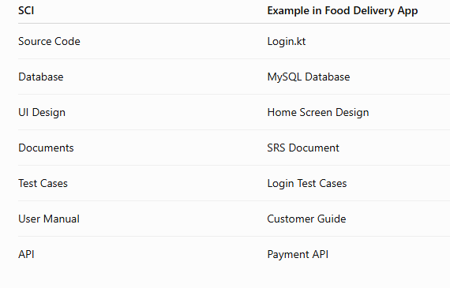
Software Configuration Items
A Software Configuration Item (SCI) is any item that must be managed during software development.

Slide 10
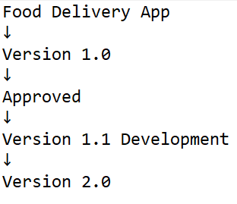
Baseline
A Baseline is an approved version of software.

Slide 11
Version Control System
Git
GitHub
GitLab
Bitbucket

Slide 12
Git Example
Suppose three developers work together.
Each developer creates a separate Branch.
After testing, All branches are merged into the Main Branch.

Slide 13
System Building
Assembling components
Compiling source code
Linking libraries
Generating executable software

Slide 14
Change Management
Change Management controls software modifications after development.
Changes may come from
  customers
  testers
  developers
  management

Slide 15
Release Management
Release Management prepares software for customer delivery.
A release includes
  Executable program
  Configuration files
  Data files
  Documentation

Slide 16
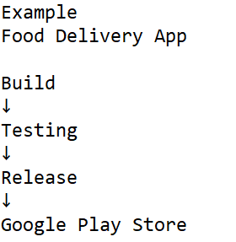
Release Types
Major Release (Version 2.0)
Minor Release (Version 2.1)
Patch (2.1.1)
Hotfix (Emergency Fix)

Slide 17
Real-World Example
A university develops a Student Management System.
  Developer A builds the Login module.
  Developer B builds the Attendance module.
  Git stores every change.
  Jenkins automatically builds the project.
  After testing, Version 2.0 is released to students.

Slide 18
Advantages of Configuration Management
Better teamwork
Easy tracking of software versions
Prevents data loss
Faster recovery
Easier maintenance
Improved software quality
Reliable software releases

Slide 19
DevOps
DevOps is a software development approach that brings Development (Dev) and Operations (Ops) teams together to build, test, release, and maintain software more quickly and reliably.

Slide 20
Summary
Version Management
System Building
Change Management
Release Management

