Slide 1
Software Quality Assurance
HNDIT-4022
Static Verification Techniques

Slide 2
Software Verification Vs Validation
Verification is
Verification typically involves reviews and meetings to evaluate documents, plans, code, requirements, and specifications. This can be done with checklists, issues lists, walkthroughs, and inspection meetings.
Two Types of Verification;
  Dynamic verification, also known as Test or Experimentation - This is good for finding bugs
  Static verification, also known as Analysis - This is useful for proving correctness of a program although it may result in false positives

Slide 3
Software Verification Vs Validation
Validation is
Validation typically involves actual testing and takes place after verifications are completed.

Slide 4
Software Verification Vs Validation…
Software verification asks the question, "Are we building the product right?"; that is, does the software conform to its specification.
Software validation asks the question, "Are we building the right product?"; that is, is the software doing what the user really requires.

Slide 5
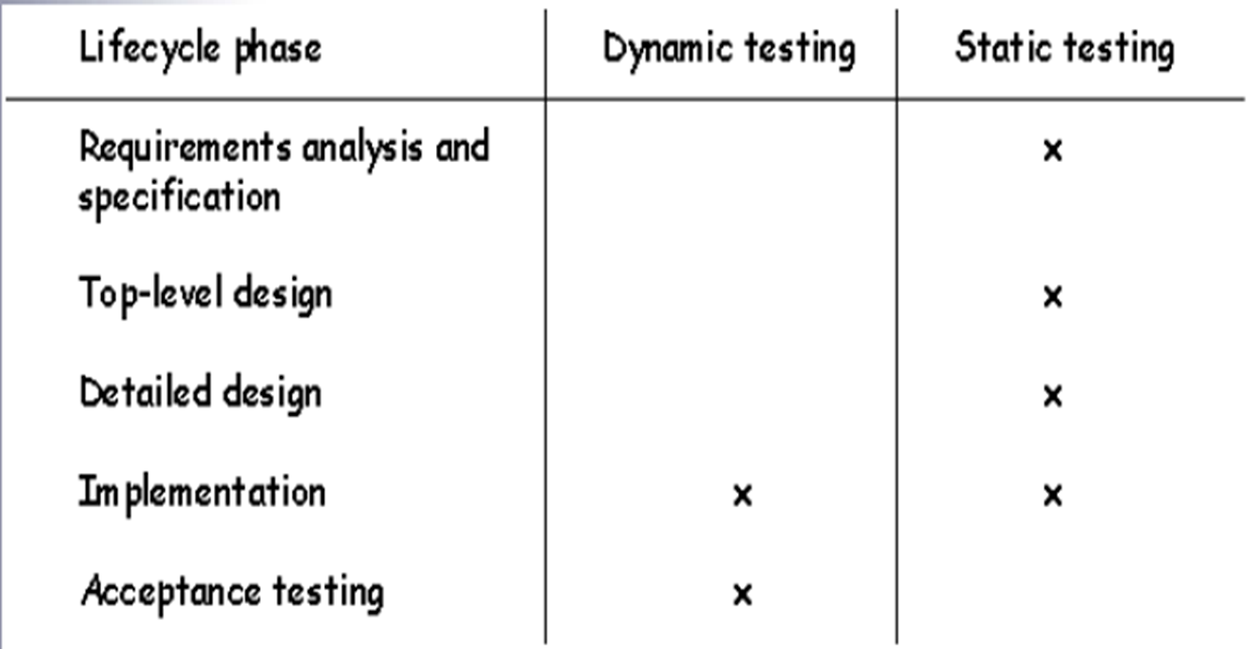
Software Verification Vs Validation…

Slide 6
What is Static Testing?
Static Testing is a software testing technique that involves reviewing and analyzing:- software documentation – design, or code without executing the software. It is a way of checking for errors and defects in the software by examining it in a “static” state rather than actively running it.
Static Testing aims to identify issues early in software development when they are easier and less costly to fix.
By catching defects early, Static Testing can help improve the software’s overall quality and reliability.
Also, it enhances maintainability and ultimately saves time and money in the long run.

Slide 7
What is Static Testing?...
There are two basic types of static testing.
1. People-based - People-based techniques are generally known as “reviews" There are different ways in which reviews can be performed.
2. Tool-based -The tool-based techniques examine source code and are known as "static analysis"

Slide 8
Why Static Testing?
Static Testing is a valuable technique because it helps detect errors and defects in software before it is tested.
For example, You review software requirements as part of Static Testing. You may identify potential conflicts that could be difficult to address later in the development cycle. Similarly, if you review code during Static Testing, you may spot issues like
coding errors,
inconsistent naming conventions
Notes:
This can save time, resources, and costs in the long run. Also, it catches issues early when they are easier and less expensive to fix.

Slide 9
When to Perform Static Testing?
Static testing is recommended to be done during the design, documentation, and development phases before dynamic testing commences.

Slide 10
Objectives of Static Testing
Ensure all programming conventions, standards, and guidelines are followed.
Verify that the source code is complete and can be compiled & built.
Ensure that all design and implementation specifications are met.
Identify areas of the software that may have logical, structural, formatting, or syntactic errors.

Slide 11
What is Subject to Static Testing?
Here are some major features that are subject to static testing,
Requirements & Specifications Review
Structural Design Analysis
Code Review
Database Analysis
Documentation Review
User Manual Review
Notes:
Requirements & Specifications Review: This includes analyzing the functional and non-functional requirements. We can also look at the feasibility of meeting the specified needs.
Structural Design Analysis: We must review the system’s static structure and flow diagrams to ensure it meets the system requirements.
Code Review: This involves manually inspecting and analyzing the source code to ensure the absence of errors and adherence to conventions and standards.
Database Analysis: We need to check for inconsistencies and ensure that all the database objects are consistent and aligned with the database design.
Documentation Review: We must assess the documentation to ensure accuracy and readability.
User Manual Review: We must review the user guide to ensure users can easily use the system.

Slide 12
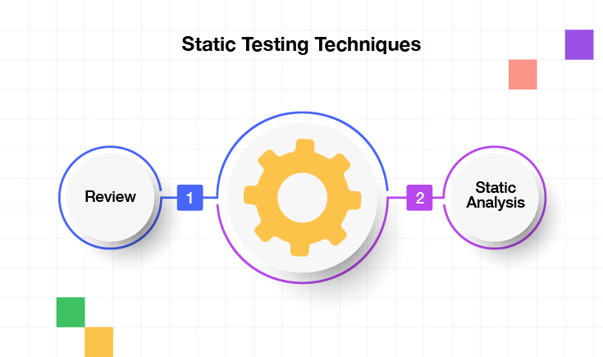
Static Testing Techniques
Static Testing is a necessary software testing technique comprising two approaches;
Review
Static Analysis

Slide 13
Static Testing Techniques…
Review
Reviews are a necessary feature of Static Testing. It enables testers to identify defects and issues in documentation, such as requirements and design. The importance of reviews lies in detecting the sources of failure at the earliest stage.
Static Analysis
Static Analysis refers to the process of analyzing computer software without executing it. This is typically done by examining the source code, bytecode, or other program representations. The purpose of static analysis is to identify potential issues, vulnerabilities, or bugs early in the software development lifecycle.
.

Slide 14
Benefits of Static Testing
Static Testing provides several benefits to software development projects.
Early defect detection
Improved code quality
Reduced costs and time
Prevention of common issues
Improved collaboration
Notes:
Early defect detection: Static Testing helps detect errors, defects, and bugs early in the development process when they are most cost-effective and easier to fix.
Improved code quality: Static Testing helps ensure that code is well-structured, easy to maintain, and meets industry-recognized coding standards. This leads to higher code quality and reduces the chance of bugs and defects in the final product.
Reduced costs and time: Detecting defects early on reduces the costs and time associated with fixing them. This can save significant amounts of resources throughout the development cycle.
Prevention of common issues: Static Testing helps prevent common issues such as syntax errors, null pointer exceptions, and resource leaks. By proactively addressing these issues during development, teams can avoid problems later.
Improved collaboration: Static Testing helps identify issues in a collaborative environment, promoting knowledge-sharing and fostering communication between team members.

Slide 15
Type of Static Testing
Static Testing can be covered under two different types:
Manual Static Testing
Automated Static Testing

Slide 16
Manual Method of Static Testing
Manual static testing methods are techniques used to identify errors and defects in software code and documentation without actually executing the code
Inspections
Walkthroughs
Informal reviews
Technical reviews
Audits

Slide 17
Automation Method of Static Testing
This method leverages specialized tools to analyze source code, documentation, and other artifacts without execution.
Static Analysis : Tools dissect the code’s structure, logic, and flow, identifying potential errors like:
Syntactic errors
Logic errors
Security vulnerabilities
Code quality issues
Coding standard violations
Code Reviews & Lint Checks
Formal Methods

Slide 18
Automation Method of Static Testing…
Code Reviews & Lint Checks: Tools scan the code for adherence to defined coding standards and best practices, highlighting areas for improvement.
Formal Methods: Utilize mathematical techniques to prove the correctness of code properties and ensure they adhere to specific specifications.

Slide 19
Tools Used for Static Testing
Here are some tools;
Checkstyle
SourceMeter
Soot
Lint
SonarQube
PDM
Findings
Notes:
Loss of money – this can include losing customers right through to financial penalties for non-compliance to legal requirements
Loss of time – this can be caused by transactions taking a long time to process but can include staff not being able to work due to a fault or failure
Damage to business reputation – if an organization is unable to provide service to their customers due to software problems then the customers will lose confidence or faith in this organization (and probably take their business elsewhere)
Injury or death – It might sound dramatic but some safety-critical systems could result in injuries or deaths if they don’t work properly (e.g. flight traffic control software)

Slide 20
What is Tested in Static Testing?
Key areas of Static Testing;
Code Quality
Syntax errors
Coding standards
Potential bugs
Performance bottlenecks
Security vulnerabilities
Documentation Quality
Requirements completeness and consistency
Design document correctness
Test plan completeness and feasibility
Notes:
Loss of money – this can include losing customers right through to financial penalties for non-compliance to legal requirements
Loss of time – this can be caused by transactions taking a long time to process but can include staff not being able to work due to a fault or failure
Damage to business reputation – if an organization is unable to provide service to their customers due to software problems then the customers will lose confidence or faith in this organization (and probably take their business elsewhere)
Injury or death – It might sound dramatic but some safety-critical systems could result in injuries or deaths if they don’t work properly (e.g. flight traffic control software)

Slide 21
How Static Testing is Performed?
How static testing is performed;
The first step in static testing is planning.
prepare the necessary artifacts, such as source codes, design documents, requirements documents, and test cases.
Static analysis is the core of this testing.
Code reviews are an essential component of the static testing process.
Small team of experts systematically reviews the code and finds potential errors using various methods.
Any issues or bugs during the static testing process are reported and documented.
The results collected during the static testing process should be analyzed to determine the quality of the software product. This is the final step in static testing.
Notes:
Loss of money – this can include losing customers right through to financial penalties for non-compliance to legal requirements
Loss of time – this can be caused by transactions taking a long time to process but can include staff not being able to work due to a fault or failure
Damage to business reputation – if an organization is unable to provide service to their customers due to software problems then the customers will lose confidence or faith in this organization (and probably take their business elsewhere)
Injury or death – It might sound dramatic but some safety-critical systems could result in injuries or deaths if they don’t work properly (e.g. flight traffic control software)

Slide 22
Advantages of Software Review
Defects can be identified earlier stage of development (especially in formal review).
Earlier inspection also reduces the maintenance cost of software.
It can be used to train technical authors.
Reviews can improve software development productivity and reduce development timescales.
They can also reduce testing time and cost.
Reviews generally reduce fault levels and lead to increased quality. This can also result in improved customer relations.
Reviews are cost-effective.

Slide 23
Activity:
What is Static Testing?
What is tested in static testing?
Who inspects the documents in static testing?
State the different between Static testing and Dynamic testing.

Slide 24
Q&A’s ?
Thank you !

