Slide 1
Software Quality Assurance
HNDIT-4022
Software Testing Techniques

Slide 2
Software Testing Techniques
Testing Techniques:
Testing techniques are the means used by testers to accomplish their test objectives.
Software Testing Techniques help you design better test cases. Since exhaustive testing is not possible;
Manual Testing Techniques help reduce the number of test cases to be executed while increasing test coverage.
They help identify test conditions that are otherwise difficult to recognize.

Slide 3
Type of Software Testing Technique
Black Box Testing
White Box Testing
Gray Box Testing

Slide 4

Black Box Testing
Black Box Testing : tester tests the application.software by applying different inputs and comparing the output with expected results.
It is also known as Behavioural Testing.

Slide 5
Techniques in Black Box Testing
Boundary Value Analysis
Equivalence class partitioning
Decision Table based testing
State Transition
Error guessing

Slide 6
White Box Testing
White box testing is a verification technique where software engineers can use to examine if the code works as expected or not.
It is the strategy testing is based on
Software’s internal paths
Design and coding
Logics
Structures
Implementation of software under test

Slide 7
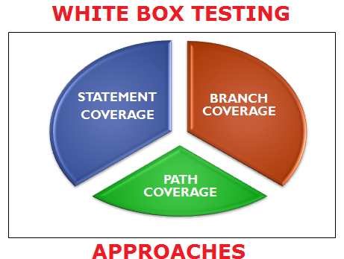
Techniques in White Box Testing

Slide 8

Gray Box Testing
It is a software testing methodology to test the software with partial knowledge of the code in the application—a combination Black and White box testing.

Slide 9
Techniques in Gray Box Testing
Matrix Testing
Regression Testing
Orthogonal Array Testing
Pattern Testing

Slide 10
Q&A’s ?
Thank you !

