Slide 1
Software Quality Assurance
HNDIT-4022
Test Case Design & Test Cases

Slide 2
What's a 'Test Case'?
Test Case is;
A test case is a set of actions performed on a system to determine if it satisfies software requirements and functions correctly.
A test case describes an input, action, or event and an expected response, to determine if a feature of a software application is working correctly.

Slide 3
Test Case-Definitions:
IEEE Standard 610 (1990) defines test case as follows:
“A set of test inputs, execution conditions, and expected results developed for a particular objective, such as to exercise a particular program path or to verify compliance with a specific requirement.”
IEEE Standard 829 (1983) defines test case as follows:
“Documentation specifying inputs, predicted results, and a set of execution conditions for a test item.”
According to Ron Patton (2001):
“Test cases are the specific inputs that you’ll try and the procedures that you’ll follow when you test the software.”
Boris Beizer (1995):
“A sequence of one or more subtests executed as a sequence because the outcome and/or final state of one subtest is the input and/or initial state of the next. The word ‘test’ is used to include subtests, tests proper, and test suites.”

Slide 4
Why we need test cases?
We will write the test for the following reasons:
To require consistency in the test case execution
To make sure a better test coverage
It depends on the process rather than on a person
To avoid training for every new test engineer on the product
Notes:
To require consistency in the test case execution: we will see the test case and start testing the application.
To make sure a better test coverage: for this, we should cover all possible scenarios and document it, so that we need not remember all the scenarios again and again.
It depends on the process rather than on a person: A test engineer has tested an application during the first release, second release, and left the company at the time of third release. As the test engineer understood a module and tested the application thoroughly by deriving many values. If the person is not there for the third release, it becomes difficult for the new person. Hence all the derived values are documented so that it can be used in the future.
To avoid giving training for every new test engineer on the product: When the test engineer leaves, he/she leaves with a lot of knowledge and scenarios. Those scenarios should be documented so that the new test engineer can test with the given scenarios and also can write the new scenarios.

Slide 5
Types of Test Cases
Positive Test Cases
Negative Test Cases
Notes:
Positive Test Cases: Entering valid data into an application to determine if its processing results are correctly produced as defined in the requirement specification.
Negative Test Cases: Entering incorrect data intentionally to determine if an application will recognize the data entered is invalid and take appropriate action

Slide 6
Elements of a Test Case
Followings are the elements of test cases:
Test Case ID
Test Scenario
Test Case Description
Test Steps
Prerequisite
Test Data
Expected Result
Actual Result
Environment Information
Comments

Slide 7
Attributes of a Good Test Case
Attributes of a good test case are as follows:
Accurate
Economical
Repeatable, self-standing
Appropriate
Traceable

Slide 8
Test Case Design Techniques
What is a Test Design Technique?
Test case design technique is a procedure for selecting or designing tests based on a structural or functional model of the software. It is successful at finding faults and deriving good test cases.

Slide 9
Categories of Test Design Techniques
Test design techniques can be widely categorized into three different areas as follows:
1. Specification-Based or Black Box Design Techniques
2. Structure based or White Box Design Techniques
3. Experienced Based Testing Techniques

Slide 10
Advantages of Test Design Techniques
Test Design finds Faults in early stage.
Faults found early are cheaper to fix.
Early test design technique can prevent faults from entering into the system.
Change requests can be reduced considerably through test design.
Early test design helps to build quality and stops fault multiplication.

Slide 11
How to Choose a Test Design Technique?
Following are the list of factors that influence the selection of the appropriate test design technique for a particular kind of problem:
The type of system,
Risk identified,
Customer requirements,
Models for use case modeling,
Requirements models or tester knowledge.

Slide 12
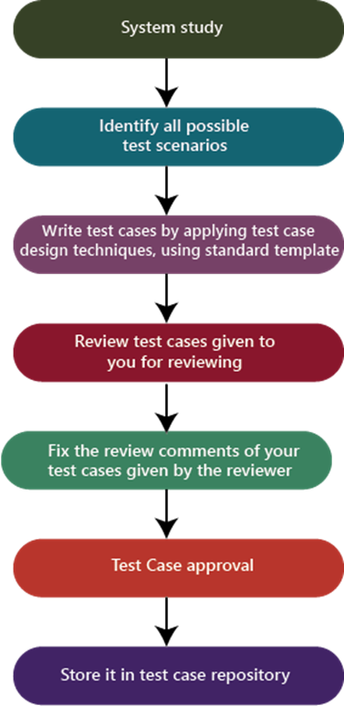
The Process To Write Test Cases

Slide 13
Best Practice for writing good Test Case.
1. Test Cases need to be simple and transparent
2. Create Test Case with End User in Mind
3. Avoid test case repetition
4. Do not Assume
5. Ensure 100% Coverage
6. Test Cases must be identifiable
7. Implement Testing Techniques
8. Self-cleaning
9. Repeatable and self-standing
10. Peer Review

Slide 14
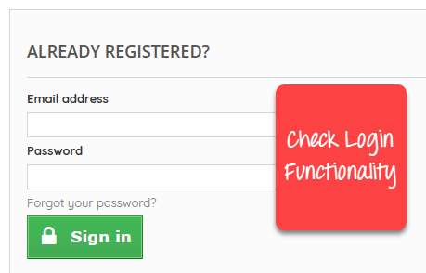
The Process To Write Test Cases
Example : Create a Test Case for the scenario: Check Login Functionality.
Notes:
Positive Test Cases:
– Successful login with valid credentials.
– Login with a valid username and case-insensitive password.
– Successful login with a remembered username and password fields.
– Successful login after password reset.
– Login from multiple devices simultaneously.
– Successful login using a social media account integration.
– Login with a valid username and password within specified character limits.
– Successful login with special characters in the password.
Negative Test Cases:
– Unsuccessful login with an invalid username and password.
– Login with a blank username and password.Unsuccessful login with an expired account.
– Login attempt with an account locked due to multiple unsuccessful tries.
– Login with a valid username and an incorrect case-sensitive password.

Slide 15
Q&A’s ?
Thank you !

