Slide 1
Software Quality Assurance
HNDIT-4022
White Box Testing

Slide 2
White Box Testing
White box testing techniques analyze the internal structures the used data structures, internal design, code structure, and the working of the software rather than just the functionality as in black box testing. It is also called glass box testing or clear box testing or structural testing. White Box Testing is also known as transparent testing or open box testing.

Slide 3
White Box Testing
White box testing is a verification technique where software engineers can use to examine if the code works as expected or not.
It is the strategy testing is based on
Software’s internal paths
Design and coding
Logics
Structures
Implementation of software under test

Slide 4
Process of White Box Testing
Input: Requirements, Functional specifications, design documents, source code.
Processing: Performing risk analysis to guide through the entire process.
Proper test planning: Designing test cases to cover the entire code. Execute rinse-repeat until error-free software is reached. Also, the results are communicated.
Output: Preparing final report of the entire testing process.

Slide 5
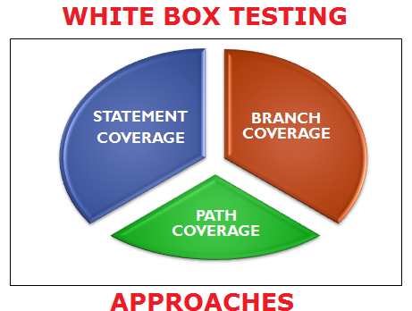
Techniques in White Box Testing

Slide 6
Testing Techniques…
1. Statement Coverage
In this technique, the aim is to traverse all statements at least once. Hence, each line of code is tested. In the case of a flowchart, every node must be traversed at least once. Since all lines of code are covered, it helps in pointing out faulty code.

Slide 7
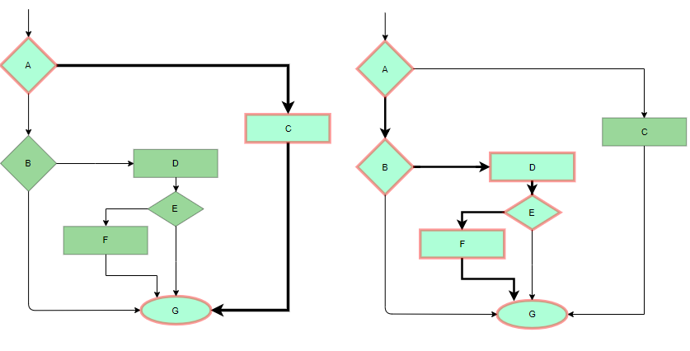
1. Statement Coverage…

Slide 8
2. Branch Coverage:
In this technique, test cases are designed so that each branch from all decision points is traversed at least once. In a flowchart, all edges must be traversed at least once.

Slide 9
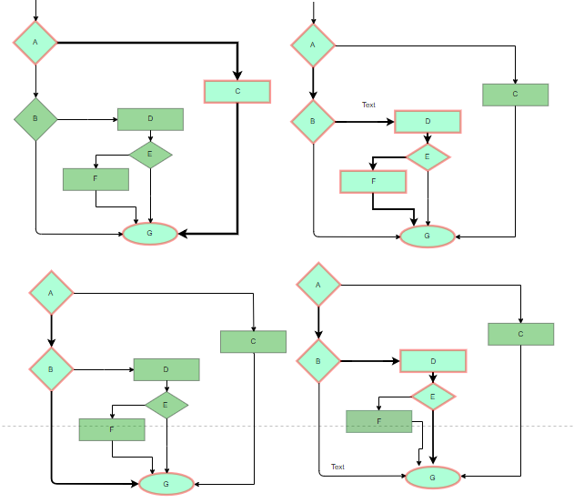
2. Branch Coverage…

Slide 10
3. Condition Coverage
In this technique, all individual conditions must be covered as shown in the following example:
READ X, Y
IF(X == 0 || Y == 0)
PRINT ‘0’
#TC1 – X = 0, Y = 55
#TC2 – X = 5, Y = 0

Slide 11
Other White Box Testing Techniques
4. Multiple Condition Coverage
5. Basic Path Testing
6. Loop Testing
Simple loops
Nested loops
Concatenated loops
White Testing is performed in 2 Steps;
Tester should understand the code well
Tester should write some code for test cases and execute them

Slide 12
Tools required for White box testing:
PyUnit
Sqlmap
Nmap
Parasoft Jtest
Nunit
VeraUnit
CppUnit
Bugzilla
Fiddler
JSUnit.net
OpenGrok
Wireshark
HP Fortify
CSUnit

Slide 13
Features of White box Testing:
Code coverage analysis
Access to the source code
Knowledge of programming languages
Identifying logical errors
Integration testing
Unit testing
Optimization of code
Security testing
Verification of Design
Check for Accurate Code
Identifying Coding Mistakes
Path Examination
Determining the Dead Code

Slide 14
Advantages of Whitebox Testing:
Thorough Testing:
Code Optimization:
Early Detection of Defects:
Integration with SDLC:
Detection of Complex Defects:
Comprehensive Test Cases:
Testers can ensure that the code meets coding standards and is optimized for performance.

Slide 15
Disadvantages of White box Testing:
Programming Knowledge and Source Code Access:
Overemphasis on Internal Workings:
Bias in Testing:
Test Case Overhead:
Dependency on Tester Expertise:
Inability to Detect Missing Functionalities:
Increased Production Errors:

Slide 16
Q&A’s ?
Thank you !

