Slide 1
Software Quality Assurance
HNDIT-4022
System Integration Testing (SIT)

Slide 2
What is System Integration Testing (SIT)?
System Integration Testing, or SIT, is a QA process that is leveraged to ensure the compatibility of two or more systems. It helps to ensure that the systems are working together correctly and that any interactions are appropriate and safe. This process can involve the testing of software, systems, or networks. It can also involve testing of the system’s performance, integrity, and compatibility.

Slide 3
Importance of System Integration Testing
System integration testing is an essential part of many business operations.
It allows for the identification and cleaning up of systems, data, and processes.
The importance of system integration testing is evident as it verifies that all components of a system interact with each other correctly.
This type of testing ensures that any changes made to one component do not have an adverse impact on the other components or the overall system.
SIT also helps identify and resolve any compatibility issues between different systems, which are necessary for successful integration.
Notes:
In the absence of SIT, there is a risk that modifications or updates made to one component could cause unexpected problems in another component or even crash the entire system. Additionally, SIT helps reduce the cost and time associated with debugging and troubleshooting problems related to integration issues.
SIT also helps identify potential security risks in a system by testing how different components interact with each other, as well as how they respond to external inputs such as user input or data from other systems. By conducting thorough SIT tests, organizations can ensure that their systems are secure and free from vulnerabilities before they go live.

Slide 4
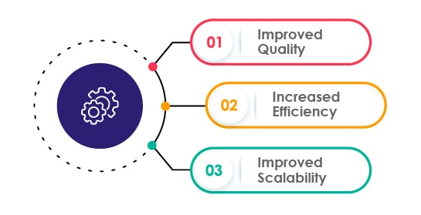
Benefits of System Integration Testing
Notes:
In the absence of SIT, there is a risk that modifications or updates made to one component could cause unexpected problems in another component or even crash the entire system. Additionally, SIT helps reduce the cost and time associated with debugging and troubleshooting problems related to integration issues.
SIT also helps identify potential security risks in a system by testing how different components interact with each other, as well as how they respond to external inputs such as user input or data from other systems. By conducting thorough SIT tests, organizations can ensure that their systems are secure and free from vulnerabilities before they go live.

Slide 5
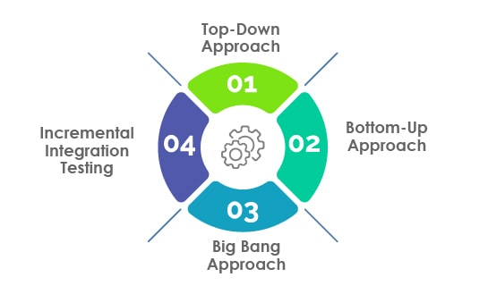
System Integration Testing Techniques
Notes:
In the absence of SIT, there is a risk that modifications or updates made to one component could cause unexpected problems in another component or even crash the entire system. Additionally, SIT helps reduce the cost and time associated with debugging and troubleshooting problems related to integration issues.
SIT also helps identify potential security risks in a system by testing how different components interact with each other, as well as how they respond to external inputs such as user input or data from other systems. By conducting thorough SIT tests, organizations can ensure that their systems are secure and free from vulnerabilities before they go live.

Slide 6
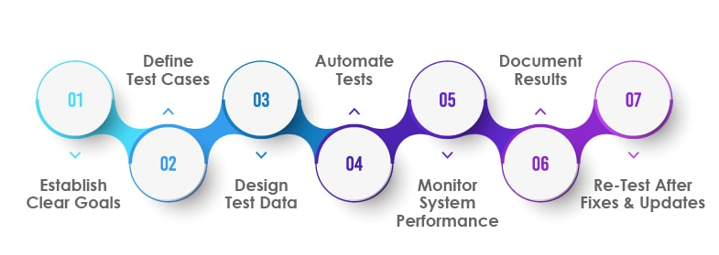
System Integration Testing: Best Practices
Notes:
In the absence of SIT, there is a risk that modifications or updates made to one component could cause unexpected problems in another component or even crash the entire system. Additionally, SIT helps reduce the cost and time associated with debugging and troubleshooting problems related to integration issues.
SIT also helps identify potential security risks in a system by testing how different components interact with each other, as well as how they respond to external inputs such as user input or data from other systems. By conducting thorough SIT tests, organizations can ensure that their systems are secure and free from vulnerabilities before they go live.

Slide 7
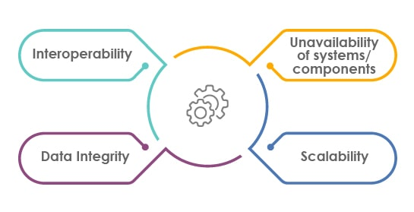
Factors to Consider While Integration Testing
Notes:
In the absence of SIT, there is a risk that modifications or updates made to one component could cause unexpected problems in another component or even crash the entire system. Additionally, SIT helps reduce the cost and time associated with debugging and troubleshooting problems related to integration issues.
SIT also helps identify potential security risks in a system by testing how different components interact with each other, as well as how they respond to external inputs such as user input or data from other systems. By conducting thorough SIT tests, organizations can ensure that their systems are secure and free from vulnerabilities before they go live.

Slide 8
Objective of System Integration Testing
To meet software with user requirements.
To maximize the memory usage.
To control data flow in within the system.
To test the control flow of the system.
To find the errors and bugs in the system.
To minimize time consumption for testing process.
Notes:
In the absence of SIT, there is a risk that modifications or updates made to one component could cause unexpected problems in another component or even crash the entire system. Additionally, SIT helps reduce the cost and time associated with debugging and troubleshooting problems related to integration issues.
SIT also helps identify potential security risks in a system by testing how different components interact with each other, as well as how they respond to external inputs such as user input or data from other systems. By conducting thorough SIT tests, organizations can ensure that their systems are secure and free from vulnerabilities before they go live.

Slide 9
Major States of SIT
There are three major states of SIT.
Data state within the integration layer
Data state within the database layer
Data state within the application layer
Notes:
Data state within the integration layer: Integration layer is the medium used for data transformation. Different web services are involved in this layer which is used as medium for data sending and receiving. There are several check-points where the validation of data is checked and there are several protocols used in it. Middleware is also used as medium for transformation which allows the data mapping against the cross-checking.
Data state within the database layer: Database layer consists of several steps involved in it. It checks whether the data is transformed from integration layer to database layer. Data properties are checked and data validation process is performed. Mainly SQL is used for data storing and data manipulation process.
Data state within the application layer: Application layer is used to create a data map for databases and check its interaction with user interface. Data properties are also checked in it.
In the absence of SIT, there is a risk that modifications or updates made to one component could cause unexpected problems in another component or even crash the entire system. Additionally, SIT helps reduce the cost and time associated with debugging and troubleshooting problems related to integration issues.
SIT also helps identify potential security risks in a system by testing how different components interact with each other, as well as how they respond to external inputs such as user input or data from other systems. By conducting thorough SIT tests, organizations can ensure that their systems are secure and free from vulnerabilities before they go live.

Slide 10
Q&A’s ?
Thank you !

