Slide 1
Software Quality Assurance
HNDIT-4022
System Testing

Slide 2
What is System Testing ?
System testing is a type of software testing that evaluates the overall functionality and performance of a complete and fully integrated software solution. It tests if the system meets the specified requirements and if it is suitable for delivery to the end-users.
This type of testing is performed after the integration testing and before the acceptance testing.

Slide 3
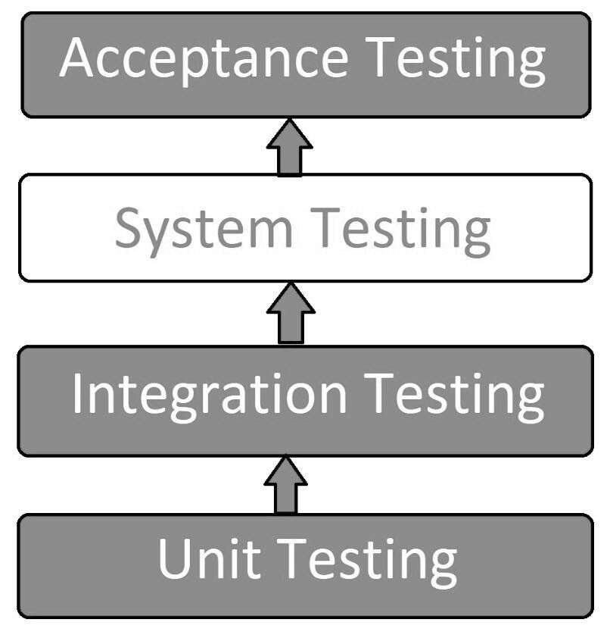
What is System Testing ?

Slide 4
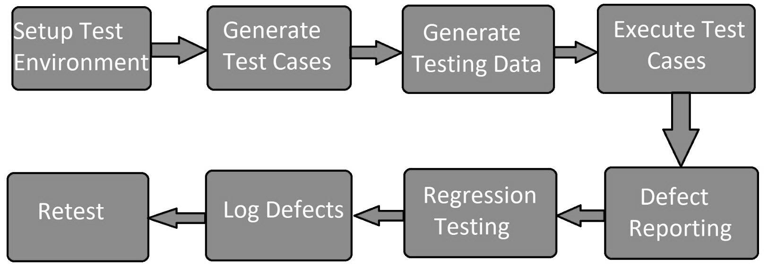
System Testing Process
Notes:
Test Environment Setup: Create testing environment for the better quality testing.
Create Test Case: Generate test case for the testing process.
Create Test Data: Generate the data that is to be tested.
Execute Test Case: After the generation of the test case and the test data, test cases are executed.
Defect Reporting: Defects in the system are detected.
Regression Testing: It is carried out to test the side effects of the testing process.
Log Defects: Defects are fixed in this step.
Retest: If the test is not successful then again test is performed.

Slide 5
Objectives of System Testing
Objectives of system testing include:
• Reducing risk
• Verifying whether the functional and non-functional behaviors of the system are as designed and specified
• Validating that the system is complete and will work as expected
• Building confidence in the quality of the system as a whole
• Finding defects
• Preventing defects from escaping to higher test levels or production
Notes:
Test Environment Setup: Create testing environment for the better quality testing.
Create Test Case: Generate test case for the testing process.
Create Test Data: Generate the data that is to be tested.
Execute Test Case: After the generation of the test case and the test data, test cases are executed.
Defect Reporting: Defects in the system are detected.
Regression Testing: It is carried out to test the side effects of the testing process.
Log Defects: Defects are fixed in this step.
Retest: If the test is not successful then again test is performed.

Slide 6
Types of System Testing
System testing is divided into more than 50 types, but software testing companies typically uses some of them. These are listed below:
Regression Testing
Load Testing
Functional Testing
Recovery Testing
Migration Testing
Usability Testing
Software and Hardware Testing
Performance Testing:
Load Testing
Stress Testing
Scalability Testing
Notes:
Regression Testing
Regression testing is performed under system testing to confirm and identify that if there's any defect in the system due to modification in any other part of the system. It makes sure, any changes done during the development process have not introduced a new defect and also gives assurance; old defects will not exist on the addition of new software over the time.
Load Testing
Load testing is performed under system testing to clarify whether the system can work under real-time loads or not.
Functional Testing
Functional testing of a system is performed to find if there's any missing function in the system. Tester makes a list of vital functions that should be in the system and can be added during functional testing and should improve quality of the system.
Recovery Testing
Recovery testing of a system is performed under system testing to confirm reliability, trustworthiness, accountability of the system and all are lying on recouping skills of the system. It should be able to recover from all the possible system crashes successfully.
Migration Testing
Migration testing is performed to ensure that if the system needs to be modified in new infrastructure so it should be modified without any issue.
Usability Testing
The purpose of this testing to make sure that the system is well familiar with the user and it meets its objective for what it supposed to do.
Software and Hardware Testing
This testing of the system intends to check hardware and software compatibility. The hardware configuration must be compatible with the software to run it without any issue. Compatibility provides flexibility by providing interactions between hardware and software.
Performance Testing: Performance Testing is a type of software testing that is carried out to test the speed, scalability, stability and reliability of the software product or application.
Load Testing: Load Testing is a type of software Testing which is carried out to determine the behavior of a system or software product under extreme load.
Stress Testing: Stress Testing is a type of software testing performed to check the robustness of the system under the varying loads.
Scalability Testing: Scalability Testing is a type of software testing which is carried out to check the performance of a software application or system in terms of its capability to scale up or scale down the number of user request load.

Slide 7
Why is System Testing Important?
System Testing gives hundred percent assurance of system performance as it covers end to end function of the system.
It includes testing of System software architecture and business requirements.
It helps in mitigating live issues and bugs even after production.
System testing uses both existing system and a new system to feed same data in both and then compare the differences in functionalities of added and existing functions so, the user can understand benefits of new added functions of the system.
Notes:
Regression Testing
Regression testing is performed under system testing to confirm and identify that if there's any defect in the system due to modification in any other part of the system. It makes sure, any changes done during the development process have not introduced a new defect and also gives assurance; old defects will not exist on the addition of new software over the time.
Load Testing
Load testing is performed under system testing to clarify whether the system can work under real-time loads or not.
Functional Testing
Functional testing of a system is performed to find if there's any missing function in the system. Tester makes a list of vital functions that should be in the system and can be added during functional testing and should improve quality of the system.
Recovery Testing
Recovery testing of a system is performed under system testing to confirm reliability, trustworthiness, accountability of the system and all are lying on recouping skills of the system. It should be able to recover from all the possible system crashes successfully.
Migration Testing
Migration testing is performed to ensure that if the system needs to be modified in new infrastructure so it should be modified without any issue.
Usability Testing
The purpose of this testing to make sure that the system is well familiar with the user and it meets its objective for what it supposed to do.
Software and Hardware Testing
This testing of the system intends to check hardware and software compatibility. The hardware configuration must be compatible with the software to run it without any issue. Compatibility provides flexibility by providing interactions between hardware and software.
Performance Testing: Performance Testing is a type of software testing that is carried out to test the speed, scalability, stability and reliability of the software product or application.
Load Testing: Load Testing is a type of software Testing which is carried out to determine the behavior of a system or software product under extreme load.
Stress Testing: Stress Testing is a type of software testing performed to check the robustness of the system under the varying loads.
Scalability Testing: Scalability Testing is a type of software testing which is carried out to check the performance of a software application or system in terms of its capability to scale up or scale down the number of user request load.

Slide 8
Tools used for System Testing
JMeter
Gallen Framework
Selenium
HP Quality Center/ALM
IBM Rational Quality Manager
Selenium
Appium
LoadRunner
Apache JServ
SoapUI
Notes:
Regression Testing
Regression testing is performed under system testing to confirm and identify that if there's any defect in the system due to modification in any other part of the system. It makes sure, any changes done during the development process have not introduced a new defect and also gives assurance; old defects will not exist on the addition of new software over the time.
Load Testing
Load testing is performed under system testing to clarify whether the system can work under real-time loads or not.
Functional Testing
Functional testing of a system is performed to find if there's any missing function in the system. Tester makes a list of vital functions that should be in the system and can be added during functional testing and should improve quality of the system.
Recovery Testing
Recovery testing of a system is performed under system testing to confirm reliability, trustworthiness, accountability of the system and all are lying on recouping skills of the system. It should be able to recover from all the possible system crashes successfully.
Migration Testing
Migration testing is performed to ensure that if the system needs to be modified in new infrastructure so it should be modified without any issue.
Usability Testing
The purpose of this testing to make sure that the system is well familiar with the user and it meets its objective for what it supposed to do.
Software and Hardware Testing
This testing of the system intends to check hardware and software compatibility. The hardware configuration must be compatible with the software to run it without any issue. Compatibility provides flexibility by providing interactions between hardware and software.
Performance Testing: Performance Testing is a type of software testing that is carried out to test the speed, scalability, stability and reliability of the software product or application.
Load Testing: Load Testing is a type of software Testing which is carried out to determine the behavior of a system or software product under extreme load.
Stress Testing: Stress Testing is a type of software testing performed to check the robustness of the system under the varying loads.
Scalability Testing: Scalability Testing is a type of software testing which is carried out to check the performance of a software application or system in terms of its capability to scale up or scale down the number of user request load.

Slide 9
Advantages of System Testing
The testers do not require more knowledge of programming to carry out this testing.
It will test the entire product or software so that we will easily detect the errors or defects which cannot be identified during the unit testing and integration testing.
The testing environment is similar to that of the real time production or business environment.
It checks the entire functionality of the system with different test scripts and also it covers the technical and business requirements of clients.
Notes:
After this testing, the product will almost cover all the possible bugs or errors and hence the development team will confidently go ahead with acceptance testing
Verifies the overall functionality of the system.
Detects and identifies system-level problems early in the development cycle.
Helps to validate the requirements and ensure the system meets the user needs.
Improves system reliability and quality.
Facilitates collaboration and communication between development and testing teams.
Enhances the overall performance of the system.
Increases user confidence and reduces risks.
Facilitates early detection and resolution of bugs and defects.
Supports the identification of system-level dependencies and inter-module interactions.
Improves the system’s maintainability and scalability.

Slide 10
Disadvantages of System Testing
This testing is time consuming process than another testing techniques since it checks the entire product or software.
The cost for the testing will be high since it covers the testing of entire software.
It needs good debugging tool otherwise the hidden errors will not be found.
Can be time-consuming and expensive.
Requires adequate resources and infrastructure.
Can be complex and challenging, especially for large and complex systems.
Dependent on the quality of requirements and design documents.

Slide 11
Disadvantages of System Testing…
Limited visibility into the internal workings of the system.
Can be impacted by external factors like hardware and network configurations.
Requires proper planning, coordination, and execution.
Can be impacted by changes made during development.
Requires specialized skills and expertise.
May require multiple test cycles to achieve desired results.

Slide 12
Q&A’s ?
Thank you !

