Slide 1
Software Quality Assurance
HNDIT-4022
Software Testing & Quality Management

Slide 2
What is Software Testing?
Testing is the primary activity of detecting and solving technical issues in the software source code and assessing the overall product usability, performance, security, and compatibility.

Slide 3
What is Software Quality?
Software quality refers to the degree to which a software product or system satisfies the stated and implied needs of its customers and users. It also relates to how the software product meets the quality standards set by the industry and how it compares with other similar software products.
Notes:
In the absence of SIT, there is a risk that modifications or updates made to one component could cause unexpected problems in another component or even crash the entire system. Additionally, SIT helps reduce the cost and time associated with debugging and troubleshooting problems related to integration issues.
SIT also helps identify potential security risks in a system by testing how different components interact with each other, as well as how they respond to external inputs such as user input or data from other systems. By conducting thorough SIT tests, organizations can ensure that their systems are secure and free from vulnerabilities before they go live.

Slide 4
What is Quality Assurance?
Quality assurance is a proactive process that starts from the very beginning of the software development process. The goal of quality assurance is to prevent defects by focusing on the process used to create the product quality of the software. It includes activities like defining and setting quality standards, process standards, quality planning, and continuous improvement.
Notes:
In the absence of SIT, there is a risk that modifications or updates made to one component could cause unexpected problems in another component or even crash the entire system. Additionally, SIT helps reduce the cost and time associated with debugging and troubleshooting problems related to integration issues.
SIT also helps identify potential security risks in a system by testing how different components interact with each other, as well as how they respond to external inputs such as user input or data from other systems. By conducting thorough SIT tests, organizations can ensure that their systems are secure and free from vulnerabilities before they go live.

Slide 5
What is Quality Control?
In the software development lifecycle, quality control is the stage where the software product is tested and reviewed.
Quality control helps to ensure that the software product meets the quality standards that were set during quality planning.
It is a critical aspect of software quality management and involves the development team, testing team, and sometimes even software users in a structured and organised set.
Notes:
In the absence of SIT, there is a risk that modifications or updates made to one component could cause unexpected problems in another component or even crash the entire system. Additionally, SIT helps reduce the cost and time associated with debugging and troubleshooting problems related to integration issues.
SIT also helps identify potential security risks in a system by testing how different components interact with each other, as well as how they respond to external inputs such as user input or data from other systems. By conducting thorough SIT tests, organizations can ensure that their systems are secure and free from vulnerabilities before they go live.

Slide 6
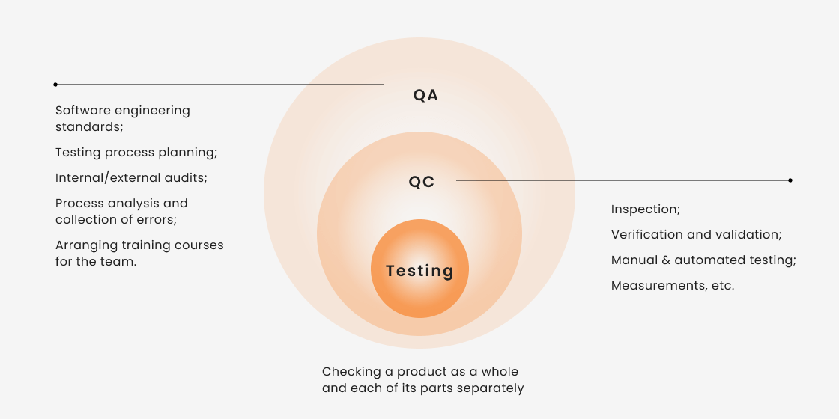
Software Quality Assurance vs Quality Control vs Testing

Slide 7
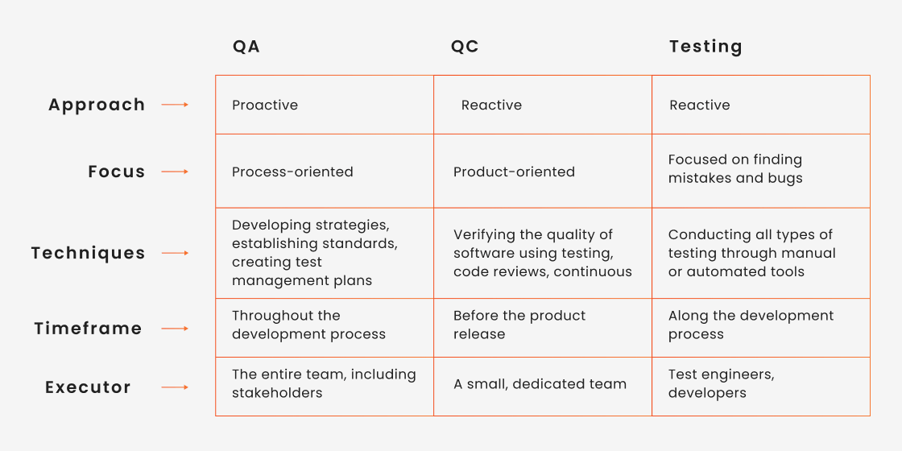
Software Quality Assurance vs Quality Control vs Testing

Slide 8
What is Software Quality Management?
Software quality management is a systematic process of ensuring that software meets the highest standards in terms of functionality, reliability, and user satisfaction.
Software Quality Management (SQM) is the process of constant improvement of product quality, integrated into the development process until the expectations are achieved.
Notes:
In the absence of SIT, there is a risk that modifications or updates made to one component could cause unexpected problems in another component or even crash the entire system. Additionally, SIT helps reduce the cost and time associated with debugging and troubleshooting problems related to integration issues.
SIT also helps identify potential security risks in a system by testing how different components interact with each other, as well as how they respond to external inputs such as user input or data from other systems. By conducting thorough SIT tests, organizations can ensure that their systems are secure and free from vulnerabilities before they go live.

Slide 9
Why Software Quality Management is Important?
It helps to identify and correct errors in software, which is essential for the effective implementation of a project.
The quality of the software is simply the measurement of how well the product has been able to fulfill customer needs.
It is measured by how often errors are found and repaired, how well the software works under different conditions, and how easily software can be maintained.
Software quality is determined by comparing actual results against the expected results.Software quality can include a large variety of factors such as degree of completeness, efficiency, usability, correctness, and reliability.
Notes:
In the absence of SIT, there is a risk that modifications or updates made to one component could cause unexpected problems in another component or even crash the entire system. Additionally, SIT helps reduce the cost and time associated with debugging and troubleshooting problems related to integration issues.
SIT also helps identify potential security risks in a system by testing how different components interact with each other, as well as how they respond to external inputs such as user input or data from other systems. By conducting thorough SIT tests, organizations can ensure that their systems are secure and free from vulnerabilities before they go live.

Slide 10
What are Software Quality Management Metrics?
Software metrics can be classified into three categories
Product metrics - Mean Time to Failure/ Defect Density /Customer Problems /Customer Satisfaction
Process metrics - Defect density during machine testing/ Defect arrival pattern during machine testing/ Phase-based defect removal pattern/ Defect removal effectiveness
Project metrics - Fix backlog and backlog management index/ Fix response time and fix responsiveness/ Percent delinquent fixes/ Fix quality
Notes:
Product metrics − Describes the characteristics of the product such as size, complexity, design features, performance, and quality level.
Process metrics − These characteristics can be used to improve the development and maintenance activities of the software.
Project metrics − This metrics describe the project characteristics and execution. Examples include the number of software developers, the staffing pattern over the life cycle of the software, cost, schedule, and productivity.
In the absence of SIT, there is a risk that modifications or updates made to one component could cause unexpected problems in another component or even crash the entire system. Additionally, SIT helps reduce the cost and time associated with debugging and troubleshooting problems related to integration issues.
SIT also helps identify potential security risks in a system by testing how different components interact with each other, as well as how they respond to external inputs such as user input or data from other systems. By conducting thorough SIT tests, organizations can ensure that their systems are secure and free from vulnerabilities before they go live.

Slide 11
Benefits of Software Quality Management
Improves product quality.
Adds to customer satisfaction.
The software meets user needs and expectations and generates more value, leading to increased user adoption and potentially higher revenue.
Helps bring down the cost of rework as defects are detected early in SDLC.
Assists in making credible and reliable product development decisions and test management strategies.
Increases productivity.
Notes:
Product metrics − Describes the characteristics of the product such as size, complexity, design features, performance, and quality level.
Process metrics − These characteristics can be used to improve the development and maintenance activities of the software.
Project metrics − This metrics describe the project characteristics and execution. Examples include the number of software developers, the staffing pattern over the life cycle of the software, cost, schedule, and productivity.
In the absence of SIT, there is a risk that modifications or updates made to one component could cause unexpected problems in another component or even crash the entire system. Additionally, SIT helps reduce the cost and time associated with debugging and troubleshooting problems related to integration issues.
SIT also helps identify potential security risks in a system by testing how different components interact with each other, as well as how they respond to external inputs such as user input or data from other systems. By conducting thorough SIT tests, organizations can ensure that their systems are secure and free from vulnerabilities before they go live.

Slide 12
Q&A’s ?
Thank you !

