Slide 1

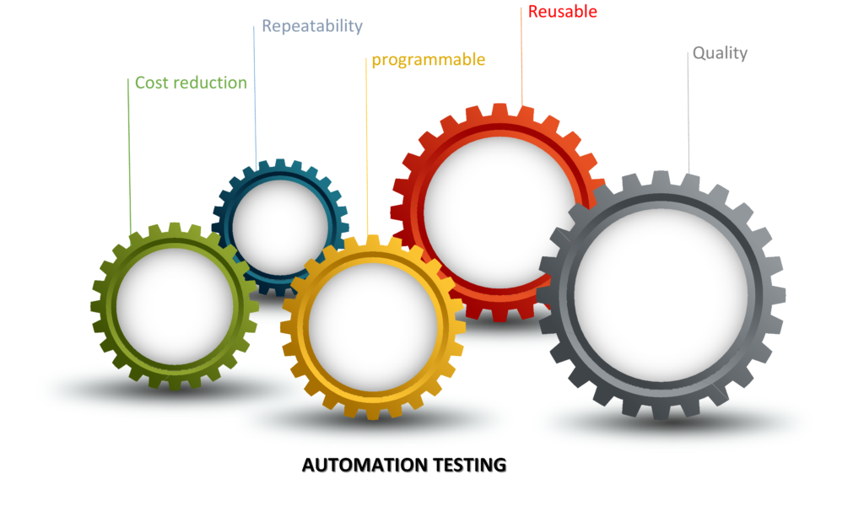
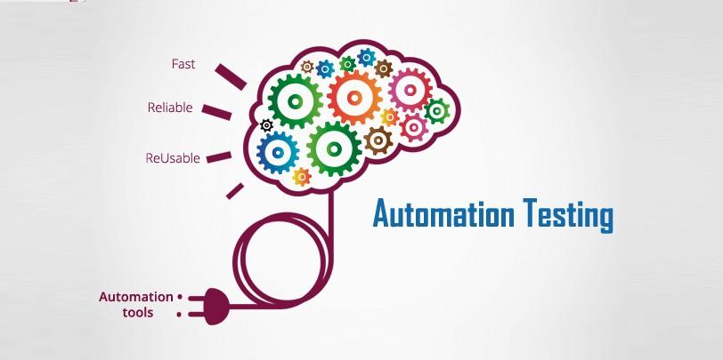
Software Quality Assurance
HNDIT-4022
AUTOMATION TESTING

Slide 2
CONTENT
What is automation testing?
Why automation testing?
Manual testing vs Test automation.
Test case types to automate.
Automation Testing Process.
Framework for Automation.
Different type of software test that can be automated.
Automation Testing Tools.
The Dark side of automation testing.
References.

Slide 3
01.What is automation testing?
Software testing techniques.
Used special automation tool.
Practice of running test automatically.
The execution of tests and then compares actual test results with predicted or expected results.
This is done automatically with little or no intervention from the test engineer.

Slide 4
02.Why automation testing?
Automated testing saves money and time.
Vastly increase your test coverage.
Testing improves accuracy.
Automated test helps developer and testers.
Automation test does what manual test cannot.
Speed of your test execution.

Slide 5
03.Manual testing VS automation
Manual testing is done by QA tester and Automation testing is done automatically using automation tools and script.
Manual testing is time consuming with less efficient and in Automation more testing less time and greater efficiency.
Manual testing is less reliable and Automation testing more reliable.
Manual testing needs have a more straightforward test execution setup and Automation testing requires less complex test execution set up.
Manual testing No need for programming and Automation testing Programming knowledge is a must.

Slide 6
04.Test case types to automate
High-risk Business Critical
Repeatedly
executed
Time-consuming
Difficult to perform manually
Test Case

Slide 7
05.Automation Testing Process
Test Tool Selection
Define scope of Automation
Planning , Designing and Development
Test Execution
Maintenance

Slide 8

05.Automation Testing Process (cotd.)
1.Test Tool Selection – criteria
What is the budget of your organization.
What is the actual price of your selected tool.
Does tool support Operating System /Device which your application runs.
Does the tool support the technologies and third party controls.
Does th tool support connecting to different data source.
How the report mechanism of testing tool.
Can the tool be integrated with test case and bug management repositories?

Slide 9

2.Define Scope Of Automation
Business Scenarios.
Description of manual test cases.
Common Functionalities related to applications.
Technical Feasibility.
Test Case complexity.
Ability to use the same test cases for cross-browser testing.
Reused business components.
End – to – End flows.
Validation.

Slide 10

3.Planing , Designing and Development
Automation tool selection.
Framework designing with features.
Items categorization with in-scope and out-scope.
Automation testbed preparation.
Schedule and Timeline of scripting and execution
Deliverables of Automation Testing

Slide 11

4.Test Execution
Test script are run in this phase.
Ready with input test data.
Use automation tool or Test Management Tool (Eg:-Quality center)
Generated report with related detail after executed.

Slide 12

5.Maintenance
Check whether the software is working with added new features or not.
This phase work when new automation test script are added.
Therefore need for reviewed and maintained.
To improve the effectiveness of automation scripts with each successive release cycle.

Slide 13
06.Framework for automation
1.Data Driven Automation Framework
2. Keyword Driven Automation Framework
3.Modular Automation Framework
4. Hybrid Automation Framework

Slide 14



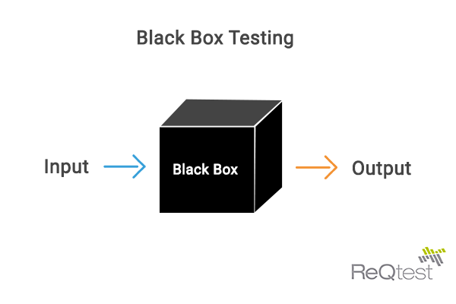
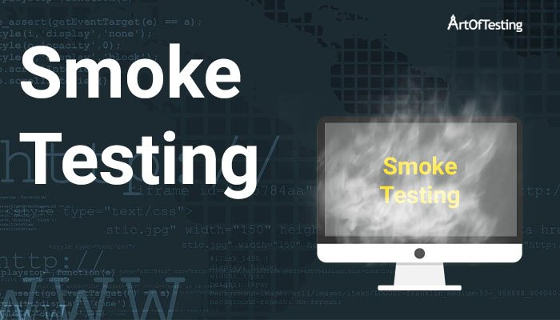
7.Different type of software test that can be automated
Unit Testing.
Integration Testing.
Functional Testing.
Keyword Testing.
Regression Testing.
Data – Driven Testing.
Black-box testing.
Smoke Testing.

Slide 15




8.Automation Testing Tools.
1.Commercial Automation Tools
IBM Rational Functional Tester
Katalon studio
Ranorex
Sahi pro
Apache JMeter
Appium
RedHoodHQ
Cypress

Slide 16


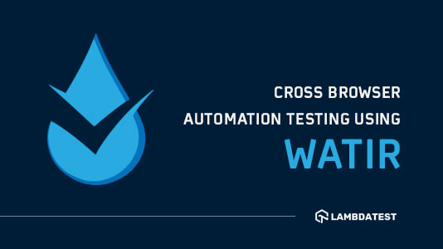

8.Automation Testing Tools (cotd).
2.Open Source DevOps Automation Testing Tools
Citrus
Galen
Karate – DSL
Robot Framework
Selenium
Watir
Gauge

Slide 17

9.The Dark side of automation testing
Automating the wrong things.
The tools you picked can't solve your problems.
The tools you selected aren't a good fit for your testers.
You failed to add up the total cost of tool ownership.
You chose a tool just because it's open source.
You didn't foster a testing culture that embraces automation.

