Slide 1

Software Quality Assurance
HNDIT-4022
Performance testing and reporting with -
Apache JMeter

Slide 2
Agenda
Introduction
History
Protocols
Features
How it works?
Installation
Thread Group
Controller
Execution Order
Demo

Slide 3
Introduction
JMeter is a software that can perform load test, performance test, regression test ,stress test etc.. On the different protocols and the technology,
JMeter is an Open Source testing software.
It is 100% pure Java application for load and performance testing.
JMeter is designed to cover categories of tests like load, functional, performance, regression, etc.

Slide 4
History
Stefano Mazzocchi of the Apache Software Foundation was the original developer of JMeter. He wrote it primarily to test the performance of Apache JServ (now called as Apache Tomcat project). Apache later redesigned JMeter to enhance the GUI and to add functional testing capabilities.

Slide 5
Protocols
The following protocols are supported by JMeter,
Web - HTTP, HTTPS
Web services - SOAP / REST
FTP services
Database via JDBC drivers
Directory - LDAP
Message-oriented middleware (MOM) via JMS
Mail - SMTP(S), POP3(S) and IMAP(S)
Native commands or shell scripts
TCP

Slide 6
Features
Followings are some of the feature of JMeter;
Multithreading Framework
Compatible with TCP
100% Java scripted
Compatible with LDAP
Data Analysis and Visualization
Pluggable Samplers
Compatible with Database via JDBC
GUI Design and Interface
Dynamic Input
Compatible with SOAP / REST
Result Analysis and Caches
Compatible with Native Commands
Highly Extensible Core
Compatible with FTP
Compatible with Web – HTTP, HTTPS
Scriptable Samplers
Compatible with Mail – SMTP(S)
Compatible with POP3(S) and IMAP(S)
Compatible with Message-oriented middleware via JMS

Slide 7
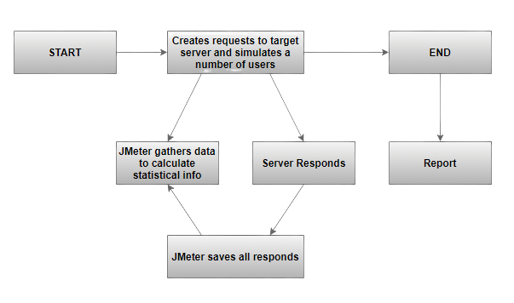
How it works?
Take a look at the following figure that describe how JMeter works,

Slide 8
What we can do with JMeter
Using command line parameters in JMeter for load testing.
Database load testing with JMeter
Load test TCP protocol services with JMeter
Run a stress test in JMeter
Performance and load testing with JMeter
Test SOAP services with JMeter
Generate Random variables in JMeter
Apache Kafka load testing using JMeter
Build a distributed load testing infrastructure with AWS, Docker and JMeter
Load testing video streaming with JMeter

Slide 9
Installation
JMeter Environment Setup – Java JDK 1.6 or above required
Set JAVA_HOME
Download JMeter - http://jmeter.apache.org/download_jmeter.cgi
Set JMETER_HOME (export PATH=$PATH:$JMETER_HOME/bin)
Run JMeter via command line or GUI

Slide 10
Thread Group
Thread Group elements are the beginning points of your test plan.
Set the number of threads
Set the ramp-up period
Set the number of times to execute the test

Slide 11
Controller
JMeter has two types of Controllers:
Samplers
Samplers allow JMeter to send specific types of requests to a server. They simulate a user request for a page from the target server.
Logic Controllers
Logic Controllers control the order of processing of Samplers in a Thread. Logic controllers can change the order of a request coming from any of their child elements.

Slide 12
Execution Order
Configuration elements
Pre-Processors
Timers
Sampler
Post-Processors
Assertions
Listeners

Slide 13
Demo - Http Request Demo with Recording
Configuration of JMeter
Create Sample project for selected website to check record (HTTP test script Recorder)
User Defined Variable.
Report Generation - Summary report generation
Summary Report - report visualization on the Dashboard

Slide 14

Thank You !

