Slide 1
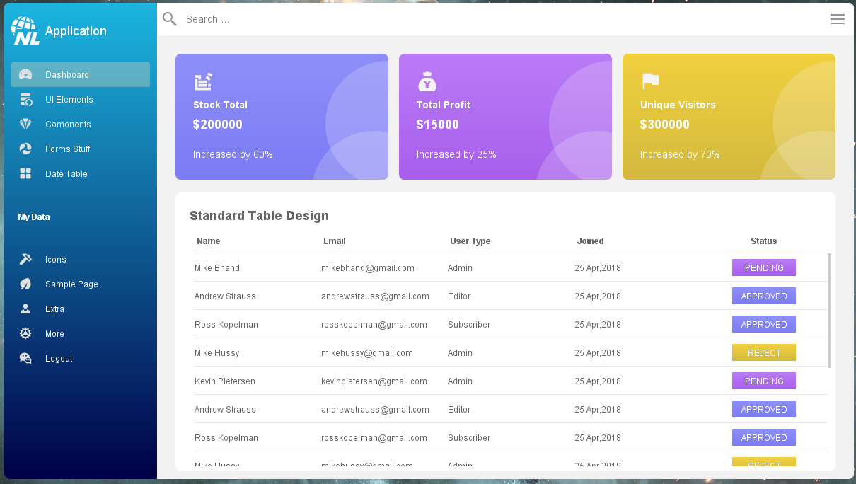
GUI Designing with Java Swing

Slide 2
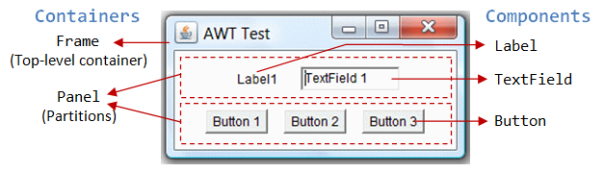
Introduction to GUI in Java
GUI (Graphical User Interface) is a visual way of interacting with a computer application using graphical elements like:
  Windows
  Buttons
  Menus
  Icons
  Text fields

Slide 3
Importance of GUI in Applications
Accessibility: Opens up software use to non-technical users
User Engagement: Visually attractive UIs improve user satisfaction
Efficiency: Simplifies complex tasks through graphical interactions
Standardization: GUI elements follow predictable patterns (e.g., File > Open)
Feedback & Guidance: Immediate visual responses help prevent user errors

Slide 4
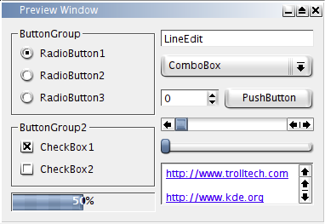
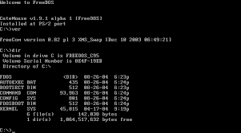
Difference between CLI and GUI

Slide 5
Difference between CLI and GUI
Feature | CLI | GUI
Interaction | Typed commands | Mouse clicks, drag and drop, icons
Ease of Use | Requires memorization of commands | Intuitive and easier to learn
Speed | Faster for experts | Slower for some tasks
Multitasking | Harder to handle multiple tasks | Easier with multiple windows
User Base | Developers, system admins | General users

Slide 6
Java GUI Toolkits: AWT vs Swing vs JavaFX
Feature | AWT | Swing | JavaFX
Introduced | Java 1.0 | Java 1.2 | Java 8 (officially in Java 7)
Lightweight? | No – depends on native OS widgets | Yes – written in Java | Yes – modern & rich
Look & Feel | Platform-dependent | Pluggable Look & Feel | CSS-based styling
UI Controls | Limited set | Rich set of components | Modern, customizable
Performance | Fast, basic | Slower than AWT | Better performance for modern UIs
Use Today | Mostly legacy | Still used in many apps | Preferred for new desktop UIs

Slide 7
javax.swing Package
javax.swing is a Java GUI toolkit that provides a rich set of components for building graphical user interfaces in desktop applications.
Features of Swing
  Lightweight components
  Pluggable look and feel
  MVC architecture
  Rich set of components

Slide 8
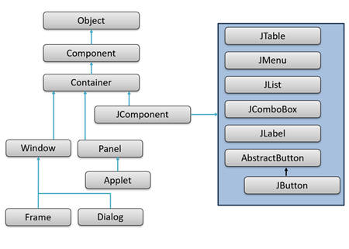
Core Swing Components

Slide 9
Core Swing Components
Top-Level Containers | Control Components (Basic UI Elements) | Containers and Layouts | Menus and Toolbars | Other Components
JFrame JDialog JApplet JWindow | JButton JLabel JTextField JTextArea JCheckBox JRadioButton JComboBox JList JPasswordField | JPanel JScrollPane Layout Managers: FlowLayout BorderLayout GridLayout BoxLayout GridBagLayout | JMenuBar JMenu JMenuItem JToolBar | JTabbedPane JSplitPane JTree JTable JProgressBar JSlider JSpinner

Slide 10
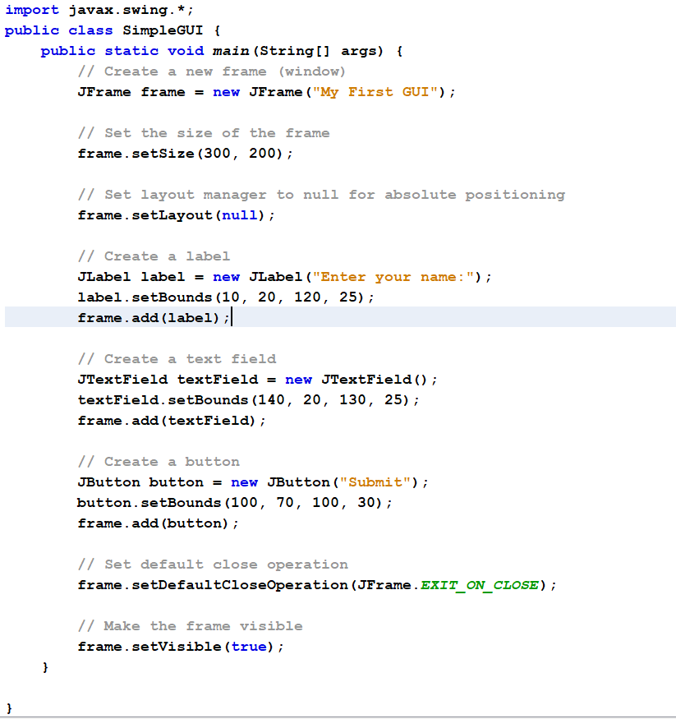
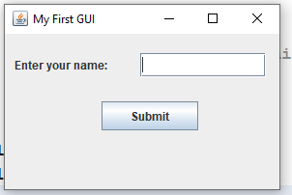
Notes:
import javax.swing.*;
public class SimpleGUI {
public static void main(String[] args) {
// Create a new frame (window)
JFrame frame = new JFrame("My First GUI");
// Set the size of the frame
frame.setSize(300, 200);
// Set layout manager to null for absolute positioning
frame.setLayout(null);
// Create a label
JLabel label = new JLabel("Enter your name:");
label.setBounds(10, 20, 120, 25);
frame.add(label);
// Create a text field
JTextField textField = new JTextField();
textField.setBounds(140, 20, 130, 25);
frame.add(textField);
// Create a button
JButton button = new JButton("Submit");
button.setBounds(100, 70, 100, 30);
frame.add(button);
// Set default close operation
frame.setDefaultCloseOperation(JFrame.EXIT_ON_CLOSE);
// Make the frame visible
frame.setVisible(true);
}
}

Slide 11
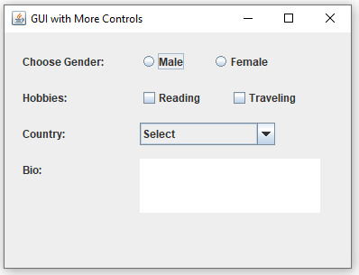
Example 02

Slide 12
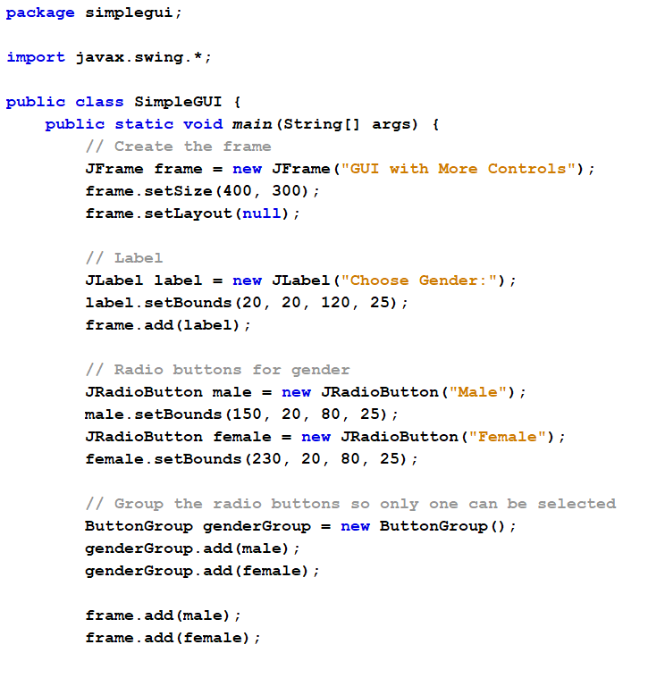
Radio Buttons
Notes:
package simplegui;
import javax.swing.*;
public class SimpleGUI {
public static void main(String[] args) {
// Create the frame
JFrame frame = new JFrame("GUI with More Controls");
frame.setSize(400, 300);
frame.setLayout(null);
// Label
JLabel label = new JLabel("Choose Gender:");
label.setBounds(20, 20, 120, 25);
frame.add(label);
// Radio buttons for gender
JRadioButton male = new JRadioButton("Male");
male.setBounds(150, 20, 80, 25);
JRadioButton female = new JRadioButton("Female");
female.setBounds(230, 20, 80, 25);
// Group the radio buttons so only one can be selected
ButtonGroup genderGroup = new ButtonGroup();
genderGroup.add(male);
genderGroup.add(female);
frame.add(male);
frame.add(female);
// Checkboxes for hobbies
JLabel hobbyLabel = new JLabel("Hobbies:");
hobbyLabel.setBounds(20, 60, 100, 25);
JCheckBox cb1 = new JCheckBox("Reading");
cb1.setBounds(150, 60, 100, 25);
JCheckBox cb2 = new JCheckBox("Traveling");
cb2.setBounds(250, 60, 100, 25);
frame.add(hobbyLabel);
frame.add(cb1);
frame.add(cb2);
// Combo box for country selection
JLabel countryLabel = new JLabel("Country:");
countryLabel.setBounds(20, 100, 100, 25);
String[] countries = { "Select", "USA", "India", "UK", "Germany" };
JComboBox<String> countryBox = new JComboBox<>(countries);
countryBox.setBounds(150, 100, 150, 25);
frame.add(countryLabel);
frame.add(countryBox);
// Text area
JLabel bioLabel = new JLabel("Bio:");
bioLabel.setBounds(20, 140, 100, 25);
JTextArea bioArea = new JTextArea();
bioArea.setBounds(150, 140, 200, 60);
frame.add(bioLabel);
frame.add(bioArea);
// Set default close operation
frame.setDefaultCloseOperation(JFrame.EXIT_ON_CLOSE);
// Make the frame visible
frame.setVisible(true);
}
}

Slide 13
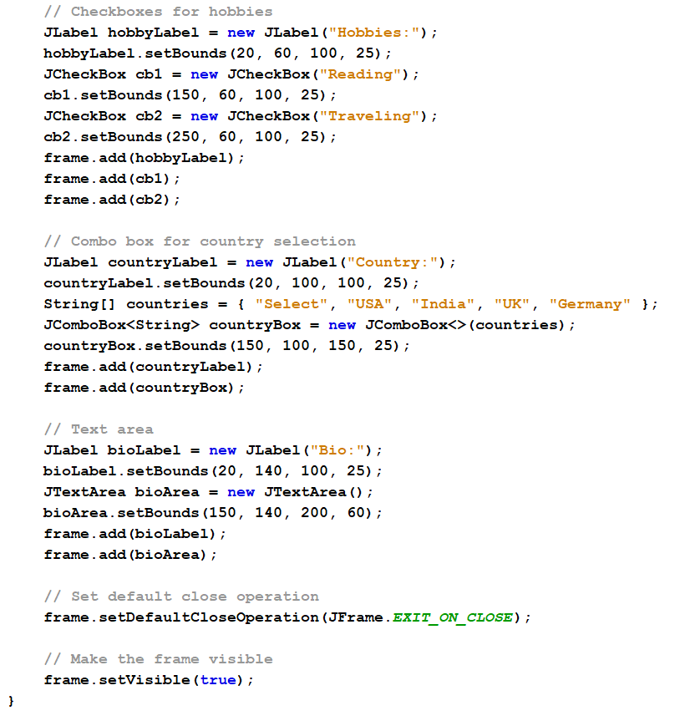
Check Box
Combo Box
Text Area

Slide 14
Question
Why do we sometimes import java.awt when using Swing?
Even though you're building GUI applications with Swing (javax.swing), some important foundational classes come from AWT (java.awt). Swing is actually built on top of AWT, and many GUI elements in Swing depend on AWT classes.

