Slide 1
Java Event Handling

Slide 2
What is Event Handling?
Event handling is the mechanism that controls how events (like button clicks or key presses) are managed in a Java GUI.
Events are user actions like:
  Clicking a button
  Typing text
  Selecting a radio button

Slide 3
Event Handling in Java
Java uses event-driven programming
GUI components (like JButton) generate events
To respond to those events, you:
  Create an event listener
  Register it to the component

Slide 4
Event Listener Interfaces
Common interfaces:
  ActionListener – for buttons
  ItemListener – for checkboxes, radio buttons
  KeyListener – for keyboard input
  MouseListener – for mouse clicks
Example: implements ActionListener

Slide 5
Steps to Handle Events
Import necessary packages (java.awt.event.*)
Implement the listener interface
Override the event method (e.g., actionPerformed)
Register the listener using .addActionListener()

Slide 6
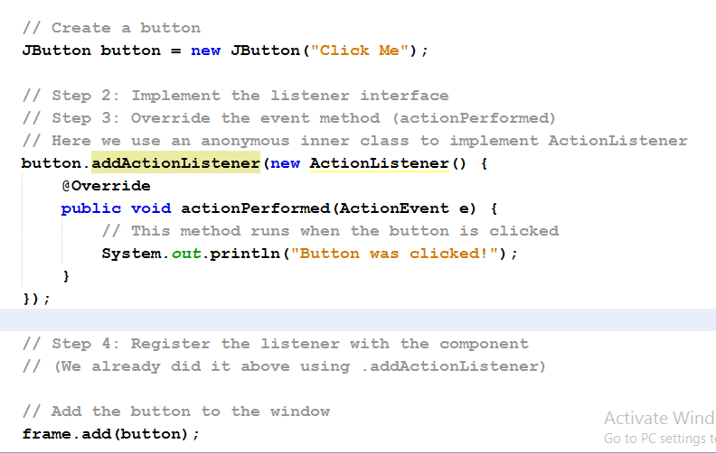
Code Example – Button Click

Slide 7
button.addActionListener(...)
This registers a listener to the button.
The listener is an object that "listens" for button clicks.
When the button is clicked, the listener will react.

Slide 8
public void actionPerformed(ActionEvent e)
This is the event-handling method.
It must be overridden, because it's part of the ActionListener interface.
It runs automatically when the button is clicked.
System.out.println("Button was clicked!");
This is the actual response to the click event.
It prints a message to the console — you can change this to do anything you want (open a new window, change text, etc.).

Slide 9
Summary in Plain English
You tell the button: “Hey, when someone clicks you, run this code.”
That code is wrapped in something called an ActionListener.
You override the actionPerformed method to define exactly what happens when the click occurs.
The code is added inline, meaning right next to where it’s used, to keep it simple.

Slide 10
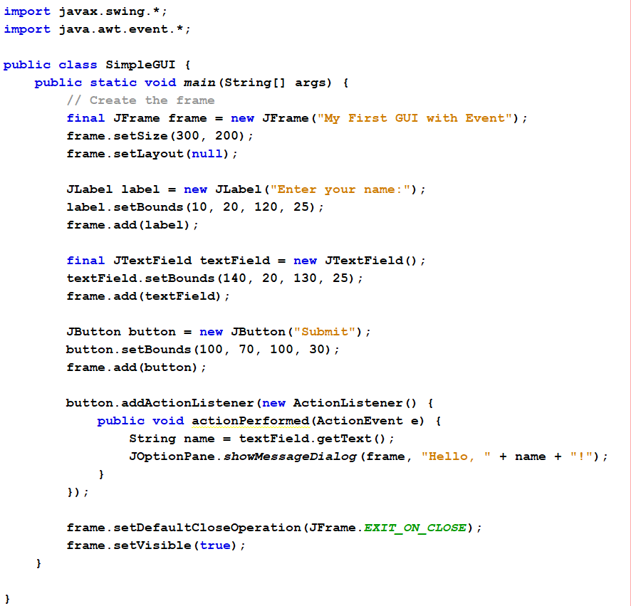
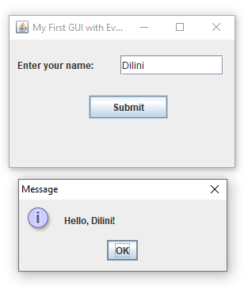
Notes:
import javax.swing.*;
import java.awt.event.*;
public class SimpleGUIWithEvent {
public static void main(String[] args) {
JFrame frame = new JFrame("My First GUI with Event");
frame.setSize(300, 200);
frame.setLayout(null);
JLabel label = new JLabel("Enter your name:");
label.setBounds(10, 20, 120, 25);
frame.add(label);
final JTextField textField = new JTextField(); // FIX: marked final
textField.setBounds(140, 20, 130, 25);
frame.add(textField);
JButton button = new JButton("Submit");
button.setBounds(100, 70, 100, 30);
frame.add(button);
button.addActionListener(new ActionListener() {
public void actionPerformed(ActionEvent e) {
String name = textField.getText(); // Now allowed
JOptionPane.showMessageDialog(frame, "Hello, " + name + "!");
}
});
frame.setDefaultCloseOperation(JFrame.EXIT_ON_CLOSE);
frame.setVisible(true);
}
}

Slide 11
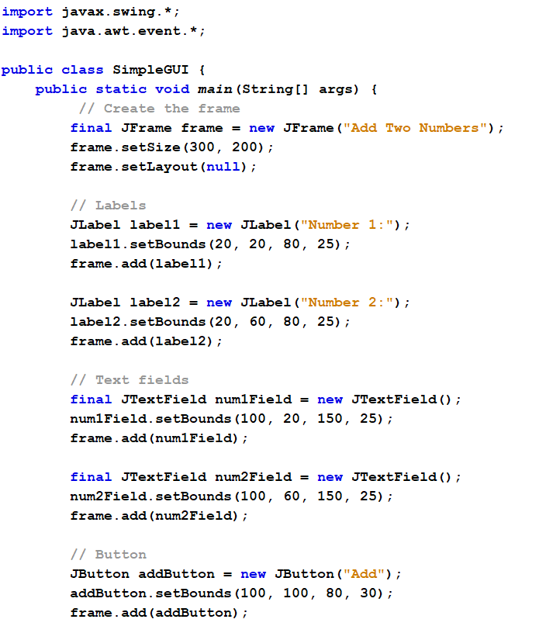
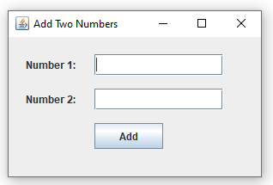

Slide 12
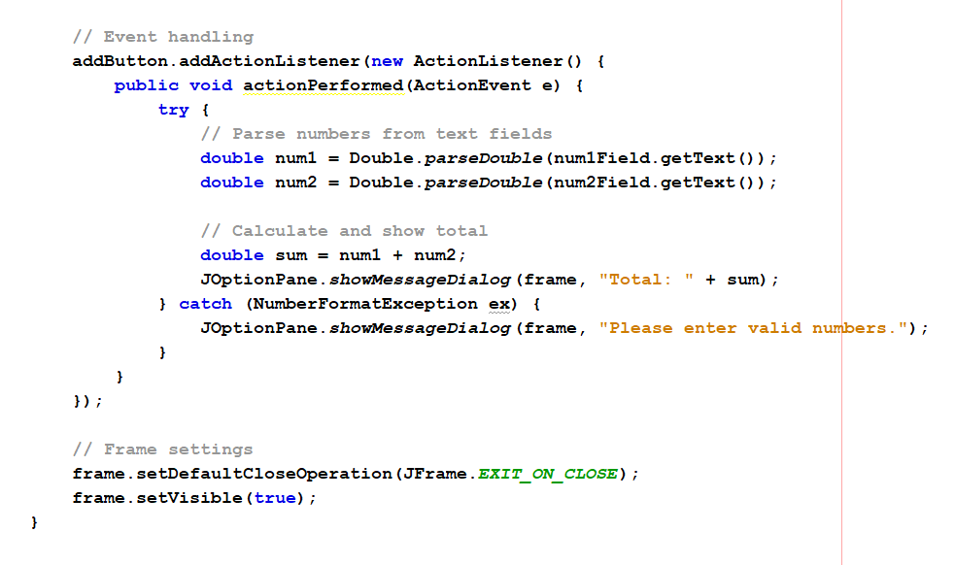
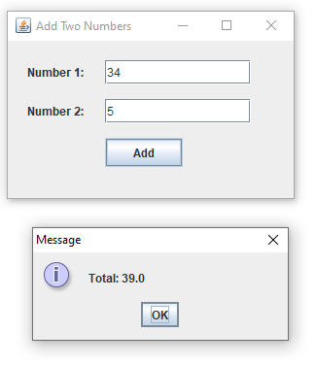
Notes:
import javax.swing.*;
import java.awt.event.*;
public class AddTwoNumbersGUI {
public static void main(String[] args) {
// Create the frame
JFrame frame = new JFrame("Add Two Numbers");
frame.setSize(300, 200);
frame.setLayout(null);
// Labels
JLabel label1 = new JLabel("Number 1:");
label1.setBounds(20, 20, 80, 25);
frame.add(label1);
JLabel label2 = new JLabel("Number 2:");
label2.setBounds(20, 60, 80, 25);
frame.add(label2);
// Text fields
final JTextField num1Field = new JTextField();
num1Field.setBounds(100, 20, 150, 25);
frame.add(num1Field);
final JTextField num2Field = new JTextField();
num2Field.setBounds(100, 60, 150, 25);
frame.add(num2Field);
// Button
JButton addButton = new JButton("Add");
addButton.setBounds(100, 100, 80, 30);
frame.add(addButton);
// Event handling
addButton.addActionListener(new ActionListener() {
public void actionPerformed(ActionEvent e) {
try {
// Parse numbers from text fields
double num1 = Double.parseDouble(num1Field.getText());
double num2 = Double.parseDouble(num2Field.getText());
// Calculate and show total
double sum = num1 + num2;
JOptionPane.showMessageDialog(frame, "Total: " + sum);
} catch (NumberFormatException ex) {
JOptionPane.showMessageDialog(frame, "Please enter valid numbers.");
}
}
});
// Frame settings
frame.setDefaultCloseOperation(JFrame.EXIT_ON_CLOSE);
frame.setVisible(true);
}
}

Slide 13
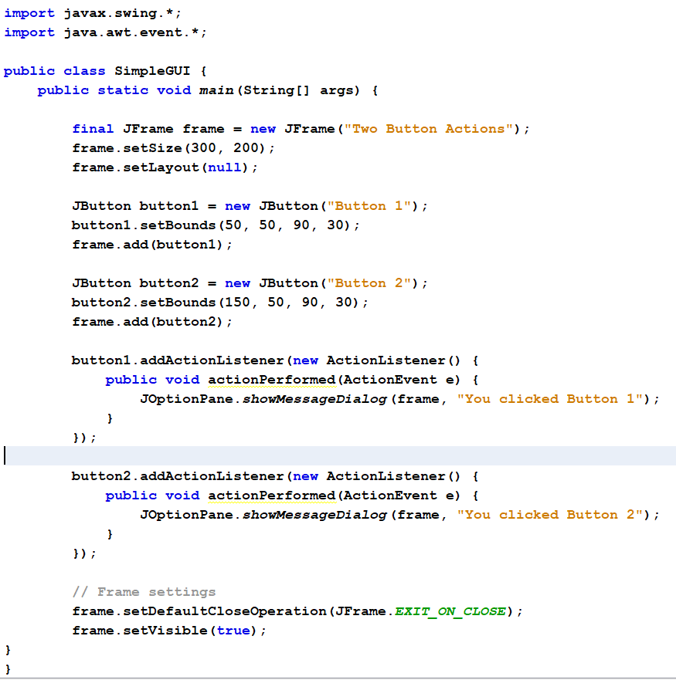
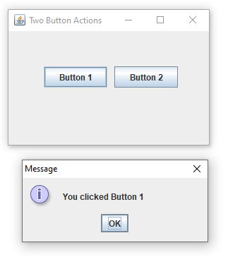
Notes:
import javax.swing.*;
import java.awt.event.*;
public class TwoButtonsExample {
public static void main(String[] args) {
// Create the frame
JFrame frame = new JFrame("Two Button Actions");
frame.setSize(300, 200);
frame.setLayout(null);
// Create Button 1
JButton button1 = new JButton("Button 1");
button1.setBounds(50, 50, 90, 30);
frame.add(button1);
// Create Button 2
JButton button2 = new JButton("Button 2");
button2.setBounds(150, 50, 90, 30);
frame.add(button2);
// Button 1 action
button1.addActionListener(new ActionListener() {
public void actionPerformed(ActionEvent e) {
JOptionPane.showMessageDialog(frame, "You clicked Button 1");
}
});
// Button 2 action
button2.addActionListener(new ActionListener() {
public void actionPerformed(ActionEvent e) {
JOptionPane.showMessageDialog(frame, "You clicked Button 2");
}
});
// Frame settings
frame.setDefaultCloseOperation(JFrame.EXIT_ON_CLOSE);
frame.setVisible(true);
}
}

