Slide 1
HNDIT2012 Fundamentals of Computer Programming
Introduction to computer programs

Slide 2
Computer
Programmable electronic machine which working under a given set of instruction
Computer program is a set of instructions to execute by computer

Slide 3
Computer Programming Language
Programming Language is a language designed to communicate with computer
Because computer is an electronic machine, it can only understand voltage levels
  0 to represent lower voltage level
  1 to represent higher voltage level
This language is known as machine language

Slide 4
Components of a Language
Semantics
  Meaning
Syntax
  How the meaning is presented

Slide 5
Generation of Programming Languages
First-Generation Languages :
  These are low-level languages like machine language.
Second-Generation Languages :
  These are low-level assembly languages used in kernels and hardware drives.
Third-Generation Languages :
  These are high-level languages like C, C++, Java, Visual Basic, and JavaScript.
Fourth Generation Languages :
  These are languages that consist of statements that are similar to statements in the human language. These are used mainly in database programming and scripting, like Perl, Python, Ruby, SQL, and MatLab
Fifth Generation Languages :
  These are the programming languages that have visual tools to develop a program like, Mercury, OPS5, and Prolog.

Slide 6
Generation of Programming Languages
1GL
2GL
3GL
4GJ
5GL
Low level
High level

Slide 7
Translation
Interpreting
Instructions are translated and executed one after one.
HTML,
Compiling
  Translate all the instructions of the program in a one step and create an executable file.
  Some languages create intermediate form known byte code (java)

Slide 8
Translators
Interpreter
Compiler
converts source code statements into equivalent machine language statements and execute.
Source program is required for every execution
Slow execution
Once all errors have been corrected translates the entire source code as a single unit.
After the compilation process the source program is no more required
Faster execution

Slide 9
Java Programming Language

Slide 10

How Java is working
Source Code
  Source code is plain text
  File name extension is .java
  Compiler is Javac
  Object code/byte code extension is .class

Slide 11
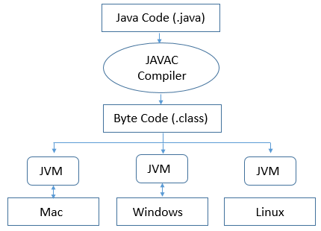
How Java is working
Write Once, Run Anywhere.

Slide 12
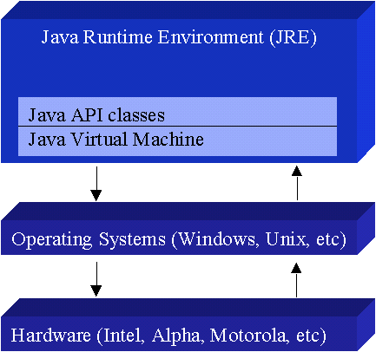
Java Virtual Machine
Collection of software components that enables a computer to run a Java program
Lods , Versifies and execute code
Interpreter which provides runtime environnent
Virtual machine is a software that emulate a computer system, which provide functionality of a physical computer

Slide 13
Features of Java Language
Case sensitive
  Compiler recognize the deferent between simple and capital letters
Secure
  When this byte codes are executed , the JVM can take care of the security.
Robust
  Strong memory management
  Exception handling mechanism
  Type checking mechanism
Portable
  Program written in Java can be run on deferent computing environments.
Multithreaded
  Java supports parallel processing through execution of multiple threads

Slide 14
First Java Program
class HelloWorldApp
{
public static void main(String[] args)
{
System.out.println("Hello World!"); // Display the text.
}
}
Save with .java extension
If a public class is present, the class name should match the file name

Slide 15
Hello World
class keyword is used to declare a class in java.
public keyword is an access modifier which represents visibility, it means it is visible to all.
static is a keyword is used to create static method. no need to create object to invoke the static method
void is the return type of the method
main represents startup of the program.
String[] args is used for command line argument.
System.out.println() is used print statement.

Slide 16
Comments
Statements which are ignored by compiler
Used to add explanation of code
Make the source code is easier for humans to understand (increase the readability of code)
Line comments
  // Comments a line of code
Block comments
  /* */ Comments a block of code

Slide 17
Escape Sequences
Notation | Character represented
\n | Newline
\r | Carriage return
\b | Backspace
\s | Space
\t | tab
\" | Double quote
\' | Single quote
\\ | backslash

