Slide 1
HNDIT2012 Fundamentals of Computer Programming
Introduction to IDE

Slide 2
Integrated Development Environment
A software application that helps programmers develop software code efficiently.
IDE increases developer productivity by combining capabilities such as software editing, building, testing, and packaging in an easy-to-use application.

Slide 3
Features of an IDE
Code editor
  Write and edit code
Build automation
  Compiling computer source code into binary code
  Packaging binary code
  Running automated tests

Slide 4
Features of an IDE
Form Designer
  Allows a programmer to build forms with a drag and drop interface.
Debugger
  Test and find bugs (errors)
Refactoring
  Restructuring existing computer code without changing its external behavior

Slide 5
Features of an IDE
Syntax highlight:
  The code editor provides a feature to colour different text depending on the function that it carries out

Slide 6






Popular Java IDE

Slide 7

NetBeans allows applications to be developed from a set of software components called modules.
NetBeans runs on Windows, macOS, Linux and Solaris.
In addition to Java development, it has extensions for other languages like PHP, C, C++, HTML5 and JavaScript.

Slide 8
Installing NetBeans
Visit
  https://netbeans.apache.org/download/index.html

Slide 9
Features of NetBeans IDE
Easy to install with easy configurations
Code Editing.
Graphical User Interface.
Debugging
Form designer

Slide 10

Debugging
The process of identifying and removing errors from computer hardware or software.

Slide 11
Types of errors
Syntax errors
  Syntax errors are detected at compile-time
  Intelligent IDE identify syntax errors in coding time
Logical errors
  Error in code logic to produce an unexpected output
Run time error

Slide 12
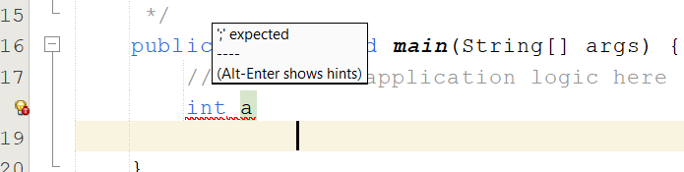
Syntax errors in NetBeans
NetBeans IDE find the syntax errors
Underline the error with wavy red line.
Display an explanation of the error when mouse pointer is moving the on the wavy red line.

Slide 13
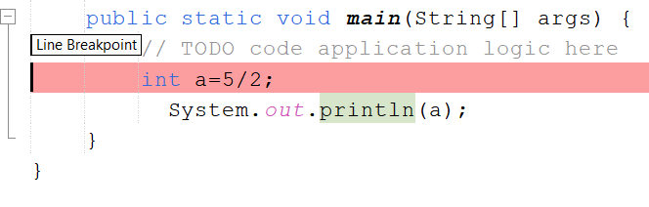
Debugging in NetBeans
Setting Breakpoints
  Breakpoint tells the debugger where to stop during execution

Slide 14
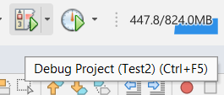
Debugging in NetBeans
Start debugging
  Execution will halt at breakpoint

Slide 15



Debugging in NetBeans
Step over
  Run to next line
Step into
  Enter to a method and stop at the first line
Step out
  Run to method completion

Slide 16
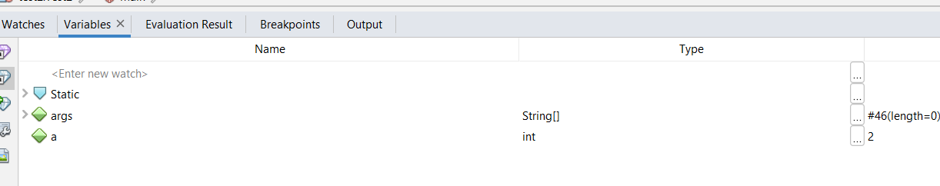
Debugging in NetBeans
Variable window
  Display the values of variables

Slide 17
Software Versioning

Slide 18
Software versioning
Software versioning is the process of assigning either unique version names or unique version numbers to unique states of computer software.
Within a given version number category, these numbers are generally assigned in increasing order and correspond to new developments in the software.

Slide 19



Versioning with NetBeans
Apache NetBeans IDE provides support for the Git, Mercurial and Subversion version control systems, which are distributed version control and source code management systems

Slide 20
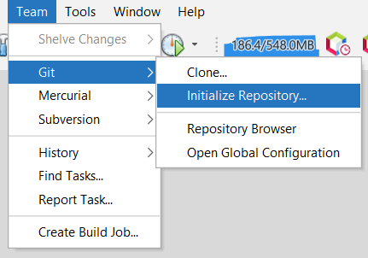
Git versioning with NetBeans
Initialize a repository

Slide 21
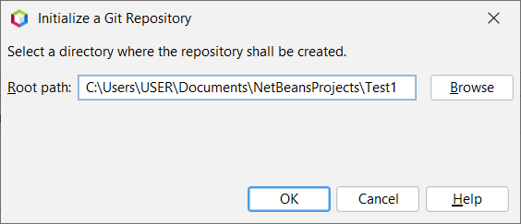
Initialize a repository
Repository allows developer to save versions of the code, which can access when needed.
A .git subfolder is created in current working directory, which all the project snapshots are stored. This will also create a new main branch.
C:\Users\USER\Documents\NetBeansProjects\Test1\.git
Notes:
The default branch is also the initial branch that Git checks out locally when someone clones the repository. Unless you specify a different branch, the default branch in a repository is the base branch for new pull requests and code commits.

Slide 22
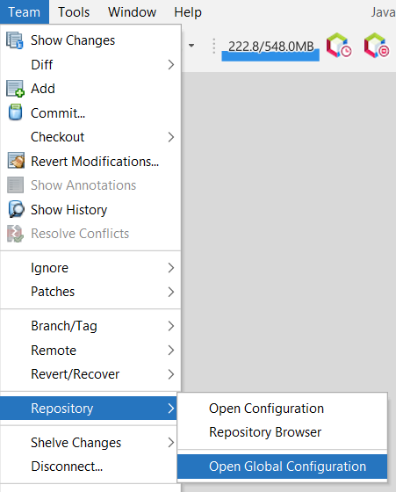
Global configuration

Slide 23
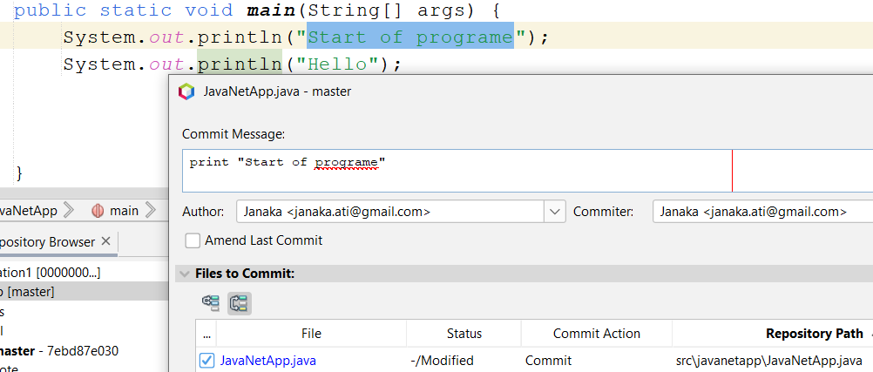
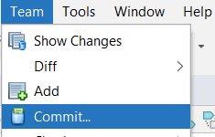
Commit
Commit means snapshots or milestones along the timeline of a Git project.
So, developer can do time to time changes in project and commit with a suitable message.

Slide 24
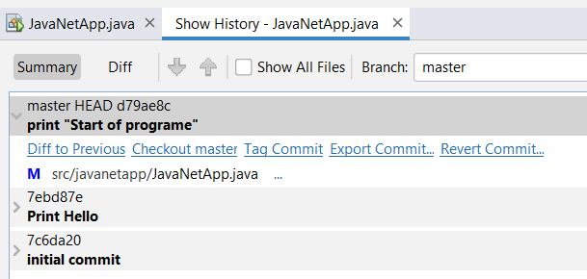
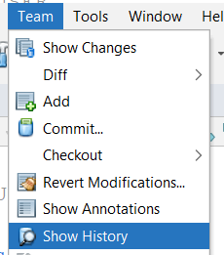
View Commit history
Display the commit history

Slide 25

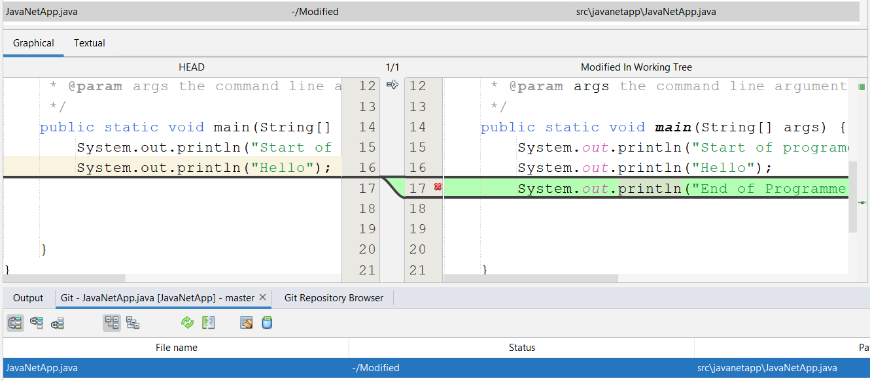
Show changes
Display the changes in project

Slide 26
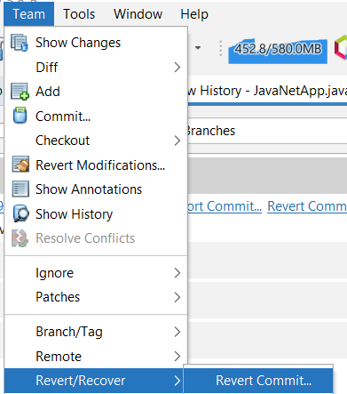
Revert commit
Reverse back to previous commit

