Slide 1
HNDIT2012 Fundamentals of Computer Programming
Variables and Data Types

Slide 2
Terminology
Key word – special reserved word which is having a meaning to compiler. So key words cant be used for identifiers
Identifiers - word used by a programmer to name a variable, method, class or label

Slide 3
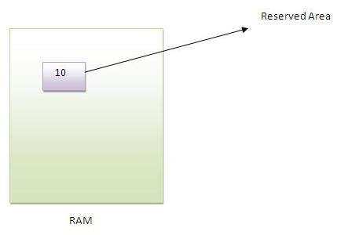
Variable
Variable is a location in computer memory which can hold data.

Slide 4
Data type
Classification of data (value of a variable ) which tells the compiler or interpreter how the programmer intends to use the data.

Slide 5
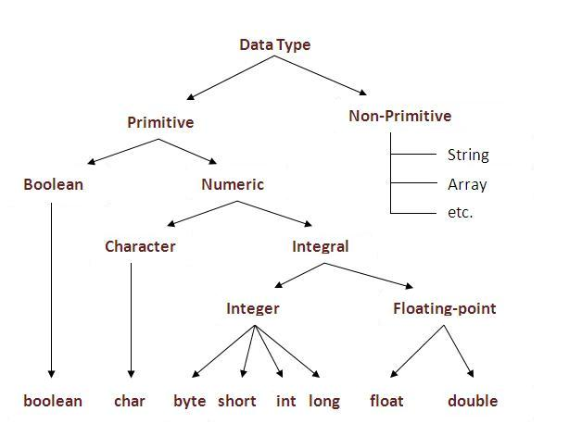

Slide 6
Primitive data types
byte:
  8-bit signed two's complement integer
  -128 to 127 (inclusive)
  Default value is 0.
short:
  16-bit signed two's complement integer
  -32,768 to 32,767 (inclusive)
  Default value is 0.
int:
  32-bit signed two's complement integer
  -2,147,483,648 to 2,147,483,647 (inclusive)
  Default value is 0

Slide 7
Primitive data types
long:
  64-bit signed two's complement integer
  -9,223,372,036,854,775,808 to 9,223,372,036,854,775,807 (inclusive).
float:
  Single precision 32-bit IEEE 754 floating point.
double:
  Double precision 64-bit IEEE 754 floating point.
boolean:
  Two possible values: true and false
char:
  Single 16-bit Unicode character
  '\u0000' (or 0) to '\uffff' (or 65,535 inclusive).

Slide 8
Creating and Accessing Variables
int A;
A=10;
char B;
B=57;

Slide 9
Variable/Identifier Naming
Java keywords cant be used as variable names
Variable names are case sensitive
All identifiers should begin with a letter (A to Z or a to z), currency character ($),underscore (_)
Subsequent characters may be letters, digits, dollar signs, or underscore characters.
  legal identifiers:
    age, $salary, _value, __1_value
  Iillegal identifiers:
    123abc, -salary

Slide 10
Variable declaration
Informing the compiler about the variables that a program is going to use is variable declaration
Declaration inform three things
  Variable name, Data type and access level
Syntax
Type identifier;
Access_modifier Type identifier;
Example
int a;
int a, b, c; // Declares.
private int a;

Slide 11
Variable initialization
Initialization
  Setting an initial value to a variable
Syntax
Type identifier=initial value;
Access_modifier Type identifier=initial value;
Example
int a = 10, b = 10; // initialization
double pi = 3.14159;
Public double pi = 3.14159;

Slide 12
Literal
The value stored in a variable

Slide 13
Variables in calculations
class TestVar
{
public static void main(String[] args)
{
int a=2,b=4,c;
c=a+b;
System.out.println("Total is : "+ c);
}
}

Slide 14
Types of Variables
Local Variable
  A variable that is declared inside the method is called local variable.
Instance Variable
  A variable that is declared inside the class but outside the method is called instance variable . It is not declared as static. So values of Instance Variable are unique to each instance of a class
Static variable
  A variable that is declared as static is called static variable. It cannot be local. There is exactly one copy of this variable, regardless of how many times the class has been instantiated
Parameters
  Variables which pass values with method calls

Slide 15
Type conversion / Type casting
Changing a value from one data type to another type is known as data type conversion
Implicit conversion
  Automatic conversion by JVM
Explicit conversion
  Not automatically done by JVM
  Programmer need to specify the target type in parentheses

Slide 16
Widening Conversion
Value of lower size data type converted to a value of a higher size data type without loss of information
This is done implicitly by the JVM and also known as implicit casting
int a = 100;
double b = a;
System.out.println(b);
//integer (4 Byte) converted into double (8 Byte)

Slide 17
Widening Conversion
byte can be converted to short, int, long, float, or double
short can be converted to int, long, float, or double
char can be converted to int, long, float, or double
int can be converted to long, float, or double
long can be converted to float or double
float can be converted to double

Slide 18
Narrowing Conversion
value of higher size data type converted to a value of a lower size data type which can result in loss of information
This is not done implicitly by the JVM and requires explicit casting.
double a = 100.7;
int b = (int) a;
System.out.println(b);

Slide 19
Narrowing Conversion
short can be converted to byte or char
char can be converted to byte or short
int can be converted to byte, short, or char
long can be converted to byte, short, or char
float can be converted to byte, short, char, int, or long
double can be converted to byte, short, char, int, long, or float

Slide 20
Character functions
SN | Methods with Description
1 | isLetter() Determines whether the specified char value is a letter.
2 | isDigit() Determines whether the specified char value is a digit.
3 | isWhitespace() Determines whether the specified char value is white space.
4 | isUpperCase() Determines whether the specified char value is uppercase.
5 | isLowerCase() Determines whether the specified char value is lowercase.
6 | toUpperCase() Returns the uppercase form of the specified char value.
7 | toLowerCase() Returns the lowercase form of the specified char value.
8 | toString() Returns a String object representing the specified character value that is, a one-character string.

Slide 21
Numeric functions
Sr.No | Methods with Description
1 | abs() This method returns the absolute value of a double value.
2 | cbrt() This method returns the cube root of a double value.
3 | Sqrt() Return the square root
4 | pow(x,y) Return the power
5 | min(x,y) Return the minimum
6 | max(x,y) Return the maximum
7 | ceil(x) Returns the double value that is greater than or equal to the nearest integer
8 | Floor(x) Returns the double value that is smaller than or equal to the nearest integer

