Slide 1
HNDIT2012 Fundamentals of Computer Programming
Expressions and Operators

Slide 2
Operators
Assignment Operators
Arithmetic Operators
Relational Operators
Bitwise Operators
Logical Operators

Slide 3
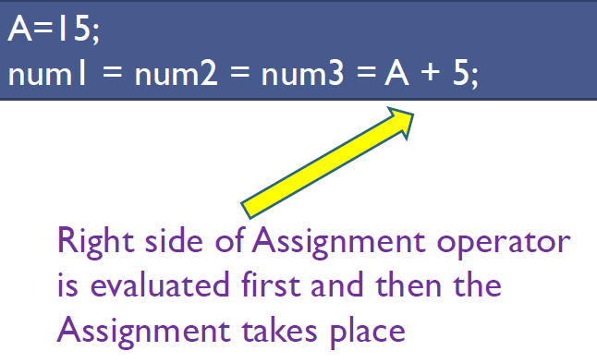
Assignment Operator (=)

Slide 4
Arithmetic operators
Operator | Description
+ | Additive operator (also used for String concatenation)
- | Subtraction operator
* | Multiplication operator
/ | Division operator
% | Remainder operator
++ | Increment operator
-- | Decrement operator

Slide 5
Operator Precedence
* | / | %
+ | -
When operators of equal precedence appear in the same expression they are evaluated from left to right;

Slide 6
Increment Operator
Pre Increment | Post Increment
int x,y; x= 5; y = ++x; System.out.println (“x = “ + x); System.out.println (“y = “ + y); | int x,y; x= 5; y = x++; System.out.println (“x = “ + x); System.out.println (“y = “ + y);
x=x+1;
y=x;
y=x;
x=x+1;

Slide 7
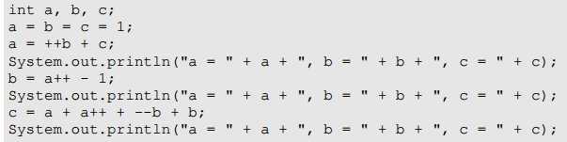
Write the output

Slide 8
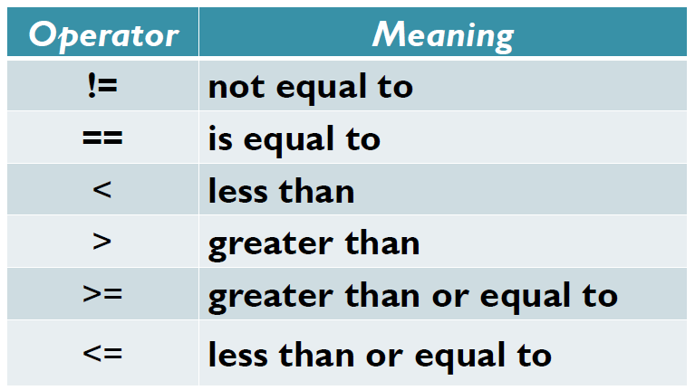
Relational Operators

Slide 9
Which of the following are relational expressions in Java?
x == 3
x = 3
x >= 3
x * 3
3 < x
x - 3 <= 10

Slide 10
For each of the following statements, assign variable names for the unknowns and rewrite the statements as relational expressions.
A customer's age is 65 or more.
The temperature is less than 0 degrees.
A person's height is over 6 feet.
The current month is 12 (December).
A person is older than 55 or has been at the company for more than 25 years.
A width of a wall is less than 4 meters but more than 3 meters.
An employee's department number is less than 500 but greater than 1, and they've been at the company more than 25 years.

Slide 11
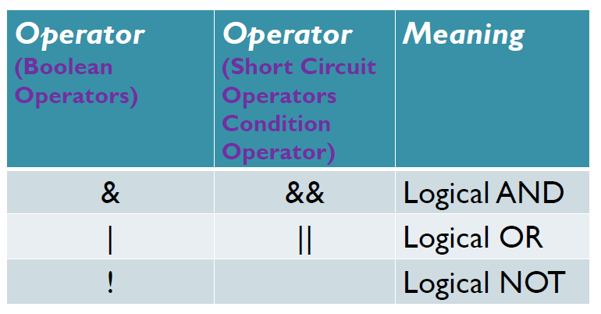
Logical Operators
short circuit logical operators evaluate second expression only if that is needed.

Slide 12
Given that a = 5, b = 2, c = 4, and d = 5, what is the result of each of the following Java expression?
a == 5
b * d == c * c
d % b * c > 5 || c % b * d < 7
d % b * c > 5 && c % b * d < 7

Slide 13
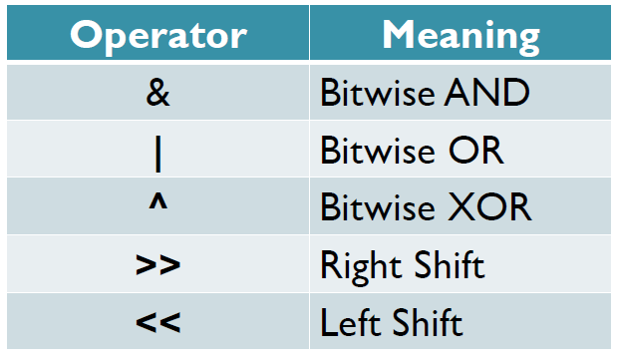
Bitwise Operators
Acts on individual bits of an integer

Slide 14
p | q | p&q
1 | 1 | 1
1 | 0 | 0
0 | 1 | 0
0 | 0 | 0
p | q | p|q
1 | 1 | 1
1 | 0 | 1
0 | 1 | 1
0 | 0 | 0
p | q | p^q
1 | 1 | 0
1 | 0 | 1
0 | 1 | 1
0 | 0 | 0
p | ~p
1 | 0
0 | 1

Slide 15
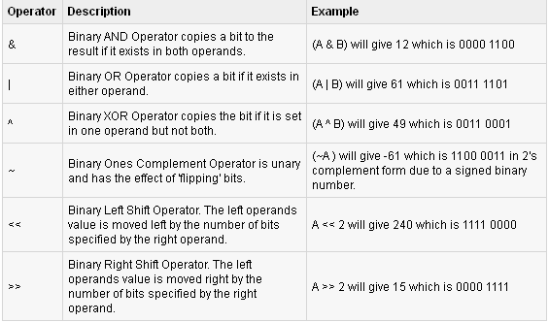
Shift Operators

Slide 16
class Test {
public static void main(String args[]) {
int a = 60;
int b = 13;
int c = 0;
c = a & b;
System.out.println("a & b = " + c );
c = a | b;
System.out.println("a | b = " + c );
c = a ^ b;
System.out.println("a ^ b = " + c );
c = ~a;
System.out.println("~a = " + c );
c = a << 2;
System.out.println("a << 2 = " + c );
c = a >> 2;
System.out.println("a >> 2 = " + c );
}
}

Slide 17
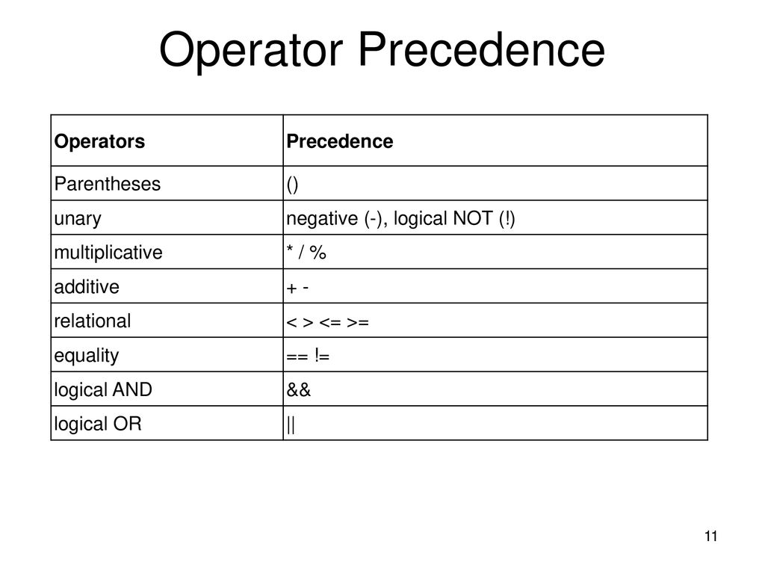

Slide 18
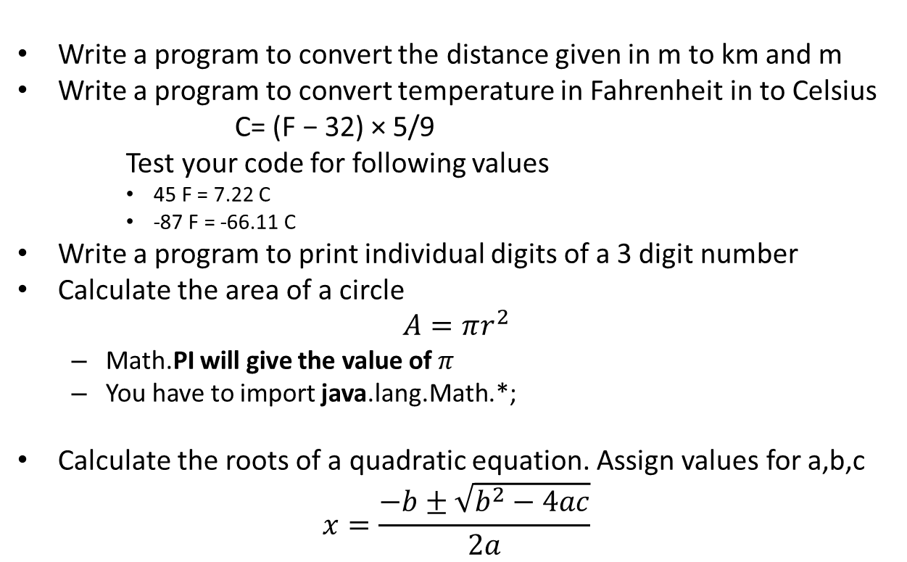
Exercise
Write a program to convert the distance given in m to km and m
Write a program to convert temperature in Fahrenheit in to Celsius
C= (F − 32) × 5/9
Test your code for following values
    45 F = 7.22 C
    -87 F = -66.11 C
Write a program to print individual digits of a 3 digit number
Calculate the area of a circle
$$A=πr^{2}$$
  Math.PI will give the value of $π$
  You have to import java.lang.Math.*;
Calculate the roots of a quadratic equation. Assign values for a,b,c
$$x=\frac{−b±\sqrt{b^{2}−4ac}}{2a}$$

