Slide 1

HNDIT2012
Fundamentals of Programming
Java Control Statements

Slide 2
Control Structures in Programming Languages
Control Structures are just a way to specify flow of control in programs. There are three basic types of logic, or flow of control, known as:
Sequence logic, or sequential flow
Selection logic, or conditional flow
Iteration logic, or repetitive flow

Slide 3
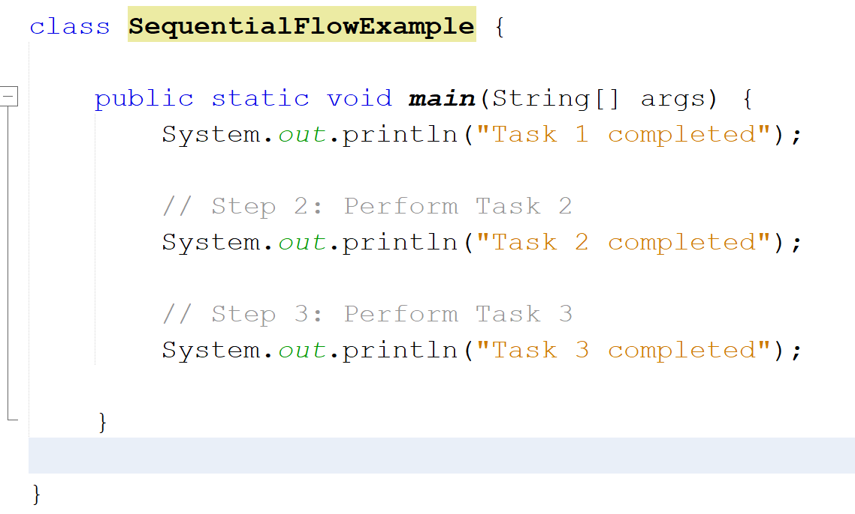
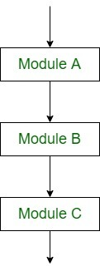
Sequential flow

Slide 4
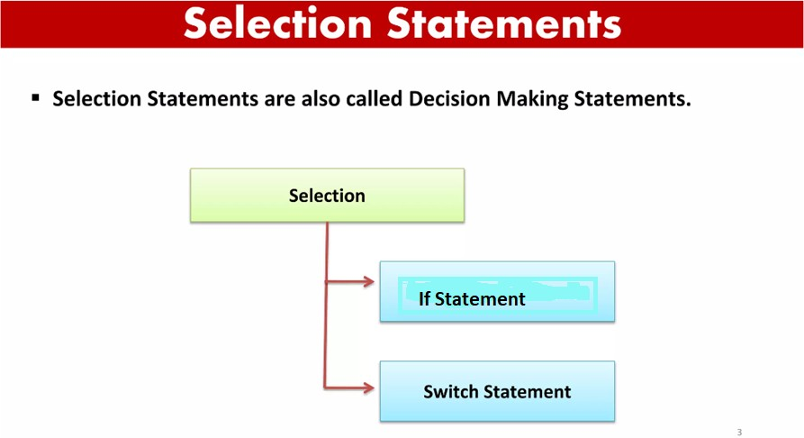

Slide 5
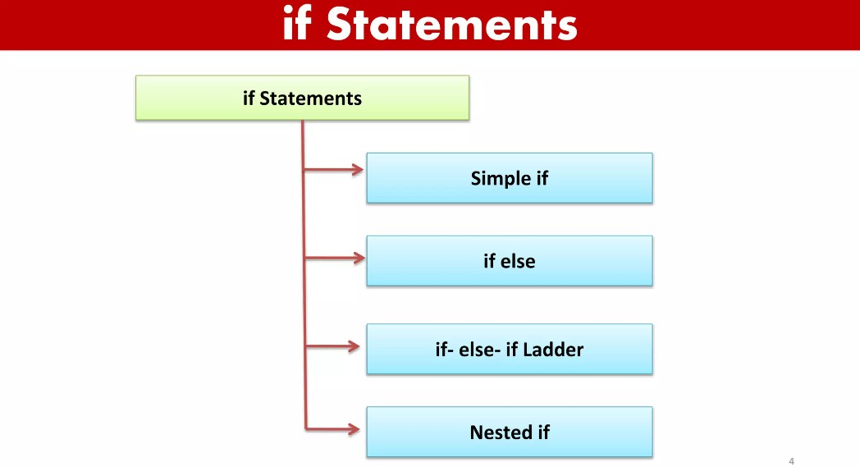

Slide 6
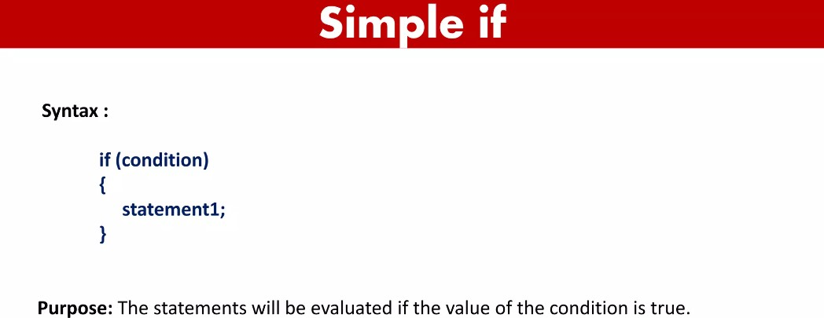

Slide 7
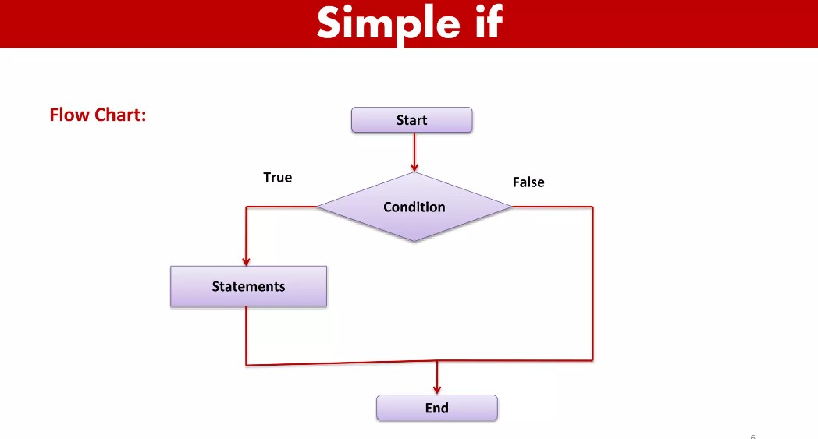

Slide 8
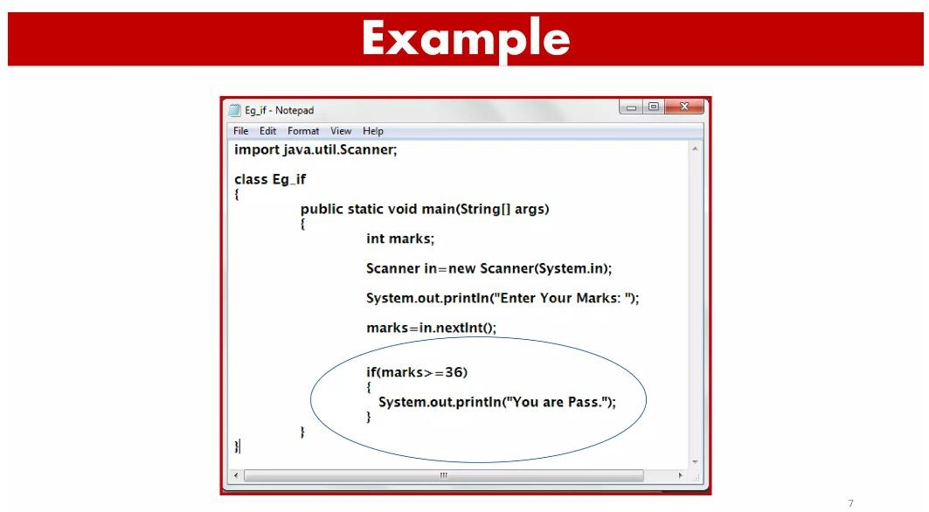

Slide 9
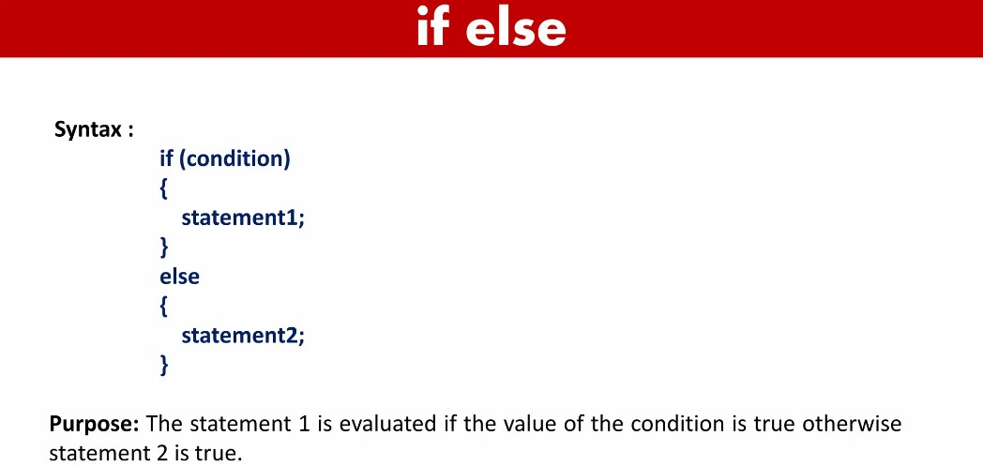

Slide 10
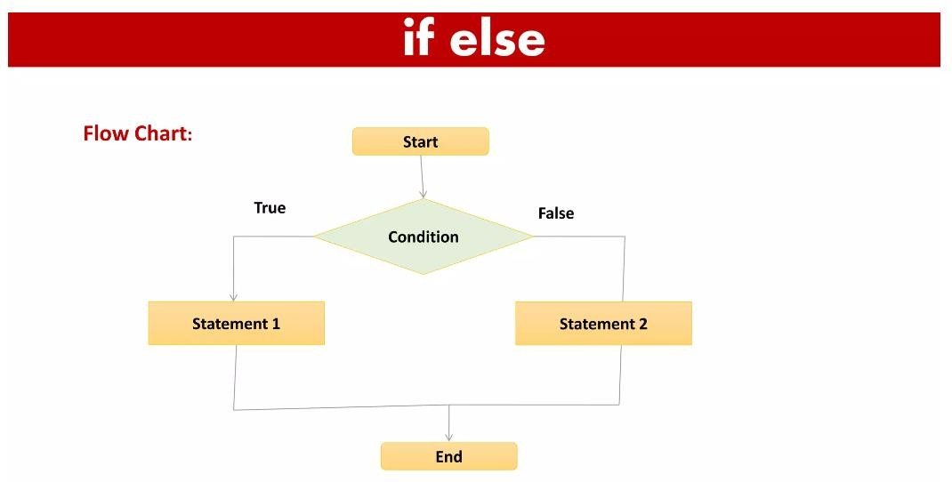

Slide 11
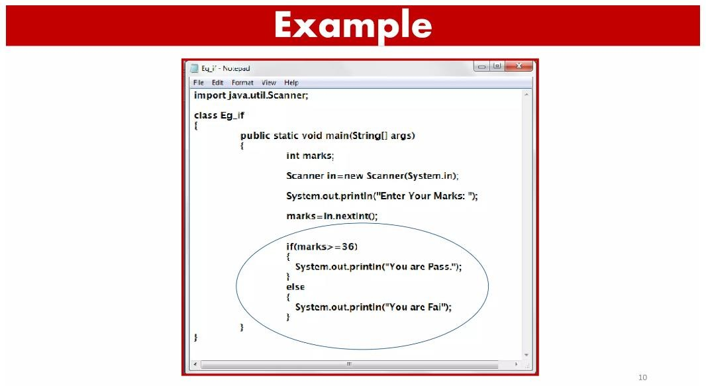

Slide 12
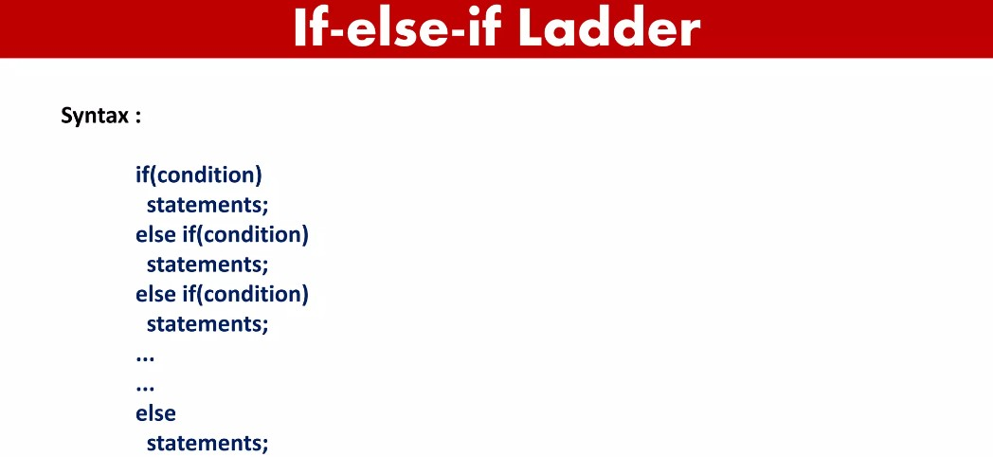

Slide 13
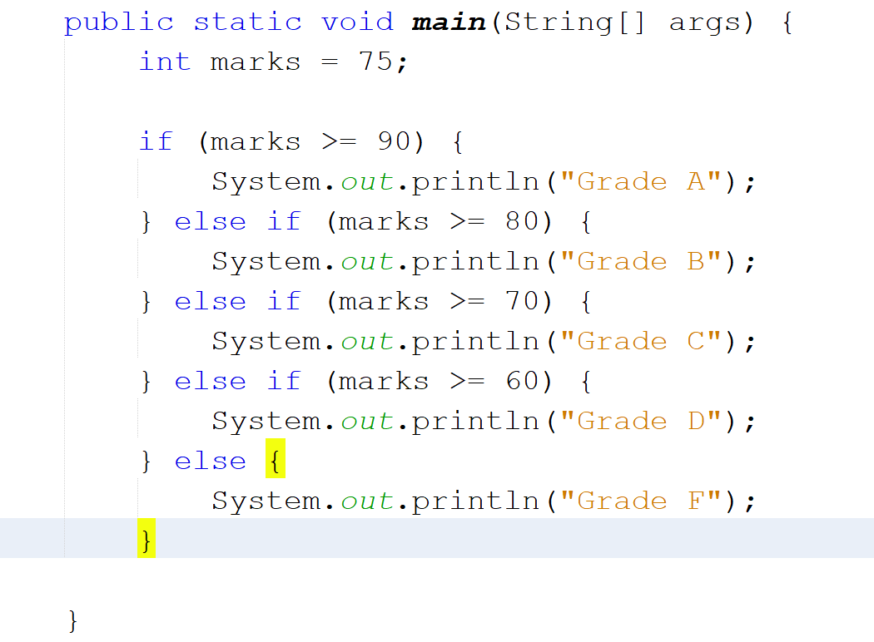

Slide 14
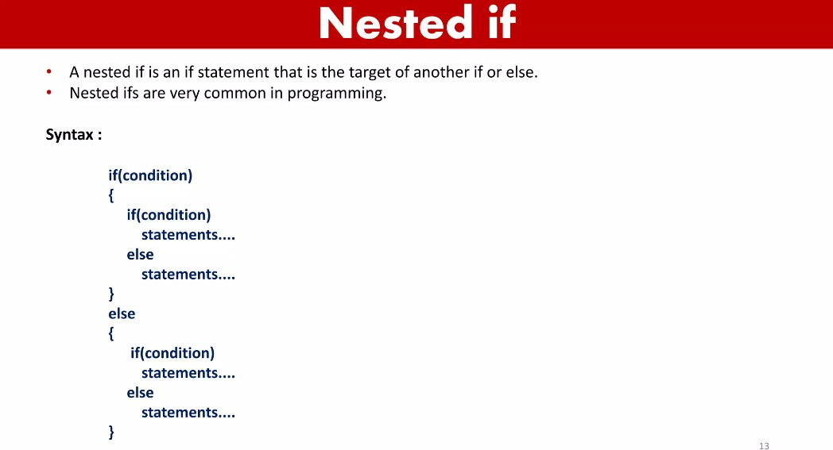

Slide 15
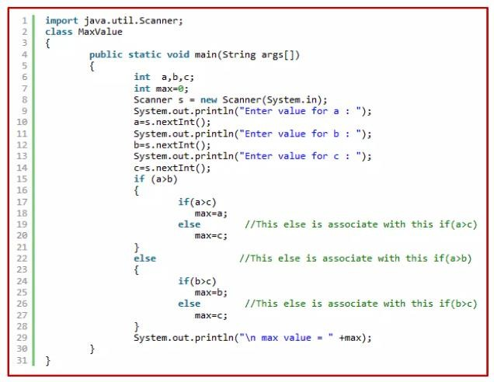

Slide 16
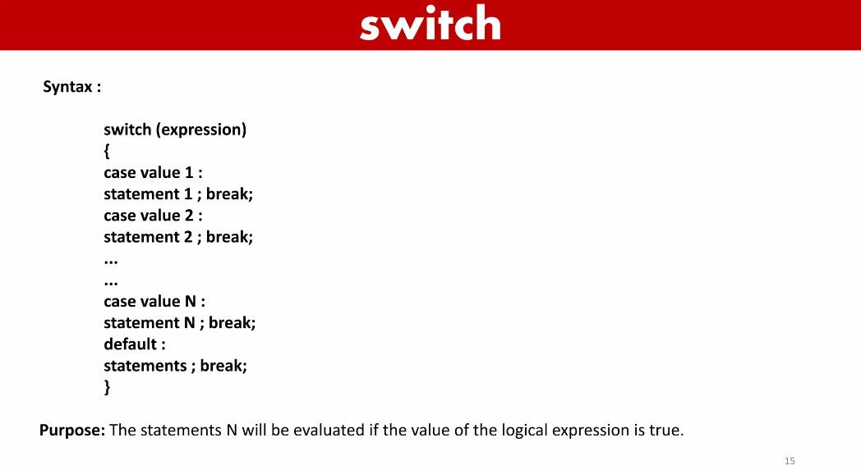
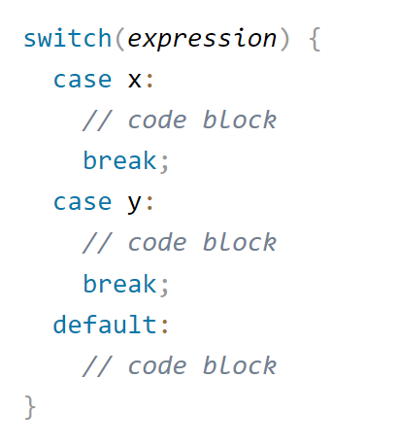
The switch expression is evaluated once.
The value of the expression is compared with the values of each case.
If there is a match, the associated block of code is executed.
The break and default keywords are optional.
Java works with
  byte, short, char, and int (primitive) data types.
  String, Character, Byte, Short, and Integer classes

Slide 17
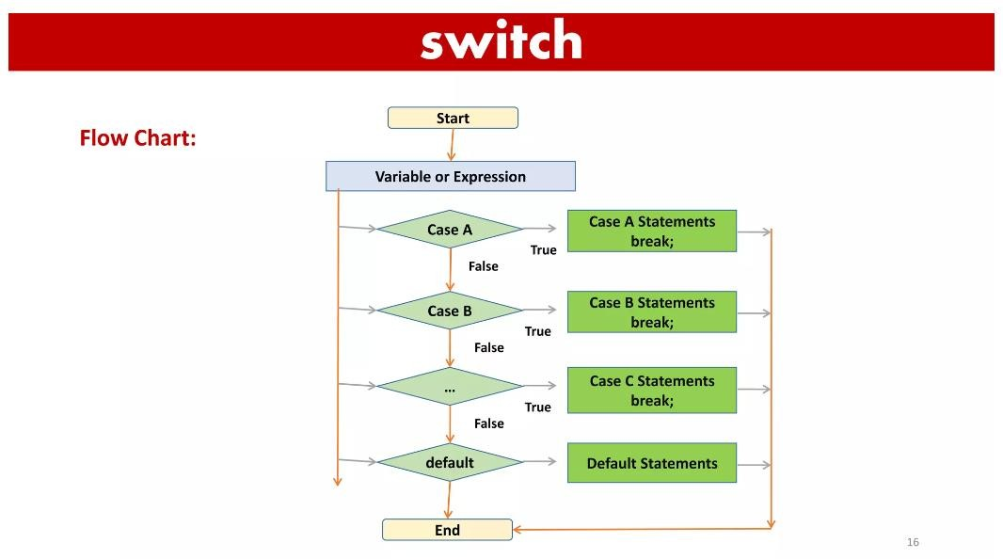

Slide 18
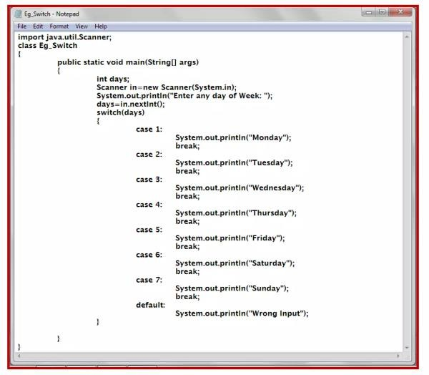

Slide 19


