Slide 1
HNDIT 2012
Fundamentals of Programming
Arrays

Slide 2
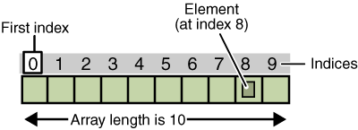
Array
An array is a container object that holds a fixed number of sequential collection of elements of a same type.
Each item in an array is called an element
Each element is accessed by its numerical index.
Index numbering begins with 0

Slide 3
Declaring an Array
Syntax
dataType[] arrayRefVar; //declares an array of integers
dataType arrayRefVar[]; //declares an array of integers
arrayRefVar = new int[10]; // allocates memory for 10 integers
Example
int[] Marks; //declares an array of integers
int Marks[]; //declares an array of integers
Marks= new int[10]; // allocates memory for 10 integers
Marks [0]=67; // initialize first element

Slide 4
Declaring an Array
Syntax
arrayRefVar = new dataType[arraySize];
dataType[] arrayRefVar = new dataType[arraySize];
Example
Marks= new int[10]; // allocates memory for 10 integers
int[] Marks= new ;

Slide 5
Declaring and Initializing an Array
Syntax
dataType[] arrayRefVar = {val0, val1, ...,};
Example
int[] Marks= { 60, 45, 65,94, 78,72,62,78,88};

Slide 6
Array Length
<array_reference>.length will provide the length of the array object.
For an example :
  double[] myList = new double[10];
  System.out.println(myList.length);
  This would print value 10 as the output.
Array indices are start from 0 to <array_reference>.length-1.

Slide 7
Accessing array elements
class TestVar
{
public static void main(String[] args)
{
int Marks[]= new int[10]; // allocates memory for 10 integers
Marks [0]=67;
Marks[1]=49;
Marks[2]=57;
Marks[3]=68;
Marks[4]=74;
Marks[5]=81;
Marks[6]=78;
Marks[7]=64;
Marks[8]=91;
Marks[9]=54;
System.out.print(Marks[0]);
}
}

Slide 8
Accessing array
class Test
{
public static void main(String[] args)
{
int count = 0;
int[] arr ={12,4,6,8,0,2,-2} ;
while (count < arr.length)
{
System.out.println(arr [count]);
count++;
}
}
}

Slide 9
Enhanced For-Loop (For-Each Loop)
int[] numbers = {1, 2, 3, 4};
for (int num : numbers) {
System.out.println(num);
}

Slide 10
Arrays Utility Class (from java.util)
Helpful methods to manipulate arrays
Arrays.toString(array)
Arrays.sort(array)
Arrays.equals(arr1, arr2)
Arrays.copyOf(array, newLength)
Arrays.fill(array, value)
Arrays.binarySearch(array, key)

Slide 11
Multidimensional Arrays
Represented in the form of rows and columns, also known as matrix. It is also known as array of arrays or list of arrays.
Data is accessed by row and column based index.

Slide 12
Declaration of 2D arrays
Syntax
DataType[][] arrayName;
arrayName = new DataType[rows][columns];
Or
DataType[][] arrayName = new DataType[rows][columns];
Example
int[][] Marks;
Marks= new int[3][4]; // 3 rows and 4 columns
Or
int[][] Marks = new int[3][4];

Slide 13
Declaring and Initializing of 2D Arrays
Syntax
dataType[][] arrayName = {{val0, val1,val2},{val3,val4,val5} ...,};
Example
int[][] Marks= { {34,12,54},{67,78,56} }; // 2 rows and 3 columns

Slide 14
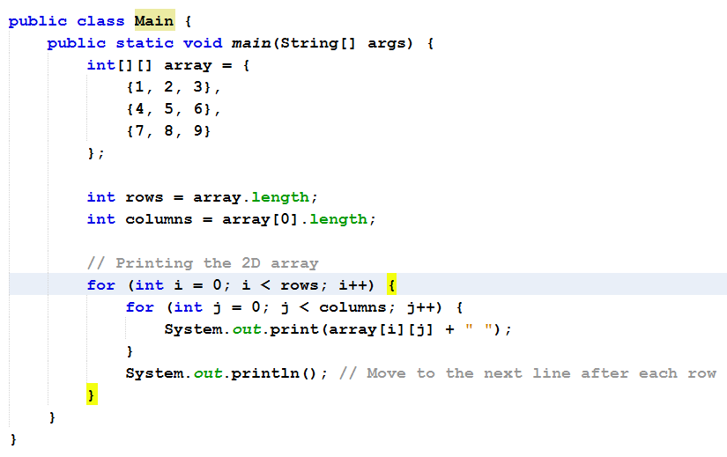
Printing a 2D Array

Slide 15
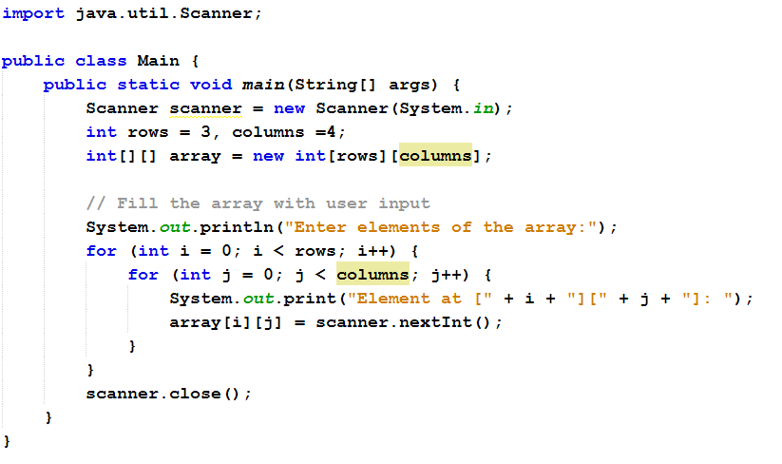
Fill 2D Array with user Inputs

Slide 16
Array vs ArrayList
Feature | Array | ArrayList
Fixed size | ✅ | ❌ (dynamic)
Type-safety | ✅(primitives too) | ✅ (only objects)
Performance | Faster | Slightly slower

