Slide 1
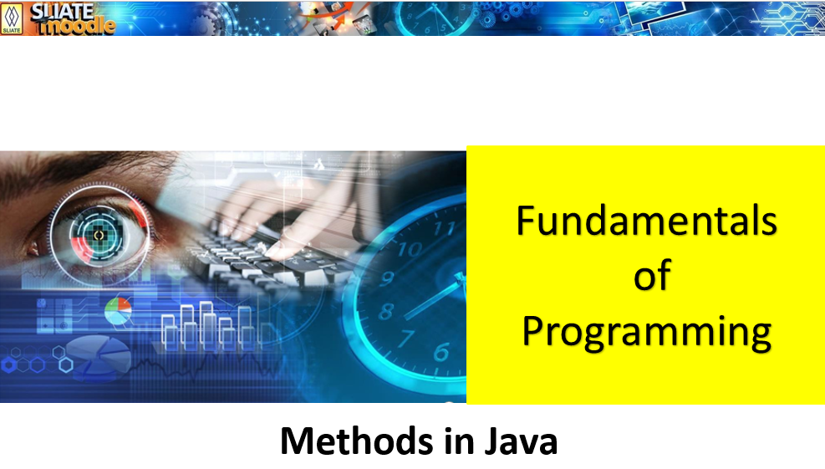

Slide 2
What is a method ?
A method is a block of code or collection of statements or a set of code grouped together to perform a certain task or operation.
They are also known as functions.
The method is executed only when we call or invoke it.
Why use methods?
  To reuse code: define the code once, and use it many times.
  Provides easy modification of the code, just by adding or removing a chunk of code.

Slide 3
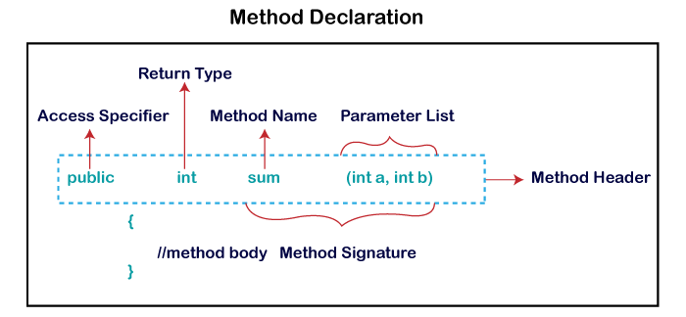
Method Declaration
A method must be declared within a class.
The method declaration provides information about method attributes, such as visibility, return-type, name, and arguments.
It has six components that are known as method header, as we have shown in the following figure.

Slide 4
Method Declaration - Access Specifier
Access specifier or modifier is the access type of the method. It specifies the visibility of the method. Java provides four types of access specifier:
  Public: The method is accessible by all classes when we use public specifier in our application.
  Private: When we use a private access specifier, the method is accessible only in the classes in which it is defined.
  Protected: When we use protected access specifier, the method is accessible within the same package or subclasses in a different package.
  Default: When we do not use any access specifier in the method declaration, Java uses default access specifier by default. It is visible only from the same package only.

Slide 5
Method Declaration
Return Type: Return type is a data type that the method returns. It may have a primitive data type, object, collection, void, etc. If the method does not return anything, we use void keyword.
Method Name: It is a unique name that is used to define the name of a method. It must be corresponding to the functionality of the method. Suppose, if we are creating a method for subtraction of two numbers, the method name must be subtraction(). A method is invoked by its name.
Parameter List: It is the list of parameters separated by a comma and enclosed in the pair of parentheses. It contains the data type and variable name. If the method has no parameter, left the parentheses blank.
Method Body: It is a part of the method declaration. It contains all the actions to be performed. It is enclosed within the pair of curly braces.

Slide 6
Types of Methods
There are two types of methods in Java:
  User defined Methods
    Written by the programmer according to the requirements.
  Predefined Method
    Method that is already defined in the Java class libraries.
    Also known as the standard library method or built-in method.
    Eg: length(), equals(), compareTo(), sqrt(), etc.

Slide 7
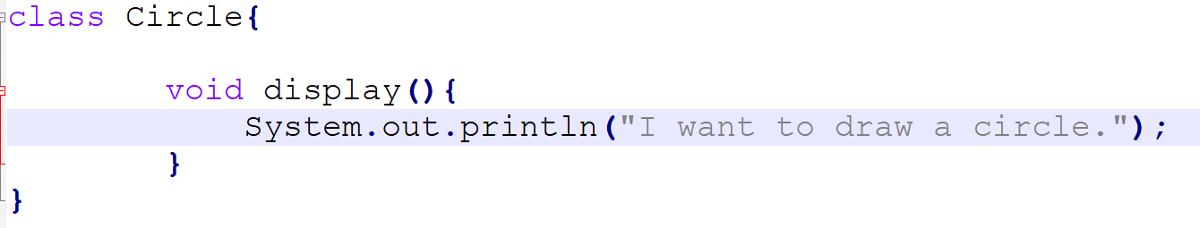
User defined Methods (Example 01)
Write a method to print the string “I want to draw a circle.”.

Slide 8
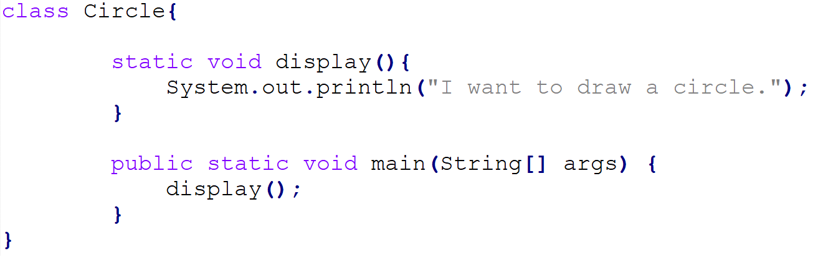
Call or invoke a user defined method

Slide 9
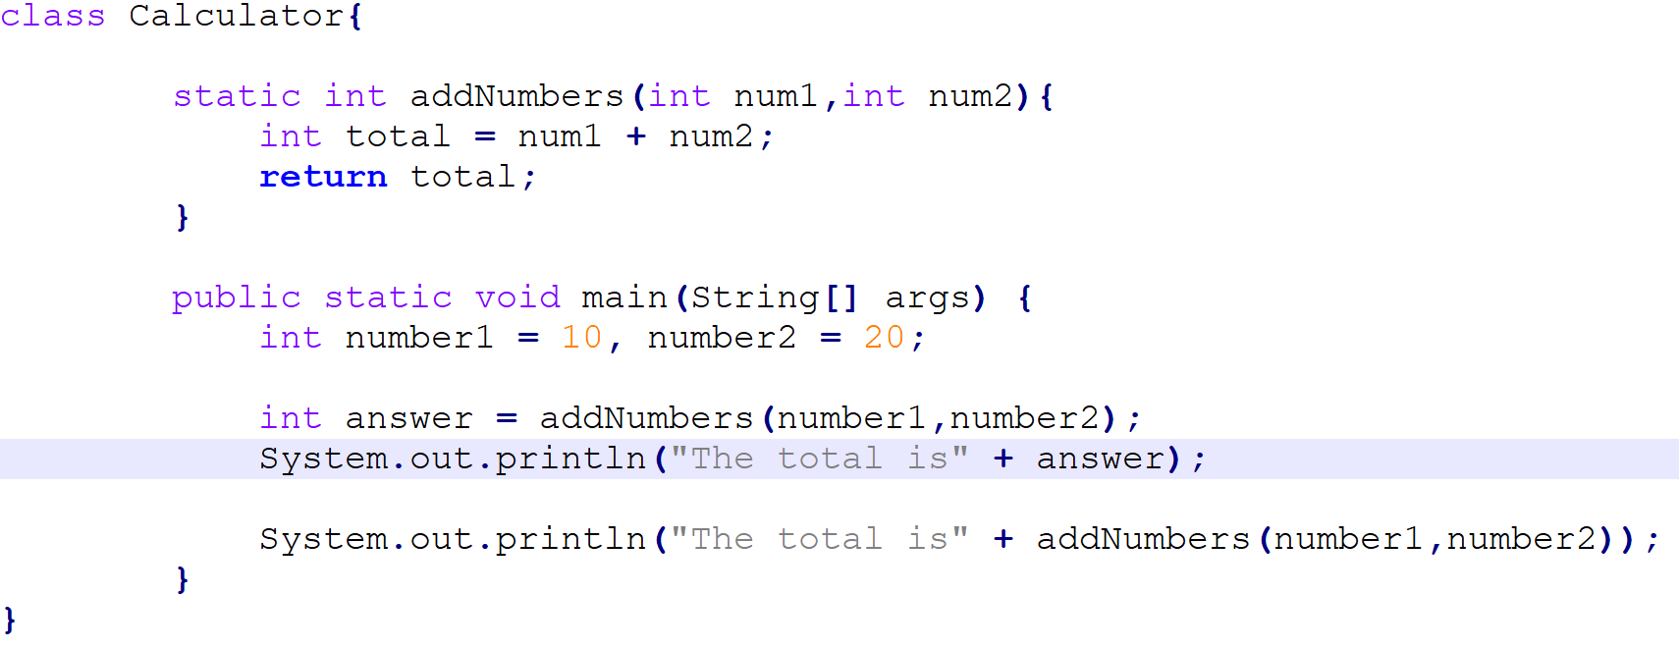
User defined Methods (Example 02)
Write a method to get two integers and return the total.

Slide 10
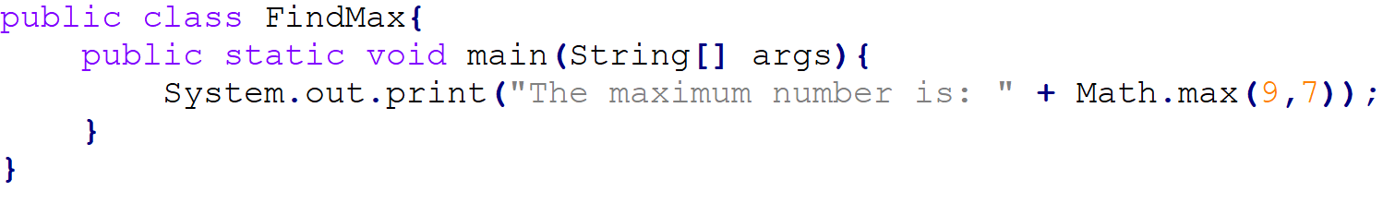
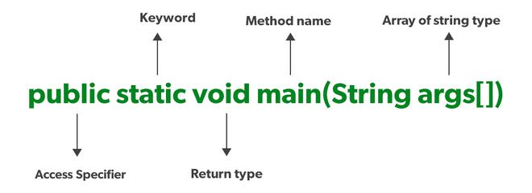
Predefined Method
In the code above three predefined methods main(), print(), and max() has used directly without declaration.
print() method is defined in the java.io.PrintStream class. It prints the statement that we write inside the method. For example, print("Java"), it prints Java on the console.
The max() method is a method of the Math class that returns the greater of two numbers.
The main() is the starting point for JVM to start execution of a Java program. Without the main() method, JVM will not execute the program.

Slide 11
Static Method vs Instance Method
Static Method
Instance Method
Method that belongs to a class rather than an instance of a class.
Can call it without creating an object.
It is invoked by using the class name.
Method belongs to a instance of a class.
Must create a object of the class to invoke it.
It is invoked by using the object name.

Slide 12
Static Method vs Instance Method

Slide 13
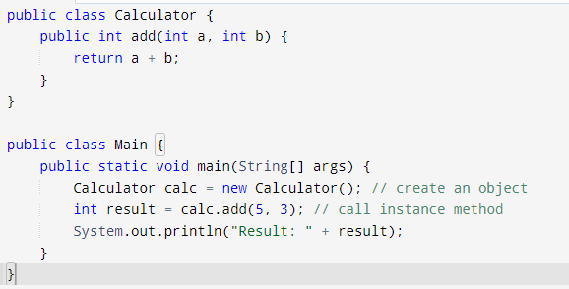
An instance method is tied to a specific object (instance) of a class.
You need to create an object of the class to call an instance method.

Slide 14
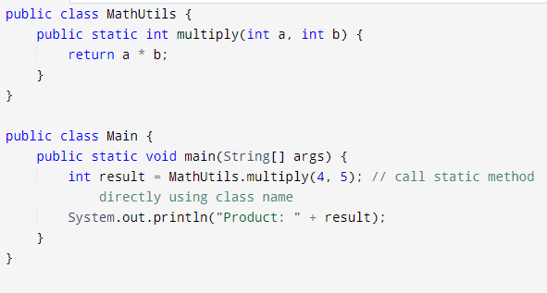
A static method is tied to a specific class.
You can call the static method with the class name.

Slide 15


