Slide 1
HNDIT2012 Fundamentals of Computer Programming
Exceptions Handling

Slide 2
Program Errors
Syntax errors (compile time)
  Caused by an incorrectly written code such as misspelled keyword or variable, and incomplete code.
Runtime errors
  Occurs when a statement attempts an operation that is impossible to carry out.
  Ex: division by zero.
Logical errors
  Occurs when code complies and runs without generating an error, but the result produced is incorrect.

Slide 3
Run time errors
Occurs at program run time
Condition that changes the normal flow of execution
  Program run out of memory
  File does not exist in the given path
  Network connections are dropped
  OS limitations

Slide 4
Exception
Unexpected behavior of program
An exception is an event, which occurs during the execution of a program, that disrupts the normal flow of the program's instructions.

Slide 5
exception object
When an error occurs within a method, the method creates an object and hands it off to the runtime system.
The object, called an exception object.
Contains information about the error, including its type and the state of the program when the error occurred.
Creating an exception object and handing it to the runtime system is called throwing an exception.

Slide 6
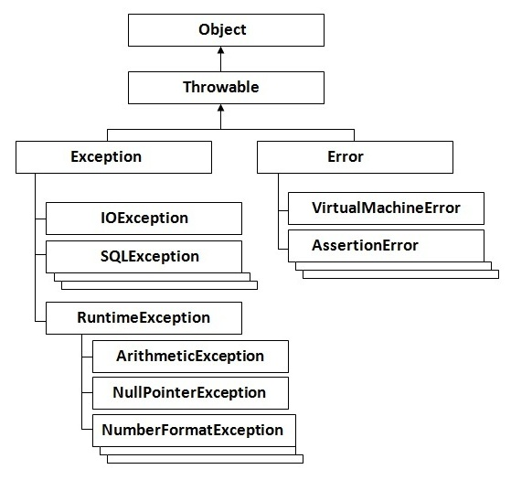
Hierarchy of Java Exception classes

Slide 7
Types of Java Exceptions
Checked exceptions
      ArithmeticException
      ClassCastException
      NullPointerException
      ArrayIndexOutOfBoundsException
      NegativeArraySizeException
      ArrayStoreException
      IllegalThreadStateException
      SecurityException, etc.
Unchecked
  Runtime exceptions
  Errors

Slide 8
Types of Exceptions
Checked exceptions
  Occurs at the compile time
  Also called as compile time exceptions.
  Cannot be ignored at the time of compilation by programmer.
  All exceptions are checked exceptions, other than Error, RuntimeException, and their subclasses
IOException
SQLException
ClassNotFoundException
IllegalAccessException

Slide 9
Types of Exceptions
Runtime exceptions
  At the time of execution.
  Never checked
  These include programming bugs, such as logic errors or improper use of an API.
ArithmeticException
NullPointerException
ArrayIndexOutOfBoundsException
InvalidArgumentException
NumberFormatException

Slide 10
Types of Exceptions
Errors
  Not exceptions at all, but problems that arise beyond the control of the user or the programmer.
  Errors are typically ignored in your code because you can’t rarely do anything about an error.
  For example, if a stack overflow occurs, an error will arise. They are also ignored at the time of compilation.
OutOfMemoryError
VirtualMachineError
AssertionError

Slide 11
Exception handling
Exception handling in java is one of the powerful mechanism to handle the runtime errors

Slide 12
try catch block
Syntax
try
  {
  //Protected code
  }
catch(ExceptionName e1)
  {
  //Catch block
  }

Slide 13
try catch block
Example 1
public class Main
{
public static void main(String[] args) {
try{
int a=4, b=0;
int c=a/b;
System.out.println(c);
}
catch(ArithmeticException E)
{
System.out.print("Error"+ E.toString());
}
}
}

Slide 14
Multiple catch Blocks
try
{ //Protected code
}
catch(ExceptionType1 e1)
{ //Catch block
}
catch(ExceptionType2 e2)
{ //Catch block
}
catch(ExceptionType3 e3)
{ //Catch block
}

Slide 15
try catch block
Example 2
public class Main
{
public static void main(String[] args) {
try{
int a=4;
int b=0;
int c=a/b;
System.out.println(c);
}
catch(ArithmeticException E)
{
System.out.print("Error"+ E.toString());
}
}
}

Slide 16
finally Block
A finally block of code always executes, whether or not an exception has occurred.

Slide 17
try catch with finally
Example 3
public class ExcepTest
{ public static void main(String[] args)
{
try{
int a=4;
int b=0;
int c=a/b;
System.out.println(c);
}
catch(ArithmeticException E)
{ System.out.print("Error"+ E.toString()); }
finally
{ System.out.print("End"); }
}
}

Slide 18
Throwable
Superclass of all errors and exceptions
All exceptions and errors extend from a common java.lang.Throwable parent class

Slide 19
Nesting try blocks
public class Demo
{
public static void main(String args[])
{
try
{
try
{
System.out.println("going to divide");
int b =39/0;
}
catch(ArithmeticException e)
{ System.out.println(e); }
System.out.println("other statement");
}
catch(Exception e){System.out.println("handeled");}
System.out.println("normal flow..");
}
}

Slide 20
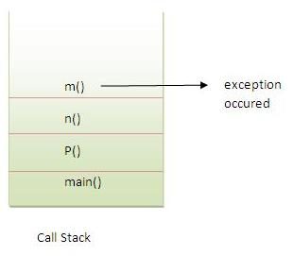
Exception Propagation
class Demo
{
void m(){ int data=50/0; }
void n(){ m(); }
void p()
{
try{
n();
}
catch(Exception e)
{System.out.println("exception handled");}
}
public static void main(String args[])
{
Demo obj=new Demo();
obj.p();
System.out.println("normal flow...");
}
}
An exception is first thrown from the top of the stack is not caught, it drops down to the previous method in the call stack.

Slide 21
throw
The Java throw keyword is used to explicitly throw an exception.
We can throw either checked or unchecked exception in java by throw keyword. The throw keyword is mainly used to throw custom exception.
Refer Lab8
throw new ArithmeticException("not valid");

Slide 22
throws
Keyword in the signature of method to indicate that method might throw one of the listed type exceptions
Use throws keyword to delegate the responsibility of exception handling to the caller (method or JVM), then caller method is responsible to handle that exception.
throws keyword is required only for checked exception and usage of throws keyword for unchecked exception is meaningless.
Only checked exceptions are required to be thrown using the throws keyword

Slide 23
class TestVar
{
static void fun() throws IllegalAccessException
{
System.out.println("Inside fun(). ");
throw new IllegalAccessException("demo");
}
public static void main(String args[])
{
try
{ fun(); }
catch(Exception e)
{
System.out.println("Caught in main"+e.toString());
}
}
}

