Slide 1
HNDIT2012
Fundamentals of Computer Programming
Week 10 – Access Modifiers, Classes and Objects

Slide 2
HNDIT2012 Fundamentals of Computer Programming
Access Modifiers

Slide 3
Lesson Introduction
This lesson provides the knowledge about Access Modifiers that specify the accessibility or scope of a field, method, constructor, or class.
It also throws in the knowledge of Classes and Objects, the basic concepts of Object Oriented Programming that revolve around real-life entities.
1A-<number>

Slide 4
Modifiers
Modifiers are Language Keywords that modify the definition of a Class, Method or a Variable
Access to variables and methods in Java classes is accomplished through Access Modifiers
Access modifiers define varying levels of access between class members and the outside world (other objects)
1A-<number>

Slide 5
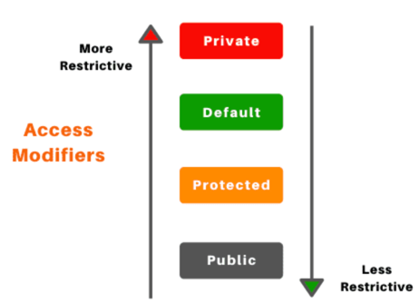
Access modifiers
Access modifiers are declared immediately before the type of a member variable or the return type of a method.
There are four access levels :
  Default
  Public
  Protected
  Private

Slide 6
1. Default access modifier
The Default access modifier is applied by default in the absence of an access modifier.
Specifies that only classes in the same package (groups of related classes and interfaces) can have access to class’s variables and methods
  long length;
  void getlength()
  {
  return length;
  }
Notice that neither the member variable nor the method, supply an access modifier.
So they take on the default access modifier implicitly
1A-<number>

Slide 7
2. public access modifier
Specifies that class variables and methods are accessible to anyone, both inside and outside the class
This means that public class members have global visibility and can be accessed by any other objects.
public int count;
public boolean isActive;
1A-<number>

Slide 8
3. protected access modifier
Specifies that class members are accessible only to methods in that class and subclasses of that class.
This means that protected class members have visibility limited to subclasses.
protected char middleinitial;
protected char getMiddleInitial()
{
return middleInitial;
}
1A-<number>

Slide 9
4. private access modifier
Specifies that class members are only accessible by the class they are defined in.
This means that no other class has access to private class members, even subclasses.
1A-<number>

Slide 10
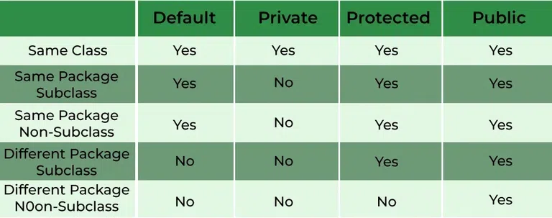
1A-<number>

Slide 11
Classes and Objects
1A-<number>

Slide 12
Objects
An object is a self-contained element of a computer program that represents a related group of features and is designed to accomplish specific tasks.
Also known as instances.
Each object has a specific role in a program, and all objects can work with other objects in specifically defined ways.
1A-<number>

Slide 13
Objects
    More definitions for an Object
      A ‘thing’ may have a physical presence such as a ‘table’,‘chair’ or an abstract concept such as ‘a job’ .
      An object is an abstract representation of a ‘thing’ in the real world.
      We simulate a problem domain in the real - world through objects.
      An object has a unique identity, attributes (What it knows or data about it), and behavior (What it can do).
1A-<number>

Slide 14
Objects
Employee Object Example
      For example, an Employee object (say employee1) will have the following attributes (what it knows):
        name
        age
        salary
      It will also have the following behavior (what it can do):
        set salary
        get salary
        set name
        set age
1A-<number>

Slide 15
Classes
A Class is a template used to create multiple objects with similar features.
When we write a program in an OO language, we don’t need to define individual objects. Instead, we define classes of objects. Classes embody all features of a particular set of objects.
For example, a Class "Tree" describes the features of all trees:
  Has leaves & roots
  Grows
  Creates chlorophyll
The Tree Class serves as an abstract model for the concept of a tree.
Every class written in java made up of two components: Attributes (what it knows) and Behavior (what it can do)
1A-<number>

Slide 16
Classes
1. Attributes
Individual things that differentiate one class of objects from another and determine the appearance, state and other qualities of that class.
– E.g: Color orange, raw umber, lemon yellow, maize
Attributes of a class of objects also can include information about an object’s state.
In a class, attributes are defined by variables.
Each object can have different values for its variables. These are called instance variables.
1A-<number>

Slide 17
Classes
    Instance variables and Class variables
      Instance variables
        An instance variable is an item of information that defines an attribute of one particular object.
        The object’s class defines what kind of attribute it is, and each instance object stores its own value for that attribute.
        Instance variables also known as object variables.
      Class variables
        A Class variables is an item of information that defines an attribute of an entire class.
        The variable applies to the class itself and to all of its instances.
1A-<number>

Slide 18
Classes
2. Behavior
Behavior is the way that a class of objects can do to change their attributes, and also what they do when ask them to do something.
Examples for behavior
  Get angry
  Calm down
  Eat a peasant
Behavior for a class of objects is done by using methods.
1A-<number>

Slide 19
Classes
Creating a Class
Open the text editor to create Java programs. Start with class definition.
class Jabberwock
{
}
Then create instance variables
String color; boolean hungry;
1A-<number>

Slide 20
Classes
Creating a Class (continued)
After that the programmer can add behavior to the class by adding methods.
void feedJabberwock()
{
if (hungry == true)
{
System.out.println(“yum – a peasant”); hungry = false;
}
else
System.out.println(“No, thanks – already ate”);
}
Use one of the following procedures to compile the program, depending on the system you’re using.
javac Jabberwock.java
1A-<number>

Slide 21
Classes
Creating Objects
Objects are created by instantiating classes. To use a class in a program, you must first create an instance of it. Objects of a class can be created using the new operator.
Employee newEmp = new Employee();
Object References following declaration will create an Object reference
Employee newEmp2;
You can create multiple References to the same object
Employee newEmp; newEmp = new Employee(); newEmp2 = newEmp;
1A-<number>

