Slide 1
HNDIT
Fundamentals of Programming
Week11: Object Oriented Programming concepts

Slide 2
Lesson introduction
In this module, you will realize the importance of object-oriented thinking and learn how to design software using object-oriented techniques.

Slide 3
Introduction
Structured and Object Oriented Anal are different techniques of developing a computer system.
Structured
  Is the traditional approach of software development based upon the waterfall model that focus is only on process and procedures.
Object Oriented
  Whereas in Object Oriented, the focus is more on capturing the real world objects in the current scenario that are of importance to the system.

Slide 4
What is object-orientation?
In object-orientation, your program will be split into several small, manageable, reusable programs.
Each small program has its own identity, data, logic and how it’s going to communicate with the rest of the other small programs.

Slide 5
Object
When you think about Objects, you should think about the real-world situations.
Object Orientation was intended to be closer to the real world, hence, make it easier and more realistic.
Objects can be modelled according to the needs of the application.
An object may have a physical existence, like a car or an intangible conceptual existence, like a project.
Each Objects has its own attributes, and behavior.
Objects are separate from one another.
They have their own existence, their own identity that is independent of other objects.

Slide 6

Object cont...
Attributes
  It’s the characteristics or the properties of the Object
Methods
  Methods are the things that the Object can do

Slide 7
The concepts and terms in object orientation
Abstraction ,Encapsulation, Inheritance, Polymorphism

Slide 8

Encapsulation
Encapsulation referrers to combining data and associated functions as a single unit.
Binding (or wrapping) code and data together into a single unit is known as encapsulation.
It also implies the idea of hiding the content of a Class, unless it is necessary to expose.
We need to restrict the access to our class as much as we can so that we can change the properties and the behaviors only from inside the class

Slide 9
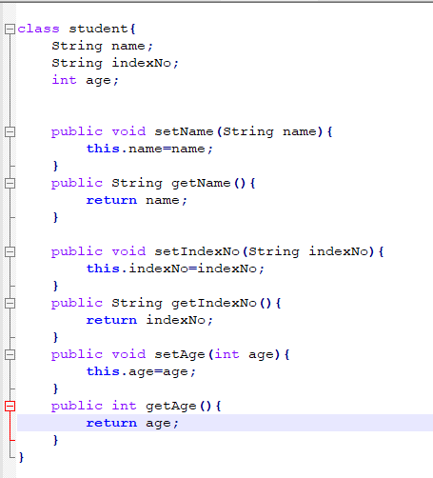
Encapsulation Example
In java
status(variables)
and
behavior(methods)
related to a object are included into one single unit called as class

Slide 10
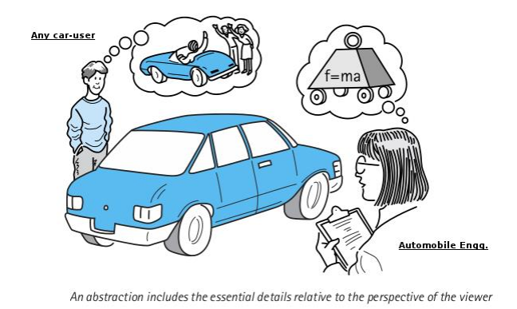
Abstraction
Hiding unnecessary details from the ordinary user.
It handle complexity .
That allows the user to perform more complex logic on top of the given abstraction without worrying about all the hidden complexity.

Slide 11

Example
Making coffee with a coffee machine is an excellent example of abstraction.
A coffee machine user should only know how to use the coffee machine to make coffee, for instance, how to put water and coffee beans, switch it on and select the kind of coffee.
The user does not need to know how the coffee machine is working internally on brewing a fresh cup of delicious coffee.
Further, the user do not need to know the ideal temperature of the water or the amount of ground coffee.
Someone else worried about that and created a coffee machine that now acts as an abstraction and hides all these details.
You, as a coffee machine user, simply interact with a simple interface that doesn’t require any knowledge about the internal implementation of the coffee machine.

Slide 12
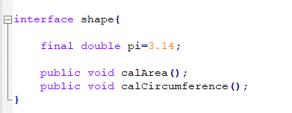
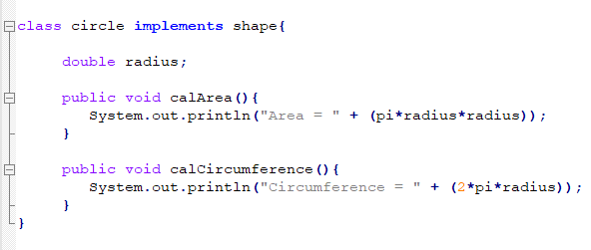
Abstraction Example
In java interfaces contains method which does not have any method body
Those methods should implement in it’s sub classes.

Slide 13
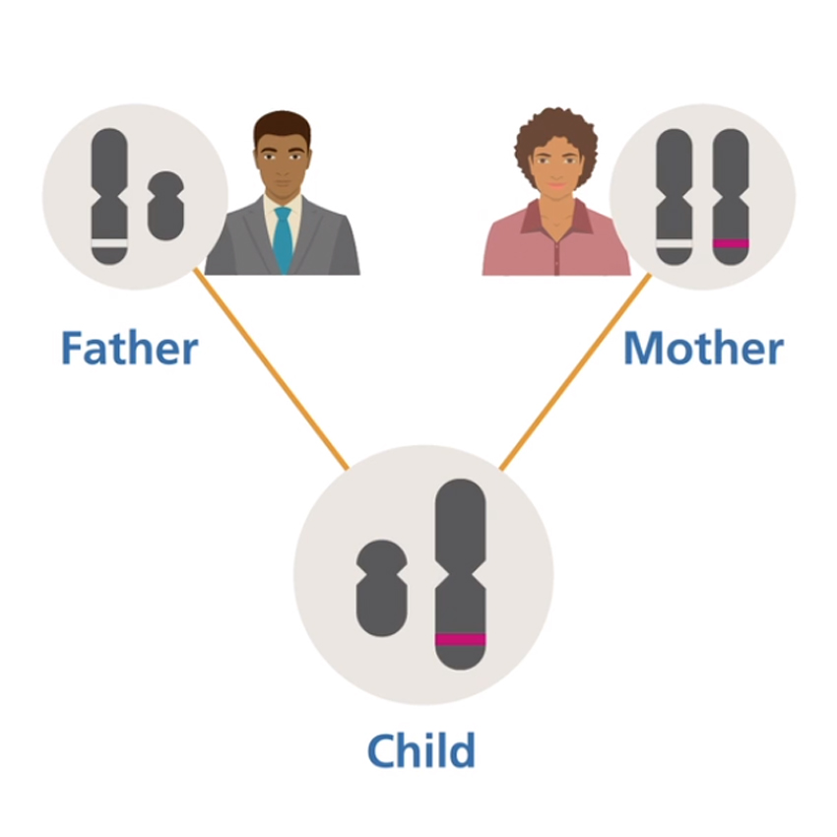
Inheritance
Forming a new class from an existing class.
Existing class is base class/parent class/super class and new class is derived class/child class/sub class.
Helps to reduce the code size

Slide 14
Example
Different kinds of objects often have a certain amount in common with each other.
For example:
  Mountain bikes, road bikes, and tandem bikes, for example, all share the characteristics of bicycles (current speed, current pedal cadence, current gear).
  Additional features that make them different: tandem bicycles have two seats and two sets of handlebars; road bikes have drop handlebars; some mountain bikes have an additional chaining, giving them a lower gear ratio.
  Object-oriented programming allows classes to inherit commonly used state and behavior from other classes.
  In this example, Bicycle now becomes the superclass of Mountain Bike, Road Bike, and Tandem Bike

Slide 15
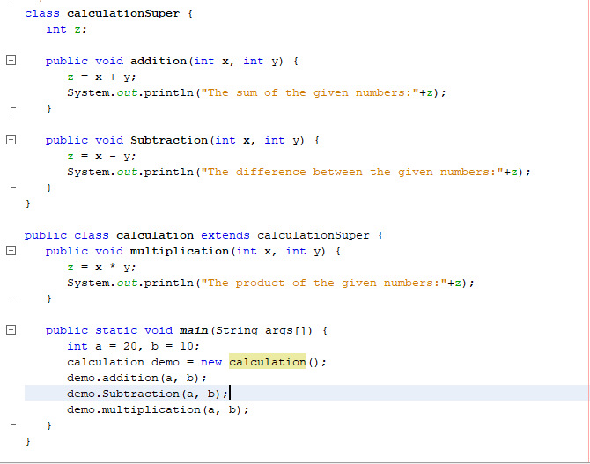
Inheritance
extends is the keyword used to inherit the properties of a class.
In the given program, when an object to calculation class is created, a copy of the contents of the superclass (calculationSuper) is made within it. That is why, using the object of the subclass you can access the members of a superclass.
The Superclass reference variable can hold the subclass object, but using that variable you can access only the members of the superclass, so to access the members of both classes it is recommended to always create reference variable to the subclass

Slide 16

Polymorphism
Polymorphism is the state where an object can take the shape of many different forms, and lets us do the right thing at the right time.
It describes the concept that objects of different types can be accessed through the same interface
Each type can provide its own, independent implementation of this interface.

Slide 17
Polymorphism
Overriding and overloading are the core concepts in Java programming. They are the ways to implement polymorphism in our Java programs.

Slide 18
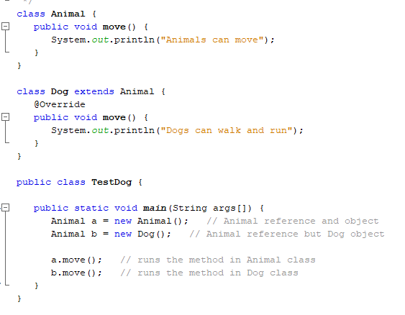
Overriding
When the method signature (name and parameters) are the same in the superclass and the child class, it’s called overriding.
If a class inherits a method from its superclass, then there is a chance to override the method provided that it is not marked final.
The benefit of overriding is: ability to define a behavior that's specific to the subclass type, which means a subclass can implement a parent class method based on its requirement.

Slide 19
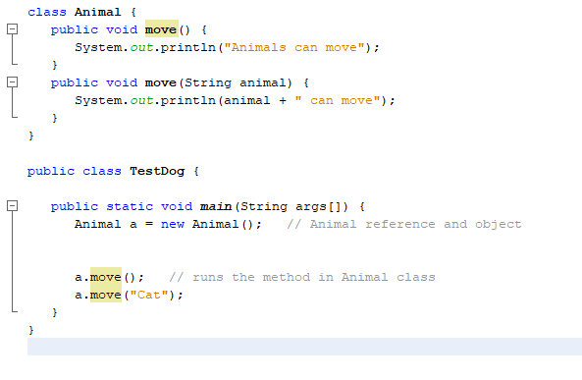
Overloading
When two or more methods in the same class have the same name but different parameters, it’s called overloading.

Slide 20
Q & A

