Slide 1

Forecasting Household Energy Consumption
Matthew Landrum
Yehang Rai
Hans Holmes

Slide 2

Purpose
Growing Energy Demand and Renewable integration.
Need of stability , cost efficiency and sustainability.
Leveraging Machine Learning and time-series models to predict household energy consumption.

Slide 3
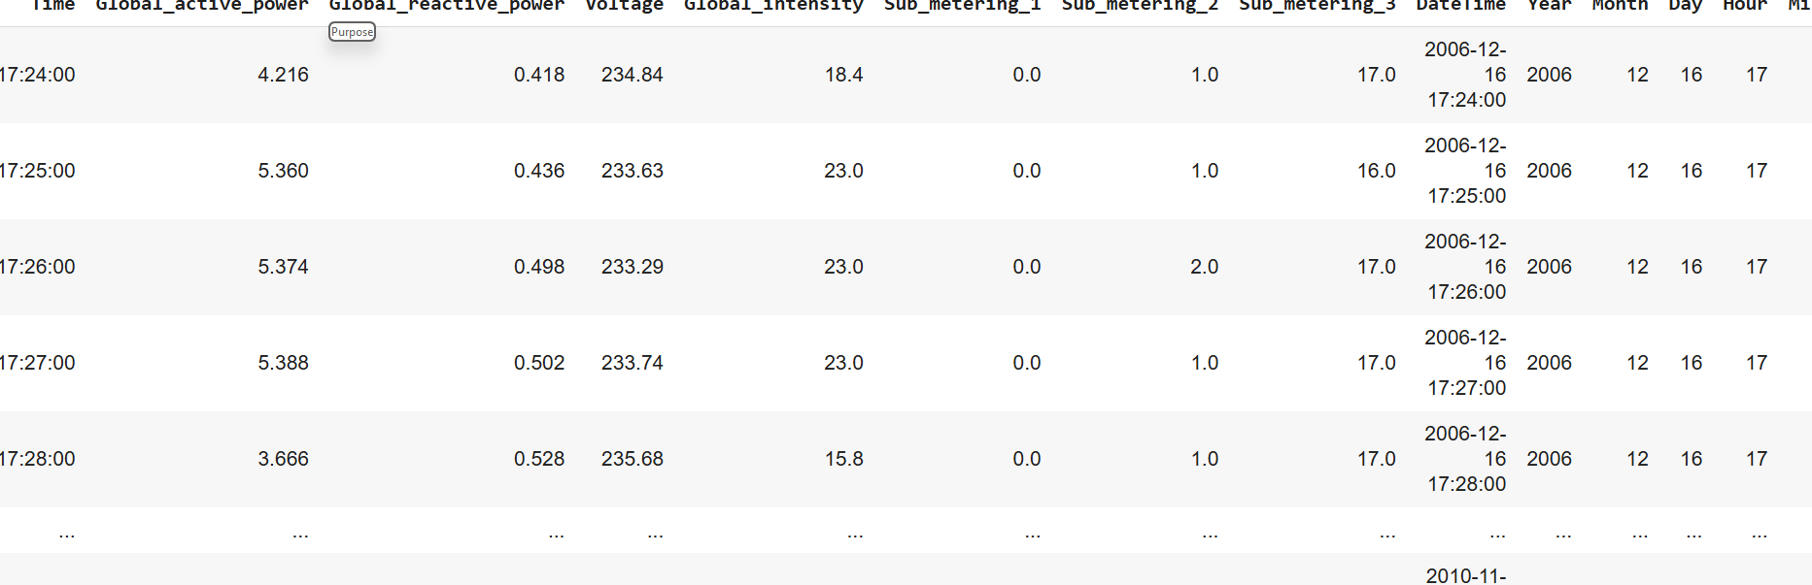
Data Overview
Household Energy usage data over several years, recorded every minute.
Key Variables: Global Active power, global reactive power, Voltage, Global intensity
Global active power represents the total active power consumed by the household: crucial target variable

Slide 4
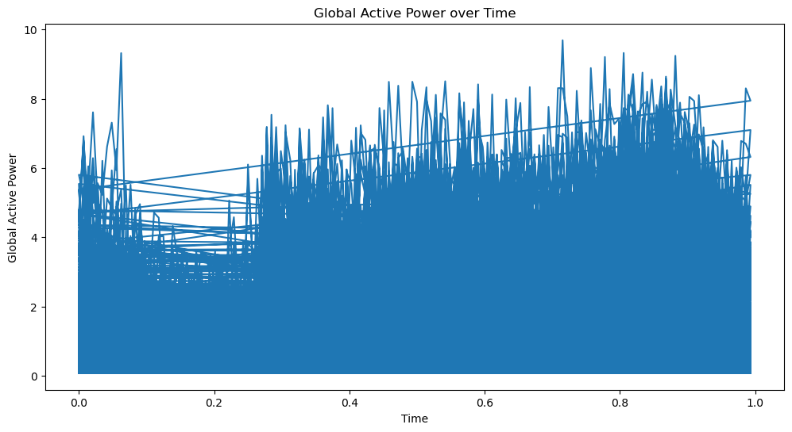
Exploratory Data Analysis
Noticeable variability in the energy consumption throughout the day.
Since there are certain trends, seasonal features could be introduced to the model.

Slide 5
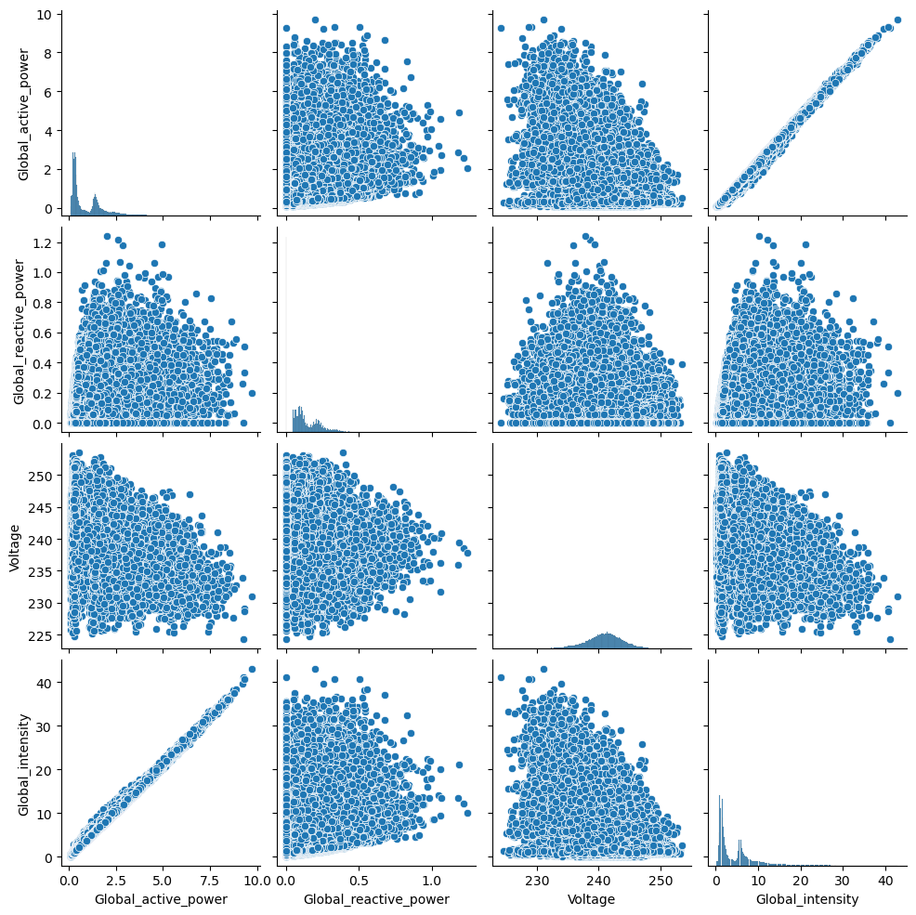
Global Active Power and Global Intensity have a strong positive correlation. Global Intensity can be one of the predictive features
Voltage exhibits more symmetric distribution.

Slide 6
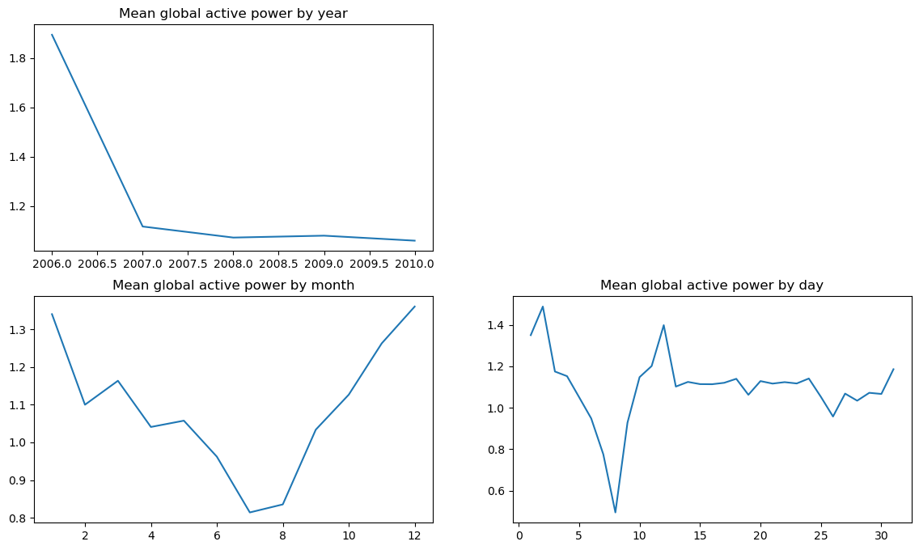
The mean global active power varies considerably over the days of a month, with certain peaks and troughs. These variations could be attributed to holidays, weekends, or specific days with increased activity.
The monthly fluctuations indicate higher energy consumption during the colder months (October-December) and lower consumption during the summer months (June-August).

Slide 7

Data Cleaning
Rows with missing values were removed because imputing them could introduce bias.
25,979 rows out of 2,075,259 missing.
Thresholds for outliers was determined based on the 99th percentile of the variable and any outliers were removed.
The data was aggregated to 10-minute Intervals

Slide 8

Feature Engineering
Created new features to improve prediction accuracy:
🡪 Normalized time: Time as a value between 0 and 1( eg: 0.2=4:48AM)
Is_holiday: Weekends marked as 1 and Weekdays as 0.
Rationale to this is to capture real-world behavior and energy usage patterns.

Slide 9
Features Used for Prediction
Time helps identify how energy fluctuates throughout the day.
Global Intensity was highly correlated with our target variable.
A binary feature indicating weekend or holiday.
Voltage was included to capture fluctuations that may influence energy consumption patterns.
Although not highly correlated global_reactive power was used because it represents the power being returned to the grid, which may influence the energy consumption.

Slide 10
Models and Why were it used?
Linear regression 🡪 Helps understand linear trends, with global_active power as the predictor.
Decision Tree 🡪 Works well with mix of numeric and categorical data.
Random Forest 🡪 Used because reduces overfitting.
MLP Regressor🡪 Captures highly non-linear patterns.
LightGBM 🡪 Handles large data sets and captures non-linear relationships.
XGBoost Regressor🡪 Known for its speed and Predictive power.
ARIMA 🡪 Focuses on time-dependent data and captures seasonality.
)Prophet 🡪 Also accounts for trends and seasonality in the data

Slide 11
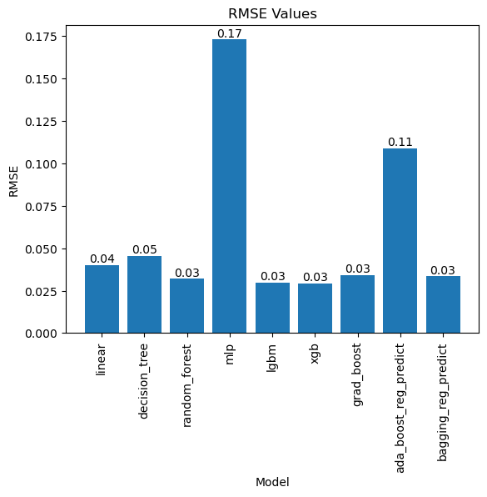
Model Performance
Root Mean Square Error was used as the evaluation metric.
RMSE penalized larger errors more heavily, making it ideal for ensuring accurate predictions.

Slide 12
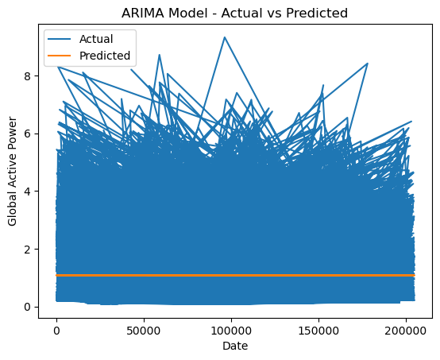
ARIMA Performing Predictor
Applied to capture trends and seasonal cycles
Struggled with short-term fluctuations due to its limited ability to handle high frequency variations

Slide 13
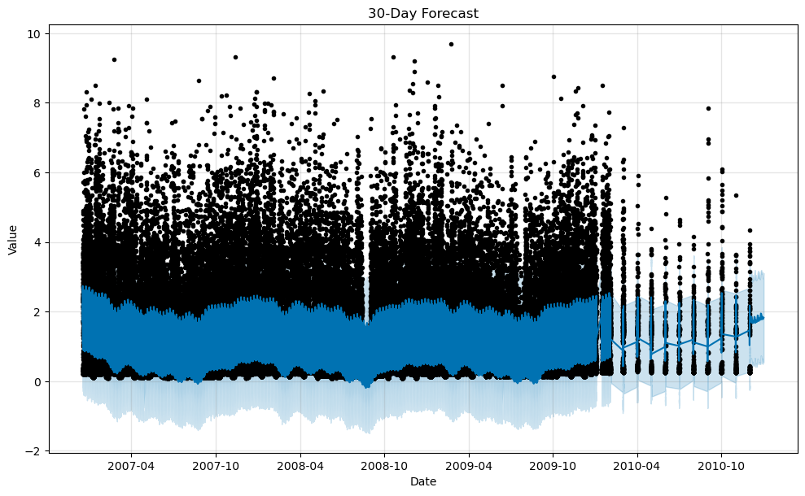
Prophet
Also struggled with frequent changes
Slightly better suited for long-term forecasts

Slide 14
Conclusion
Ensemble models provide high accuracy
Future Work:
Hyperparameter Tuning can be done to improve model performance.
Use feature selection techniques like PCA, SHAP.
Focus more on Time Series Model’s like LSTM.

