Slide 1

Yancai or Jiangcai? A Case Study of Word Reinterpretation in Middle Chinese Literature
Yao Zhang
Cornell University
03/22/2024

Slide 2
Content
General problem of word interpretation in Middle Chinese literature
Case study: Reinterpretation of a ghost word jiangcai
(For all the examples and the slides, see https://github.com/Yeheyinyan/AOS234_Talk_YaoZhang.git)

Slide 3
General problem
in Middle Chinese philology

Slide 4
General philological problem
In MC literature, words blur due to…
misinterpretation in lexical semantics
(caused by diachronic change and dialectal difference)
miswritten/misread characters

Slide 5
How to recover?
Blurring words can be recovered by referring to …
contexts and conventional expressions
parallel text (contemporaneous/later, same/other languages)
alternative interpretations with similar characters/sounds

Slide 6
How to recover?
Blurring words can be recovered by referring to …
contexts and conventional expressions
parallel text (contemporaneous/later, same/other languages)
alternative interpretations with similar characters/sounds
Different types of evidence can lead to different results

Slide 7
Case study
A ghost word in Yanshi Jiaxun

Slide 8
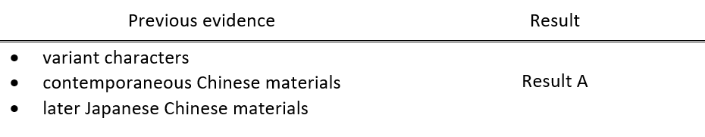
New evidence type, new interpretation

Slide 9
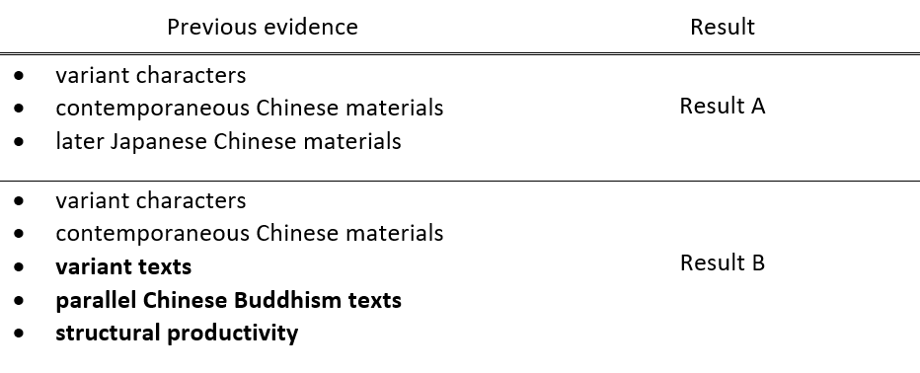
New evidence type, new interpretation

Slide 10
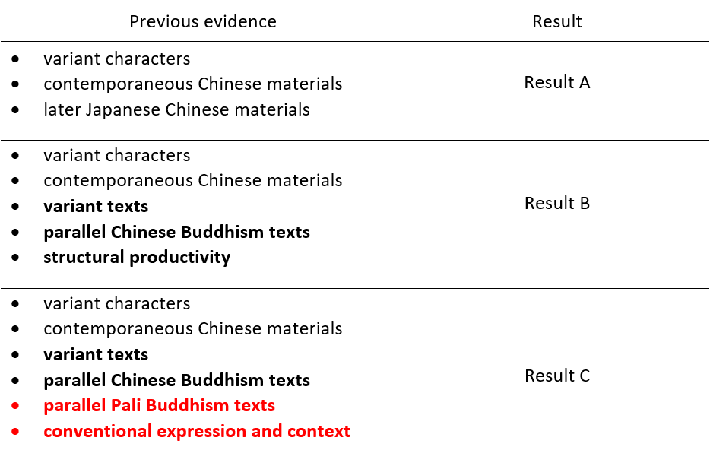
New evidence type, new interpretation

Slide 11
Case study: jiangcai in Yanshi Jiaxun
Background
Yanshi Jiaxun “Family Instructions for the Yan Clan”
A book written at around 6-7 cent. CE
Significant work in Chinese philology and historical linguistics

Slide 12
Case study: jiangcai in Yanshi Jiaxun
Background: Yanshi Jiaxun “Family Instructions for the Yan Clan”
A book written at around 6-7 CE
Significant work in Chinese philology and historical linguistics
separate chapters focusing on philological and dialectal topics
large vocabulary of Middle Chinese colloquialism.

Slide 13
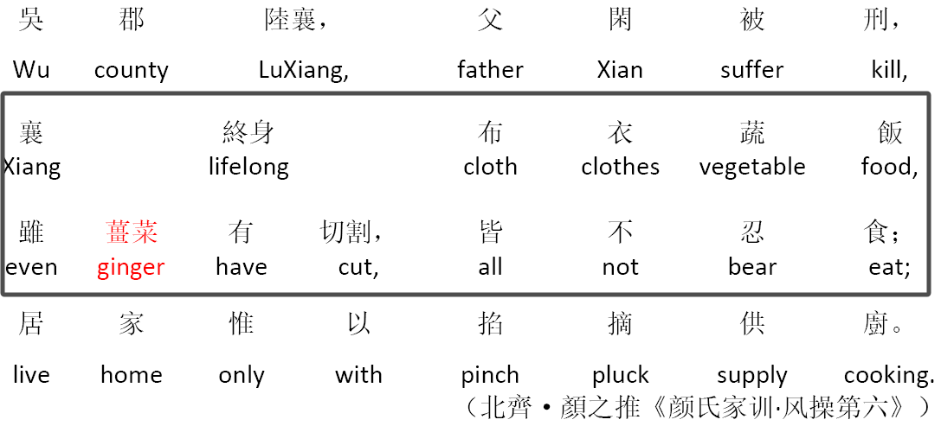
Case study: jiangcai in Yanshi Jiaxun
Problem: Written form and semantic meaning of jiangcai
“Lu, Xiang comes from Wu County. His father Xian is killed, so Xiang lives a simple life with clothes made of cloth and food containing vegetables through out his life. He cannot bear eating ginger which needs to be cut, and all the cooking ingredients are pinched or plucked.”

Slide 14
You (2017) first questioning the gloss
There is no need to use disyllabic form for the word ‘ginger’, since the word has always been monosyllabic jiang though out Classical Chinese.
Ginger has nothing special which separates it from other common vegetables.

Slide 15
Questioning the gloss
Problem: Written form and semantic meaning of jiangcai
Correct character: 壃(疆)菜? 薑菜?

Slide 16
Questioning the gloss
Problem: Written form and semantic meaning of jiangcai
Correct character: 壃菜? 薑菜?
Correct meaning:
壃(疆)菜—‘field-vegetable’
薑菜— ‘ginger-vegetable’

Slide 17
Questioning the gloss
Problem: Written form and semantic meaning of jiangcai
Correct character: 壃菜? 薑菜? Or…?
Correct meaning:
壃(疆)菜—‘field-vegetable’
薑菜— ‘ginger-vegetable’
Or…?

Slide 18
Review: 1st work
PROPOSAL (You 2017)
Writing forms 疆菜 and 薑菜, both pronounced as jiangcai, were confused.
The word in Yanshi Jiaxun should be understood as 疆菜, literarily reading ‘field-vegetable ’, instead of 薑菜 as ‘ginger-vegetable, ginger’.

Slide 19

You 2017—jiangcai is 疆菜‘field-vegetable’
Types of EVIDENCE
Variant characters of 薑 and how it can be confused with 疆:
‘ginger’薑= ≈彊=疆‘boundary, field’
Similar usage of contemporaneous material Fengsu Tongyi and gloss from later philologists
Similar usage of later Japanese Chinese material Yixinfang

Slide 20
Review: 2nd and 3rd work
PROPOSAL (Xu 2020 & Zhao 2020)
You’s interpretation is incorrect.
薑菜 is the correct form of jiangcai, which should be interpreted as ‘ginger’.

Slide 21
Xu 2020—jiangcai is薑菜‘ginger-vegetable’
Types of EVIDENCE
No convention of the jiang 疆 ‘boundary’ used as ‘field’, thus no jiangcai 疆菜‘field-vegetable ’ used as ‘vegetable’
Productive structure of ‘hyponym-hypernym’ when naming vegetables
Contemporaneous Chinese Buddhist texts containing the same 薑(菜)

Slide 22
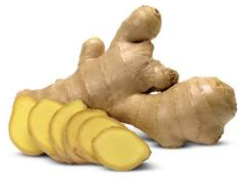
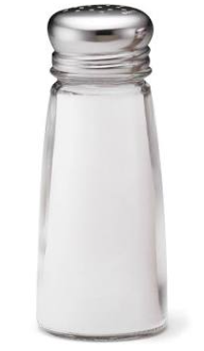
Zhao 2020 —jiangcai is薑菜‘ginger-vegetable’
More types of EVIDENCE
Variant characters of 鹽 and how it can be confused with 薑:
薑=壃≈ =鹽
Variant texts with You’s examples containing yancai 鹽菜 ‘salted vegetable, pickle’

Slide 23
MY PROPOSAL
jiangcai is a ghost word caused by misinterpretation.
The target word should be yancai 鹽菜 ‘salt(ed) vegetable’ , a common term for ‘pickle’ in Middle Chinese.

Slide 24
EVIDENCE
Variant forms of Chinese characters
Variant texts and contextual interpretation
Parallel Pali and Chinese Buddhist texts
Conventional expression containing yancai

Slide 25
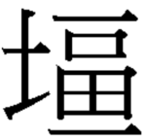
Variant characters and misreading cause ghost form
Variant characters of jiang薑 ‘ginger’
薑=壃
Variant characters of yan鹽 ‘salt’
鹽=
(Variants attested in contemporaneous inscription in Tang dynasty and later dictionaries )

Slide 26
Variant characters and misreading
Variant characters of jiang薑 ‘ginger’
薑=壃
Variant characters of yan鹽 ‘salt’
鹽=
How they confuse with each other:
=壃≈ =

Slide 27
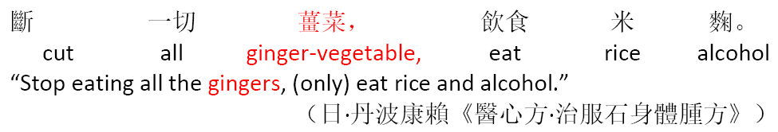
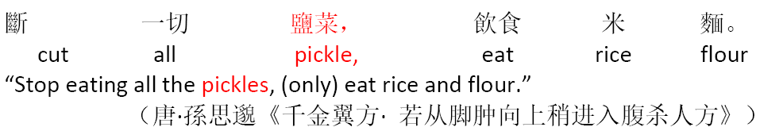
Contextual interpretation: √ ×
Variant in parallel medical texts
a.
b.

Slide 28
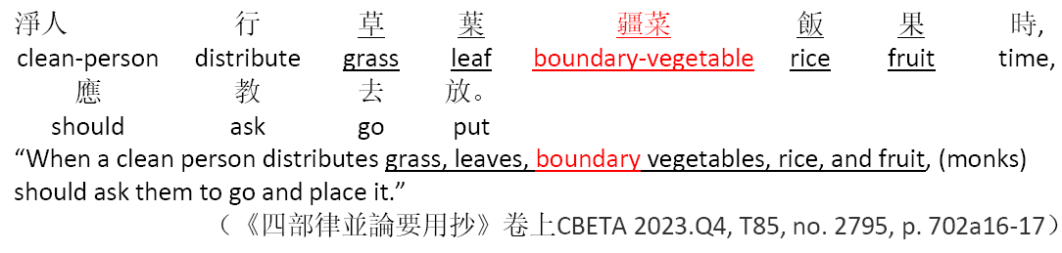
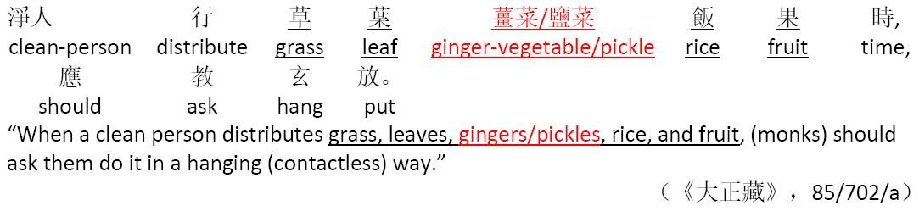
Contextual interpretation: √ ×
Variant in parallel Buddhist texts
a.
b.

Slide 29
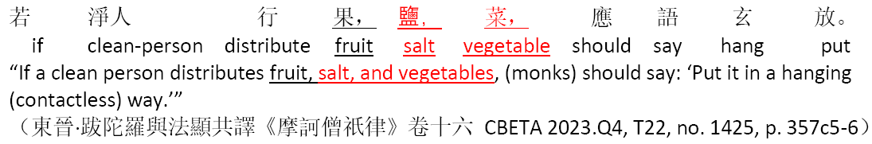
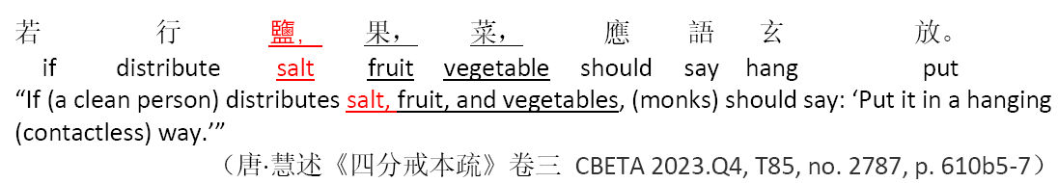
Contextual interpretation: √ ×
Variant in parallel Buddhist texts
c.
d.

Slide 30
Parallel Pali Buddhist texts differentiating jiang(cai) and yan(cai)
Target character 1 = Pali siṅgivera ‘ginger’
Lexical meaning = MC jiang ‘ginger’

Slide 31
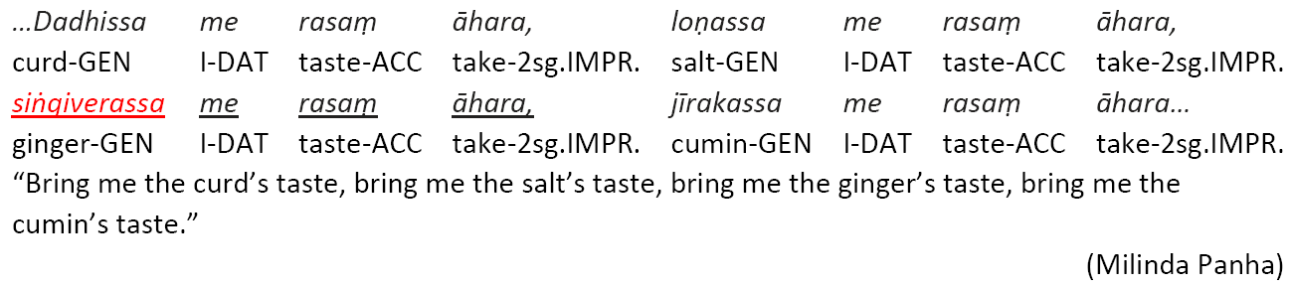
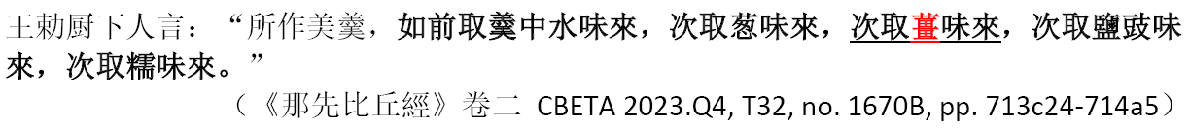
Chinese jiang薑– Pali siṅgivera ‘ginger’
Target character=Pali siṅgivera ‘ginger’

Slide 32
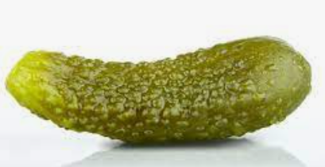
Parallel Pali Buddhist texts differentiating jiang(cai) and yan(cai)
Target character 1 = Pali siṅgivera ‘ginger’
Lexical meaning = MC jiang ‘ginger’
Target character 2 = Pali bilaṅga ‘vinegar; sour gruel’
Lexical meaning ≈ MC yancai ‘pickle’

Slide 33
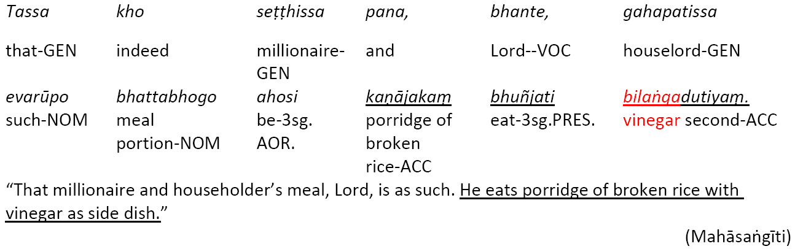
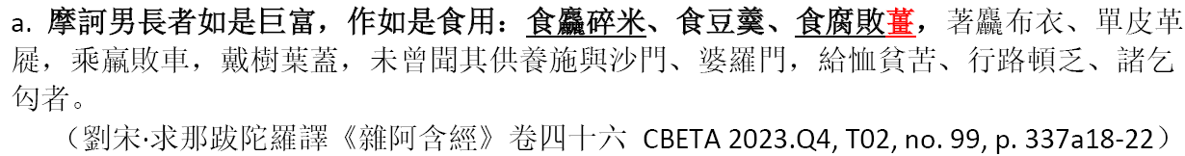
Chinese jiang薑 – Pali bilaṅga ‘vinegar’
Target character =Pali bilaṅga ‘vinegar; sour gruel’

Slide 34
Chinese jiang薑 – Pali bilaṅga ‘vinegar’
Target character =Pali bilaṅga ‘vinegar; sour gruel’

Slide 35
Blurred words in Chinese distinguished in parallel Pali texts!
Target character 1 = Pali iṅgivera ‘ginger’
Lexical meaning = MC jiang(cai) ‘ginger (vegetable)’ ⇨薑(菜)
Target character 2 =Pali bilaṅga ‘vinegar; sour gruel’
Lexical meaning ≈ MC yan(cai) ‘salt (vegetable)’ ⇨盐(菜)

Slide 36
Conventional usage and context of yancai
Conventional phrase ‘not even eating pickles’: a common expression used to mourn the death of close ones in MC
Exact context in Yanshi Jiaxun

Slide 37
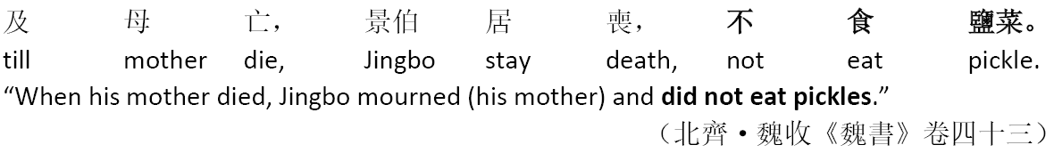
Conventional usage and context of yancai
Conventional phrase ‘not even eating pickles for mourning

Slide 38
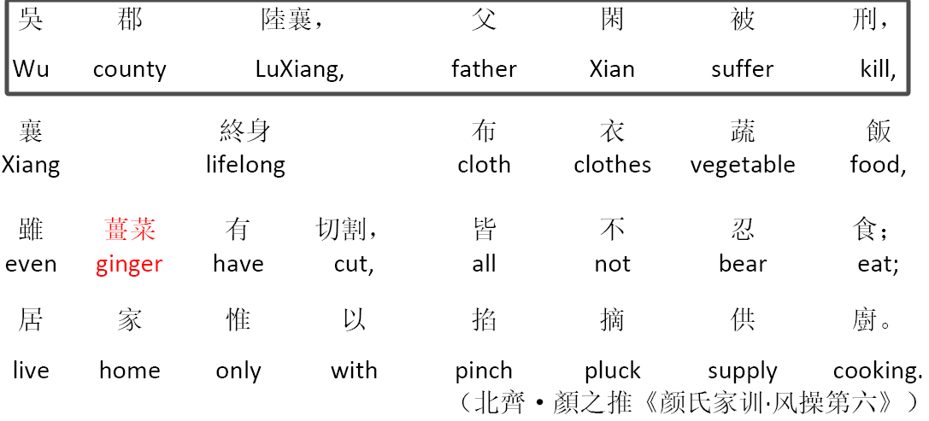
Conventional usage and context of yancai
Context in Yanshi Jiaxun
“Lu, Xiang comes from Wu County. His father Xian is killed (by cutting instruments), so Xiang lives a simple life with clothes made of cloth and food containing vegetables through out his life. He cannot bear eating pickles which needs to be cut, and all the cooking ingredients are pinched or plucked.”

Slide 39
Summary
jiangcai is a ghost word which does not exist, not only in Yanshi Jiaxun, but also in all contemporaneous Middle Chinese literature.
The ghost word results from yancai 鹽菜‘salted vegetable, pickle’ , due to misreading of characters and continued misinterpretation of lexical semantics.

Slide 40
Take-aways
Different types of evidence may lead to different interpretations.
Parallel texts of various languages should be referred to whenever possible.

Slide 41
References
Buddhadatta, A. P. (Ambalangoda Polvatte), 1887-1962 & Pali Text Society (London, England). (1955). English-Pali dictionary / aggamahāpaṇḍita A.P. Buddhadatta Mahāthera of Aggārāma, Ambalangoda. Colombo [Ceylon] : Colombo Apothecaries, for the Pali Text Society
Xu, Duoyi (徐多懿).《顔氏家訓》"薑菜"該作何解? [How to Explain Jiangcai（薑菜）in Yanshi Jiaxun ？]. Journal of Chinese Language History,2021,(1)：166-170.
You, Li (游黎).《颜氏家训》语词补释[Annotation on words in Yanshi Jiaxun]. Journal of Chinese Linguistics,2017,(6)：759-76
Zhao, Jinglian (赵静莲).“薑(壃)菜” 辨[Reinterpretation of jiangcai]. Journal of Chinese Linguistics,2020,(2)：238-240.

Slide 42
Q&A

