Slide 1


Coroutines
The future of future
Core C++ Conf. 2019
Yehezkel Bernat
YehezkelShB@gmail.com, @YehezkelShB
Notes:
I’m a SW engineer at Microsoft and also a TA (for the 7th year already) in Hadassah College Jerusalem, OOP course.
Disclaimer: While I’m very proud of the fact that two of the main features of C++20 were pushed (mainly) by Microsoft employees, I’m not representing my employer here and the views and opinions I’m expressing here are solely mine.

Slide 2
Playground Rules / Assumptions
I assume we all know about (at least the basics of) multithreading
We all feel comfortable with using:
auto for type deduction
Lambda expressions
Please ask questions

Slide 3
Intro
Today we'll learn about coroutines
Published as a TS in 2017-12-05
Merged for C++20 in Kona (Feb ‘19)
Implemented in MSVC
Implemented in Clang
gcc implementation started
More than 4 years of usage in production code (on Windows; 3y on Linux)

Slide 4
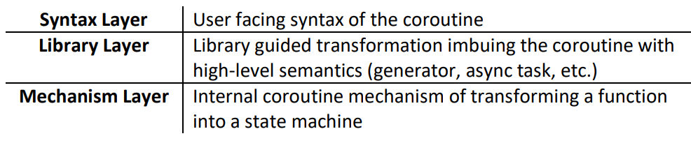
Agenda
What we are NOT going to discuss:
How the compiler transforms our code
How to write a library type for using coroutines
(See the links in the references for this kind of info)
We'll focus on the user side
https://wg21.link/p1362r0 by Gor Nishanov

Slide 5
co_await

Slide 6
std::future<T>
Get a result from an async function, passing value between threads
Arguably, std::future<T> is currently the best tool
.is_ready()
Notes:
Quick quiz: what’s the best tool C++ provides us today to pass value/result between threads?

Slide 7
std::future
Get a result from an async function, passing value between threads
Arguably, std::future<T> is currently the best tool
.is_ready()
.wait()/.wait_for()/.wait_until()
The most useful one: .get()

Slide 8
Example
std::future<int> divide(int, int);
int main()
{
auto f1 = divide(84, 2);
// Do other things...
assert(f1.get() == 42);
}

Slide 9
Real Use Case
File I/O is a long operation
Some platforms provide only async API for I/O
E.g. WinRT

Slide 10
Let’s do some I/O
std::future<std::vector<std::string>>
readLines(std::string path);
std::future<uint64_t>
countLines(std::vector<std::string> paths);
Notes:
We’ll focus on the usage side, the consumer.
The functions themselves were implemented by the local expert of by the library provider, we don’t bother ourselves with them.

Slide 11
Let’s do some I/O
std::future<std::vector<std::string>>
readLines(std::string path);
std::future<uint64_t>
countLines(std::vector<std::string> paths);
Notes:
We’ll focus on the usage side, the consumer.
The functions themselves were implemented by the local expert of by the library provider, we don’t bother ourselves with them.

Slide 12
Let’s do some I/O
std::future<std::vector<std::string>> readLines(std::string path);
std::future<uint64_t> countLines(std::vector<std::string> paths);
int main(int argc, char* argv[]) {
auto f1 = readLines(argv[1]);
auto f2 = countLines(getFileList());
// ...
for (const auto& line : f1.get())
std::cout << line << '\n';
std::cout << f2.get() << '\n';
}

Slide 13
Composite the functions
std::future<std::vector<std::string>> readLines(std::string path);
std::future<uint64_t> countLines(std::vector<std::string> paths);
int main(int argc, char* argv[]) {
auto f1 = readLines(argv[1]);
auto f2 = countLines(f1.get());
// ...
std::cout << f2.get() << '\n’;
}
Works, but first function runs synchronously
Notes:
There is also an option to use continuation, `.then()`, but it has some drawbacks, including the way it complicates the syntax

Slide 14
Pass the std::future directly
std::future<std::vector<std::string>> readLines(std::string path);
std::future<uint64_t> countLines(
std::future<std::vector<std::string>> paths);
int main(int argc, char* argv[]) {
auto f1 = readLines(argv[1]);
auto f2 = countLines(std::move(f1));
// ...
std::cout << f2.get() << '\n’;
}
Works, but doesn’t scale
Notes:
What if the first function returns `boost::future`? What if it returns `IAsyncOperation`?
Can be a template, of course, but do we want all our functions to be template functions?

Slide 15
Compose by continuation – .then()
boost::future<std::vector<std::string>>
readLines(std::string path);
uint64_t countLines(std::vector<std::string> paths);
int main(int argc, char* argv[]) {
auto f1 = readLines(argv[1])
}

Slide 16
Compose by continuation – .then()
boost::future<std::vector<std::string>>
readLines(std::string path);
uint64_t countLines(std::vector<std::string> paths);
int main(int argc, char* argv[]) {
auto f1 = readLines(argv[1]).then([](auto f) {
return countLines(f.get());
});
// ...
std::cout << f1.get() << '\n';
}

Slide 17
Cons of .then()
Not all async types implement it
It requires all the continuations to keep using the same async type
E.g. We can’t mix and match std::future<T> and boost::future<T>
It gets much uglier when we have more than one continuation
And if we need a loop? It gets even worse

Slide 18
Let’s try .get() again
int main(int argc, char* argv[]) {
auto f = std::async(std::launch::async, [argv] {
auto f1 = readLines(argv[1]);
auto f2 = countLines(f1.get());
return f2.get();
});
// ...
std::cout << f.get() << '\n’;
}

Slide 19
Let’s try .get() again
int main(int argc, char* argv[]) {
auto f = std::async(std::launch::async, [argv] {
auto f1 = readLines(argv[1]);
auto f2 = countLines(f1.get());
return f2.get();
});
// ...
std::cout << f.get() << '\n’;
}
Works, and even fully async, but what a waste of a thread

Slide 20
Enter cppcoro::task<T>
cppcoro::task<std::vector<std::string>>
readLines(std::string path);
cppcoro::task<uint64_t>
countLines(std::vector<std::string> paths);

Slide 21
cppcoro::task<std::vector<std::string>> readLines(std::string path);
cppcoro::task<uint64_t> countLines(std::vector<std::string> paths);
int main(int argc, char* argv[]) {
auto t1 = [argv]() -> cppcoro::task<uint64_t> {
std::vector<std::string> paths = co_await readLines(argv[1]);
uint64_t lines = co_await countLines(paths);
co_return lines;
};
}
Notes:
(Better to `std::move()` `paths` into the second function, but the margin is too narrow etc.)

Slide 22
cppcoro::task<std::vector<std::string>> readLines(std::string path);
cppcoro::task<uint64_t> countLines(std::vector<std::string> paths);
int main(int argc, char* argv[]) {
auto t1 = [argv]() -> cppcoro::task<uint64_t> {
std::vector<std::string> paths = co_await readLines(argv[1]);
uint64_t lines = co_await countLines(paths);
co_return lines;
};
}

Slide 23
cppcoro::task<std::vector<std::string>> readLines(std::string path);
cppcoro::task<uint64_t> countLines(std::vector<std::string> paths);
int main(int argc, char* argv[]) {
auto t1 = [argv]() -> cppcoro::task<uint64_t> {
std::vector<std::string> paths = co_await readLines(argv[1]);
uint64_t lines = co_await countLines(paths);
co_return lines;
};
}

Slide 24
cppcoro::task<std::vector<std::string>> readLines(std::string path);
cppcoro::task<uint64_t> countLines(std::vector<std::string> paths);
int main(int argc, char* argv[]) {
auto t1 = [argv]() -> cppcoro::task<uint64_t> {
std::vector<std::string> paths = co_await readLines(argv[1]);
uint64_t lines = co_await countLines(paths);
co_return lines;
};
}

Slide 25
cppcoro::task<std::vector<std::string>> readLines(std::string path);
cppcoro::task<uint64_t> countLines(std::vector<std::string> paths);
int main(int argc, char* argv[]) {
auto t1 = [argv]() -> cppcoro::task<uint64_t> {
std::vector<std::string> paths = co_await readLines(argv[1]);
uint64_t lines = co_await countLines(paths);
co_return lines;
};
}

Slide 26
cppcoro::task<std::vector<std::string>> readLines(std::string path);
cppcoro::task<uint64_t> countLines(std::vector<std::string> paths);
int main(int argc, char* argv[]) {
auto t1 = [argv]() -> cppcoro::task<uint64_t> {
std::vector<std::string> paths = co_await readLines(argv[1]);
uint64_t lines = co_await countLines(paths);
co_return lines;
};
auto t2 = []() -> cppcoro::task<void> { // Rest of main() here
co_return; // or have co_await somewhere
};
auto results = cppcoro::sync_wait(cppcoro::when_all(t1(), t2()));
}

Slide 27
cppcoro::task<std::vector<std::string>> readLines(std::string path);
cppcoro::task<uint64_t> countLines(std::vector<std::string> paths);
int main(int argc, char* argv[]) {
auto t1 = [argv]() -> cppcoro::task<uint64_t> {
std::vector<std::string> paths = co_await readLines(argv[1]);
uint64_t lines = co_await countLines(paths);
co_return lines;
};
auto t2 = []() -> cppcoro::task<void> { // Rest of main() here
co_return; // or have co_await somewhere
};
auto results = cppcoro::sync_wait(cppcoro::when_all(t1(), t2()));
}

Slide 28
cppcoro::task<std::vector<std::string>> readLines(std::string path);
cppcoro::task<uint64_t> countLines(std::vector<std::string> paths);
int main(int argc, char* argv[]) {
auto t1 = [argv]() -> cppcoro::task<uint64_t> {
std::vector<std::string> paths = co_await readLines(argv[1]);
uint64_t lines = co_await countLines(paths);
co_return lines;
};
auto t2 = []() -> cppcoro::task<void> { // Rest of main() here
co_return; // or have co_await somewhere
};
auto results = cppcoro::sync_wait(cppcoro::when_all(t1(), t2()));
std::cout << std::get<0>(results) << '\n';
}
Notes:
I cheated a bit. There is another thread running in the background, driving the completion of the async I/O operations (see the full example code in GitHub).
This is needed due to the way cppcoro I/O operations are implemented and interact with Windows API.
Still:
It can be done with no additional thread, it just adds another coroutine to the `main()` (see cppcoro documentation for such examples), which I preferred to remove for simplify the example a bit.
This additional thread serves any number of coroutines, it’s not a thread-per-coroutine or something like that.

Slide 29
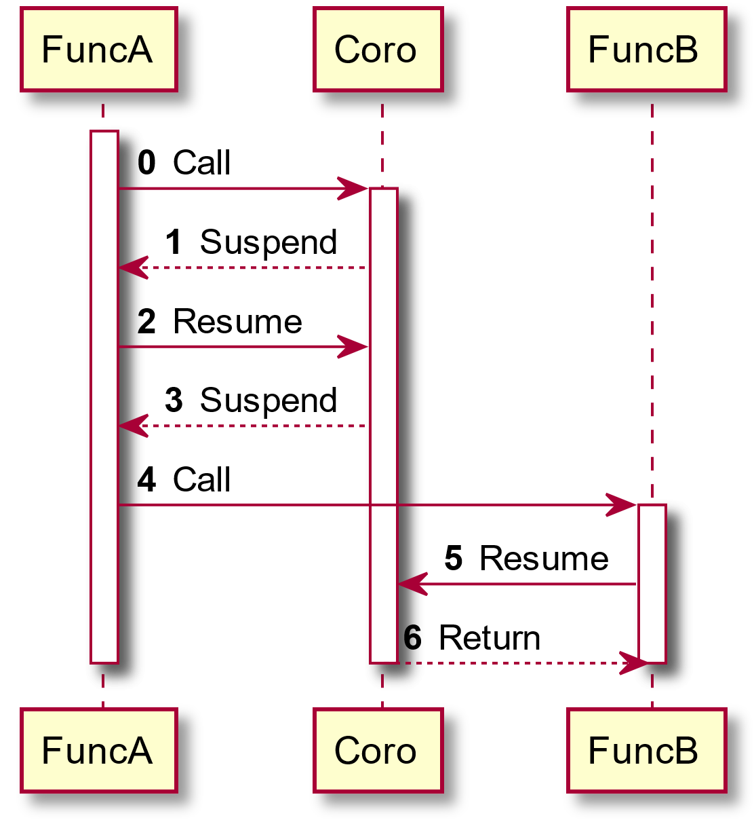
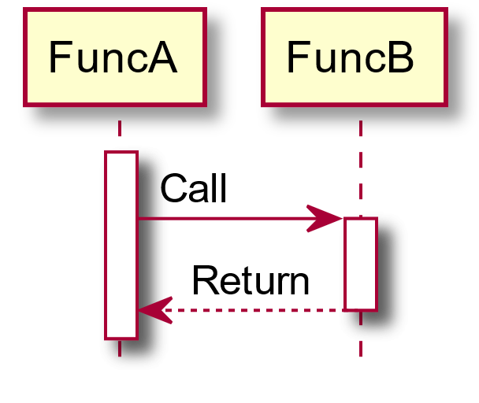
Coroutine vs. Regular Function

Slide 30
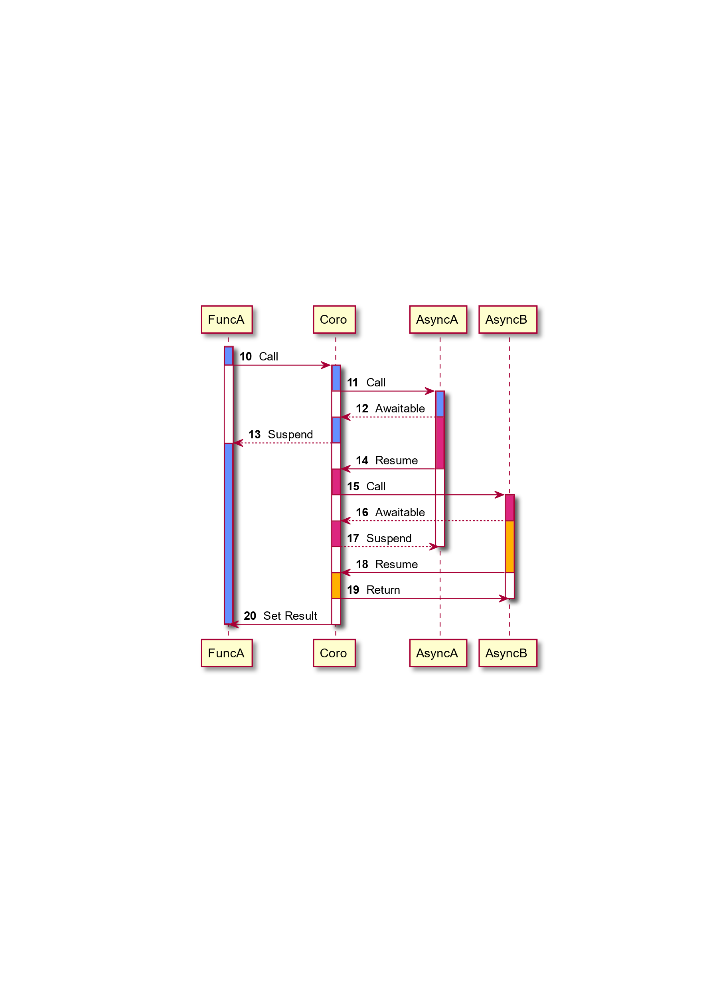
Notes:
The colors shows a thread of execution and what code it is running

Slide 31
So what is a coroutine?
A generalized form of a routine (normal function)
With regular functions, we have two operations:
Call
Return
With coroutines, there are two additional ones:
Suspend
Resume
The compiler makes sure the state (arguments and local vars) is saved
The library decides how to use it and gives semantics to the mechanism

Slide 32
Coroutines – what we have seen so far
The return type matters – semantics, behavior, what co_* word is allowed
Which is why I call such types “coroutine types”
Having one of the co_* words is what turns a function into a coroutine
We use co_await on an Awaitable type to suspend the coroutine
If it isn’t ready yet
Usually, the coroutine is resumed when the Awaitable is ready
On the thread that has set the Awaitable ready
co_return is used to return from a coroutine
Generally, every “coroutine type” is expected to be Awaitable, but not vice versa

Slide 33
The big picture: where are coroutines used?
On the top of the call stack there is a “real async” function
On the bottom – something that waits for the result
At least eventually (as always was)
Immediately in cppcoro case (or any lazy task implementation)
But it can start another task as soon as the first one suspends
It’s the in-between that was made simpler with coroutines

Slide 34
co_yield

Slide 35
Can we improve readLines()?
Isn’t it a waste of time and space to read the whole file at once?
Each line can be used separately
With a huge file, the waste is huge too, and it may just fail
Can we get the lines one-by-one?
Usually, we would expect this to involve creation of a new type, which will be iterable or at least allow getting the next line
Can it be done in a single function without all the boilerplate?
Notes:
Yes, I’m going to just use fstream+getline(), but it:
Simplifies the example
Still conveys the essence of the message
We may want to replace fstream+getline() with some platform specific API; the encapsulation simplifies this move
This is a build-up for the next step :)

Slide 36
cppcoro::generator<T>
cppcoro::generator<std::string>
readLines(std::string path) {
std::ifstream file(path);
std::string line;
while (std::getline(file, line))
co_yield line;
}

Slide 37
The consumer side
cppcoro::generator<std::vector<std::string>> readLines(std::string path);
cppcoro::task<uint64_t> countLines(std::string path);
auto t1 = [argv]() -> cppcoro::task<uint64_t> {
uint64_t lines = 0;
for (const auto& path : readLines(argv[1]))
lines += co_await countLines(path);
co_return lines;
};

Slide 38
The consumer side
cppcoro::generator<std::vector<std::string>> readLines(std::string path);
cppcoro::task<uint64_t> countLines(std::string path);
auto t1 = [argv]() -> cppcoro::task<uint64_t> {
uint64_t lines = 0;
for (const auto& path : readLines(argv[1]))
lines += co_await countLines(path);
co_return lines;
};

Slide 39
co_yield – What we have seen
Allows writing a full object as a simple function
Suspends the function (and makes it a coroutine) just like co_await
co_await – for bringing a value into the coroutine
co_yield – for passing a value out of the coroutine
Usually, used for a generator and thus forms a range
It interacts very well with std::ranges, but that is another story and shall be told another time
The return type is still playing a major role with allowing co_yield, defining the semantics, and of course defining the interface
Typically, the resumer is:
after co_await – the Awaitable (continuation)
after co_yield – the caller

Slide 40

Haven’t we lost something?
readLines() isn’t async anymore

Slide 41
cppcoro::async_generator<std::string>
readLines(std::string path) {
auto file = cppcoro::read_only_file::open(IoService::get(), path);
auto buffer = std::string(4096, '\0’); std::string line;
for (uint64_t offset = 0, fileSize = file.size(); offset < fileSize;) {
const auto bytesToRead = static_cast<size_t>(std::min<uint64_t>(buffer.size(), fileSize - offset));
const auto bytesRead = co_await file.read(offset, buffer.data(), bytesToRead);
for (size_t i = 0; i < bytesRead;) {
auto currentLineEndLocation = buffer.find('\n', i);
if (currentLineEndLocation == buffer.npos) { line.append(buffer, i); break; }
line.append(buffer, i, currentLineEndLocation - i);
co_yield line; line.clear(); i = currentLineEndLocation + 1;
}
offset += bytesRead;
}
}

Slide 42
The consumer side
cppcoro::task<uint64_t> countLines(std::string path);
auto t1 = [argv]() -> cppcoro::task<uint64_t> {
uint64_t lines = 0;
for co_await (const auto& path :
readLines(argv[1]))
lines += co_await countLines(path);
co_return lines;
};
Notes:
To propagate the asynchronicity of the generator, we add `co_await` to the `for`

Slide 43
Summary
We have learned the basics of coroutines
co_await, co_yield and co_return
Suspend and resume
The return type matters
No change to the function declaration!
We have seen a taste of what cppcoro lib provides
We have understood where coroutines (usually) fit into the big picture

Slide 44
Thank You!

Slide 45

https://xkcd.com/208/ - Regular Expressions
Wait, forgot to escape a space. Wheeeeee[taptaptap]eeeeee.
Notes:
Randall Munroe, of all people, should know that understanding jokes about the new skill is much more important (and practical) usage

Slide 46
Thank You!
while (!timeIsUp())
{
co_await question();
co_yield std::optional<Answer>{};
}

Slide 47
References
Code examples: https://github.com/YehezkelShB/CoreCpp2019-Coroutines
Gor Nishanov’s series of presentations in CppCon, starting with CppCon 2014 (“await 2.0, Stackless Resumable Functions”)
Lewis Baker’s blog post series: https://lewissbaker.github.io/
cppcoro lib: https://github.com/lewissbaker/cppcoro
Meeting C++ 2018, “Coroutine TS: A new way of thinking”, Andreas Reischuck
Code: https://github.com/arBmind/2018-cogen-en
Especially code/co_statemachine
Video: https://www.youtube.com/watch?v=RL5oYUl5548

Slide 48
Backup

Slide 49
State machine in a function
auto elevator = create();
for (auto event : getEventList())
{
std::cout << "+ " << event << '\n';
elevator.handle(event);
std::cout << "@ " << elevator.state() << '\n';
}
Based on: Meeting C++ 2018, “Coroutine TS: A new way of thinking”, Andreas Reischuck

Slide 50
StateMachine<Event, State> create() {
int curFloor = 0; int targetFloor = 0; State state = Idle{};
auto matchers = overloaded{
[](auto, AlarmPressed) -> State { return Broken{}; },
[&](Idle, Called c) -> State {
targetFloor = c.toFloor;
return c.toFloor < curFloor ? Move::Down : Move::Up;
} // ...
};
while (true) {
Event event = co_yield state;
state = std::visit(matchers, state, event);
}
}
Notes:
`Event` and `State` are both `std::variant`, the new way to write state machines

Slide 51
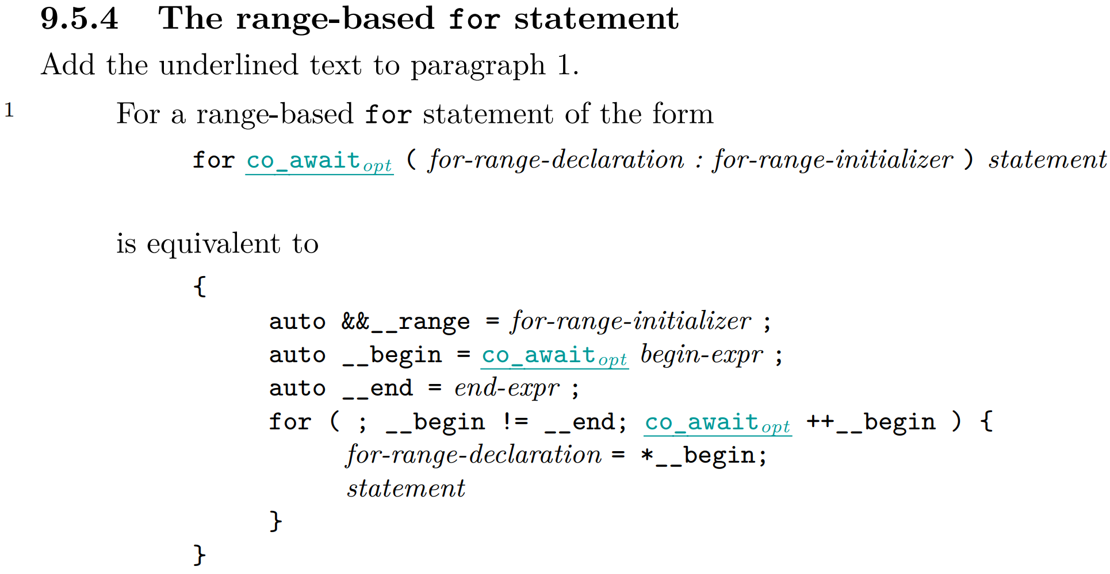
Coroutines TS
http://www.open-std.org/jtc1/sc22/wg21/docs/papers/2018/n4775.pdf

Slide 52
Compiler Support
Implemented in MSVC
VS2015 (or VS2013 w/ Nov. ‘13 CTP) – pre-TS implementation
VS2017 – TS compliant (e.g. adding co_ prefix)
Just add /await to the compilation flags
Implemented in Clang
Since clang 5
Use -fcoroutines-ts (soon: -std=c++2a) -stdlib=libc++
gcc implementation started
https://gcc.gnu.org/wiki/cxx-coroutines

Slide 53
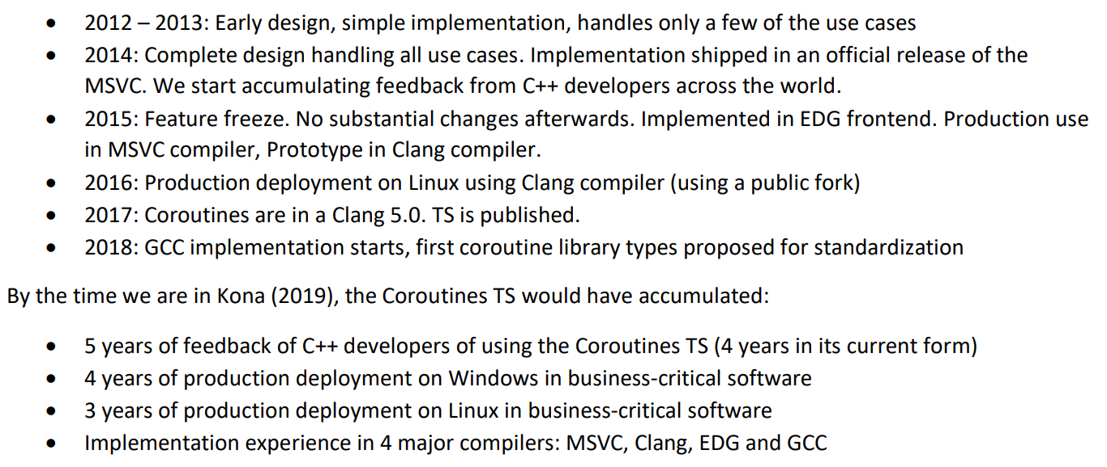
Maturity
https://wg21.link/p1362r0 by Gor Nishanov

Slide 54
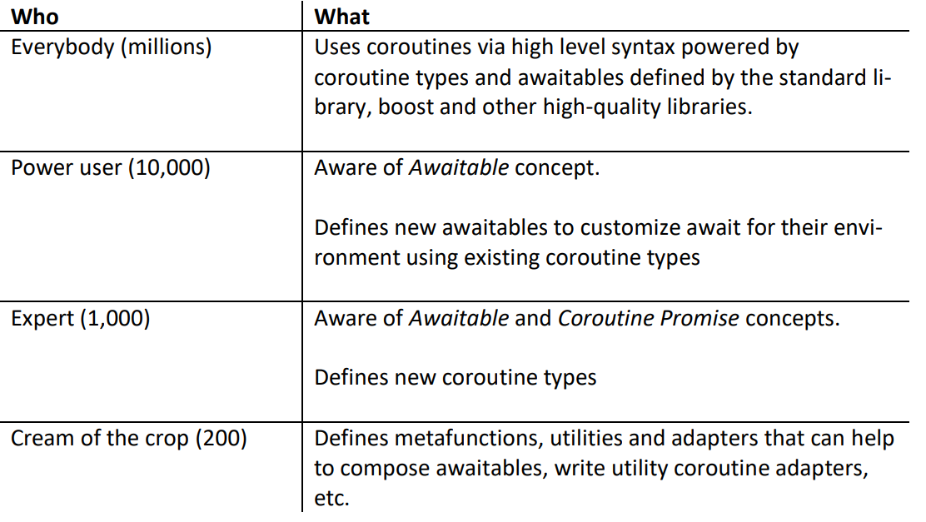
4.4 Are coroutines expert only feature?
https://wg21.link/p1362r0 by Gor Nishanov

