Slide 1
CSEN
402
Computer Organization and system programming
Programming the Basic computer (2)
Lecture
9
Textbook chapter 6
Spring 2026 Dr. Milad Ghantous MET department-German University in Cairo

Slide 2
Part 1
Subroutines

Slide 3
Subroutines
a=1
b=2
c=a+b;
func();
d=a-b;
m=a;
func();
…
A repeated chunk of code that is used repeatedly in the program.
Instead of writing it each time, we write it one time and we “Call” it whenever we need.
Functions or methods work this way. In assembly, we call them subroutines.

Slide 4
Subroutines concept
program code
When done, we branch back to where we left off to continue (5)
1
2
3
4
5
6
7
8
9
10
11
12
13
14
15
Notes
Whenever we need to call the subroutine, we branch to its starting address.
When we done, we need to return to where we left off, but this address is not always the same!
BSA is used: Branch and save the return address
we are at (4), First time we call the subroutine, we branch to it (13)
second time, we call it from (8), also go to (13)
when done, we branch back to (9)
Subroutine
code

Slide 5
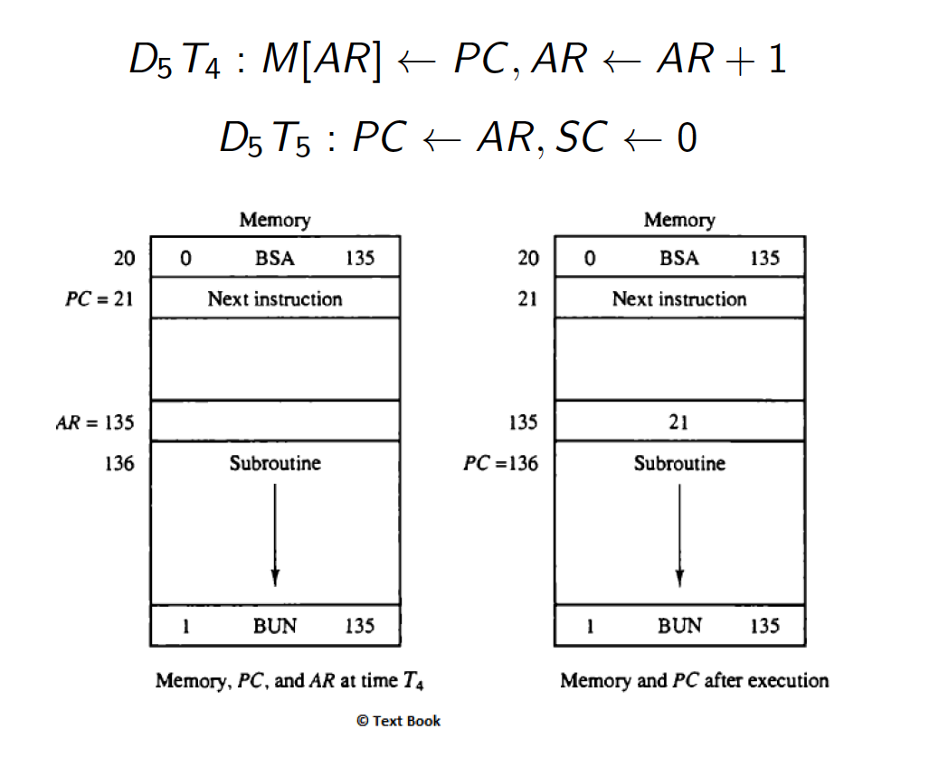
BSA reminder
Memory, PC and AR at time T4
Memory, PC after execution

Slide 6
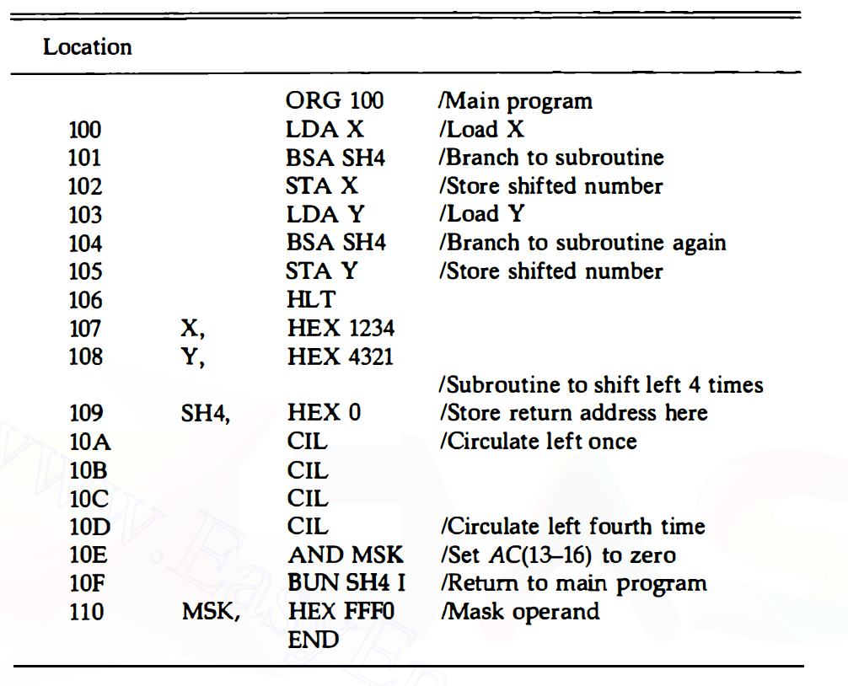
Subroutine example
Goal
A subroutine that, whenever called, logically shifts the AC content 4 times to the left.
Remember we only have circulate in our basic computer.
Main program
Note
Subroutine code
AC(3-0)

Slide 7
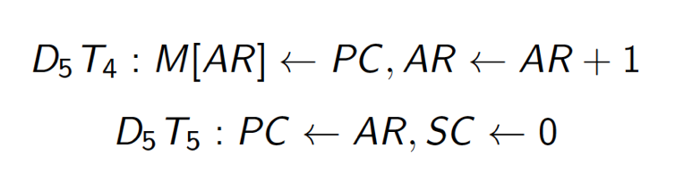
Subroutine example
@ T2:
we put the address field (lower 12 bits) of BSA SH4 in AR, this means we put 109 in AR.
@ T4:
PC is already= 102, which means M[AR] ← 102, this means M[109] = 102.
AR←AR+1 = 10A
@ T5: PC← 10A and SC←0 which means we will start executing the CIL instructions next.
AC(3-0)

Slide 8
Subroutine example
Why is the AND needed?
Answer
The CIL is a circulate which means the lower 4 bits of the AC were actually the higher 3 bits before the circulation and the E bit but we need LOGICAL shift
Hence we masked (ANDed) them with FFF0 to set the lower 4 bits to zero.
0001001000110100 becomes 0010001101001000 after four CIL (assuming E was 1)
After ANDing with FFF0, it becomes 0010001101000000
AC(3-0)

Slide 9
Subroutine example
What happens here?
Answer
Normal BSA behavior.
When subroutine ends, we have a indirect branch to 109.
So we go to [109], we find there 102, because we put it there!
Branch to 102 and continue the program.
AC(3-0)

Slide 10
A more advanced Subroutine
Another useful use of subroutines is passing parameters (values) to it and the subroutine returns a computed value using the passed parameters.
One parameter can be passed using the accumulator like the previous example but when more parameters are to be sent, we need to store them in memory and let the subroutine reads them from there.

Slide 11
Subroutine Example 2
Technique:
We can load one value in the AC and the other value in the memory following the BSA instruction.
The normal subroutine “return” must be altered to fit our new way.
Look next.
int X= 15094;
int M= 31637;
Y= OR(X,M);
function OR(a,b)
{return a || b;}

Slide 12
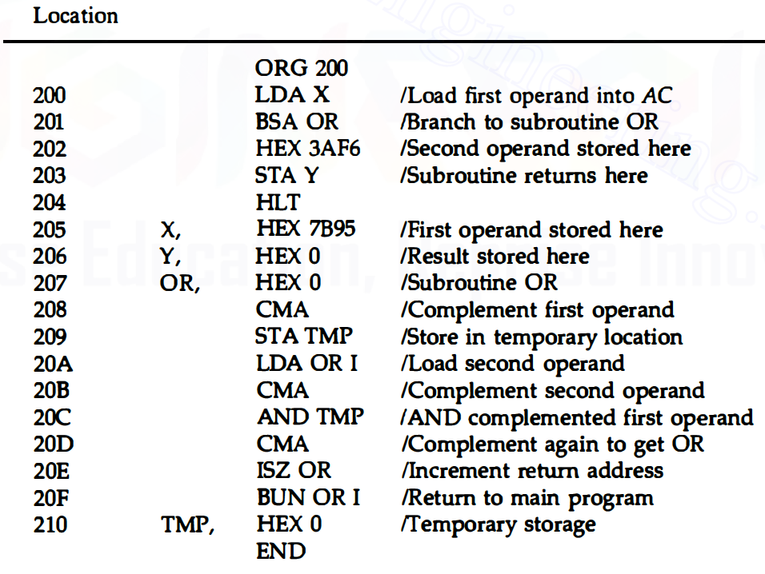
Subroutine Example 2
int X= 15094;
int M= 31637;
Y= OR(X,M);
function OR(a,b)
{return a || b;}
Main program
Subroutine code

Slide 13
Subroutine Example 2: Analysis (1)
Calling BSA:
@ T4:
PC is already 202 so
M[207]=202
AR = 208
@T5:
PC = 208 so we can start executing the subroutine
2nd operand stored in location 202, following the BSA

Slide 14
Subroutine Example 2: Analysis (2)
Calling BSA:
@ T4:
PC is already 202 so
M[207]=202
AR = 208
@T5:
PC = 208 so we can start executing the subroutine
stored in location 202, following the BSA
What’s happening here?
Notes:
we load indirect from 207, so we go to 202, we find 3AF6

Slide 15
Subroutine Example 2: Analysis (3)
How’s the OR performed?
Notes:
(X’Y’)’

Slide 16
Subroutine Example 2: Analysis (4)
What’s happening here?
Notes:
usually we branch to the subroutine start indirectly to find the return address, but this time we have an operand value there not the return address.
We increment location [207] from 202 to 203 and then we branch indirectly to 207 to find 203, we jump to it and continue the program.
The isz here is just used for incrementing.

Slide 17
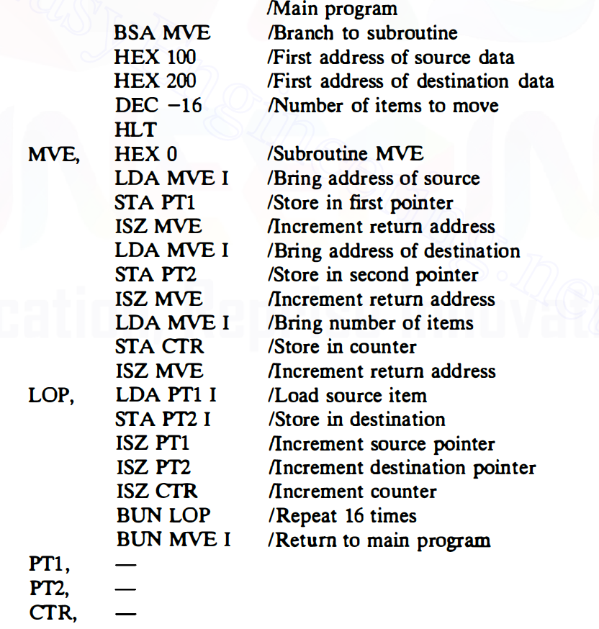
Home exercise
What’s MVE subroutine trying to do?

Slide 18
Part 2
Input output programming

Slide 19
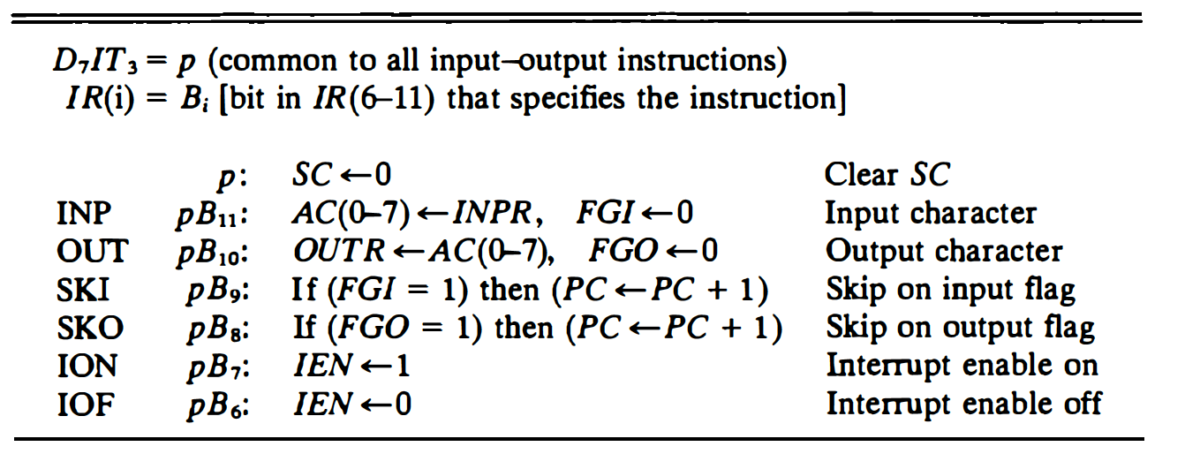
I/O instructions reminder

Slide 20
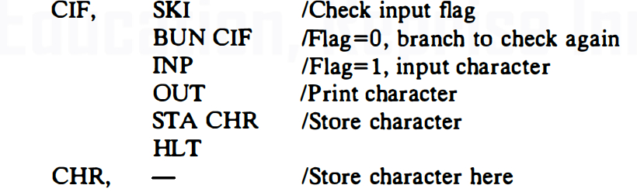
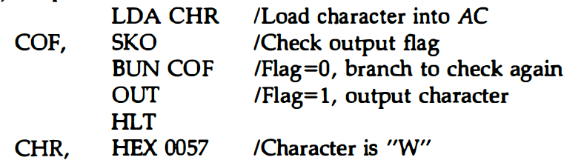
Remember these programs for inputting and outputting a character?
Input
Output
Keeps checking the input flag FGI until it becomes 1
Keeps checking the output flag FGO until it becomes 1

Slide 21
Character manipulation
A character occupies only 8 bits, this leaves 8 bits in the memory word (which is 16 bits) unused.
We can pack two characters in one memory word then!
Let’s create a subroutine that packs two characters in the accumulator.
→it’s then easy to store the AC into one word in memory using STA

Slide 22
Before we continue…
Assume we have written our SH4 subroutine “shift left AC 4 times” and it’s available for us to call and use.
(check Slide 6)

Slide 23
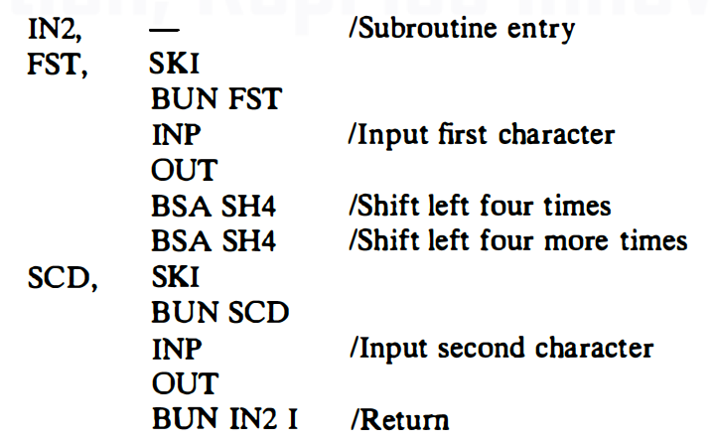
Code for subroutine IN2
Goal: Pack two characters next to each other into the accumulator.
AC initially
character 1
character 1
character 1
character 1
character 2

Slide 24
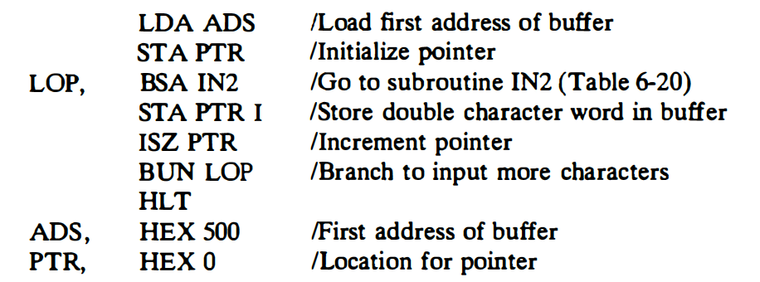
What does this code do?
Exercise 1
Remember now you have a subroutine called IN2 that you can use.
Notes:
keeps on reading characters and storing them in address 500, 501, 502,…… there’s no counter used unfortunately to stop this

Slide 25
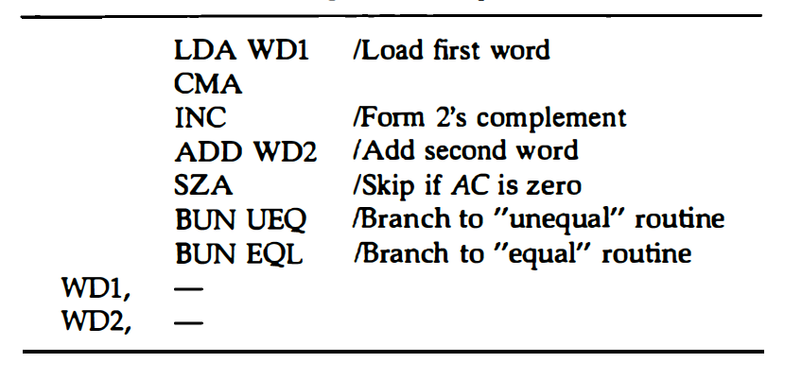
Easy practice
Exercise 2
We wish to implement this
if (a==b)
{//equal}
else
{//unequal}
Fill in the missing instruction here
This program can serve as a counter adjustment for the table lookup program done before.

Slide 26
Part 3
Interrupts

Slide 27
Interrupts
As mentioned in the previous lectures, it’s better to interrupt the running program when inputs or outputs are ready rather than keep looping and checking.
sometimes, the running program is not the one requesting inputs or outputs but another program.
When an interrupt happens, the running program pauses, we switch the other program, executes the I/O and return back to the paused one to resume.
Program 1
---
---
---
---
---
---
on interrupt
I/O program
---
---
---
---
---
---
when we finish the I/O operation, we return

Slide 28

Interrupts
The running program must have ION (to enable the interrupts).
When it happens, the instruction currently being executed is continued and the interrupt is handled right after.
What if the running program has some values saved into the processor registers E and AC? if we jump to the I/O program, they may be overridden and lost ☹

Slide 29
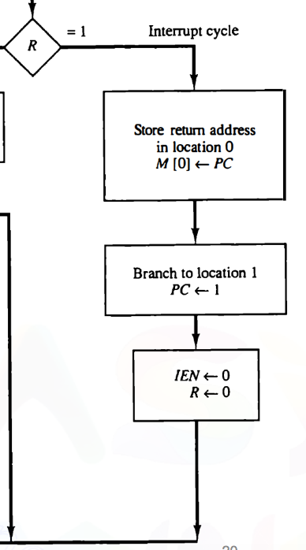
Reminder about interrupt cycle
From the last lecture, the return address is stored in memory location [0].
In memory location [1], a branch is stored to jump to the start of the interrupt routine.

Slide 30
Interrupt behavior alterations
The service routine must have instructions to perform the following tasks
1. Save contents of processor registers. (of the running program)
2. Check which flag is set.
3. Service the device whose flag is set
4. Restore contents of processor registers. (when done with the servicing of the I/O)
5. Turn the interrupt facility back on. (remember the interrupt cycle turned it off)
6. Return to the running program

Slide 31
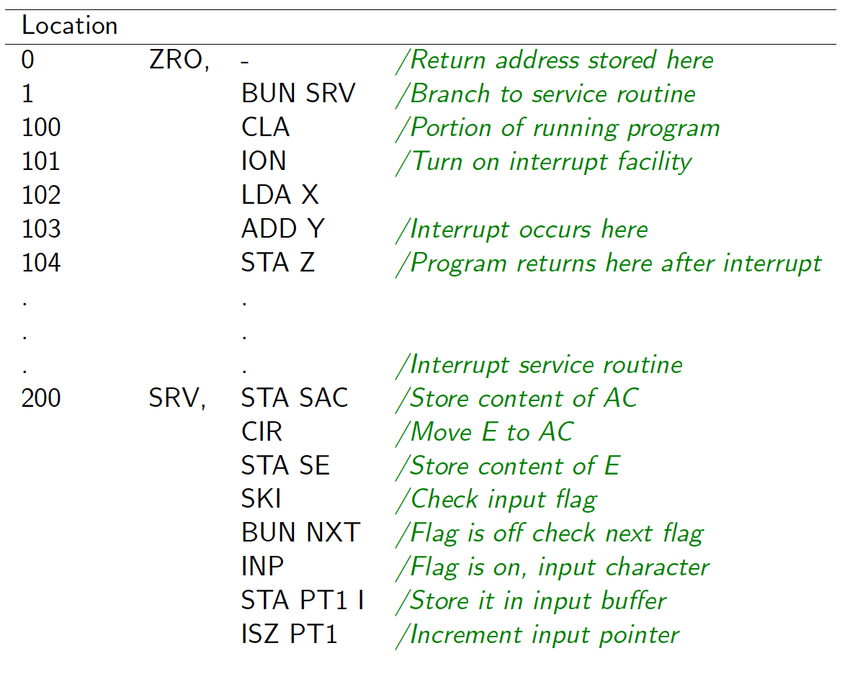
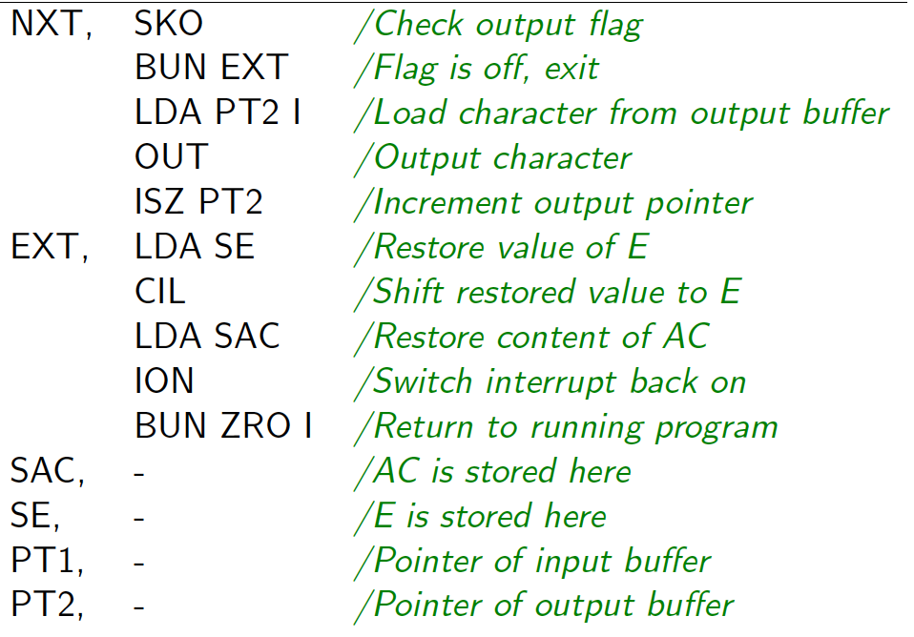
Example
What happens now if interrupt happens here?
Notes:
104 is stored in location 0, then PC is set to 1, and IEN is set to 0.
Because PC =1, we execute BUN SRV so we jump there and start our interrupt routine.

Slide 32
Example
What is going on here?
Notes:
we are saving the AC value and the E value so we don’t lose them when we come back. SAC and SE are just special locations to store them.

Slide 33
Example
What is going on here?
Notes:
we are moving the input to AC then from AC to whatever address inside PT1
Then we are incrementing the pointer value so next time we input a character it goes there instead of overriding the one we just read.
or we are moving the output from whatever PT2 is pointing to to the AC and then to output. and then incrementing the PT2 for next time.

Slide 34
Example
What is going on here?
Notes:
we finished I/O so we must restore our AC and E values. and branching back to our program by branching indirectly to ZRO which contains 104!

Slide 35
Class exercise 1 (from tutorial)
Write an interrupt service routine that performs all required functions but the input device is serviced only if a special location, MOD, contains all 1’s.
The output device is serviced only if location MOD contains all 0’s

Slide 36
Class exercise 2 (from tutorial)
Write a program for the arithmetic shift left position. Branch to OVF if an overflow occurs and set a flag FLG to 1. Otherwise, branch to EXT.

Slide 37
Class exercise 3 (from tutorial)
Write down a program to unpack two characters from location WRD and store them in bits 0 through 7 of locations CH1 and CH2. Bits 8 through 15 should contain zeros.

Slide 38
End of lecture 9

