Slide 1
CSE489 · Selected Topics in Data Science
Extractive
Summarization
A Hybrid NLP Pipeline Using Transformer Embeddings & ML Classifiers

Slide 2
Team Members
YM
HM
Yehia Mahmoud Lotfy Sakr
Hana Mohamed Mohamed
21P0166
21P0162
Faculty of Engineering · Ain Shams University

Slide 3
Project Objective
What is Extractive Summarization?
How Extractive Works
Select and extract the most salient sentences from a document — no new text is generated.
Framed as a binary classification: predict whether each sentence belongs in the summary.
Uses transformer embeddings (DistilBERT, MiniLM) + ML classifiers (Logistic Regression, XGBoost).
Hybrid features: deep semantics + position, length, TF-IDF scores.
Evaluated with ROUGE-1, ROUGE-2, ROUGE-L metrics on CNN/DailyMail dataset.
Sentence 1: Boris Becker arrived at Stanford Bridge...
Sentence 2: He was wearing a scarf with skulls.
Sentence 3: There is no suggestion he was aware...
Sentence 4: Chelsea fans cheered as he entered.
Sentence 5: The match ended in a 2-1 victory.
📋 SUMMARY
Extracted sentences 1, 3, 5 stitched in original order.

Slide 4
Dataset & Core NLP Utilities
CNN/DailyMail Dataset (v3.0.0)
Core NLP Utilities
Loaded via HuggingFace
Train: 1,000 articles sampled
Test: 100 articles sampled
Filtered: 3–25 sentences per article
Labels via ROUGE-L similarity to highlights
Sentence Splitting via spaCy
Coreference Resolution (fastcoref)
Oracle Label Creation (ROUGE-L)
Summary Builder (word-limit enforced)
Load
Dataset
Split
Sentences
Oracle
Labels
Training
Array
→
→
→
Data Preparation Pipeline

Slide 5
Embedder, Encoding & Feature Engineering
Embedder Class
Handcrafted Features
flatten() Output
Model: distilbert-base-uncased
Batch encoding (batch=16)
Mean-pooling on last hidden states
Attention mask excludes padding
Output: float32 embeddings
Relative Position: idx / total_sents
Word Count: sentence density
TF-IDF Relevance: keyword density
News front-loads key info → position matters
Features horizontally stacked onto embeddings
X matrix:
[DistilBERT (768-d) ‖ pos ‖ length ‖ tfidf]
y vector:
Binary oracle labels (0 / 1)
1,000 articles × N sentences each
→
→

Slide 6
Baseline Model: Logistic Regression & Evaluation
Logistic Regression Classifier
Sentence Classification Results (Class 1 — Summary)
Trained on hybrid feature vectors (X_train, y_train)
class_weight='balanced' — handles label imbalance
Predicts sentence-level summary probability
0.6502
0.7967
Accuracy
Recall
0.2553
0.3867
Precision
F1-Score
High Recall (0.80) — model correctly finds most summary sentences
Confusion Matrix Breakdown
 | Pred: Not Summary | Pred: In Summary
Act: Not Summary | TN = 1170 ✓ | FP = 697
Act: In Summary | FN = 61 | TP = 239 ✓

Slide 7
Predict Summary & ROUGE Evaluation
predict_summary() Pipeline
ROUGE F1 Scores (Test Set, n=100)
1. Encode sentences with DistilBERT embedder
2. Compute TF-IDF, position, length features
3. Stack into feature matrix X
4. Get class probabilities via clf.predict_proba()
5. Select top-K sentences by probability
6. build_summary() stitches in original order
7. Enforces max_summary_words = 60 limit
ROUGE (Recall-Oriented Understudy for Gisting Evaluation) measures lexical overlap between predicted and reference summaries.
ROUGE-1: Unigram overlap — single word matches
0.3846
ROUGE-2: Bigram overlap — two-word phrase matches
0.1677
ROUGE-L: Longest common subsequence — captures fluency
0.2650

Slide 8
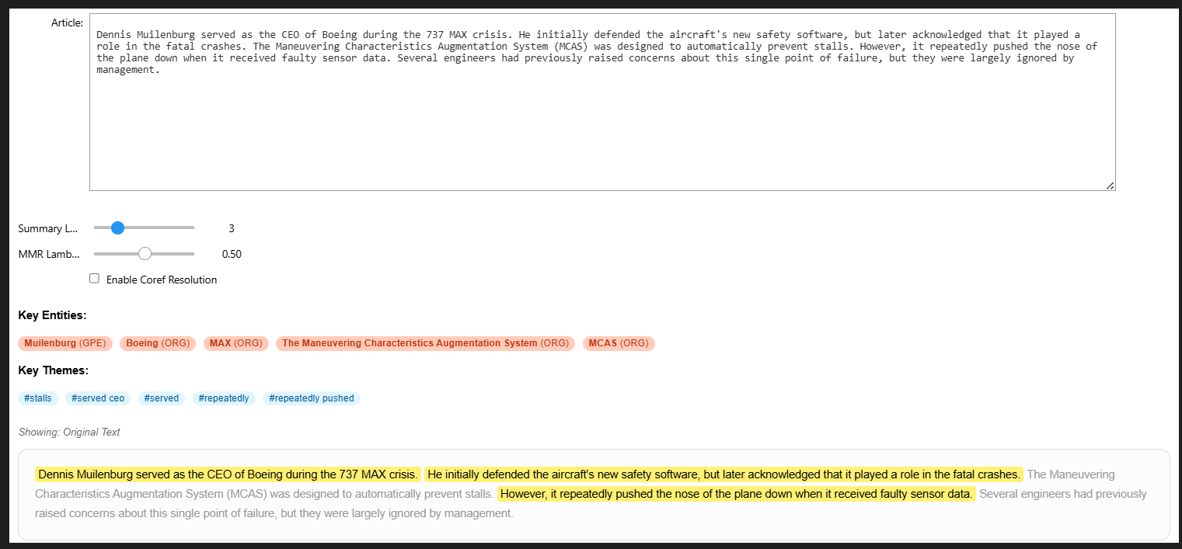
Ultimate Summarization Dashboard
TF-IDF Theme Extraction
Named Entity Recognition
MMR (Maximal Marginal Relevance)
Identifies top keyword themes across bigrams/unigrams. Surfaces the 'what' of the article instantly.
SpaCy highlights PERSON, ORG, and GPE entities — the 'who' and 'where' of each article.
Lambda slider balances relevance vs. diversity. Eliminates redundant sentences from summaries.
Coreference Resolution
Visual Sentence Highlighting
Summary Length Control
Checkbox toggle. Replaces pronouns (he, it) with actual entity names for standalone readability.
Selected sentences appear highlighted in teal; ignored text is dimmed — making model choices transparent.
IntSlider lets users set the number of sentences (K) to include, giving real-time control over verbosity.
Built with ipywidgets — interactive real-time experimentation in Jupyter Notebook

Slide 9
Lead-3 Baseline Comparison
Lead-3 Baseline: Simply extracts the first 3 sentences of every news article — exploits the journalistic inverted pyramid structure. No ML required.
Key Takeaways
Our model matches or exceeds Lead-3 on ROUGE-1 & ROUGE-L
ROUGE-2 slightly lower — bigram overlap harder to optimize
Our model adds semantic understanding & diversity (MMR)
Validated that the ML pipeline adds meaningful value

Slide 10
Alternative Architecture: MiniLM + XGBoost
Architecture A: DistilBERT + LogReg
Architecture B: MiniLM + XGBoost
768-dim contextual embeddings
Pos + Length + TF-IDF features
Logistic Regression (balanced)
Accuracy: 0.6502 | F1: 0.3867
Lower Recall: 0.71
all-MiniLM-L6-v2 (384-dim, faster)
Pos + Length features only
XGBoost (n=100, lr=0.1, d=5)
Accuracy: 0.6996 | F1: 0.4000
Higher recall: 0.80
VS

Slide 11
Thank You
Faculty of Engineering · Ain Shams University · CSE489

