Slide 1
K-Nearest Neighbors and
Radius Neighbors Classifiers

Slide 2
Nearest Neighbor Classifier
All we need is a distance function for our inputs
No training required!
Test example
Training examples from class 2
Training examples from class 1

Slide 3
K-Nearest Neighbors (KNN) Approaches
We will study the supervised learning approaches KNN classifier and radius neighbors classifier.
These basic approaches are very simple to implement and they are effective with relatively small data sets. They are slow with large data sets specially when the brute force (exhaustive) search is used.
They do not have a learning model (no learning parameters) as they require the training data to be available at the prediction time, so they are online learning approaches.
They can learn complex decision boundaries since they are not constrained to a specific model.

Slide 4
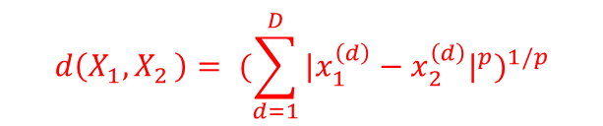
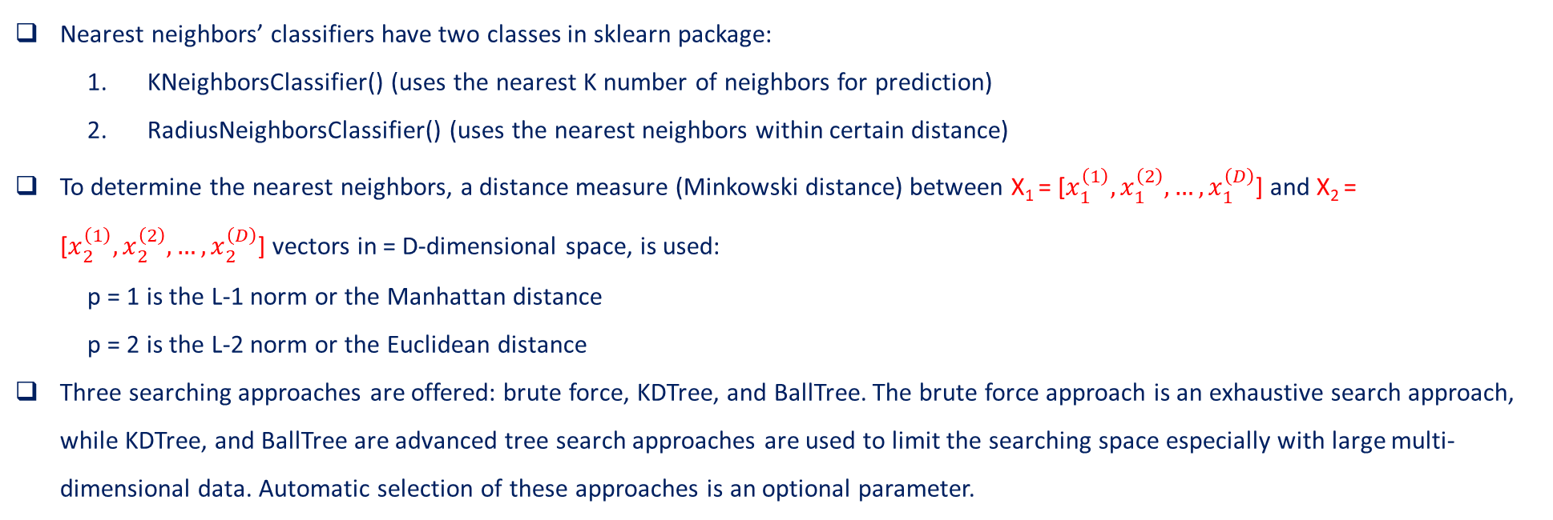
KNN Approaches in sklearn Python Package
Nearest neighbors’ classifiers have two classes in sklearn package:
  KNeighborsClassifier() (uses the nearest K number of neighbors for prediction)
  RadiusNeighborsClassifier() (uses the nearest neighbors within certain distance)
To determine the nearest neighbors, a distance measure (Minkowski distance) between X₁ = [$x_{1}^{\left(1\right)},x_{1}^{\left(2\right)}, …,x_{1}^{\left(D\right)}$] and X₂ = [$x_{2}^{\left(1\right)},x_{2}^{\left(2\right)}, …,x_{2}^{\left(D\right)}$] vectors in = D-dimensional space, is used:
p = 1 is the L-1 norm or the Manhattan distance
p = 2 is the L-2 norm or the Euclidean distance
Three searching approaches are offered: brute force, KDTree, and BallTree. The brute force approach is an exhaustive search approach, while KDTree, and BallTree are advanced tree search approaches are used to limit the searching space especially with large multi-dimensional data. Automatic selection of these approaches is an optional parameter.
$$d\left(X_{1}{, X}_{2}\right)= {(\sum_{d=1}^{D}{{{|x}_{1}^{\left(d\right)}−x_{2}^{\left(d\right)}|}^{p}})}^{1/p}$$

Slide 5
K-Nearest Neighbors Classifier

Slide 6
Basic Idea
k-NN classification rule is to assign to a test sample the majority category label of its k nearest training samples
In practice, k is usually chosen to be odd, so as to avoid ties
The k = 1 rule is generally called the nearest-neighbor classification rule

Slide 7
KNN Neighbor Classifier
Basic Algorithm (brute force with uniform weights)
  Set the number of neighbors K
  For each query point x_{query} find its distance, d_{i}, (in the feature space) with each point x_{i} in the training data (X = input, y = target labels) as:
    d_{i} = distance(x_{query} - x_{i})
  Sort d_{i} in an ascending order, d_{sorted}. Keep track of indices i.
  Find the points in training data that corresponds to the first K elements of d_{sorted,} i.e., find sets I_{K} = {i| d_{i} ∈ d_{sorted}(1, 2, … K )}, S_{K} = {y_{i} | i ∈ I_{k}}.
  find y_{predicted} = mode(S_{K}); the most frequent label/class.

Slide 8
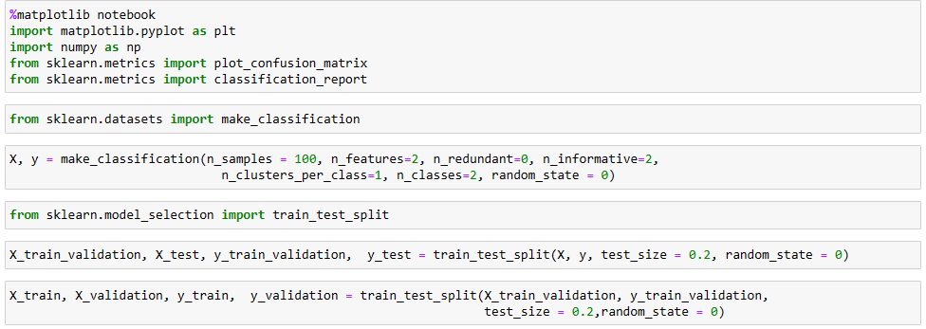
Data Generation for Classifiers
Using sklearn.metrics.make_classification()
(X, y) 100 samples of input data and corresponding labels
2 features and 2 classes
(X_test, y_test) is 20% of (X, y) data, (X_train_validation, y_train_validation) 80% of (X, y) data
(X_validation, y_validation) is 20% of (X_train_validation, y_train_validation),
(X_train, y_train) is 80% of (X_train_validation, y_train_validation),

Slide 9
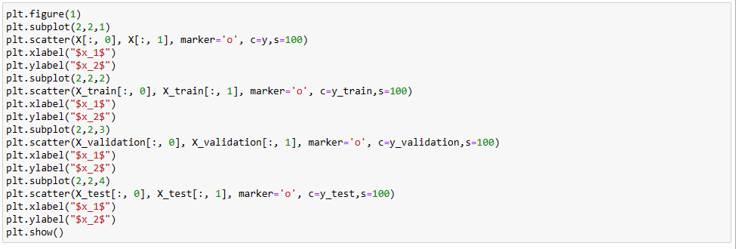
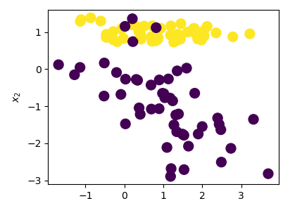
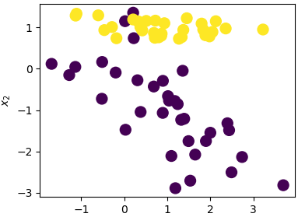
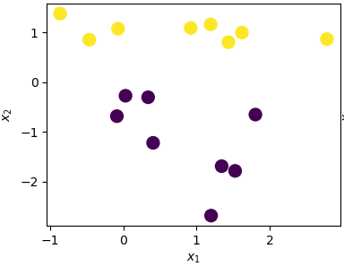
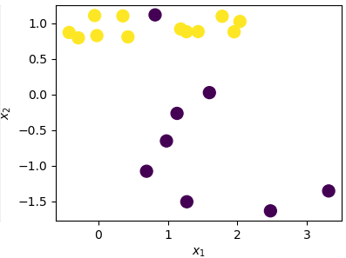
Data Generation for Classifiers
All Data
Test Data
Training Data
Validation Data

Slide 10
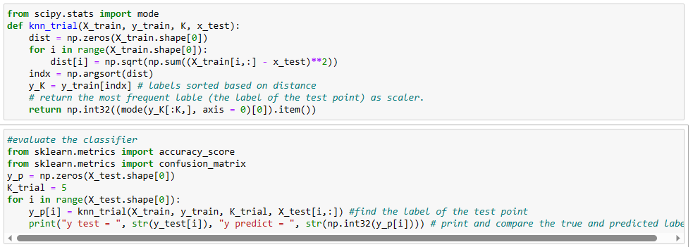
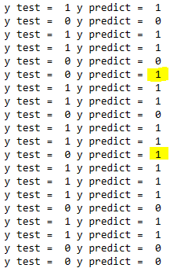
KNN Classifier Code

Slide 11
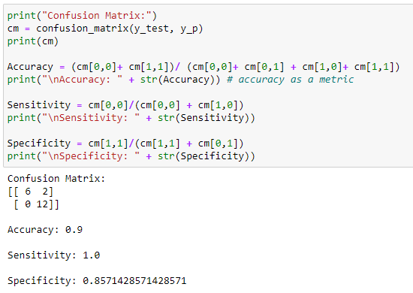
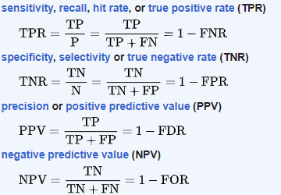
KNN Classifier Results
Confusion Matrix:
Performance Metrics:
True Label
Predicted Label |  | Positive | Negative
 | Positive | TP | FP
 | Negative | FN | TN
TP: true positive, TN: true negative, FP: false positive, and FN: false negative

Slide 12
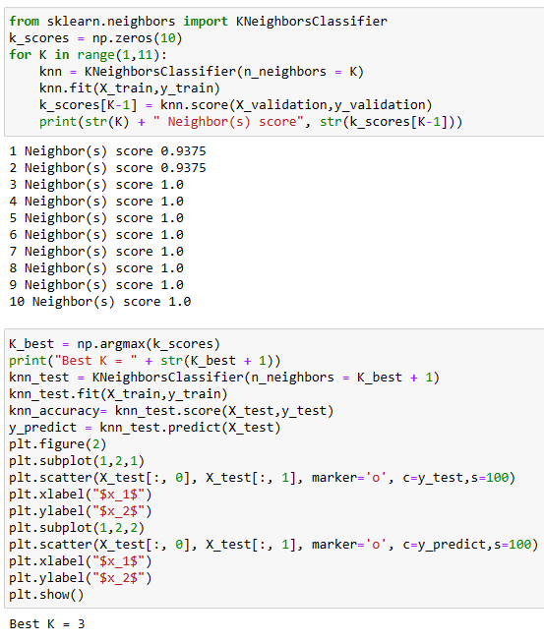
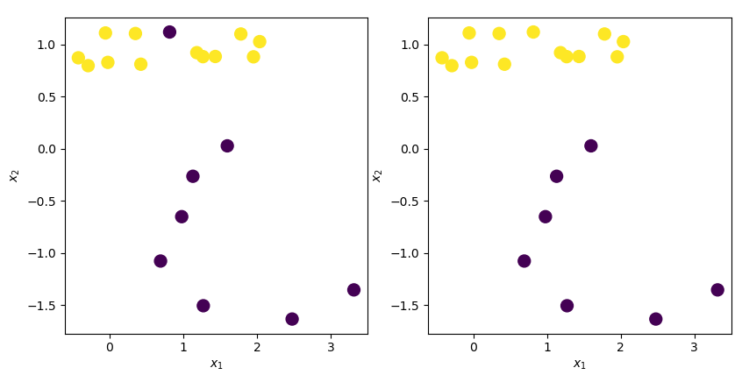

KNN Classifier Tuning with Validation Set
True/Test
Predicted

Slide 13
Radius Neighbors Classifier

Slide 14
Radius Neighbor Classifier
It is usually used when the data is sparse.
Basic Algorithm (brute force with uniform weights)
  Set the Radius value R
  For each query point x_{query} find its distance, d_{i}, (in the feature space) with each point x_{i} in the training data as:
    d_{i} = distance(x_{query} - x_{i})
  Find the points in training data that have d_{i} ≤ R. i.e. find set S_{R} = {y_{i}| d_{i} ≤ R}
  find y_{predicted} = mode(S_{R}); the most frequent label/class.

Slide 15
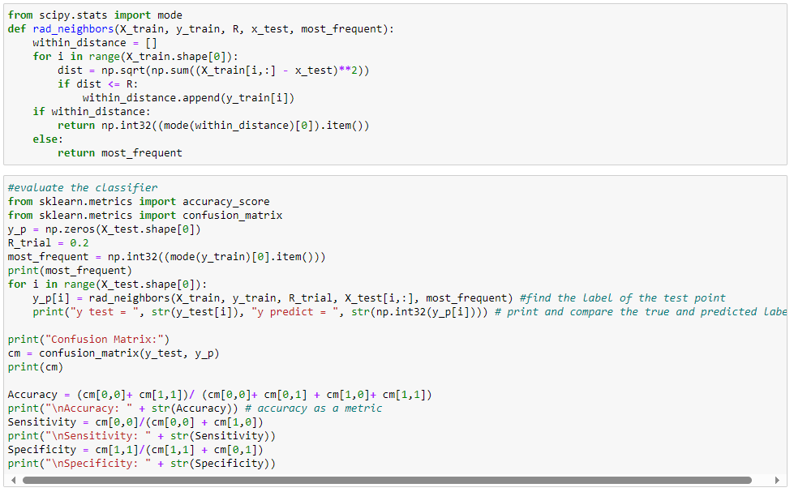
Radius Neighbor Classifier Code

Slide 16
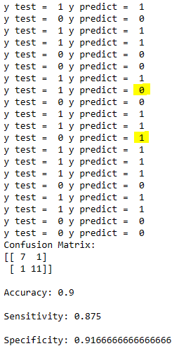
Radius Neighbor Classifier Results
Confusion Matrix:
Performance Metrics:
True Label
Predicted Label |  | Positive | Negative
 | Positive | TP | FP
 | Negative | FN | TN
TP: true positive, TN: true negative, FP: false positive, and FN: false negative

Slide 17
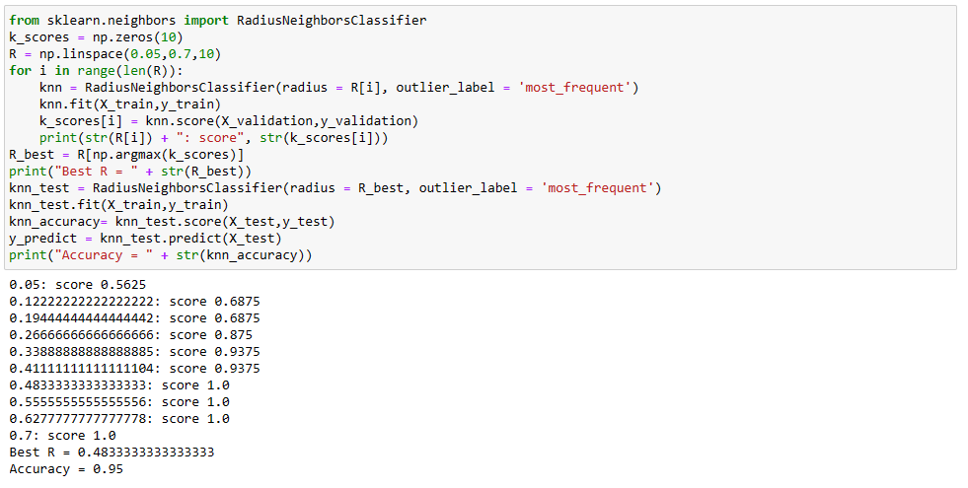
Radius Neighbor Tuning with Validation Set

Slide 18
Decision Trees (DT)

Slide 19
Decision Trees (DT)
Decision trees represent a class of supervised learning, non-linear classifiers/regressors.
The features space is split into unique regions of specific classes sequentially.
Most popular decision trees those that can split the feature space into hyperrectangles with sides are parallel to the axes. In these algorithms, a tree is constructed with several nodes and the decision at each node is taken by asking a set of questions for the individual features such as is feature x_{i} > t, where t is a threshold. Since the answer is ‘yes’ or ‘no’, these type of trees is known as ordinary binary classification trees (OBCTs).
x₂
C₄
3/4
C₂
C₅
1/2
C₁
C₃
C₆
1/4
1/4
1/2
3/4
x₁
X₁>1/4
root
no
yes
nodes
X₂>1/2
C₁
no
yes
X₁>3/4
X₁>1/2
no
yes
no
yes
C₃
C₆
C₂
X₂>3/4
no
yes
Leaves (terminals)
C₅
C₄

Slide 20
Node Impurity
There are several measures that can be used to determine the information impurity such as:
  Information Impurity (or Entropy Impurity)
  Gini Impurity
  Misclassification Impurity

Slide 21
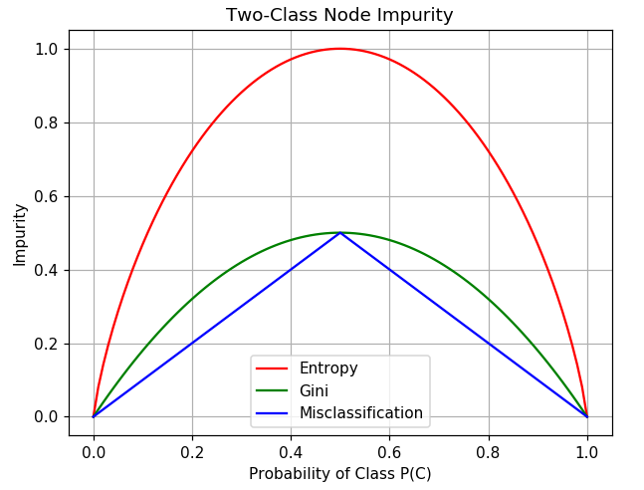

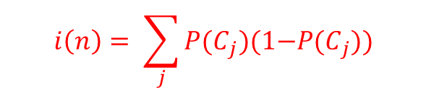
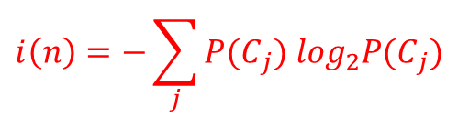
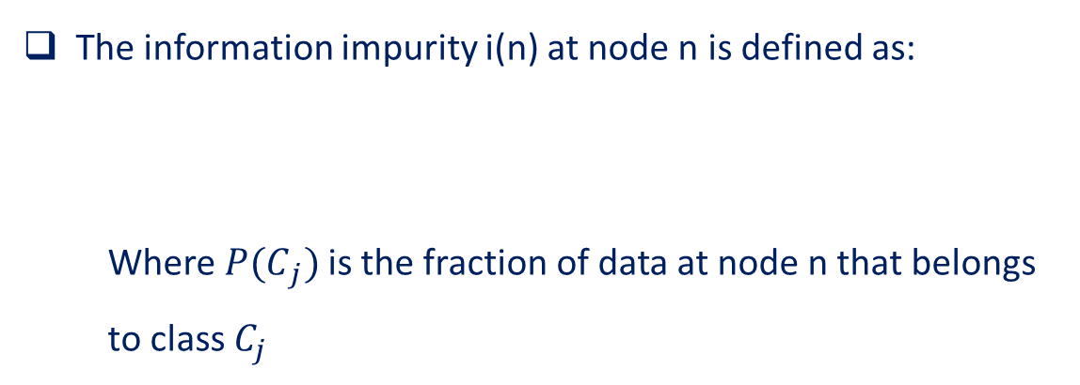
Node Impurity
The information impurity i(n) at node n is defined as:
  Where ${P(C}_{j})$is the fraction of data at node n that belongs to class $C_{j}$
$$i\left(n\right)=−\sum_{j}{{P(C}_{j}) \log_{2}{P(C}_{j})}$$
Gini impurity i(n) at node n is defined as:
$$i\left(n\right)= \sum_{j}{{P(C}_{j})(1{−P(C}_{j}))}$$
Misclassification impurity i(n) at node n is defined as:
$$i\left(n\right)=1−\max_{j}{{P(C}_{j})}$$

Slide 22
Example: Building a classification Tree Step-by-Step
Given this training dataset, we want to build a classification tree that uses Loves Popcorn, Loves Soda, and Age to predict whether or not someone will love Music 1.
Loves Popcorn | Loves Soda | Age | Music 1
Yes | Yes | 7 | No
Yes | No | 12 | No
No | Yes | 18 | Yes
No | Yes | 35 | Yes
Yes | Yes | 38 | Yes
Yes | No | 50 | No
No | No | 83 | No

Slide 23
Example
The first thing we do is to decide whether Loves Popcorn, Loves Soda, or Age should be the question we ask at the very top of the tree.
???

Slide 24
Example
To make that decision, we will start by looking at how well Loves Popcorn predicts whether or not someone loves Music 1
Loves Popcorn | Loves Soda | Age | Music 1
Yes | Yes | 7 | No
Yes | No | 12 | No
No | Yes | 18 | Yes
No | Yes | 35 | Yes
Yes | Yes | 38 | Yes
Yes | No | 50 | No
No | No | 83 | No
Loves Popcorn
Yes
No
Loves Music 1
Yes No
1 3
Loves Music 1
Yes No
2 1

Slide 25
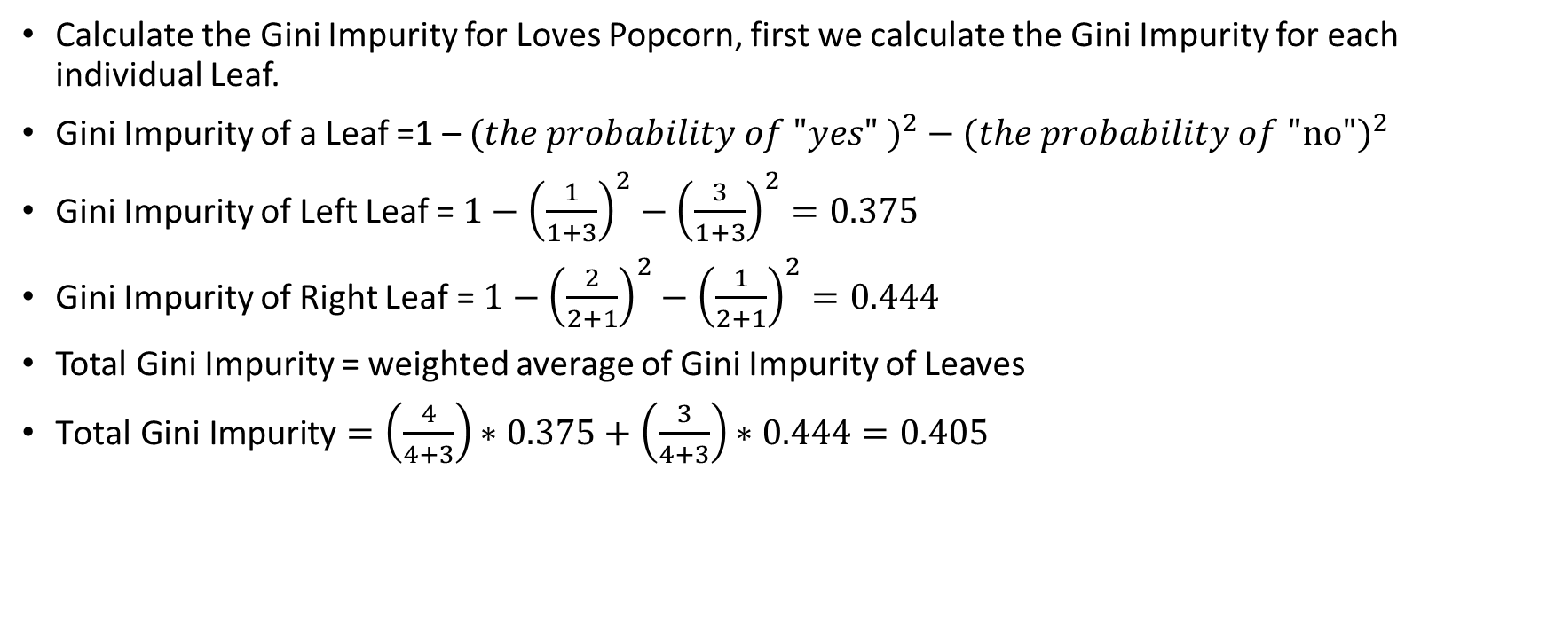
Example
Calculate the Gini Impurity for Loves Popcorn, first we calculate the Gini Impurity for each individual Leaf.
Gini Impurity of a Leaf =${\text{1 }\text{– }(the probability of "yes" )}^{2}−{(the probability of \text{"}\text{no}")}^{2}$
Gini Impurity of Left Leaf = $1−{\left(\frac{1}{1+3}\right)}^{2}−{\left(\frac{3}{1+3}\right)}^{2}=0.375$
Gini Impurity of Right Leaf = $1−{\left(\frac{2}{2+1}\right)}^{2}−{\left(\frac{1}{2+1}\right)}^{2}=0.444$
Total Gini Impurity = weighted average of Gini Impurity of Leaves
$\text{Total} \text{Gini} \text{Impurity}=\left(\frac{4}{4+3}\right)∗0.375+\left(\frac{3}{4+3}\right)∗0.444=0.405$
Loves Popcorn
Yes
No
Loves Music 1
Yes No
1 3
Loves Music 1
Yes No
2 1

Slide 26
Example
Then, we do the same with Loves Soda
Loves Popcorn | Loves Soda | Age | Music 1
Yes | Yes | 7 | No
Yes | No | 12 | No
No | Yes | 18 | Yes
No | Yes | 35 | Yes
Yes | Yes | 38 | Yes
Yes | No | 50 | No
No | No | 83 | No
Loves Soda
Yes
No
Loves Music 1
Yes No
3 1
Loves Music 1
Yes No
0 3

Slide 27
Example
In a similar way, we can calculate the Total Gini Impurity for Loves Soda.
Total Gini Impurity = 0.214
Loves Soda
Yes
No
Loves Music 1
Yes No
3 1
Loves Music 1
Yes No
0 3

Slide 28
Example
Now, we need to calculate the Gini Impurity for the Age.
First, Sort the rows by the value of Age. Then, Calculate the average Age for each adjacent rows.
Loves Popcorn | Loves Soda | Age | Music 1
Yes | Yes | 7 | No
Yes | No | 12 | No
No | Yes | 18 | Yes
No | Yes | 35 | Yes
Yes | Yes | 38 | Yes
Yes | No | 50 | No
No | No | 83 | No
Age | Music 1
7 | No
12 | No
18 | Yes
35 | Yes
38 | Yes
50 | No
83 | No
9.5
15
26.5
36.5
44
66.5

Slide 29
Example
Calculate the Gini Impurity for each average value.
The first average age is 9.5, so we use 9.5 as the threshold for splitting the rows into 2 leaves.
Total Gini Impurity = 0.429
Age | Music 1
7 | No
12 | No
18 | Yes
35 | Yes
38 | Yes
50 | No
83 | No
9.5
Age < 9.5
15
Yes
No
26.5
36.5
Loves Music 1
Yes No
0 1
Loves Music 1
Yes No
3 3
44
66.5

Slide 30
Example
Ultimately, we end up with a Gini Impurity for each potential threshold for Age.
Identify the threshold with lowest Impurity and pick it as the root.
Age | Music 1
7 | No
12 | No
18 | Yes
35 | Yes
38 | Yes
50 | No
83 | No
9.5
GI = 0.429
Age < 15
15
GI = 0.343
Yes
No
26.5
GI = 0.476
36.5
GI = 0.476
Loves Music 1
Yes No
0 2
Loves Music 1
Yes No
3 2
44
GI = 0.343
66.5
GI = 0.429

Slide 31
Example
Gini Impurity for Loves Popcorn = 0.405
Gini Impurity for Loves Soda = 0.214
Gini Impurity for Age < 15 = 0.343
Choose the lowest Gini Impurity as the root node -> Loves Soda is the root.
The node on the right is pure. It becomes a leaf.
The node on the left is Impure, we can split the 4 people in it based on Loves Popcorn or Age and calculate Gini Impurity.
Loves Soda
Yes
No
Loves Music 1
Yes No
3 1
Loves Music 1
Yes No
0 3

Slide 32
Example
When we split the 4 people who Love Soda based on whether or not they Love Popcorn, the Gini Impurity = 0.25.
Loves Popcorn | Loves Soda | Age | Music 1
Yes | Yes | 7 | No
Yes | No | 12 | No
No | Yes | 18 | Yes
No | Yes | 35 | Yes
Yes | Yes | 38 | Yes
Yes | No | 50 | No
No | No | 83 | No
Loves Popcorn
Yes
No
Loves Music 1
Yes No
1 1
Loves Music 1
Yes No
2 0

Slide 33
Example
However, when we split the 4 people based on Age < 12.5, the Gini Impurity = 0.
Loves Popcorn | Loves Soda | Age | Music 1
Yes | Yes | 7 | No
Yes | No | 12 | No
No | Yes | 18 | Yes
No | Yes | 35 | Yes
Yes | Yes | 38 | Yes
Yes | No | 50 | No
No | No | 83 | No
12.5
26.5
36.5
Age < 12.5
Yes
No
Loves Music 1
Yes No
0 1
Loves Music 1
Yes No
3 0

Slide 34
Example
Now, the only thing remaining is to assign output values for each leaf.
The output of a leaf is whatever category that has the most counts.
Loves Soda
Yes
No
Loves Music 1
Yes No
0 3
Age < 12.5
Yes
No
Loves Music 1
Yes No
0 1
Loves Music 1
Yes No
3 0

Slide 35
Example: Final Tree
Loves Soda
Yes
No
Doesn’t Love Music 1
Age < 12.5
Yes
No
Doesn’t Love Music 1
Loves Music 1

Slide 36
Decision Tree in sklearn
class sklearn.tree.DecisionTreeClassifier(*, criterion='gini', splitter='best', max_depth=None, min_samples_split=2, min_samples_leaf=1, min_weight_fraction_leaf=0.0, max_features=None, random_state=None, max_leaf_nodes=None, min_impurity_decrease=0.0, min_impurity_split=None, class_weight=None, presort='deprecated', ccp_alpha=0.0)
criterion: either ‘gini’ or ‘entropy’ for impurity measure
min_samples_split: do splitting if samples are >= min_samples_split. Also, used to determine the depth of the tree if max_depth is none.
min_samples_leaf: split will not be considered if it results in a number of samples less than min_samples_leaf (if no split then the node is a leaf).
max_features: if none, all feature will be used when consider splitting, otherwise use ‘sqrt’ as square root of the number of features, or ‘log2’ or ‘auto’ = ‘sqrt’.
max_leaf_nodes: if specified, tree cannot grow to more than this maximum value, otherwise no limit on the number of leaf nodes.
min_impurity_decrease: to consider splitting, impurity should decrease by at least min_impurity_decrease.
min_impurity_split: minimum value for impurity to consider splitting, otherwise the node is considered a leaf.
ccp_alpha: a regularization factor, the larger the value the more we prune nodes based on minimal cost-complexity approach for pruning.

Slide 37
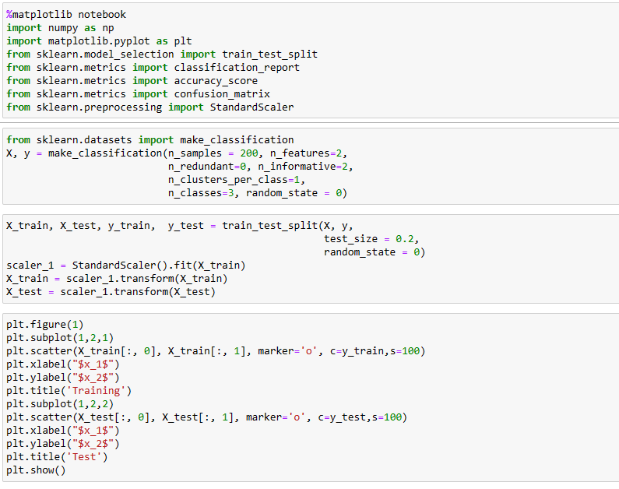
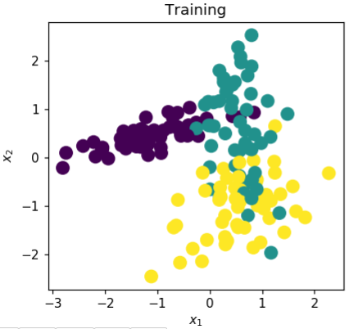
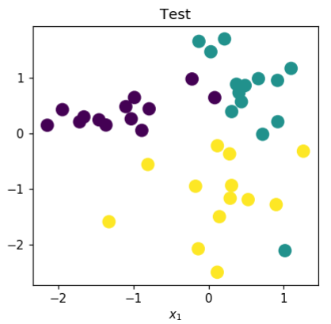
Decision Tree in sklearn, Example 1

Slide 38
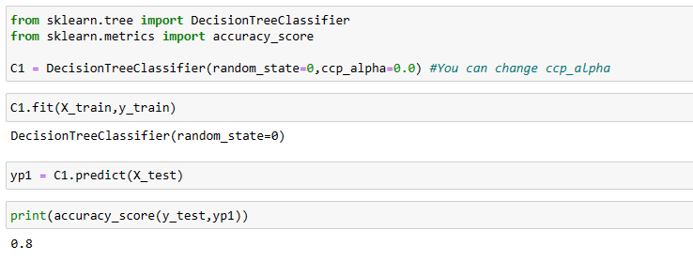
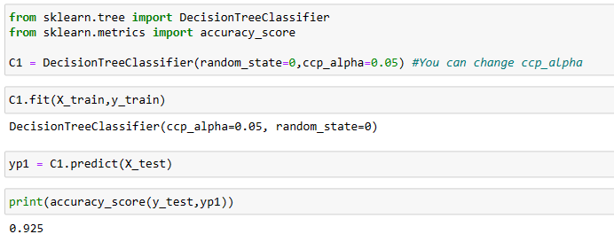
Decision Tree in sklearn, Example 1

Slide 39
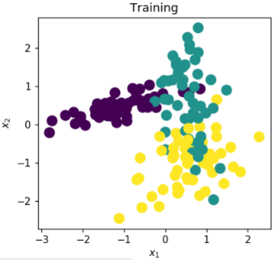
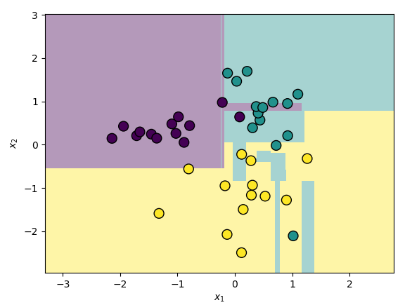
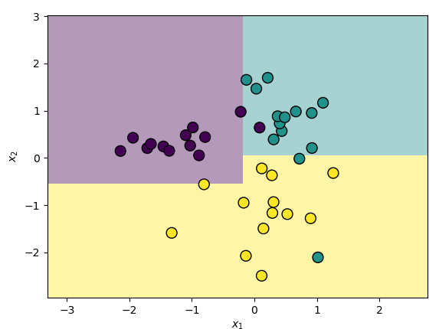
Decision Tree in sklearn, Example 1
ccp_alpha=0.0
ccp_alpha=0.05

Slide 40
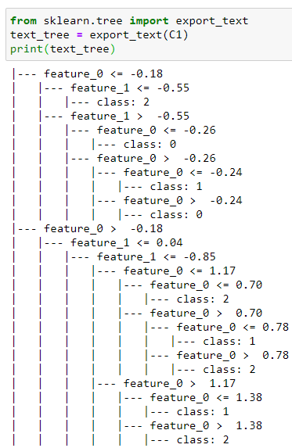
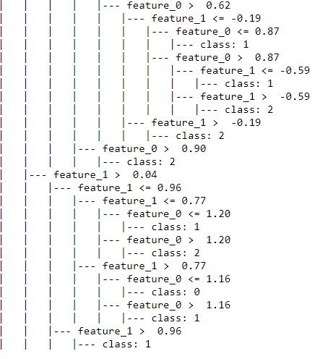
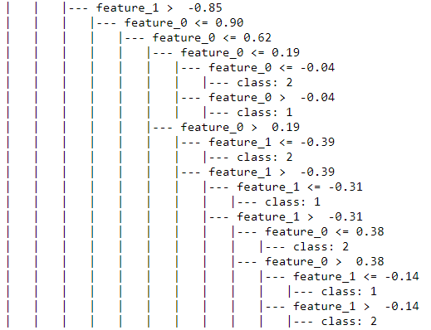
Decision Tree in sklearn, Example 1
ccp_alpha=0.0

Slide 41

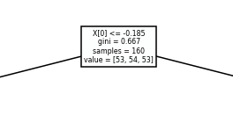
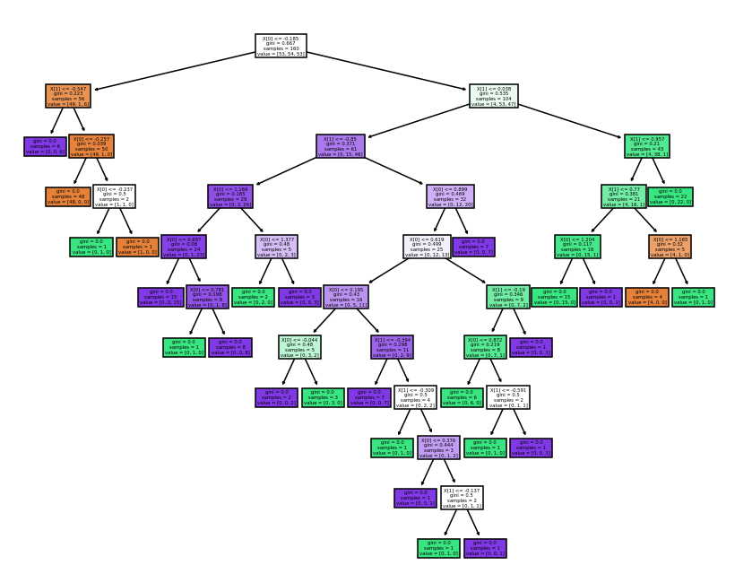
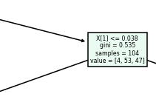
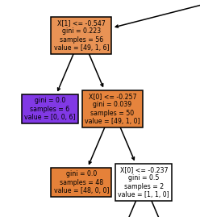
Decision Tree in sklearn, Example 1
ccp_alpha=0.0
Rule
Gini value (impurity)
# total samples at node
# samples for each class at node

Slide 42
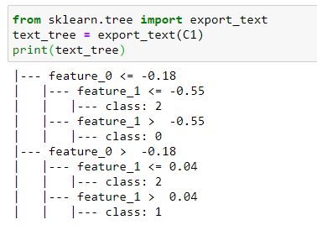
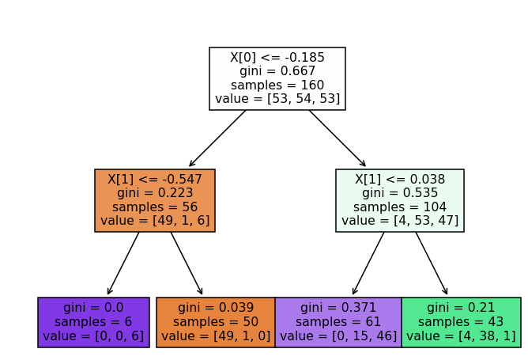
Decision Tree in sklearn, Example 1
ccp_alpha=0.05

Slide 43
Random Forest Classifiers in sklearn
A random forest is a supervised learning approach that fits a set of decision tree classifiers/regressors on different sub-samples (randomly drawn with replacement) of the input dataset.
It averages the individual predictions to improve the predictive accuracy and control over-fitting.
class sklearn.ensemble.RandomForestClassifier(n_estimators=100, *, criterion='gini', max_depth=None, min_samples_split=2, min_samples_leaf=1, min_weight_fraction_leaf=0.0, max_features='auto', max_leaf_nodes=None, min_impurity_decrease=0.0, min_impurity_split=None, bootstrap=True, oob_score=False, n_jobs=None, random_state=None, verbose=0, warm_start=False, class_weight=None, ccp_alpha=0.0, max_samples=None)
n_estimators: the number of the trees in the forest.
bootstrap: if True, random samples from the whole data is drown randomly with replacement, otherwise the whole data is used to grow the tree.
oob_score: if True, the out-of-bag approach is used with the bootstrap as a validation approach. The samples left out of the bootstrap sampling are used on trees that didn’t see such examples while training. The class assigned to the oob samples is the majority vote of the classifications from all trees that are used to test these samples.

Slide 44
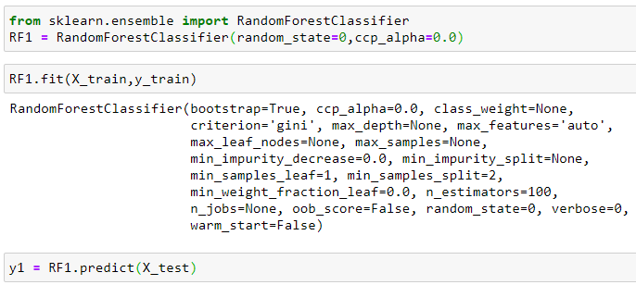
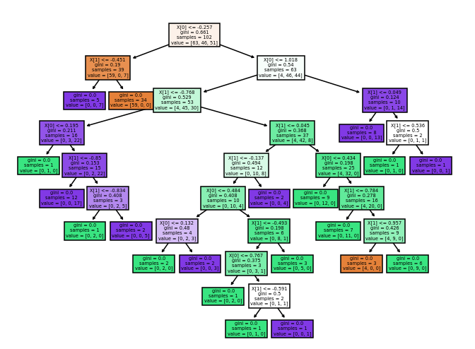

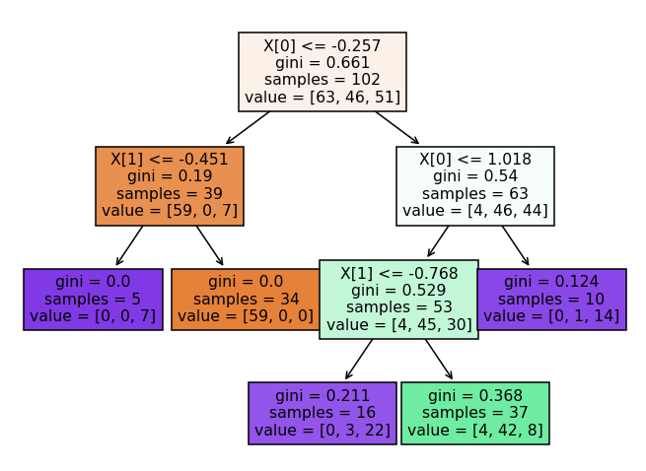

Random Forest Classifiers in sklearn
ccp_alpha=0.0
ccp_alpha=0.05

Slide 45
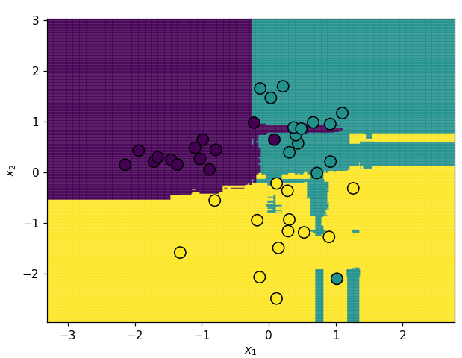
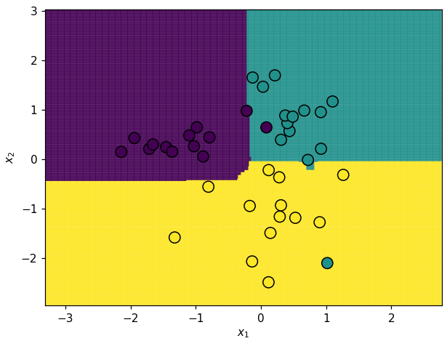
Random Forest Classifiers in sklearn
ccp_alpha=0.0
ccp_alpha=0.05
Accuracy = 0.85
Accuracy = 0.95

Slide 46
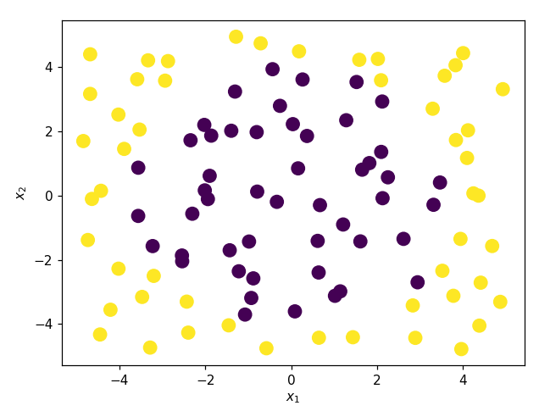
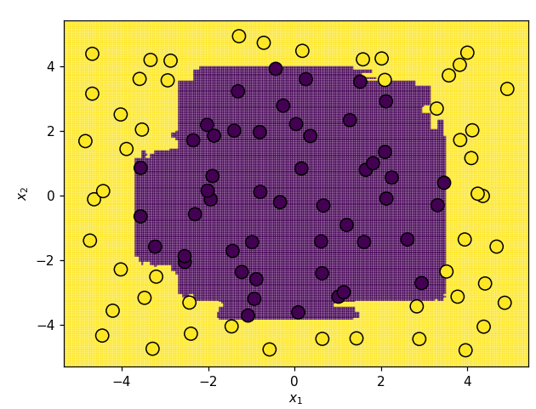
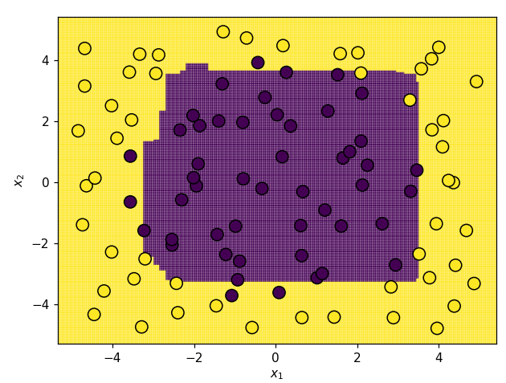
Random Forests Classifiers in sklearn
ccp_alpha=0.0
ccp_alpha=0.05

