Slide 1
SBE 4032: Advanced Topics in Medical Informatics (2)
موضوعات متقدمة في المعلوماتية الطبية (2)
Lecture #5: Autoencoder for Dimensionality Reduction
Hisham Abdeltawab, Ph.D.
Assistant Professor,
Cairo University

Slide 2
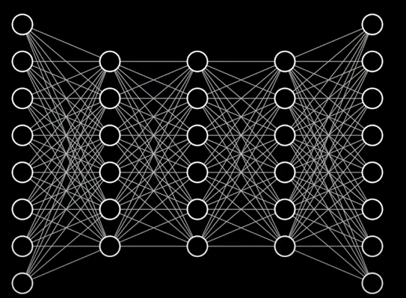

Autoencoders
Autoencoders (AE) are types of ANNs that are used to learn data encodings and thus provide unsupervised learning
AEs are specific FNN trained to capture the most important parts of the input data (images or hand-crafted features)
Training an NN to reduce E ≡ building model that learns an efficient lower dimensional representation of the data
Compression
Latent Space
Input data
Reconstructed data
Error (E) = Reconstructed data - Input data
Notes:
Generally, AEs are special ANNs types that can be used for data encoding. How? This is done through the following two septs
in it simplest form It compresses it input data to a lower dimension space
Then try to use this compressed space (latent) or the lower dimension of the data to reconstruct the original data
XXXX

Slide 3
Autoencoders (cont’d)
Autoencoders (AE) are types of ANNs that are used to learn data encodings and thus provide unsupervised learning
AEs are specific FNN trained to capture the most important parts of the input data (images or hand-crafted features)
Real data
is not random,
has a structure
If you CAN understand its structure (or how it is constrained)
→ you can condense or use less parameters to represent it
Why do
We need
compression?
The encoder approximate the function needed to transfer the data from its original space to lower-dimensional space that takes advantages of the structure in the data
Notes:
No
XXX
Our data is not random and it represent parts of the full dimension space of the input
It has a structure and we do not need every part of the original space to represent our data
But if we can understand this structure, we can easily represent it using small # of parameters i.e., compress it small fraction of the possible space
This is the job of the encoder

Slide 4
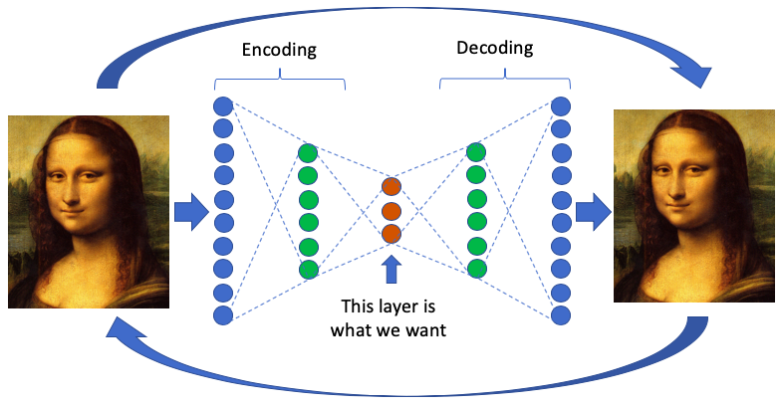
Autoencoders (cont’d)
Autoencoders (AE) are types of ANNs that are used to learn data encodings and thus provide unsupervised learning
AEs are specific FNN trained to capture the most important parts of the input data (images or hand-crafted features)
AEs capacity is that they learn a lower-dimensional representation (encoding) for a higher-dimensional data
AEs are mainly dimensionality reduction (or compression) algorithms
In AE training, the input and the output data are the same
Autoencoder
Input Data
Output Data

Slide 5
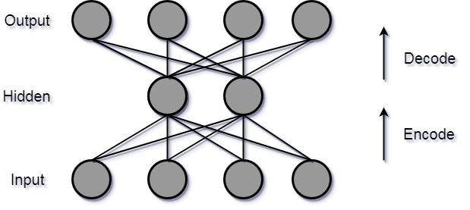
AE Architecture
Generally, AE architecture consists of three main components:
  Encoder: takes the input and compress it into a latent space (or a reduced representation)
Input

Slide 6
AE Architecture (cont’d)
Generally, AE architecture consists of three main components:
  Encoder: takes the input and compress it into a latent space (or a reduced representation)
  Code (bottleneck): the compact representation (summary or knowledge-representation)
hidden
Input

Slide 7
AE Architecture (cont’d)
Generally, AE architecture consists of three main components:
  Encoder: takes the input and compress it into a latent space (or a reduced representation)
  Code (bottleneck): the compact representation (summary or knowledge-representation)
  Decoder: reconstruct the output from the code (reduced representation). It is a similar ANN structure of the encoder
Bottleneck dimension is way smaller than the input
≡ information loss
output
hidden
Input
Notes:
Decoder: try to reverse the encoder. Try to get higher dimensional space from lower dimension space
This challenges because the bottelneck is …… which mean loss of information
We force both network parts to work together to find the most efficient way to condense the input

Slide 8

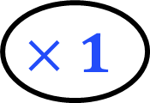
AE Architecture (cont’d)
Generally, AE architecture consists of three main components:
  Encoder: takes the input and compress it into a latent space (or a reduced representation)
  Code (bottleneck): the compact representation (summary or knowledge-representation)
  Decoder: reconstruct the output from the code (reduced representation). It is a similar ANN structure of the encoder
Bottleneck dimension is way smaller than the input ≡ information loss
Without information loss
Output
≡ useless structure
$$×1$$
Tricks are added such that the bottleneck prevents the NN from memorizing the input and overfitting on the data
Input
Notes:
Loss of information is necessary to avoid overfitting
Tricks are added discourages memorization/overfitting: like adding noise to the input before suppling it to the encoder

Slide 9
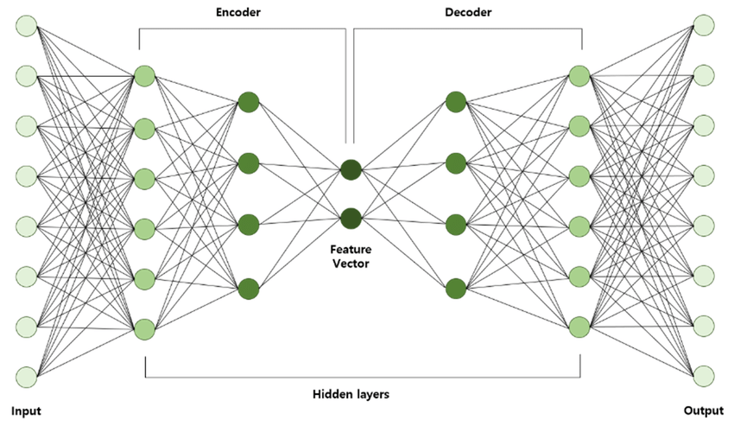
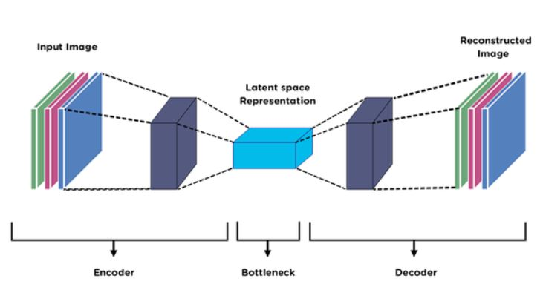
AE Architecture (cont’d)
Encoder
Decoder
Code
Input
Hidden layers
Output
Image Source: https://www.analyticsvidhya.com/blog/2021/01/auto-encoders-for-computer-vision-an-endless-world-of-possibilities/
              Image source: https://www.researchgate.net/publication/342298239_Comparison_between_Statistical_Models_and_Machine_Learning_Methods_on_Classification_for_Highly_Imbalanced_Multiclass_Kidney_Data/figures?lo=1&utm_source=google&utm_medium=organic
Notes:
AE can be used with data features or with images. We have seen the U-net contains encoder decoder structure BUT for a different task
This happens during the training process, our goal is to train a network that can learn how to latent attributes within our data
The True value of the AE lives inside that latent-space representation.

Slide 10
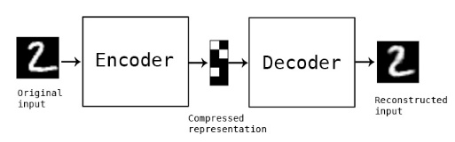
AE Architecture: Training and Testing
Autoencoders (AE) are ANNs that provide unsupervised learning
Training process: the system learns to encode the input and reconstruct it back to its original form
            The objective is to minimize the reconstruction error
Testing process: the output may be the reduced code (encoder output or the latent space)
AEs are data-specific (don’t expect AE trained on handwritten to compress Monalisa)
AEs are lossy, the output will not be exactly the same as the input
Image source: https://blog.keras.io/building-autoencoders-in-keras.html
              Image source: https://helloml.org/applications-of-autoencoders//

Slide 11
Autoencoders: Hyperparameters
Code size: The number of nodes in the middle layer, the smaller the code, the more compression or dimensionality reduction
Number of layers: Can be shallow or deep as you like
Number of nodes per layer:
In stacked autoencoders, the number of nodes per layer decreases with each subsequent layer of the encoder and increases back in the decoder (AEs are symmetric architecture)
Loss function:
Binary cross entropy or BCE (if the input values are in the range [0,1])
Mean squared error (MSE), otherwise
AEs are trained the same way as ANNs via backpropagation

Slide 12

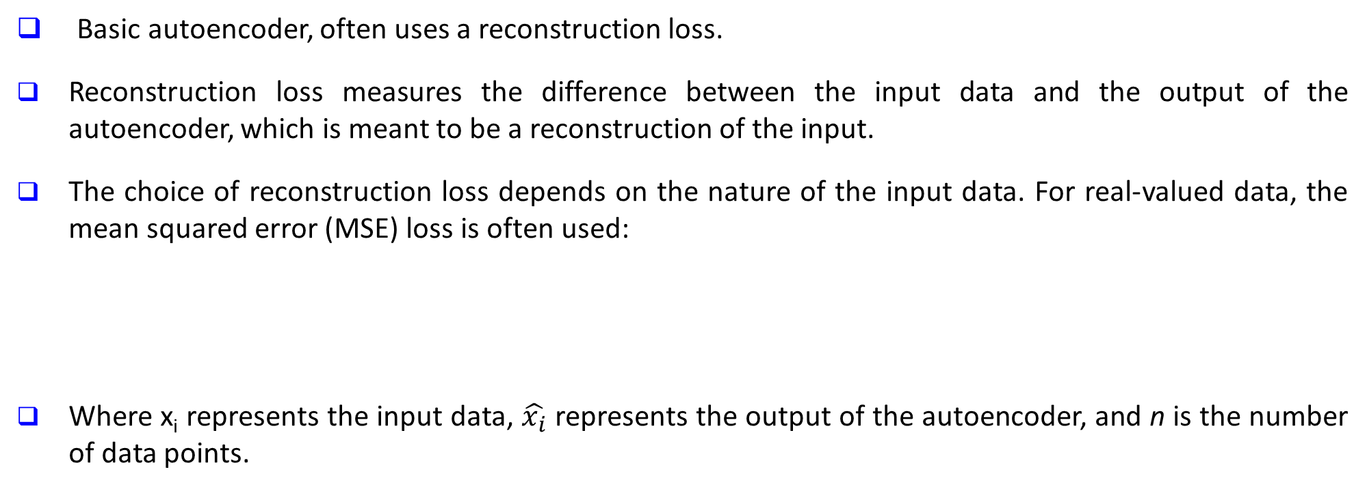
Autoencoders: Loss Function
Basic autoencoder, often uses a reconstruction loss.
Reconstruction loss measures the difference between the input data and the output of the autoencoder, which is meant to be a reconstruction of the input.
The choice of reconstruction loss depends on the nature of the input data. For real-valued data, the mean squared error (MSE) loss is often used:
Where x_{i} represents the input data, $\hat{x_{i}}$​ represents the output of the autoencoder, and n is the number of data points.

Slide 13
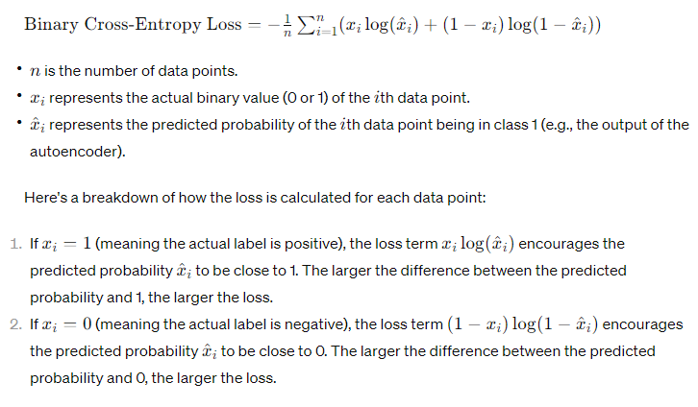
Autoencoders: Loss Function
Binary cross-entropy loss, also known as log loss, is commonly used in binary classification problems.
It measures the difference between the actual binary labels and the predicted probabilities of a model. In the context of autoencoders, it is often employed as a reconstruction loss when dealing with binary data, such as binarized images.

