Slide 1
SBE 4032: Advanced Topics in Medical Informatics (2)
موضوعات متقدمة في المعلوماتية الطبية (2)
Lecture #6: Clustering
Hisham Abdeltawab, Ph.D.
Assistant Professor,
Cairo University

Slide 2



Supervised learning
Training set: $\left\{\left(x^{\left(1\right)},y^{\left(1\right)}\right),\left(x^{\left(2\right)},y^{\left(2\right)}\right), ⋯,\left(x^{\left(m\right)},y^{\left(m\right)}\right)\right\}$
$$x_{2}$$
?
$$x_{1}$$

Slide 3

Unsupervised learning
Training set: $\left\{x^{\left(1\right)},x^{\left(2\right)},x^{\left(3\right)}, ⋯,x^{\left(m\right)}\right\}$
$$x_{2}$$
$$x_{1}$$

Slide 4
Clustering Applications
Customer Segmentation: Businesses use clustering to group customers with similar purchasing behavior, demographics, or preferences. This helps in targeted marketing and personalized services.
Image Segmentation: Clustering is used to segment images into meaningful regions based on color, texture, or other visual features.
Anomaly Detection: Clustering helps identify unusual patterns or outliers in datasets. Any data points that do not fit well into any cluster may be considered anomalies, helping in detecting fraud, errors, or unusual behavior.
And More….

Slide 5
Hierarchical Clustering
Produces a set of nested clusters organized as a hierarchical tree
Can be visualized as a dendrogram
  A tree-like diagram that records the sequences of merges or splits

Slide 6
Strengths of Hierarchical Clustering
No assumptions on the number of clusters
  Any desired number of clusters can be obtained by ‘cutting’ the dendrogram at the proper level
2 Clusters
3 Clusters
4 Clusters
5 Clusters
6 Clusters

Slide 7
Hierarchical Clustering
Two main types of hierarchical clustering
  Agglomerative:
    Start with the points as individual clusters
    At each step, merge the closest pair of clusters until only one cluster (or k clusters) left
  Divisive:
    Start with one, all-inclusive cluster
    At each step, split a cluster until each cluster contains a point (or there are k clusters)
Traditional hierarchical algorithms use a similarity or distance matrix
  Merge or split one cluster at a time

Slide 8
Agglomerative clustering algorithm
Most popular hierarchical clustering technique
Basic algorithm
  Compute the distance matrix between the input data points
  Let each data point be a cluster
  Repeat
  Merge the two closest clusters
  Update the distance matrix
  Until only a single cluster remains
Key operation is the computation of the distance between two clusters
  Different definitions of the distance between clusters lead to different algorithms

Slide 9
Input/ Initial setting
Start with clusters of individual points and a distance/proximity matrix
p1
p2
p3
p4
p5
. . .
p1
p2
p3
p4
p5
.
.
.
Distance/Proximity Matrix

Slide 10
Distance between two clusters
Each cluster is a set of points
How do we define distance between two sets of points?
  Lots of alternatives

Slide 11
Distance between two clusters
Single-link distance between clusters C_{i} and C_{j} is the minimum distance between any object in C_{i} and any object in C_{j}
The distance is defined by the two most similar objects

Slide 12
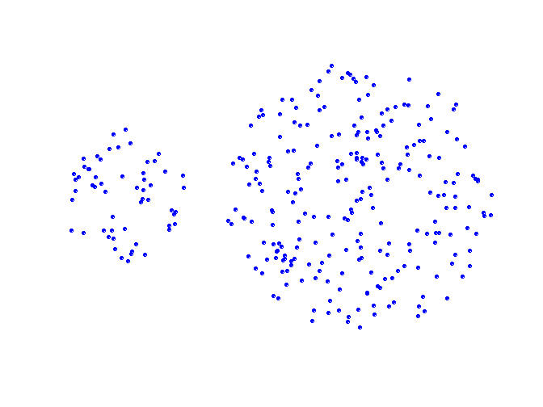
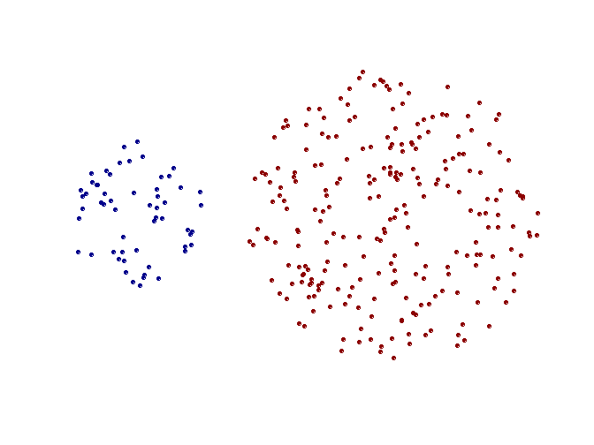
Strengths of single-link clustering
Original Points
Two Clusters

Slide 13
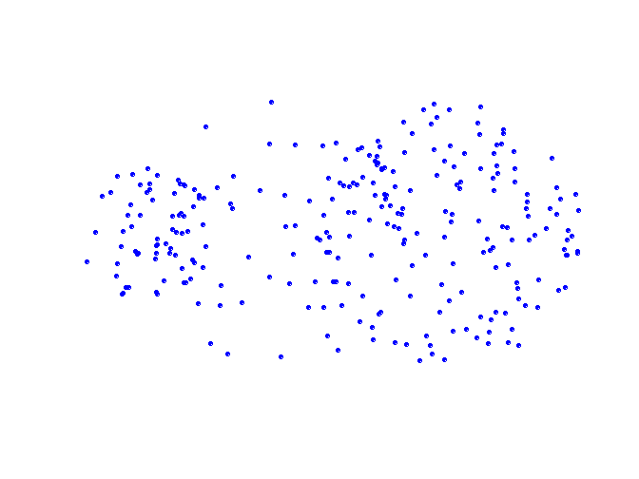
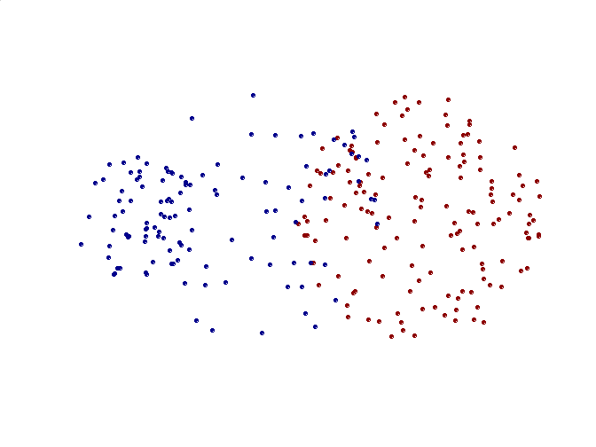
Limitations of single-link clustering
Original Points
Two Clusters
Sensitive to noise and outliers
It produces long, elongated clusters

Slide 14
Distance between two clusters
Complete-link distance between clusters C_{i} and C_{j} is the maximum distance between any object in C_{i} and any object in C_{j}
The distance is defined by the two most dissimilar objects

Slide 15
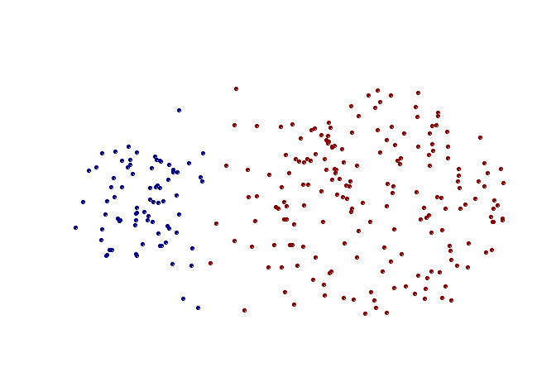
Strengths of complete-link clustering
Original Points
Two Clusters
Less susceptible to noise

Slide 16
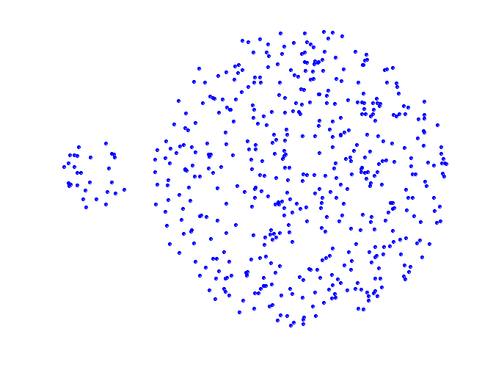
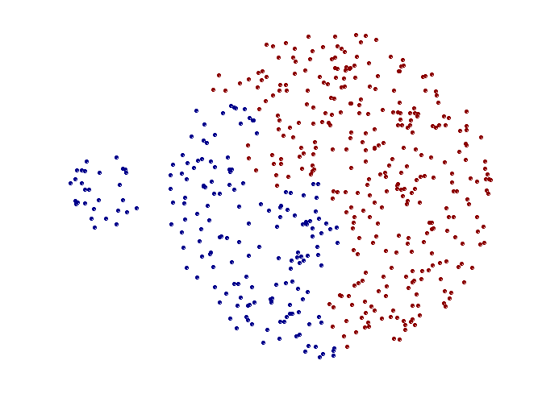
Limitations of complete-link clustering
Original Points
Two Clusters
Tends to break large clusters
All clusters tend to have the same diameter – small clusters are merged with larger ones

Slide 17
Distance between two clusters
Group average distance between clusters C_{i} and C_{j} is the average distance between any object in C_{i} and any object in C_{j}

Slide 18
Average-link clustering: discussion
Compromise between Single and Complete Link
Strengths
  Less susceptible to noise and outliers
Limitations
  Biased towards globular clusters

Slide 19
Distance between two clusters
Centroid distance between clusters C_{i} and C_{j} is the distance between the centroid r_{i} of C_{i} and the centroid r_{j} of C_{j}

Slide 20
Distance between two clusters
Ward’s distance between clusters C_{i} and C_{j} is the difference between the total within cluster sum of squares for the two clusters separately, and the within cluster sum of squares resulting from merging the two clusters in cluster C_{ij}
r_{i}: centroid of C_{i}
r_{j}: centroid of C_{j}
r_{ij}: centroid of C_{ij}

Slide 21
Ward’s distance for clusters
Similar to group average and centroid distance
Less susceptible to noise and outliers
Biased towards globular clusters

Slide 22
Hierarchical Clustering: Comparison
5
1
4
1
3
2
5
5
5
2
1
MIN
2
MAX
2
3
6
3
3
6
1
4
4
4
5
5
1
4
1
2
2
5
2
Ward’s Method
5
2
3
6
Group Average
3
3
6
4
1
1
4
4
3

Slide 23
K-means Clustering

Slide 24
K-means Clustering
K-means algorithm is used to cluster data that share similar features into several classes.
Each class is identified by its class center (centroid). The goal is to find these sets of class centers that minimize a certain error criterion.
For color images, the cluster center is a 3D color vector for each class k of the assumed number of classes K. For example, C_{k}={C_{kr}, C_{kg}, C_{kb}}, where k = 1, …, K and C_{kr,} C_{kg}, and C_{kb} are the RGB components of the mean color of pixels that belong to cluster k.

Slide 25
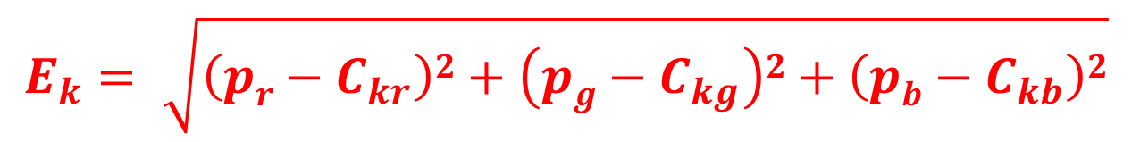
Algorithm: K-means Clustering
The following are the steps to implement the k-means algorithm for color images:
    Initialization: determine the number of clusters K, then initialize the cluster centers C_{k}. The initialization can simply be random values.
    Assignment: for each input pixel p(x,y) = {p_{r}, p_{g}, p_{b}}, find the winner cluster k, whose cluster center C_{k} has the smallest distance to the input pixel. This distance can be calculated using the Euclidean distance as:
$$E_{k}= \sqrt{\left(pr−C_{kr}\right)2+\left(pg−C_{kg}\right)2+\left(pb−C_{kb}\right)2}$$
    Add pixel p to the set S_{k} of the winner class k. Repeat for each pixel of the image.

Slide 26
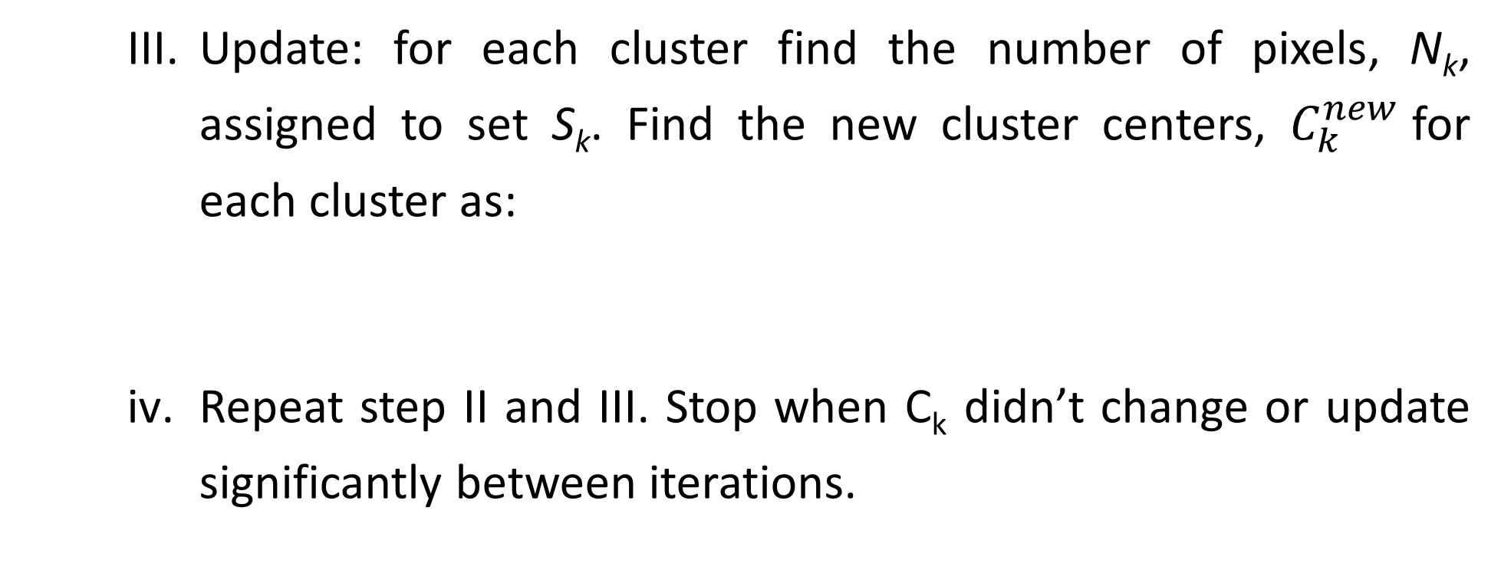
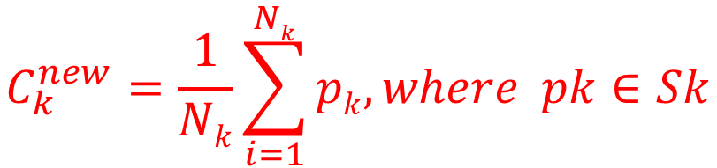
Algorithm: K-means Clustering
    Update: for each cluster find the number of pixels, N_{k}, assigned to set S_{k}. Find the new cluster centers, $C_{k}^{new}$for each cluster as:
    Repeat step II and III. Stop when C_{k} didn’t change or update significantly between iterations.
$$C_{k}^{new}=\frac{1}{Nk}\sum_{i=1}^{Nk}{pk, where pk∈Sk}$$

Slide 27
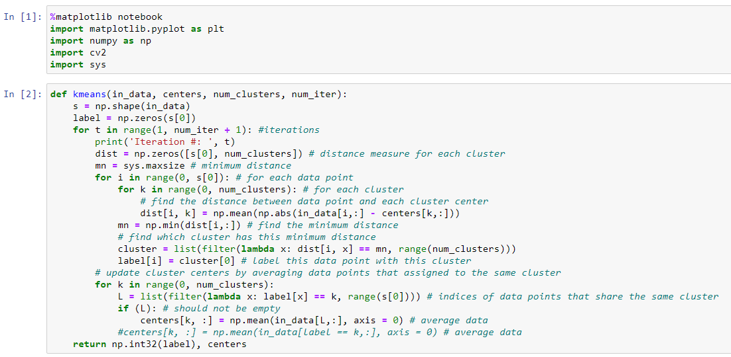
Code

Slide 28
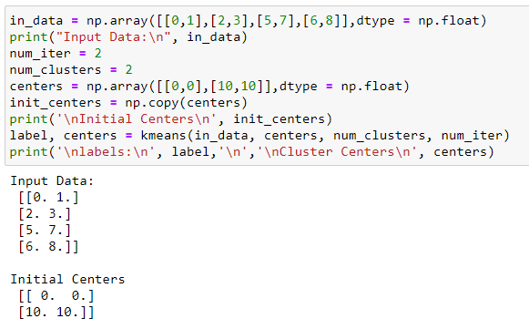
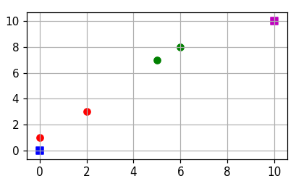
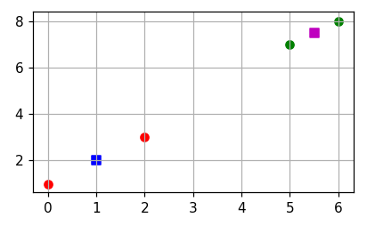
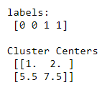
Example_1

Slide 29
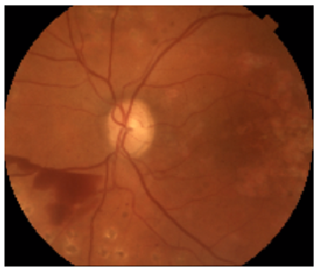
Example_2
    Use K-means to cluster the below fundus image to four classes.

Slide 30
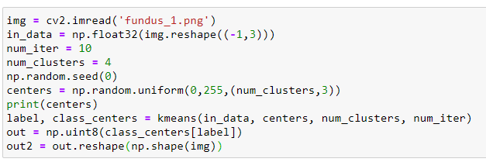


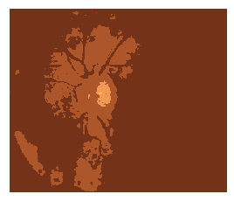
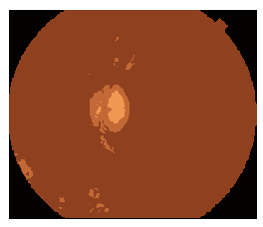
Results
Initial BGR cluster centers
input
#iterations = 2
#iterations = 5
#iterations = 10

Slide 31
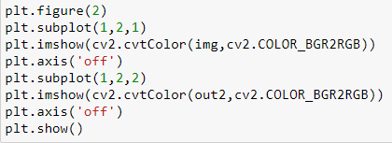
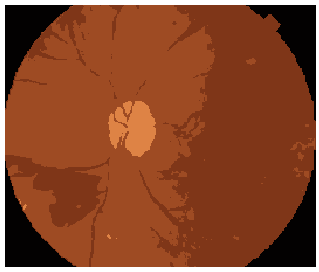

Results
[69,131,222]
[1, 1, 3]
input
#iterations = 20
[24,54,127]
[35,75,158]

Slide 32
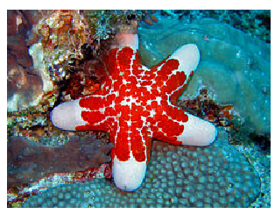
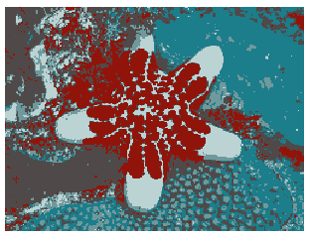
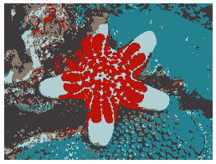
More Results: K-means Clustering
K-means results in RGB color space with different number of iterations
input
#iterations = 10
#iterations = 20

Slide 33
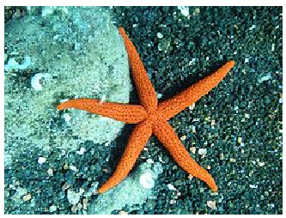
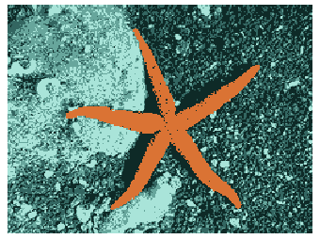

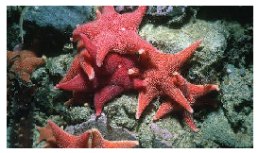
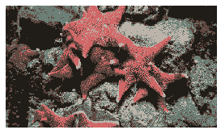

More Results: K-means Clustering
K-means results in RGB color space
BGR cluster centers
BGR cluster centers
input
K-means clustering output

Slide 34
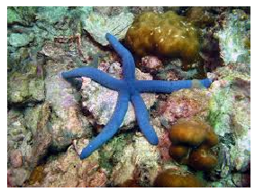
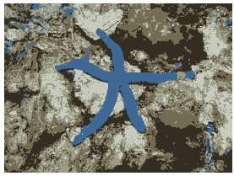
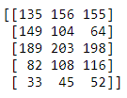
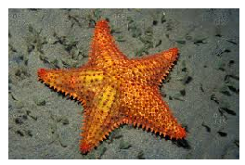
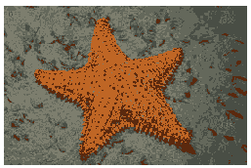
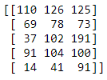
More Results: K-means Clustering
K-means results in RGB
BGR cluster centers
input
K-means clustering output
BGR cluster centers

Slide 35
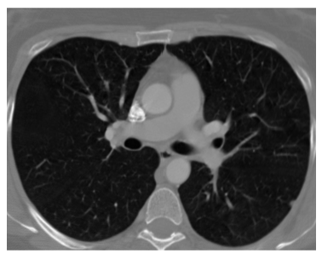
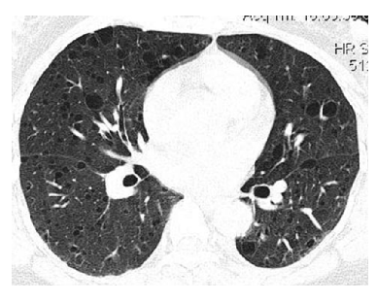
Example_3
    Use K-means to cluster the below Chest images to two classes.

Slide 36
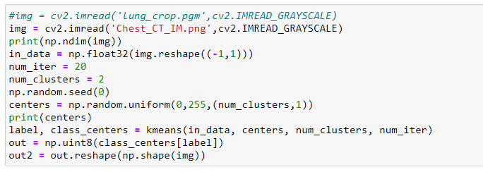
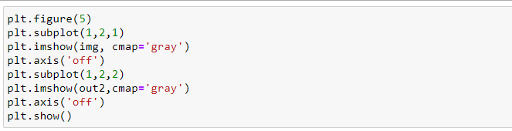
Code

Slide 37
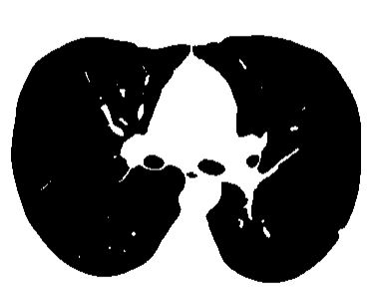
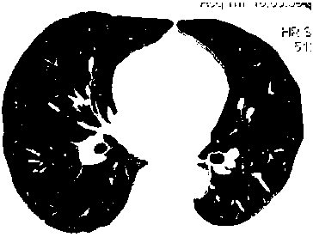


Results
Input
Output

