Slide 1
SBE 4032: Advanced Topics in Medical Informatics (2)
موضوعات متقدمة في المعلوماتية الطبية (2)
Lecture #7: Clustering: minimum spanning trees
Hisham Abdeltawab, Ph.D.
Assistant Professor,
Cairo University

Slide 2
Definitions
The usual definition of a graph G = (V, E) consists of two sets denoted by V and E.
The set V is a collection of objects known as vertices or nodes. For example, these can be such things as cities, networked computers, and even observations in a general data set, as we will see later.
The set E contains the edges (or links) of the graph, which are pairs of vertices specifying a link.
These edges can be directed or undirected. The vertex pairs are unordered, if we have an undirected graph. If the edges have a direction associated with them, then we traverse the graph (or edges) in the given direction.
Weighted graph.

Slide 3
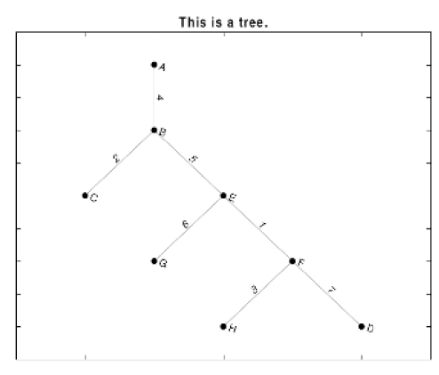
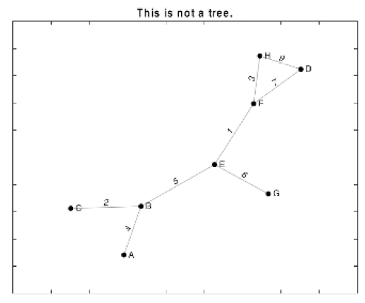
Definitions
As an example, the graph in the top panel of the Figure can be represented by the following sets V and E:
V = {A, B, C, D, E, F, G, H}
E = {{A, B}, {B, C}, {B, E}, {E, G}, {E, F}, {F, H}, {F, D}}
It is the usual practice to also denote the number of vertices in the graph as V and the number of edges as E.

Slide 4

Definitions
A tree is a connected acyclic graph.
A spanning tree of a graph G is a subgraph that (1) is a tree and (2) contains every vertex in V.
Note that a graph G will have a spanning tree if and only if it is connected.
A minimum spanning tree of a graph G is the spanning tree T that minimizes:

Slide 5
Minimum Spanning Tree
Two Algorithms
Prim: (build tree incrementally)
Pick lower cost edge connected to known (incomplete) spanning tree that does not create a cycle and expand to include it in the tree
Kruskal: (build forest that will finish as a tree)

Slide 6
Prim’s algorithm
Starting from empty T, choose a vertex at random and initialize
V = {1), E’ ={}

Slide 7
Prim’s algorithm
Choose the vertex u not in V such that edge weight from u to a vertex in V is minimal
V={1,3} E’= {(1,3) }

Slide 8
Prim’s algorithm
Repeat until all vertices have been chosen
Choose the vertex u not in V such that edge weight from v to a vertex in V is minimal
V= {1,3,4} E’= {(1,3),(3,4)}
V={1,3,4,5} E’={(1,3),(3,4),(4,5)}
….
V={1,3,4,5,2,6}
E’={(1,3),(3,4),(4,5),(5,2),(2,6)}

Slide 9
Prim’s algorithm
Repeat until all vertices have been chosen
V={1,3,4,5,2,6}
E’={(1,3),(3,4),(4,5),(5,2),(2,6)}

Slide 10
Minimum Spanning Tree Clustering
Remove the edges from MST graph from largest to smallest repeatedly:
All the items are in one cluster {1,3,4,5,2,6}.
Largest edge is between 4 and 5. So remove it, we will get two clusters: {1, 3, 4}, and {2, 5, 6}.
Next, remove the edge between nodes 3 and 4, we will get three clusters: {1, 3}, {4}, and {2, 5, 6}.
Finally, remove the edges between 1 and 3, between 2 and 5, and between 2 and 6. We will get six clusters: {1}, {2}, {3}, {4}, {5}, and {6}.
NOTE: Every observation in the initial graph represents an observation in your dataset.
How can we estimate the weights between nodes in the graph?

Slide 11
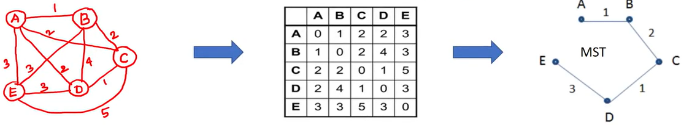
Minimum Spanning Tree: Another Example
Distance Matrix

Slide 12
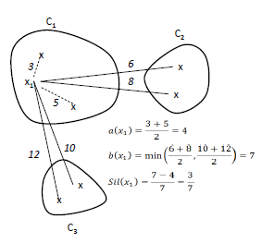

The silhouette coefficient
The silhouette coefficient is a metric used to evaluate the quality of clustering in data analysis.
It measures how similar an object is to its own cluster (cohesion) compared to other clusters (separation).
The overall silhouette coefficient is the average silhouette coefficient across all samples in the dataset.

Slide 13
The silhouette coefficient
If an observation has a value close to 1, then the data point is closer to its own cluster than a neighboring one.
If it has a silhouette width close to –1, then it is not very well-clustered.
A silhouette width close to zero indicates that the observation could just as well belong to its current cluster or one that is near to it.

