Slide 1
PROBABILISTIC WALLETS
At most one
incomplete layer
Proof by batch edits, kernel certificates, and duality
Notes:
Open with the structural claim: although a wallet may begin with many partially authorized ranks, an equally good wallet can always be made canonical. The proof is constructive and repeatedly edits only the two extreme incomplete layers.
[Sources]
- C:/Users/yehud/Documents/Retry-Simul/output/pdf/COMPLETE_PROOF_INCOMPLETE_LAYERS.pdf, p. 1 (user-provided proof).

Slide 2
The model separates ownership from compromise
Safe
Owner: yes
Attacker: no
Probability s
Stolen
Owner: no
Attacker: yes
Probability t
Leaked
Owner: yes
Attacker: yes
Probability e
Lost
Owner: no
Attacker: no
Probability ℓ
Wallet 𝓕
An upward-closed family of key sets.
Success
O ∈ 𝓕 and D ∉ 𝓕.
Layer 𝓕ₖ
Authorized sets of rank k.
Incomplete
0 < |𝓕ₖ| < C(n,k)
with s > ½.
2
Notes:
Each key independently occupies one of four states. A wallet is monotone: once a key set is authorized, every superset is authorized. Success means the owner is authorized while the attacker is not. The target structural notion is an incomplete rank layer.
[Sources]
- C:/Users/yehud/Documents/Retry-Simul/output/pdf/COMPLETE_PROOF_INCOMPLETE_LAYERS.pdf, p. 1 (user-provided proof).

Slide 3
Every wallet can reach one incomplete layer
Theorem
For every upward-closed wallet 𝓕, there exists 𝓕⋆ such that
Φₛ,ₜ,ₑ,ℓ(𝓕⋆) ≥ Φₛ,ₜ,ₑ,ℓ(𝓕)
and 𝓕⋆ has at most one incomplete layer.
Choose the lowest and highest incomplete ranks r < q.
Local step
Global finish
Remove rank r, fill rank q, or do both.
At least one edit is non-worsening.
Low sum: kernel certificate.
Each edit eliminates an incomplete layer.
No new incomplete layer appears.
High sum: reduce by duality.
3
Notes:
State the theorem in its operational form. The proof has two levels: prove that one of three local edits never lowers success, then iterate because every chosen edit strictly reduces the number of incomplete layers.
[Sources]
- C:/Users/yehud/Documents/Retry-Simul/output/pdf/COMPLETE_PROOF_INCOMPLETE_LAYERS.pdf, pp. 1 and 9 (user-provided proof).

Slide 4
Only the extreme incomplete layers need to move
Ranks < r
r through q
Ranks > q
Empty
By minimality of r, every lower layer is empty.
Boundary region
Layer r is the first partial layer; q is the last.
Full
By maximality of q, every higher layer is full.
4
Notes:
Upward closure converts the global geometry of the wallet into a simple rank picture. Everything below the first incomplete layer is empty, and everything above the last incomplete layer is full. This is why the proof can act only at r and q.
[Sources]
- C:/Users/yehud/Documents/Retry-Simul/output/pdf/COMPLETE_PROOF_INCOMPLETE_LAYERS.pdf, pp. 1-2 (user-provided proof).

Slide 5
Three batch edits act on 𝒜 = 𝓕ᵣ and the missing q-sets 𝓑
Remove
𝓕 ← 𝓕 ∖ 𝒜
Empties layer r.
α = |𝒜| / C(n,r)
Fill
𝓕 ← 𝓕 ∪ 𝓑
Fills layer q.
β = |𝓑| / C(n,q)
Joint
𝓕 ← (𝓕 ∖ 𝒜) ∪ 𝓑
Performs both boundary edits.
5
Notes:
Removing the lowest nonempty layer cannot break upward closure, and filling the highest non-full layer cannot break it either. A and B are nonempty proper fractions of their ranks, so alpha and beta lie strictly between zero and one.
[Sources]
- C:/Users/yehud/Documents/Retry-Simul/output/pdf/COMPLETE_PROOF_INCOMPLETE_LAYERS.pdf, pp. 1-2 (user-provided proof).

Slide 6
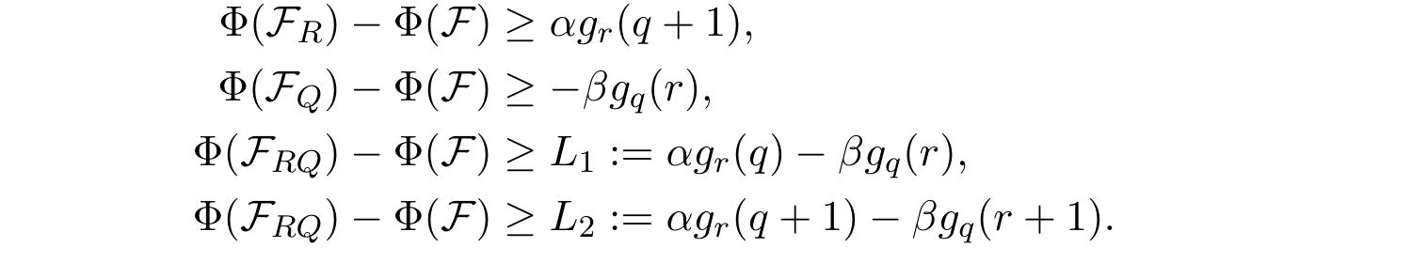
A decreasing rank kernel controls every edit
Kernel
I = |O|, J = |D|
Batch bounds
The discrete derivative is nonpositive, so every edit is controlled by a monotone kernel.
6
Notes:
Exchangeability makes O uniform within a fixed owner rank and D uniform within a fixed attacker rank. This converts gains and losses from a whole rank into the one-dimensional kernel g_k(m). Its discrete derivative is always nonpositive.
[Sources]
- C:/Users/yehud/Documents/Retry-Simul/output/pdf/COMPLETE_PROOF_INCOMPLETE_LAYERS.pdf, p. 2 (user-provided proof).

Slide 7
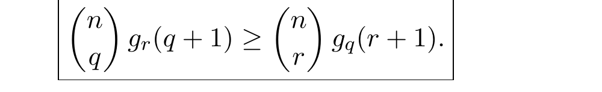
The low-sum certificate forces a good edit
If r + q ≤ n
Remove
If the remove kernel at q+1 is nonnegative, the remove edit cannot worsen success.
Fill
If the fill kernel at r is nonpositive, the fill edit cannot worsen success.
Hard sign case
Otherwise the two boundary kernels have opposite signs; the certificate compares them.
Joint
If the first joint bound fails, α < β makes the second bound strictly positive.
7
Notes:
The easy sign cases immediately choose remove or fill. In the remaining sign pattern, monotonicity and the binomial ratio imply g_r(q) >= g_q(r) > 0 and g_q(r+1) <= g_r(q+1) < 0. If the first joint bound fails, it forces alpha < beta, which makes the second joint bound positive.
[Sources]
- C:/Users/yehud/Documents/Retry-Simul/output/pdf/COMPLETE_PROOF_INCOMPLETE_LAYERS.pdf, p. 3 (user-provided proof).

Slide 8
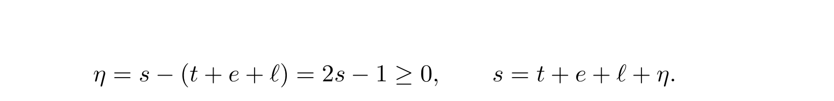
The certificate is proved coefficient by coefficient
Polynomial reduction
T
safe or stolen
E
safe or leaked
L
safe or lost
Fixing the labelled partition turns each coefficient into a difference of toggle counts.
H
safe only
8
Notes:
The condition s > 1/2 supplies a nonnegative slack variable eta. Expanding after substitution produces a homogeneous polynomial in nonnegative variables. For a fixed labelled partition, a toggle assignment chooses one of two allowed states in T, E, and L, while H is always safe. Proving every coefficient nonnegative proves the certificate.
[Sources]
- C:/Users/yehud/Documents/Retry-Simul/output/pdf/COMPLETE_PROOF_INCOMPLETE_LAYERS.pdf, p. 4 (user-provided proof).

Slide 9
Nested-set averaging leaves four cases
M meets H
If M ∩ H ≠ ∅, both negative events are impossible: H is always in O and never in D.
M meets E and L
If M ∩ E ≠ ∅ and M ∩ L ≠ ∅, then O = A is blocked by E and D = B is blocked by L.
M lies in T
If M ⊆ T, switch each coordinate of M from stolen to safe. This injects negative events into positive ones.
Two residual types
M ⊆ T ∪ L with M ∩ L ≠ ∅, or M ⊆ T ∪ E with M ∩ E ≠ ∅.
9
Notes:
Average the signed event count Lambda(A,B) over nested r- and q-sets. Fix the difference M = B minus A and sum over A disjoint from M. The first three types are immediate. Only the pure T-plus-L and T-plus-E types need additional injections.
[Sources]
- C:/Users/yehud/Documents/Retry-Simul/output/pdf/COMPLETE_PROOF_INCOMPLETE_LAYERS.pdf, p. 5 (user-provided proof).

Slide 10
The residual cases share one injection pattern
L-case
Encode a negative object by (K, J, Aₑ, s). Put j′ = j − s.
Record s using a canonical prefix of M ∩ L, then raise K by s.
Because s ≥ 1, the image satisfies the positive threshold.
E-case
Encode by (K, Aₑ, J, s). Put j′ = j + 1 − s.
Extend by a canonical prefix of M ∩ E, then raise K by s.
The recorded prefix makes the map injective.
10
Notes:
In each residual case, the counting identities guarantee enough room to move K upward in a fixed symmetric-chain decomposition. The canonical prefix makes s recoverable, and the chain map is injective; images from different (j,s) are disjoint. Hence every fixed-M contribution is nonnegative.
[Sources]
- C:/Users/yehud/Documents/Retry-Simul/output/pdf/COMPLETE_PROOF_INCOMPLETE_LAYERS.pdf, pp. 6-8 (user-provided proof).

Slide 11

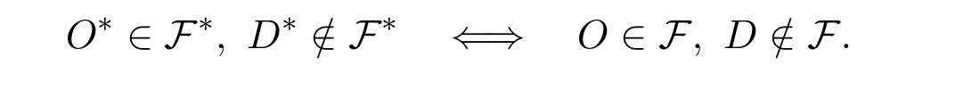


Duality converts the high-sum case to low sum
When r + q > n
Success is preserved; leaked and lost probabilities are exchanged.
Ranks transform
Edits transform
Remove ↔ fill.
Joint ↔ joint.
Apply the low-sum certificate to 𝓕⋆.
11
Notes:
The dual wallet authorizes a set exactly when the complement was unauthorized before. Complementing and swapping owner and attacker preserves the success event. The extreme ranks transform to n-q and n-r, whose sum is below n, so the low-sum lemma applies and maps back to a non-worsening edit of F.
[Sources]
- C:/Users/yehud/Documents/Retry-Simul/output/pdf/COMPLETE_PROOF_INCOMPLETE_LAYERS.pdf, p. 9 (user-provided proof).

Slide 12
THE RESULT
At most one
incomplete layer remains
Each edit removes at least one incomplete layer.
No edit creates a new incomplete layer.
Starting from an optimum preserves the optimum value.
Notes:
Choose a non-worsening edit whenever two incomplete layers remain. The number of incomplete layers decreases at every step, so the process terminates. Starting from an optimal wallet, every non-worsening step must preserve the optimal value, proving the canonical optimum exists.
[Sources]
- C:/Users/yehud/Documents/Retry-Simul/output/pdf/COMPLETE_PROOF_INCOMPLETE_LAYERS.pdf, p. 9 (user-provided proof).

