Slide 1
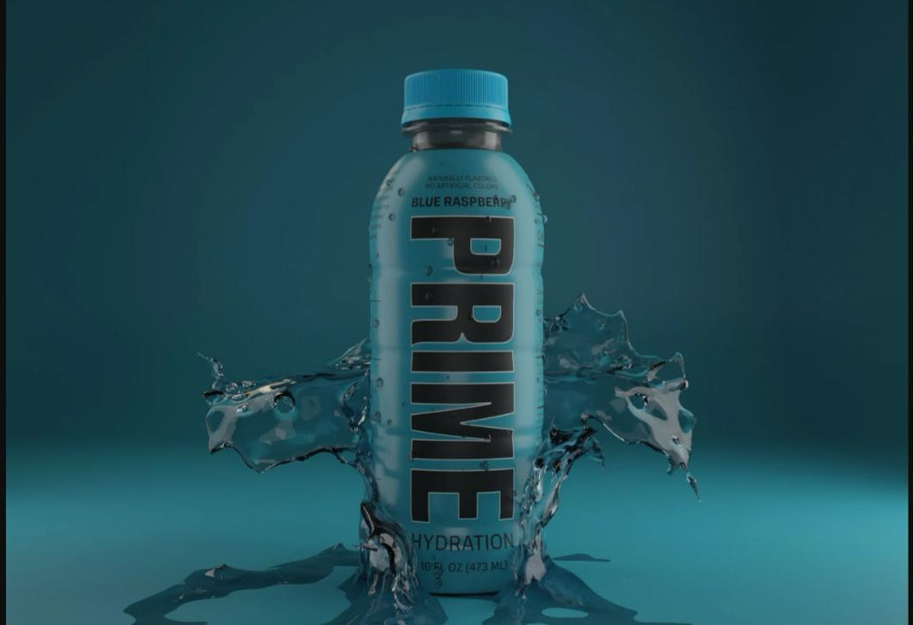
Digital Marketing
Campaign Design
for EnerPrime

Slide 2
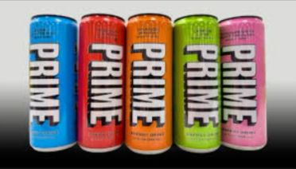
PRODUCT & CAMPAIGN OVERVIEW
EnerPrime is a natural energy drink created to meet the needs of modern consumers who require consistent energy without compromising their health. Unlike traditional energy drinks that contain high levels of sugar and artificial stimulants, EnerPrime is formulated using organic ingredients that provide sustained energy and improved focus.
The purpose of this digital marketing campaign is to introduce EnerPrime to the market, establish a strong brand identity, and communicate its health-focused value proposition. The campaign aims to create awareness, educate consumers about the benefits of natural energy drinks, and drive online sales through digital channels. This strategy focuses on long-term brand building rather than short-term promotion.

Slide 3
TARGET AUDIENCE ANALYSIS
The primary target audience for EnerPrime includes individuals between the ages of 18 and 35. This group consists mainly of college students, young professionals, fitness enthusiasts, gamers, and people with active lifestyles who often require physical and mental energy support.
This audience is digitally active and spends significant time on platforms such as Instagram, TikTok, YouTube, and Google. They prefer brands that promote wellness, transparency, and authenticity. Their purchasing decisions are influenced by peer recommendations, influencer content, online reviews, and visual storytelling. Understanding this audience helps in designing personalized and engaging marketing messages.
The 18–27 age group forms the core target market and shows high engagement with digital and influencer marketing.

Slide 4
MARKETING OBJECTIVES
The primary objective of this digital marketing campaign is to increase brand awareness and online visibility of EnerPrime among young consumers. The campaign seeks to introduce EnerPrime as a healthier alternative to conventional energy drinks and create curiosity around the product.
Another important objective is lead generation and conversion. The campaign aims to attract potential customers to the website and convert them into buyers through targeted advertising and promotional strategies. Additionally, the campaign focuses on building long-term customer relationships by encouraging engagement, repeat purchases, and brand loyalty through consistent digital interaction.

Slide 5
SOCIAL MEDIA STRATEGY
Social media platforms will serve as the foundation of the EnerPrime marketing campaign. Instagram and TikTok will be used for short-form videos and reels showcasing real-life use cases such as workouts, late-night study sessions, and professional routines. YouTube will be used for longer video content, including product explanations and influencer collaborations.
The content strategy will focus on storytelling rather than direct selling. Interactive content such as polls, challenges, giveaways, and user-generated posts will encourage audience participation. Consistent posting and audience engagement will help build trust, increase brand recall, and create a strong online community around the brand.
Instagram , YouTube , and short-form video platforms dominate young adult usage, making them ideal channels for high engagement.

Slide 6
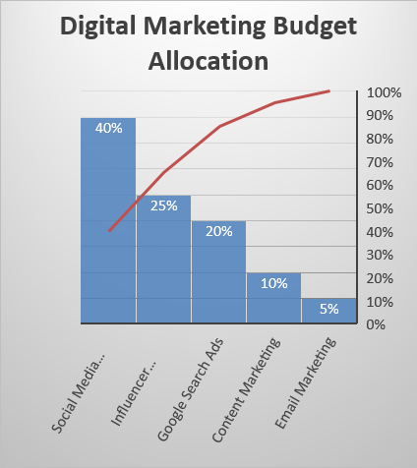
ADVERTISING STRATEGY & BUDGET
A monthly digital marketing budget of $10,000 has been allocated to ensure maximum reach and engagement. The largest portion of the budget will be dedicated to social media advertising, as these platforms offer advanced targeting options and high engagement among the target audience.
Google Search Ads will be used to capture high-intent users actively searching for energy drinks or health-related products. Influencer marketing will play a critical role in building credibility and trust, while retargeting ads will focus on converting users who have previously interacted with the brand.
Budget prioritizes social media and influencers for engagement, with search ads for high-intent users.

Slide 7
CONTENT PROMOTION & INFLUENCER MARKETING
Influencer marketing will be implemented through collaborations with micro and nano influencers in fitness, lifestyle, student, and gaming communities. These influencers will create authentic content such as product reviews, unboxing videos, daily routines, and workout integrations.
Paid promotions will be used to amplify high-performing content and reach a wider audience. Email marketing will complement the campaign by nurturing leads through newsletters, discount offers, and educational content that explains the benefits of natural energy drinks. This integrated approach ensures consistent messaging across all digital touchpoints.

Slide 8
EXPECTED OUTCOMES & PERFORMANCE METRICS
The digital marketing campaign is expected to reach over 500,000 users within the first month. Increased brand visibility, higher engagement rates, and improved website traffic are anticipated as a result of consistent content and advertising efforts.
Key performance indicators will include reach, impressions, engagement rate, click-through rate, lead generation, and sales conversions. The campaign aims for a realistic conversion rate of 3–4%, which aligns with industry benchmarks. Regular performance monitoring will allow optimization of strategies to improve results.
The campaign is expected to achieve a realistic conversion rate of 3–4%, which aligns with digital marketing benchmarks for FMCG and beverage brands. Performance tracking will help optimize future campaigns.

Slide 9

CONCLUSION
This digital marketing campaign for EnerPrime is designed to achieve sustainable growth through social media engagement, influencer credibility, and data-driven advertising strategies. By focusing on authentic content and performance tracking, the campaign ensures measurable and scalable results.
The strategy positions EnerPrime as a strong competitor in the health-focused energy drink market.

