Slide 1
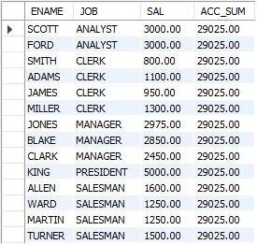
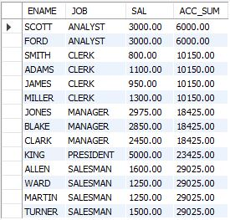
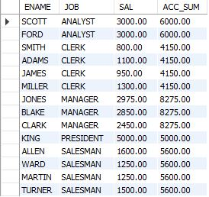
STEP 1
STEP 2
STEP 3
+
partition
+
partition
partition
+ ORDER BY JOB
+
+ PARTITION BY JOB
partition
+
partition
ASC SUM

Slide 2
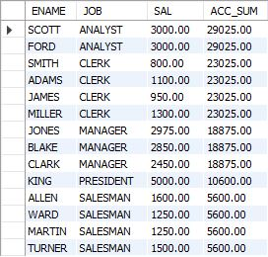
STEP 1
STEP 2
STEP 3
DESC SUM
+
partition
+
partition
+
partition
+ ORDER BY JOB
+ PARTITION BY JOB
partition
+
partition

Slide 3
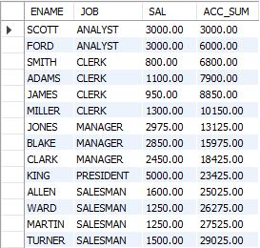
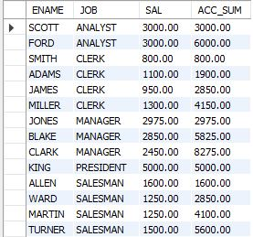
partition
(1) ASC SUM
partition
(2) ASC SUM
partition
(3) ASC SUM
+ PARTITION BY JOB
partition
(4) ASC SUM
partition
(5) ASC SUM
ASC SUM

Slide 4
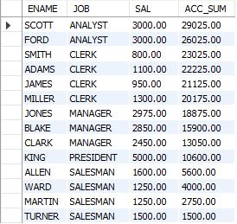
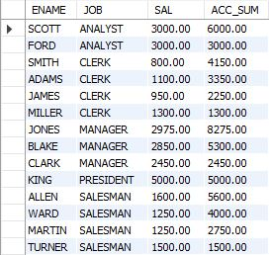
DESC SUM
partition
(1) DESC SUM
partition
(2) DESC SUM
partition
(3) DESC SUM
+ PARTITION BY JOB
partition
(4) DESC SUM
partition
(5) DESC SUM

Slide 5
SUM(value) OVER(ORDER BY value ROWS BETWEEN 1 PRECEDING AND 1 FOLLOWING ) AS acc_sum
value | acc_sum
A | A+B
B | A+B+C
C | B+C+D
D | C+D+E
E | D+E+F
F | E+F
SUM(value) OVER(ORDER BY value ROWS BETWEEN 1 PRECEDING AND 2 FOLLOWING ) AS acc_sum
value | acc_sum
A | A+B+C
B | A+B+C+D
C | B+C+D+E
D | C+D+E+F
E | D+E+F
F | E+F

Slide 6
SUM(value) OVER(ORDER BY value ROWS BETWEEN 2 PRECEDING AND 1 FOLLOWING ) AS acc_sum
value | acc_sum
A | A+B
B | A+B+C
C | A+B+C+D
D | B+C+D+E
E | C+D+E+F
F | D+E+F

