Slide 1
Chess game outcome prediction
Prepared by:
Aidar Zhumekenov
Yelaman Bexultan

Slide 2
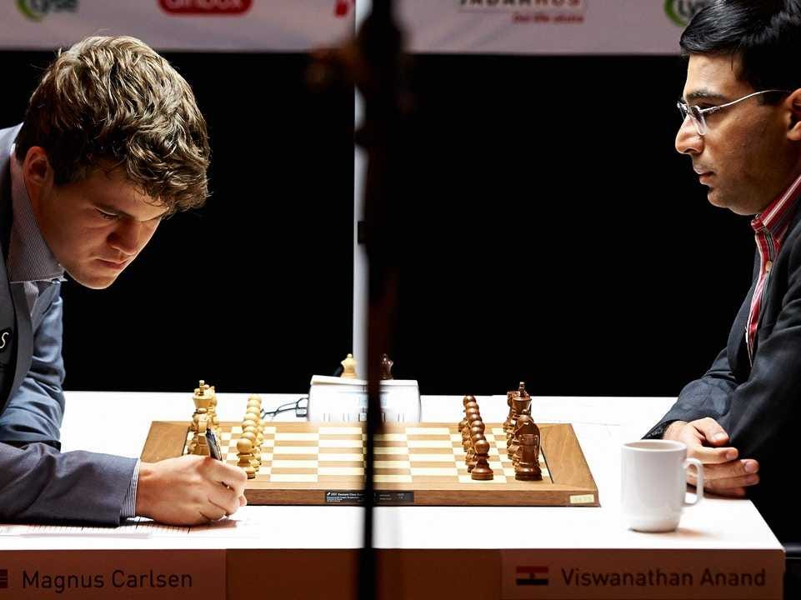
Abstract
We have a historical dataset on chess games with data for each game, meta information contained within a single chess game. We started from data preparation section, where do filtering and preprocessing on features of a dataset. Because we have 3 possible outcomes of any chess game: black, white, draw, firstly we tried to find optimal algorithm that will help us to give precise prediction on a Winner based on historical data, relationship between openings and victory for black and white, ratings and turns which affect the game.

Slide 3
Motivation and Objective
We were motivated to this project by various kinds of games and competitions, and we thought that chess is a good option for the project, in chess there are good factors and supports of statistical analysis. And our main goal is to show by example of playing chess how it is possible, thanks to Deep Learning, to make a code that can give the most accurate prediction of the game. Thus, knowing the statistics of the player's past games as well as meta-facts, you can predict future games.

Slide 4
Dataset
Source - https://www.kaggle.com/datasnaek/chess
Games – 20 000 (taken from lichess.org)
Features – 13
Useful features – Rated, Turns, Game type, Players rating, Victory status, Players ID.

Slide 5
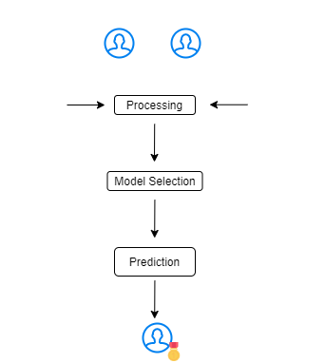
Architecture

Slide 6
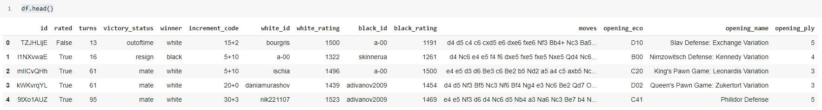
Processing
Initial dataset: features are not supervised, non-numerical features.
We need to do some preprocessing on data such as Correlation Matrix to see correlation between columns,
LabelEncoder to convert strings into numerical and select column features that will be feeded into train/test.

Slide 7
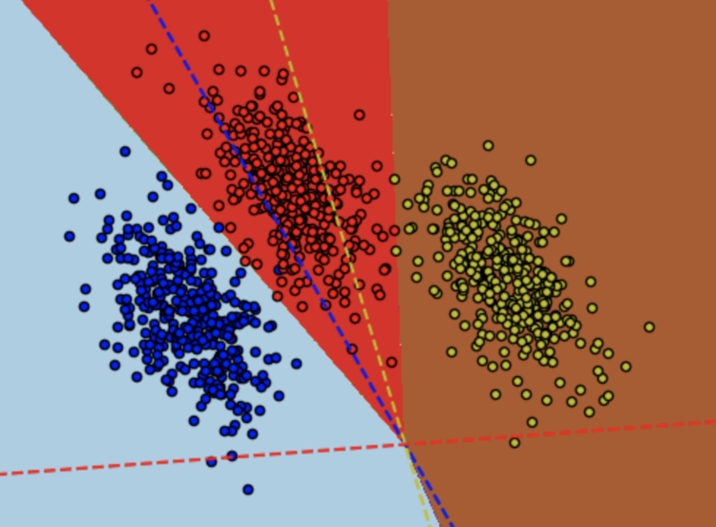
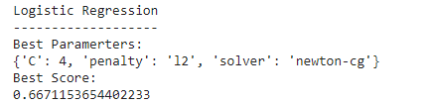
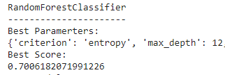
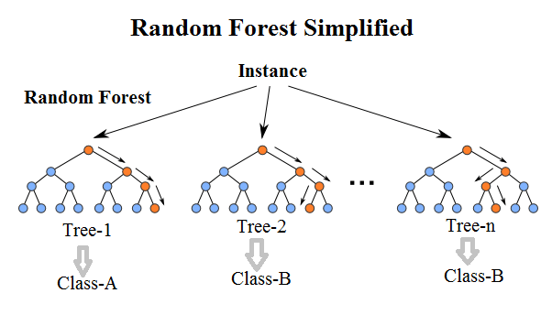
Model Selection
In this part, we compare four different algorithms, played with multiple combinations of hyperparameters to find best accuracy rate.
Logistic Regression - Logistic regression (multinomial) is used to explain the relationship between different type variables and
outcomes multinomial variable (in your case).
XGBoost - stands for eXtreme Gradient Boosting. Gradient boosting is well known for good performance.
Random Forrest - It is one of the most used algorithms, because of its simplicity and diversity.
LR
RF
XGB

Slide 8
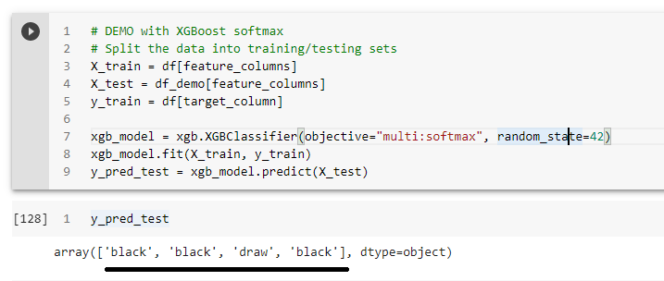
Demo
We took randomly 4 new games from lichess.org for 2 different players (jamboger, sassou), putted into games demo.scv.
https://lichess.org/MVxE7oz4 - winner ‘white’
https://lichess.org/Pl7THFmZ#1 - winner ‘black’
https://lichess.org/P0FNoKsw - ‘draw’
https://lichess.org/B1NDIRMH - winner ‘black’
Our algorithm was XGBoost (multi:softmax) due to best accuracy rate ~ 78%
The result : Black, Black, Draw, Black (3 out 4).

Slide 9
Questions?

Slide 10

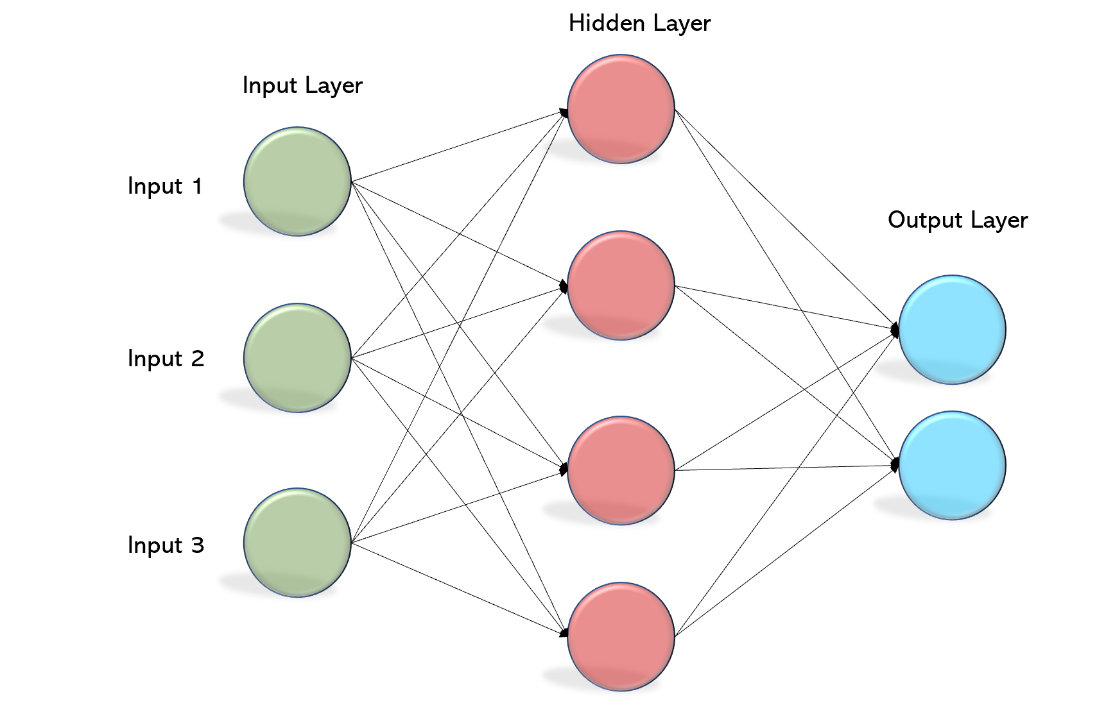

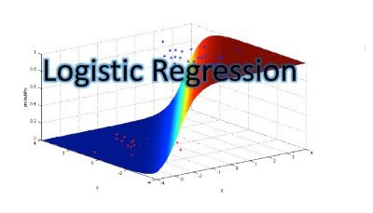
research and algorithms
We have done research and compared different algorithms like MLP, Logistic regression, XGBoost, Random Forrest, etc. and came up with the best algorithm that can give the best match prediction.

Slide 11
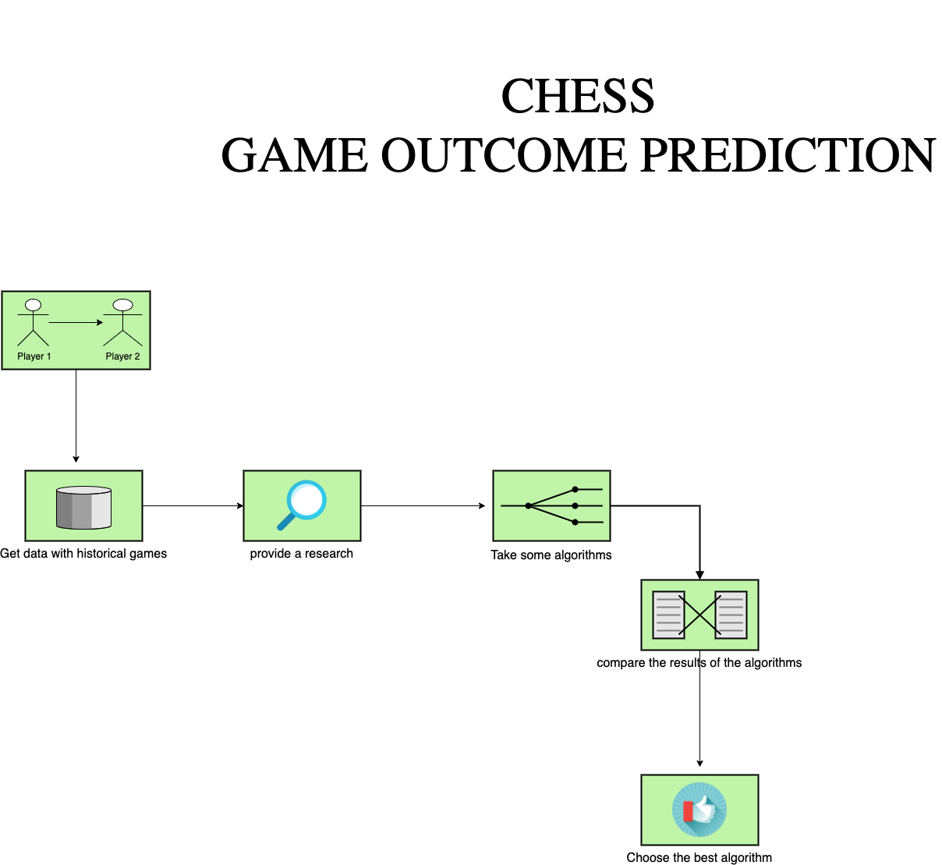
Architecture

