Slide 1
Prediction of worldwide solar energy resources based on the NASA’s meteorological data using AI and deep learning modeling techniques
Yasser El Hari

Slide 2
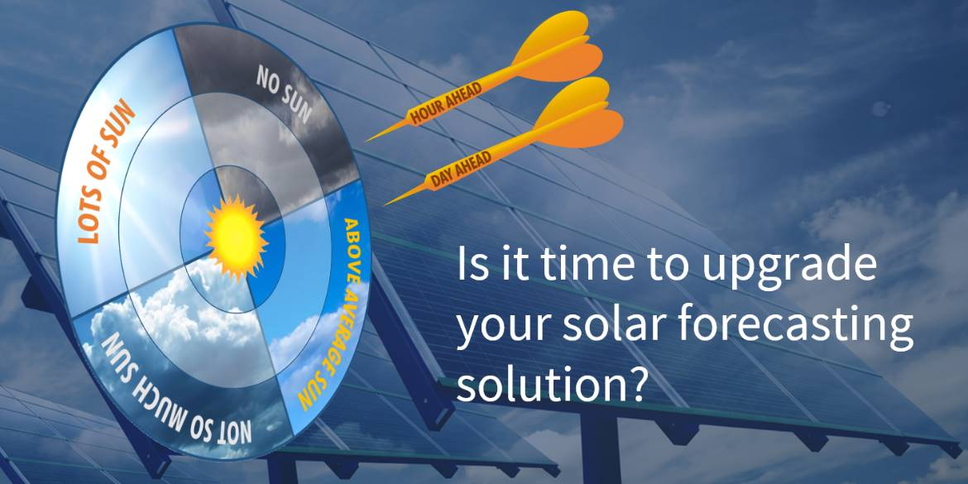
Business Context

Slide 3
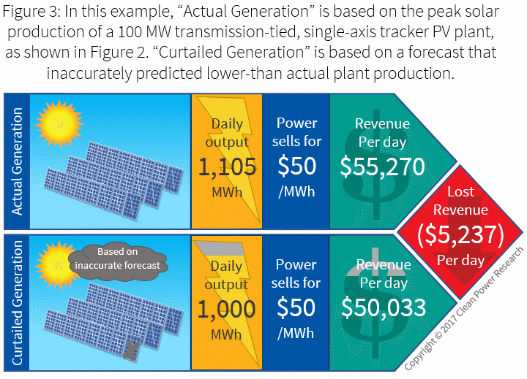
II. Problematic

Slide 4
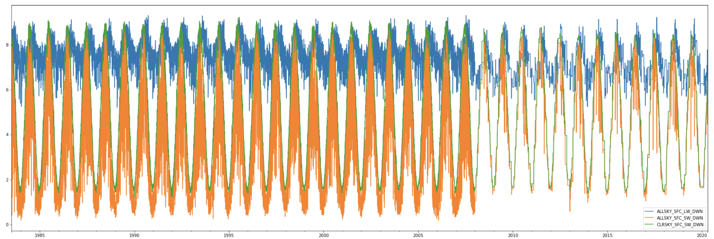
III. Data visualisation

Slide 5
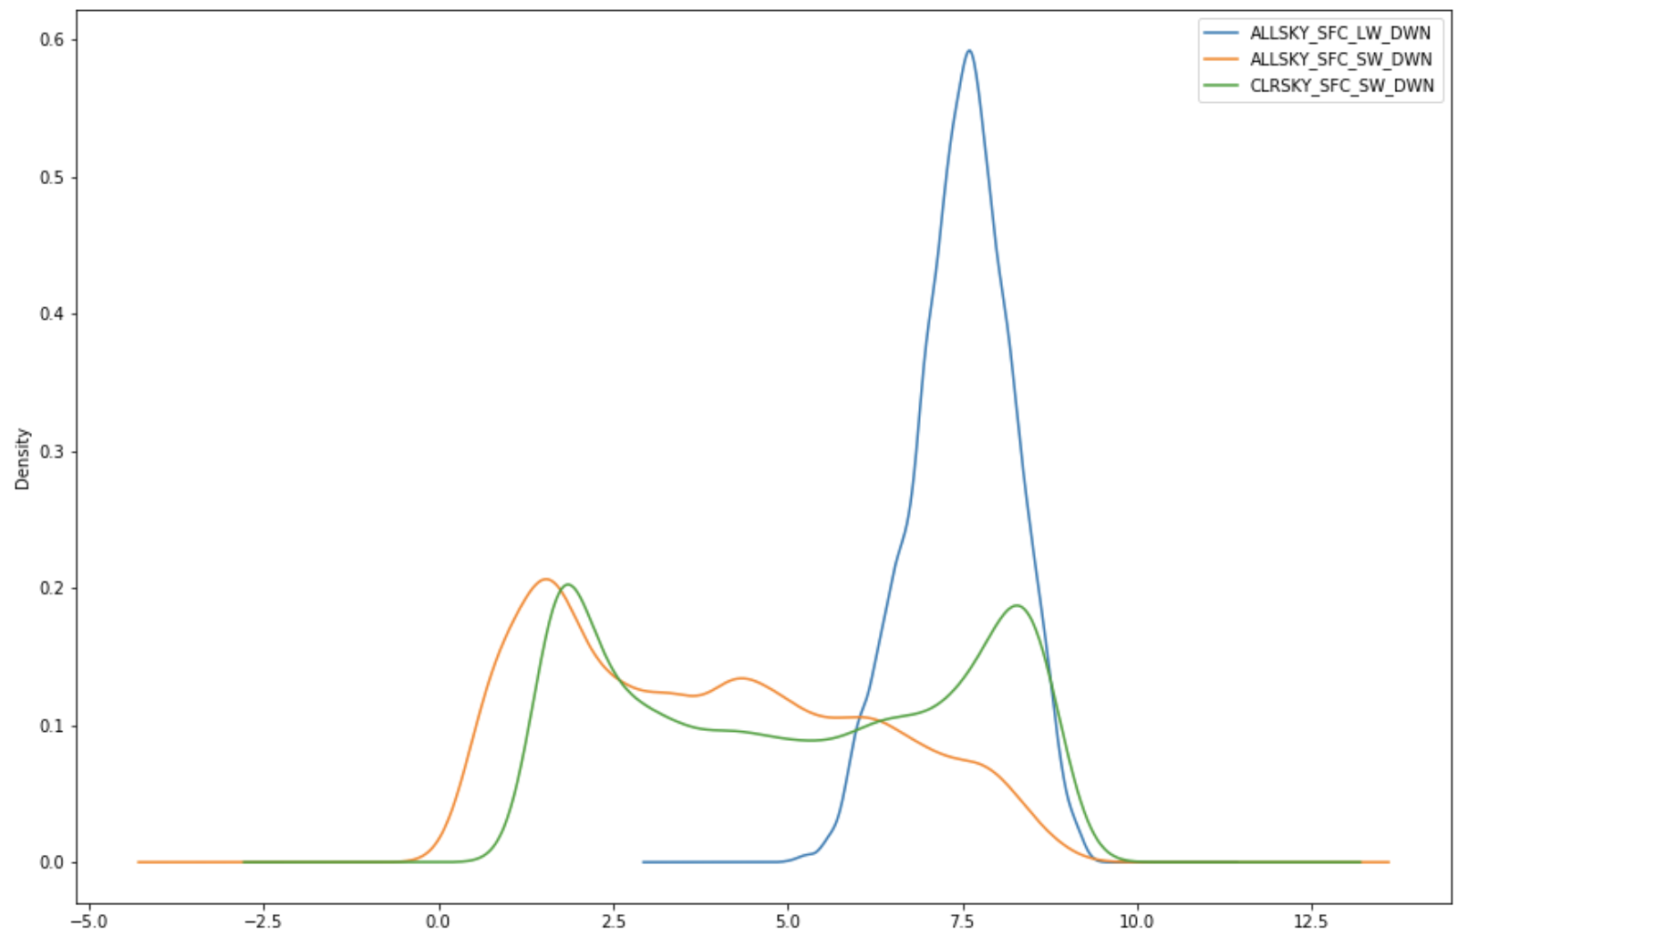
IV. Data distribution

Slide 6
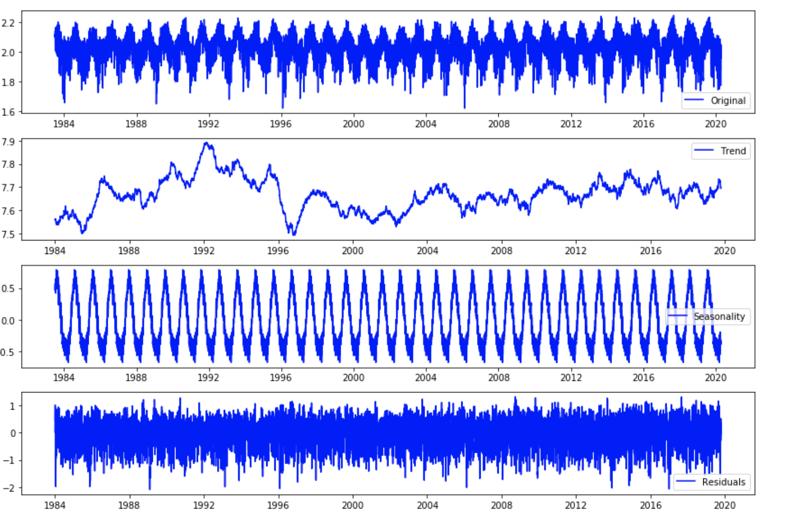
V. Times series decomposition

Slide 7
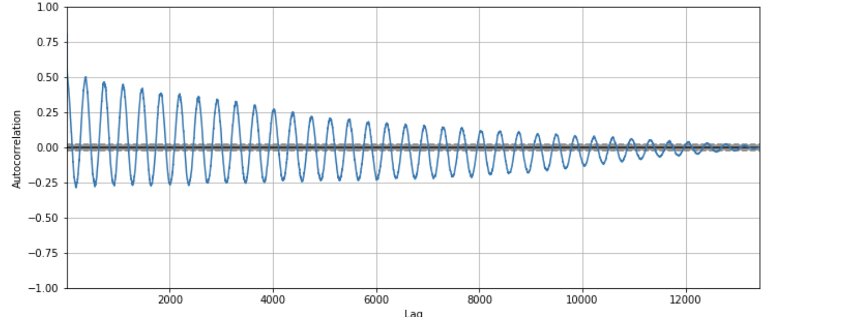
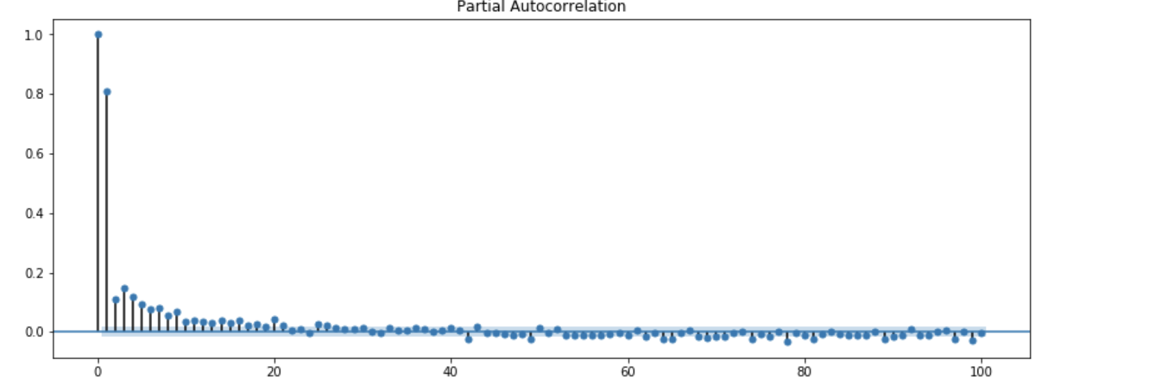
VI. ACP and PACP

Slide 8
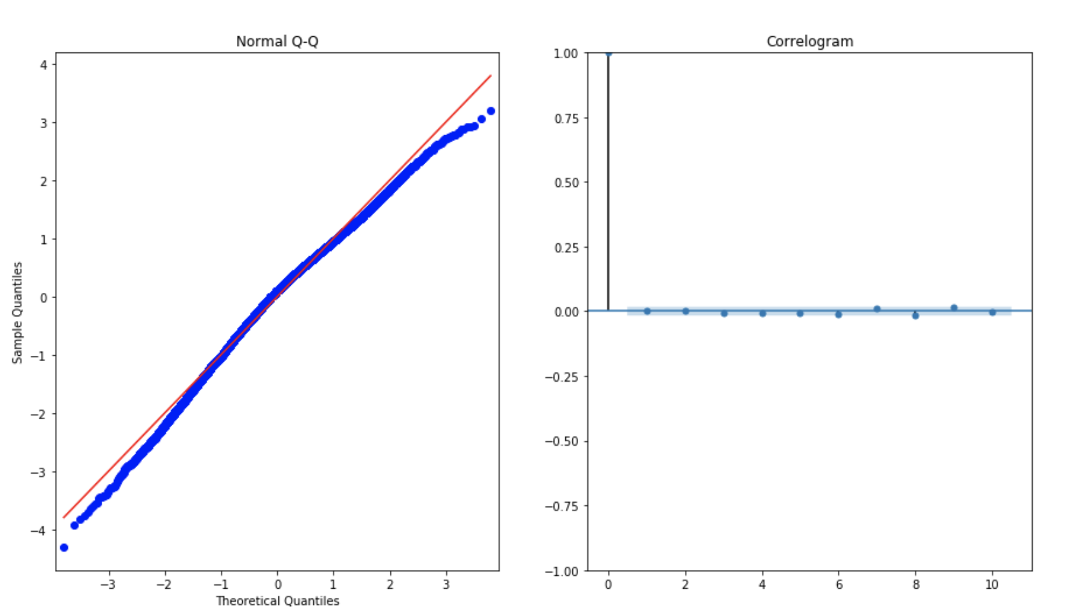
VII.ARIMA(1, 1, 1)x(0,0,1, 12) (yield to the lowest AIC) model

Slide 9
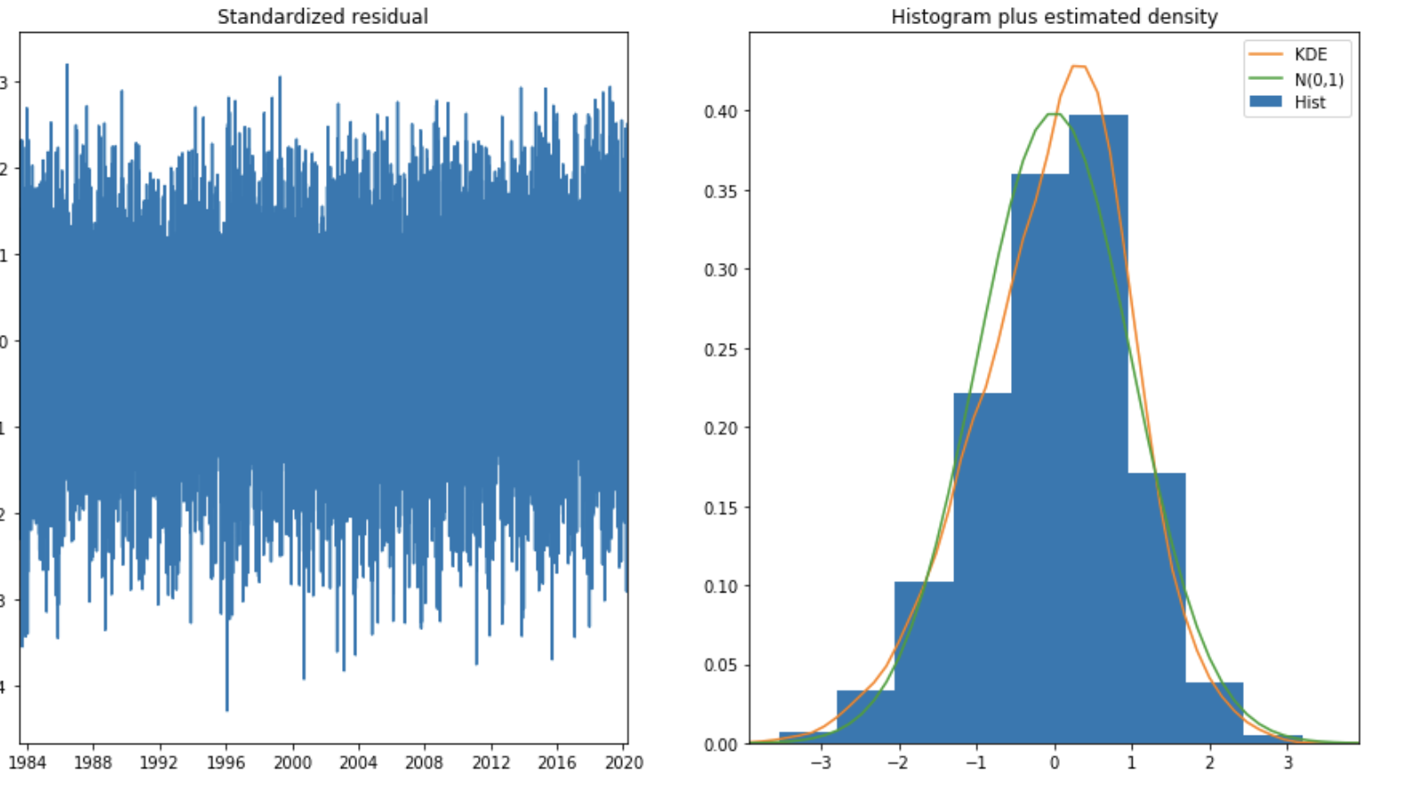
VIII Validating the model

Slide 10
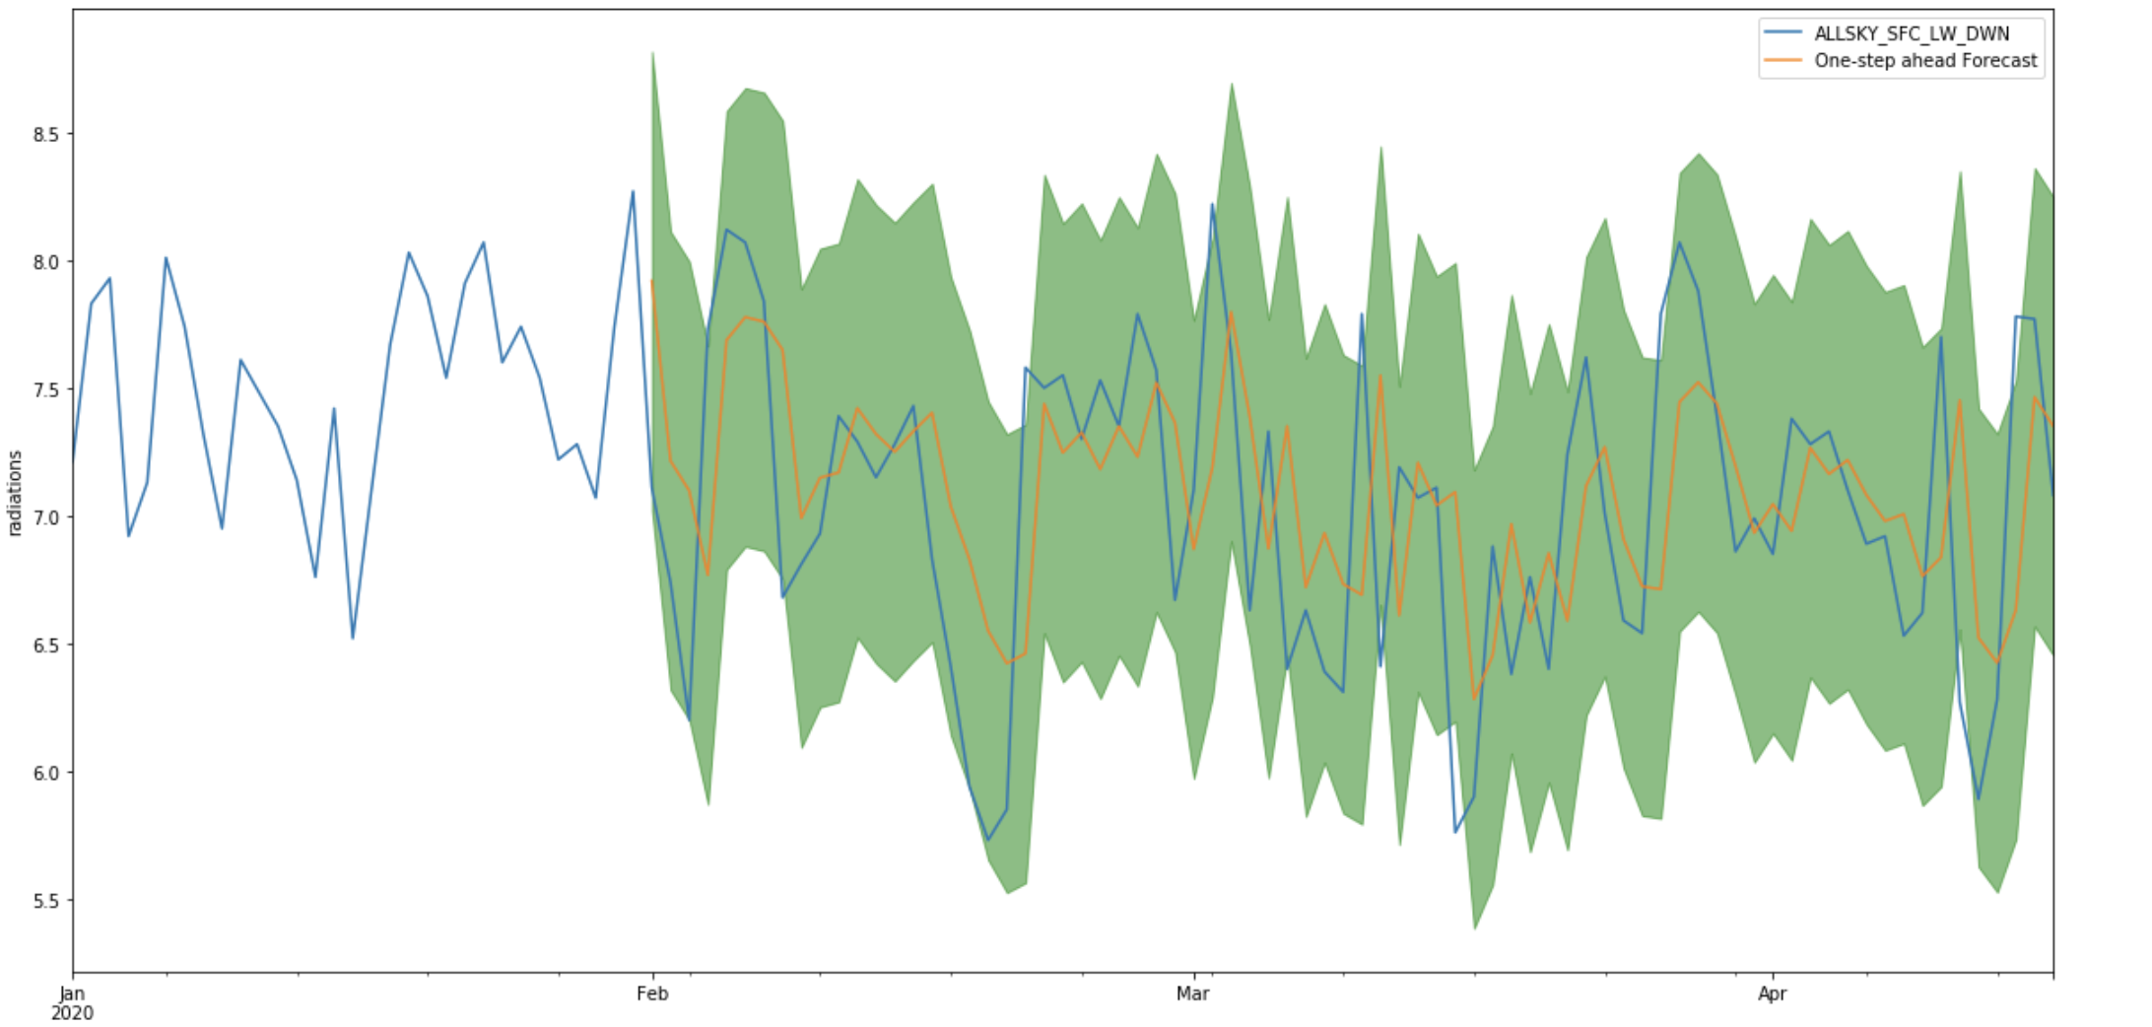
IX. Visualization of model

Slide 11
Thank you!

