Slide 1
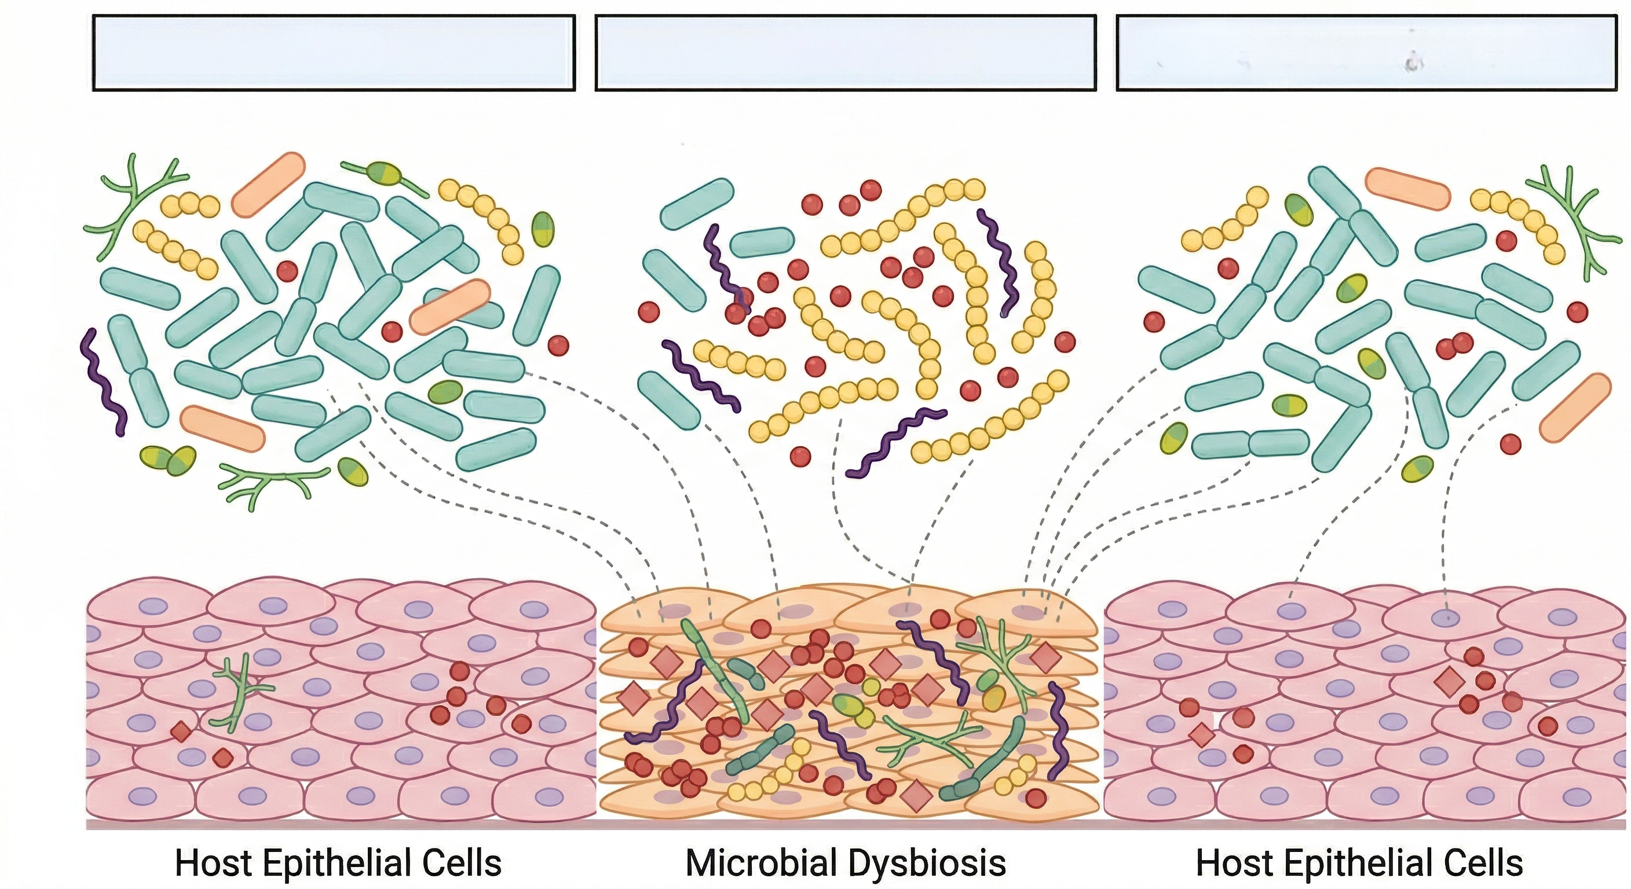
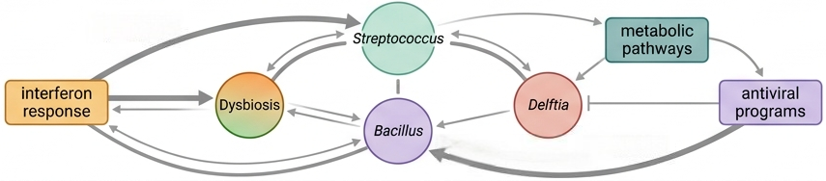
WT
db/db
Semaglutide treated
Oral
Microbiota
Oral
Mucosa
Host-microbe
interactions

