Slide 1


KitVerse
Football Jersey Shopping Website
Notes:
Source: KitVerse project files and supplied screenshots.

Slide 2
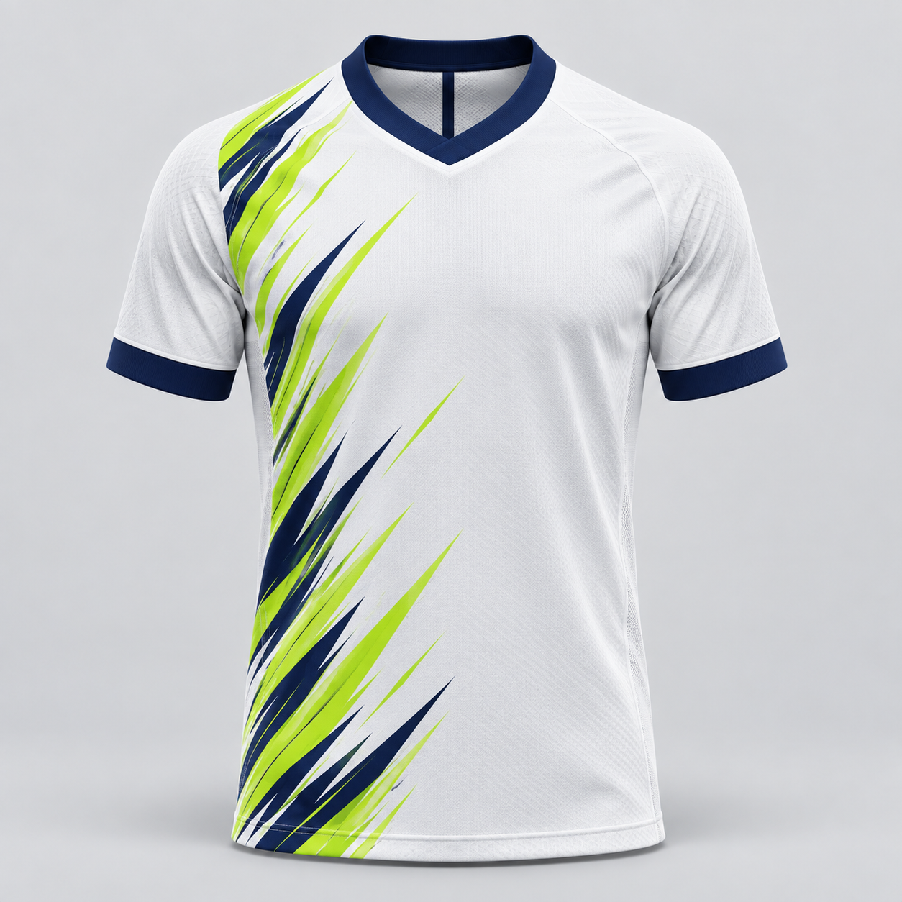
KITVERSE
Project Overview
•
Online shop for football jerseys
•
Customers browse kits by club and type
•
Sizes and prices appear on each product
•
Admin manages products and orders
02
Notes:
Source: README.md and index.php.

Slide 3
KITVERSE
Technologies Used
•
HTML builds the page content
•
CSS controls the layout and colors
•
JavaScript handles page interactions
•
PHP and MySQL run the store
•
XAMPP runs the project locally
03
Notes:
Source: README.md, PHP files, assets/*.css, assets/*.js and database/schema.sql.

Slide 4
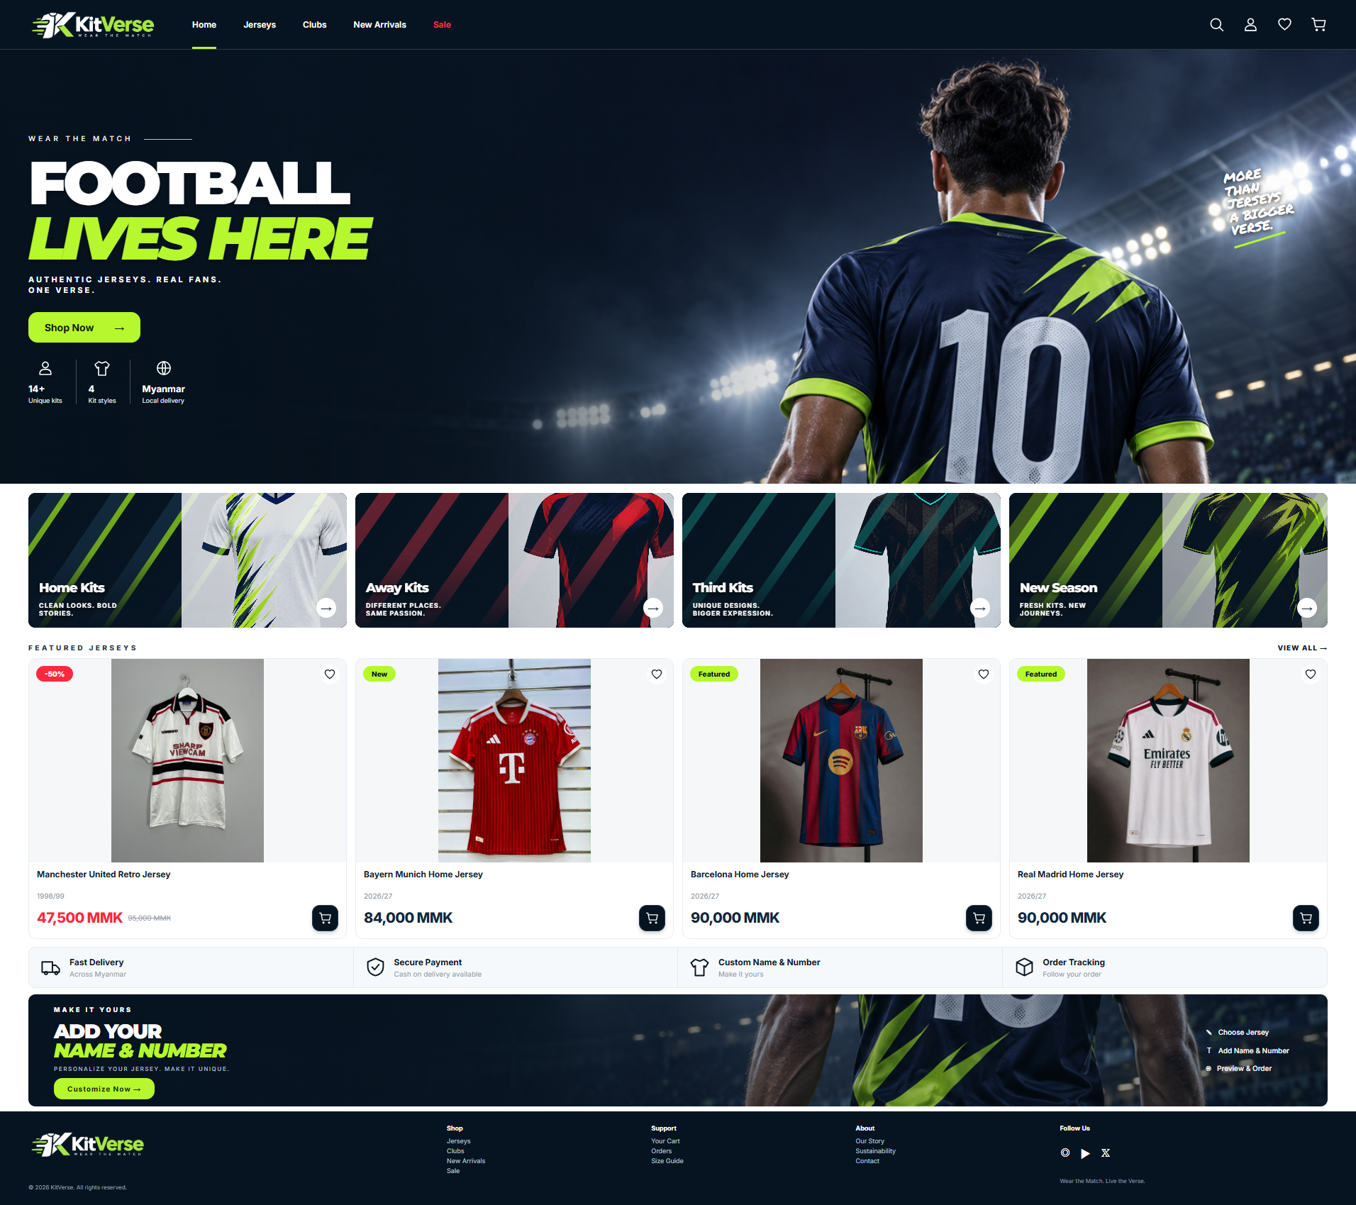
KITVERSE
Website Menus
•
Home, Jerseys and Clubs
•
New Arrivals and Sale
•
Search and Wishlist
•
Account and Cart
04
Notes:
Source: supplied home screenshot and parts/shell-start.php.

Slide 5
KITVERSE
Home Page
•
Featured jerseys on the main page
•
Home, Away and Third kit sections
•
Latest products and sale labels
•
Quick links to the shop
05
Notes:
Source: supplied home screenshot and parts/home.php.

Slide 6
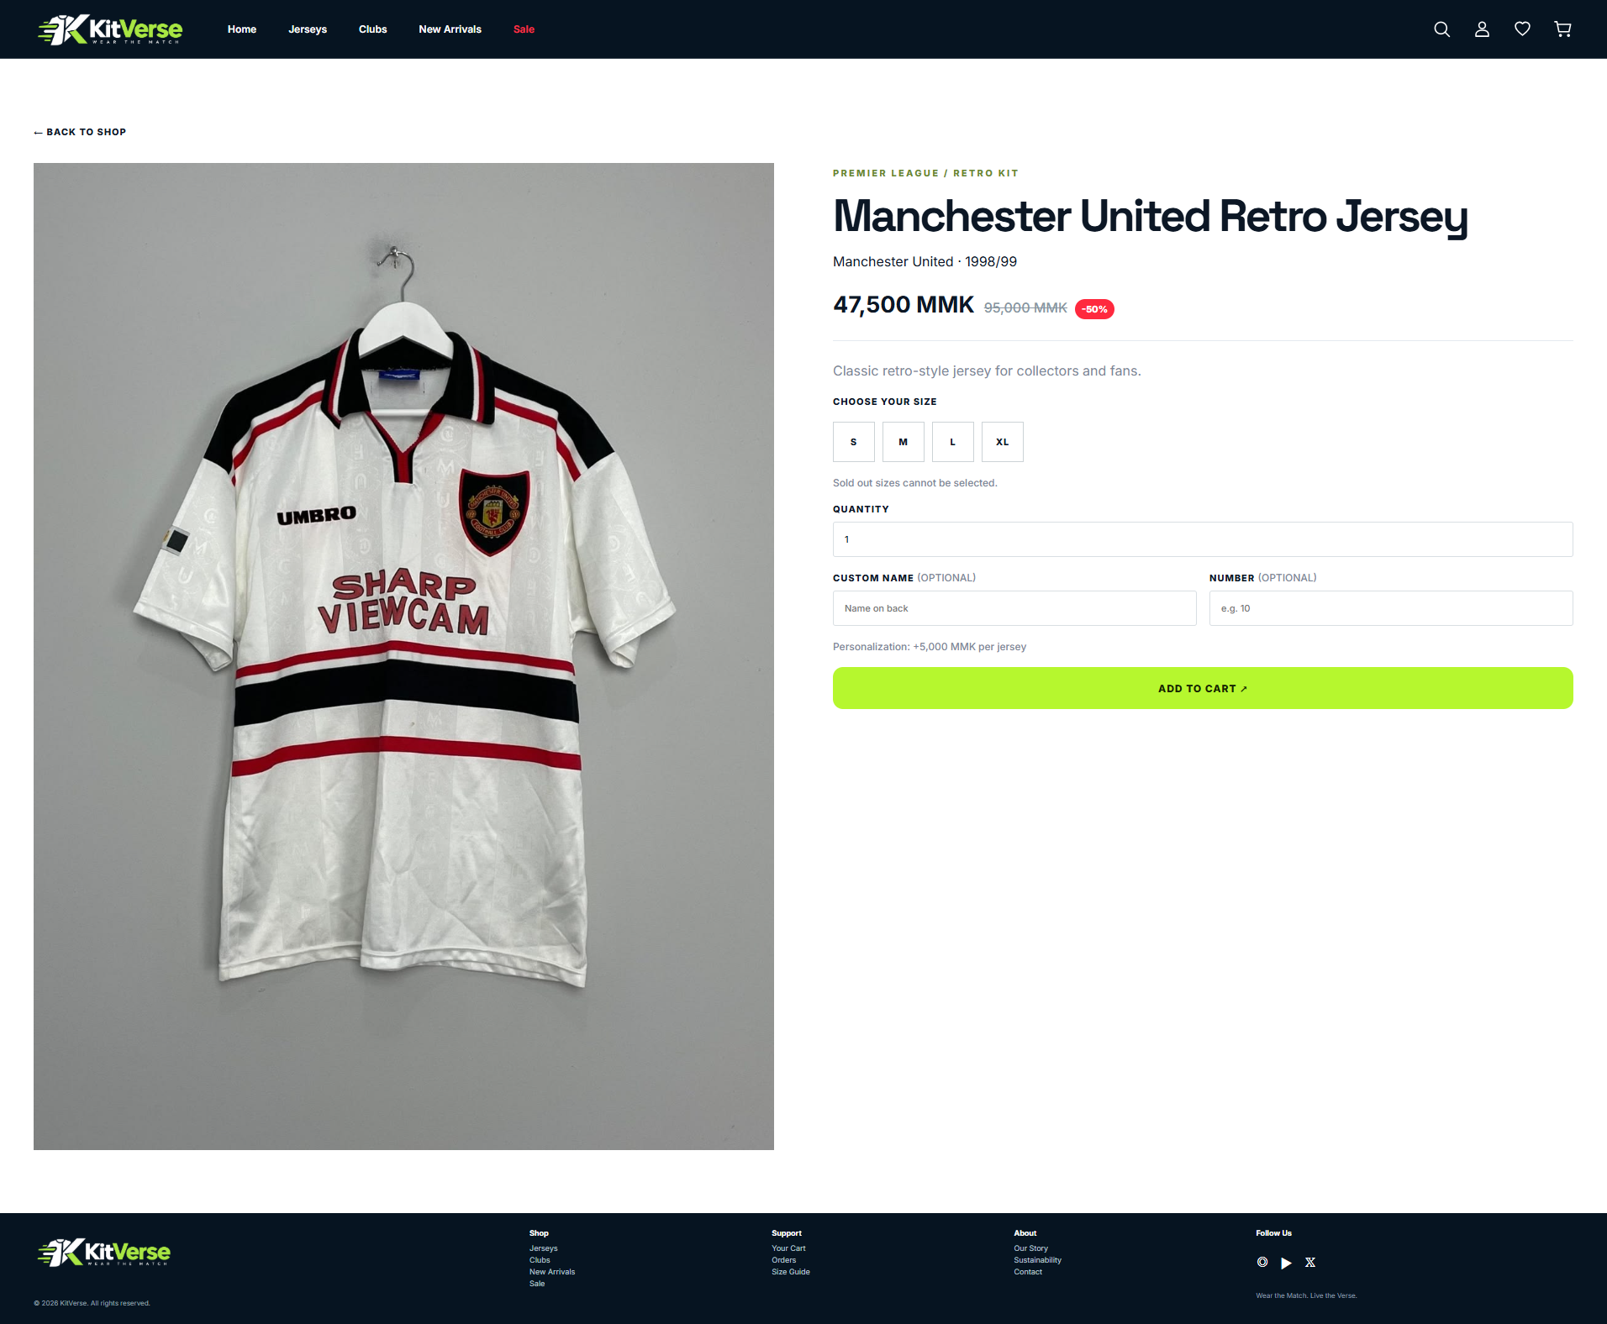
KITVERSE
Product Details
•
Jersey photo and product details
•
Price and discount are shown
•
Choose an available size and quantity
•
Add a custom name or number
06
Notes:
Source: supplied product screenshot and index.php product page.

Slide 7
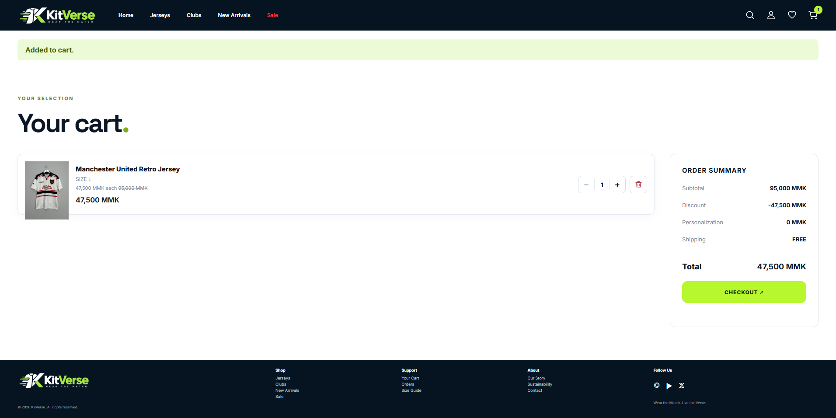
KITVERSE
Cart and Checkout
•
Add jerseys to the cart
•
Change quantity or remove items
•
View discount and order total
•
Enter details at checkout
07
Notes:
Source: supplied cart screenshot, parts/cart.php and parts/checkout.php.

Slide 8
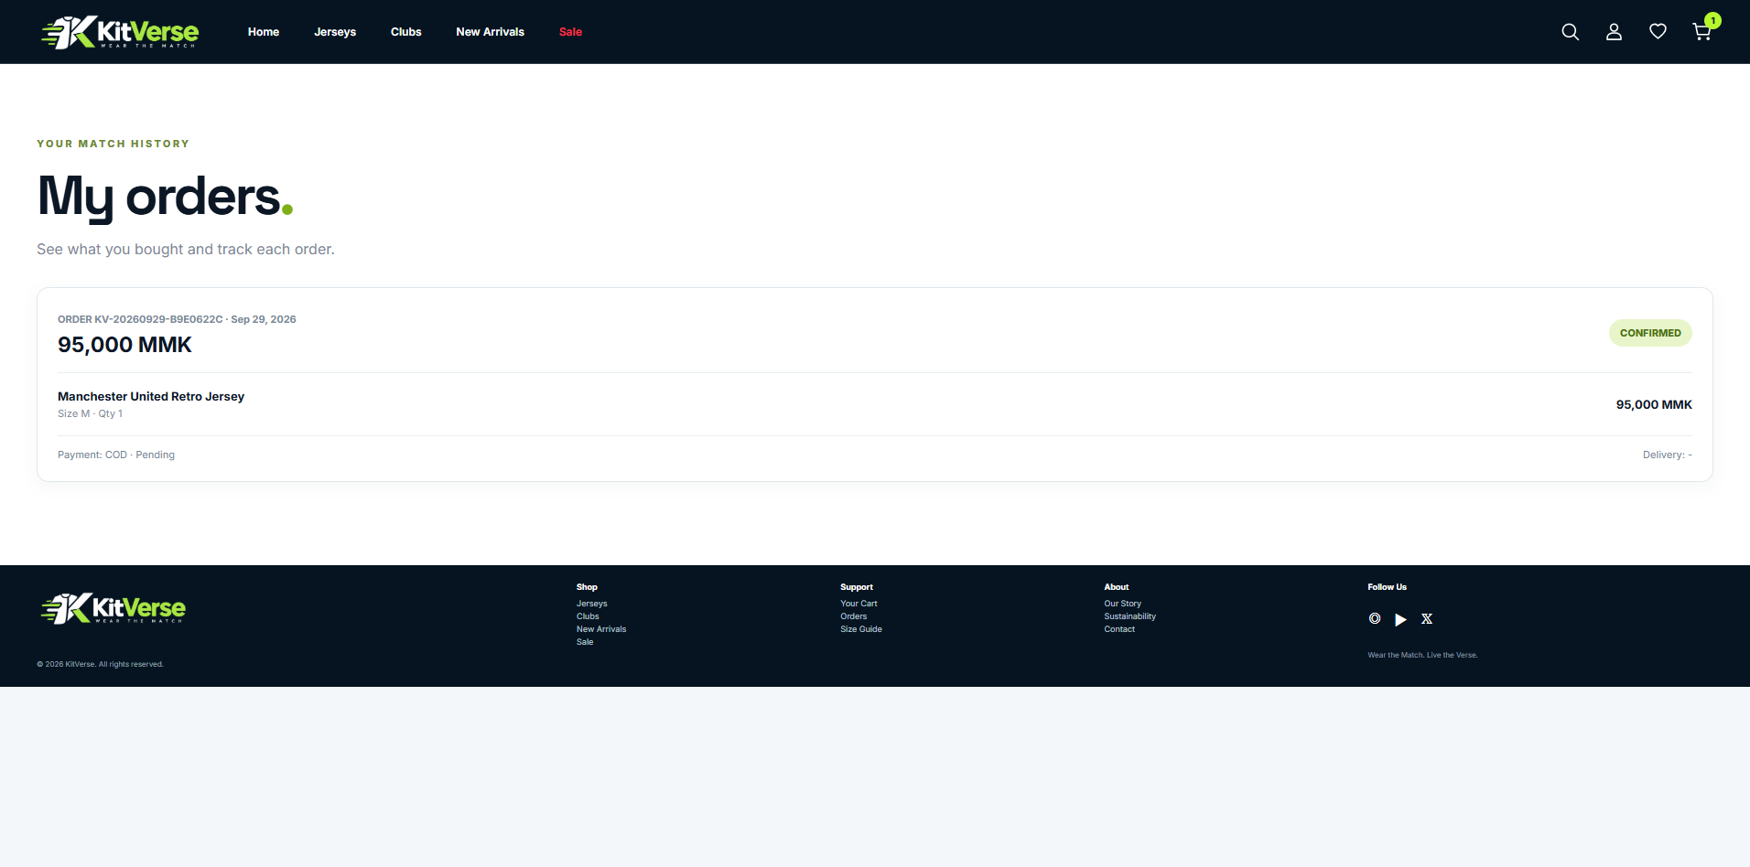
KITVERSE
Customer Account and Orders
•
Create a customer account
•
Sign in with email and password
•
View past orders
•
Check order status and payment
08
Notes:
Source: supplied orders screenshot, parts/customer-orders.php and index.php.

Slide 9
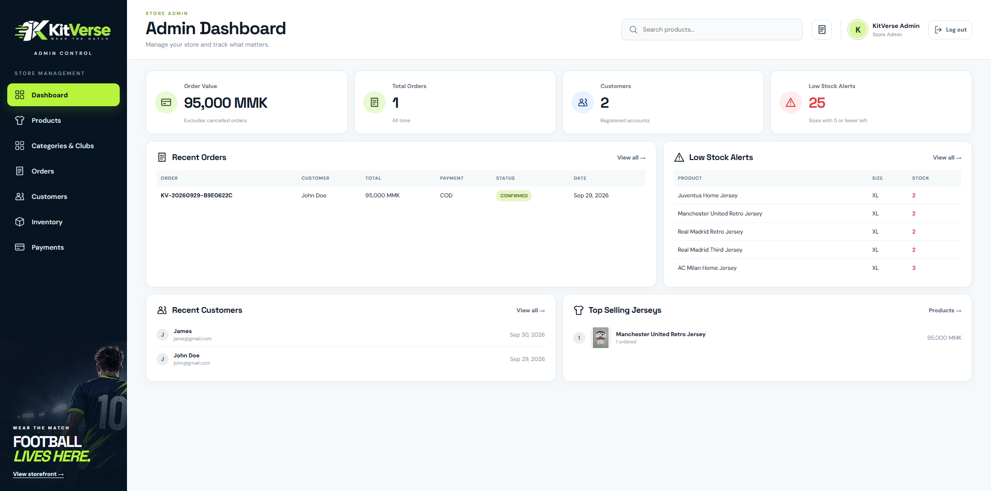
KITVERSE
Admin Dashboard
•
See total orders and order value
•
View recent orders and customers
•
See popular jerseys
•
Check low stock alerts
09
Notes:
Source: supplied admin dashboard screenshot and parts/admin-overview.php.

Slide 10
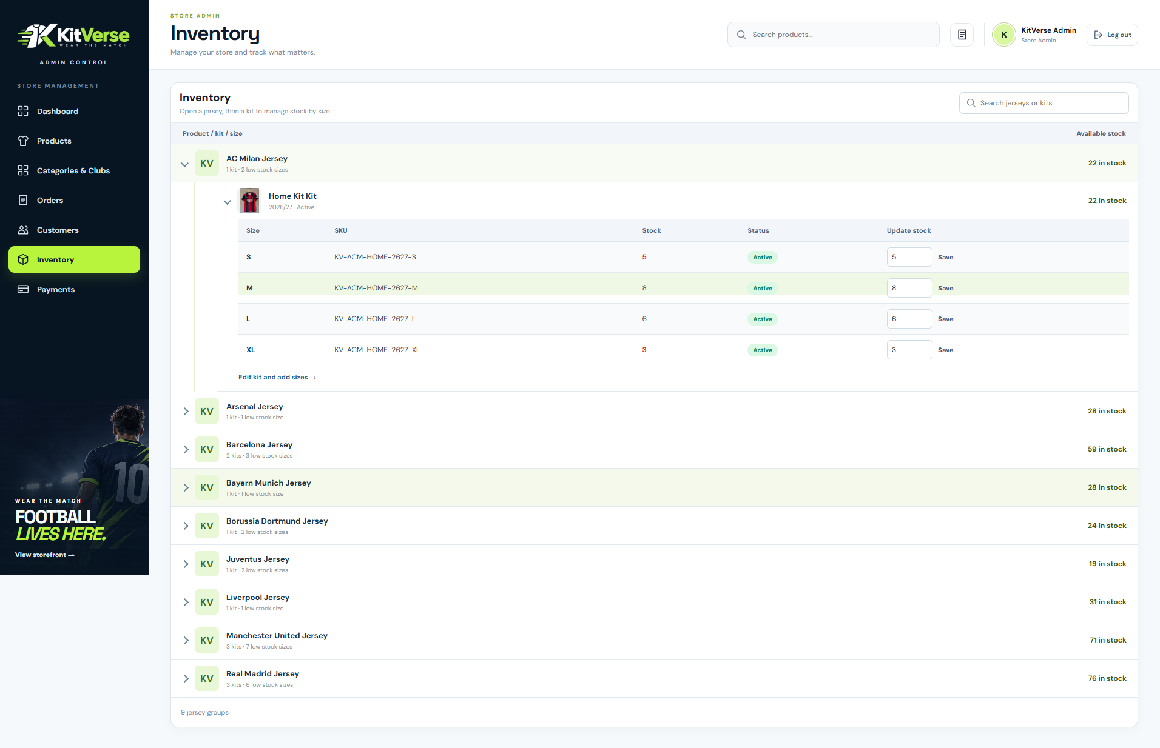
KITVERSE
Product and Stock Management
•
Add or edit products
•
Set prices and discounts
•
Upload product images
•
Update stock for each size
10
Notes:
Source: supplied inventory screenshot, parts/admin-products.php and parts/admin-inventory.php.

Slide 11
KITVERSE
Security and Summary
•
Passwords are stored with hashing
•
Admin pages need an admin account
•
Forms use security tokens
•
KitVerse supports customers and store staff
11
Notes:
Source: index.php password_hash, password_verify, is_admin, token and prepared database queries.

