Slide 1
COMPUTER NETWORKS (24CS2202) NETWORK ATTACK DETECTION USING KALI LINUX
2420030319– S. CHERISMA
2420030450- Y. SAI RAJ
Under the Esteemed Guidance of
Mr. SHAIK ASIF

Slide 2
Contents
Abstract
Introduction
Problem Statement and Objectives
Hardware and Software requirements
Results
Conclusion
Future Scope

Slide 3
Abstract
Network security plays a vital role in protecting computer systems from unauthorized access and malicious activities. This project presents a real-time network attack detection system using Kali Linux and Snort within a virtual machine environment. Kali Linux is used to generate ICMP ping-based attack traffic, while Ubuntu continuously monitors network packets through Snort. Upon detecting suspicious activity, the system generates instant console alerts along with graphical popup notifications using Zenity, enabling quick awareness and response. The implementation demonstrates an effective and practical approach to monitoring network traffic and identifying potential attacks in a controlled laboratory setup.

Slide 4
Introduction
With the rapid growth of computer networks and internet-based communication, systems have become increasingly vulnerable to various network attacks such as unauthorized access, scanning, and denial-of-service attempts. Detecting these attacks in real time is essential to maintain data confidentiality, integrity, and availability. Researchers have developed Intrusion Detection Systems (IDS) to monitor network traffic and identify suspicious activities using signature-based and anomaly-based techniques. In this project, a practical network attack detection approach is implemented using Kali Linux to simulate ICMP ping attacks and Ubuntu with Snort to monitor and analyze network packets. When malicious activity is detected, the system generates immediate console alerts along with graphical popup notifications using Zenity, providing a simple yet effective solution for real-time network security monitoring in a virtual laboratory environment.

Slide 5
Problem Statement and Objectives
Modern computer networks face continuous threats from unauthorized access, network scanning, and denial-of-service attacks, which can compromise sensitive data and system availability. Many small-scale environments lack affordable and real-time monitoring solutions to quickly detect such malicious activities. The main problem addressed in this project is how to identify network attacks instantly and alert the user in a simple and efficient manner within a virtual network setup.
The objective of this project is to design and implement a real-time network attack detection system using Kali Linux for attack simulation and Ubuntu with Snort for traffic monitoring and analysis. The system aims to detect ICMP ping-based attacks, generate console alerts, and display graphical popup notifications using Zenity. Ultimately, the project demonstrates a low-cost, practical approach to improving network security awareness and response in small or educational environments.

Slide 6
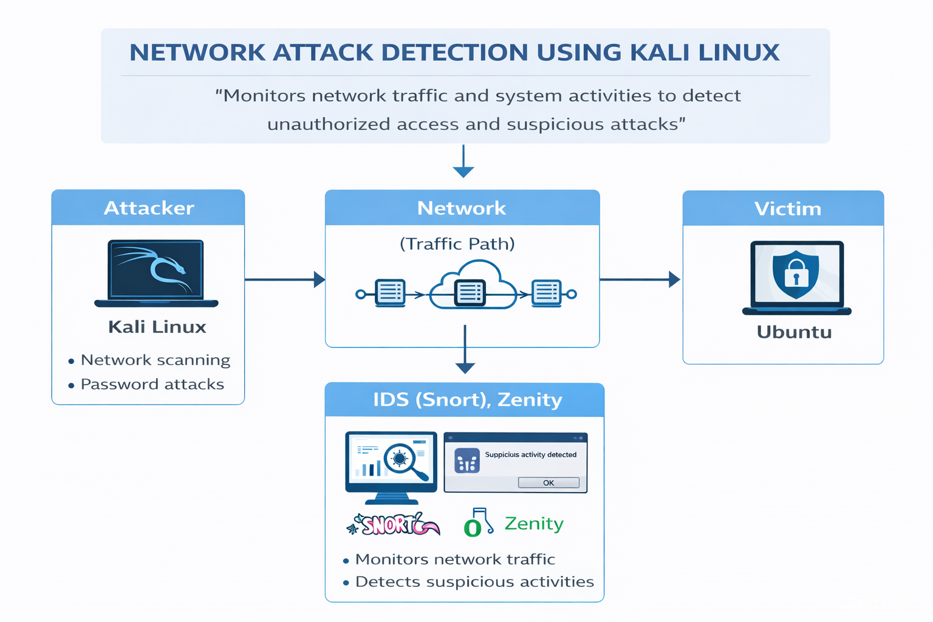
Flow Chart

Slide 7
Hardware and Software requirements
Hardware Requirements:
Laptop/Desktop with minimum 8 GB RAM and sufficient storage.
Software Requirements:
VirtualBox for virtualization.
Ubuntu Linux for monitoring and detection.
Kali Linux for generating attack traffic.
Snort for packet analysis and attack detection.
Zenity for graphical alert popups.

Slide 8
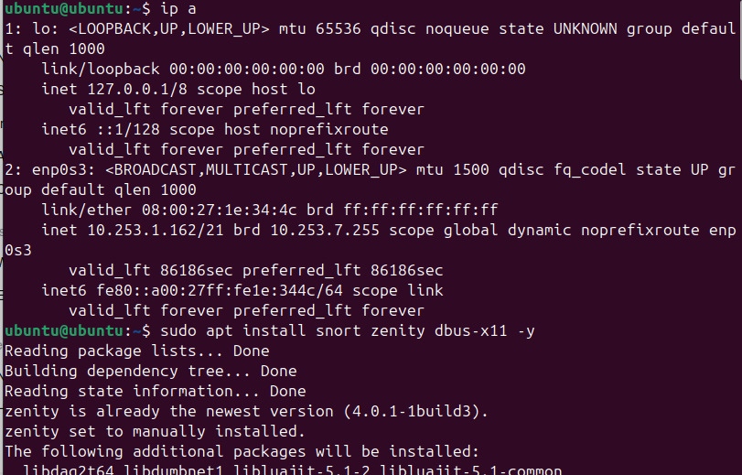
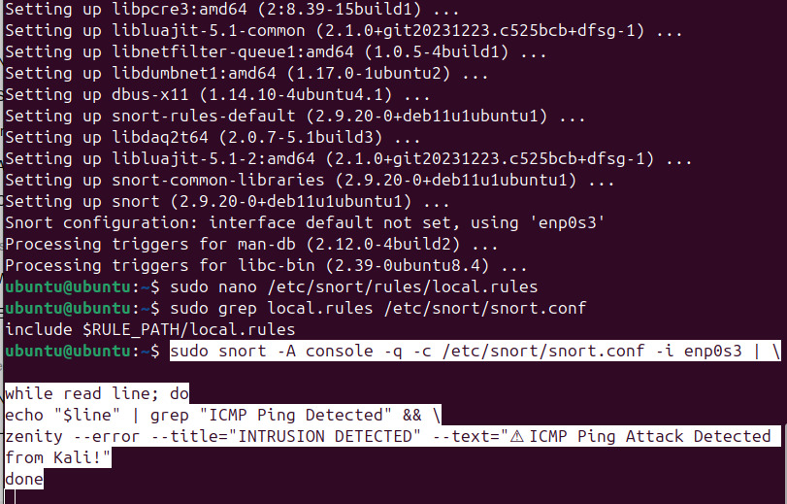
Results

Slide 9
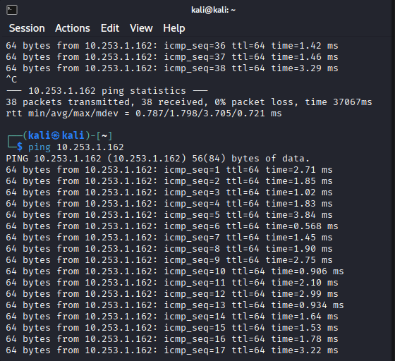
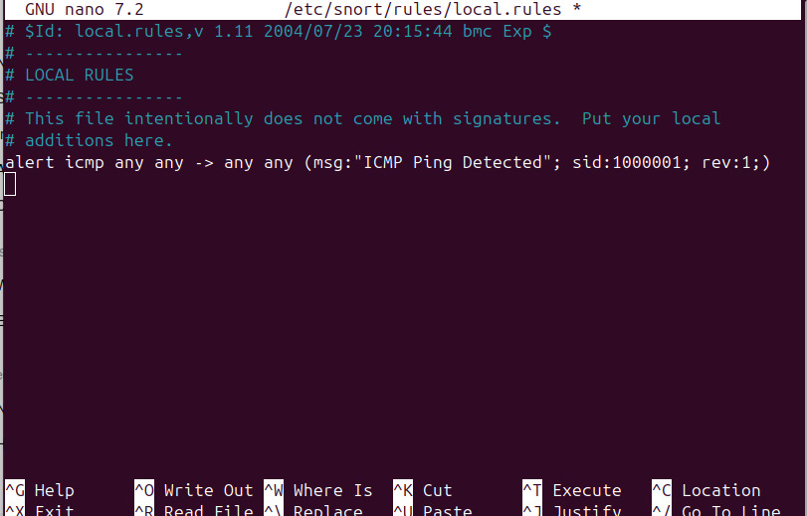
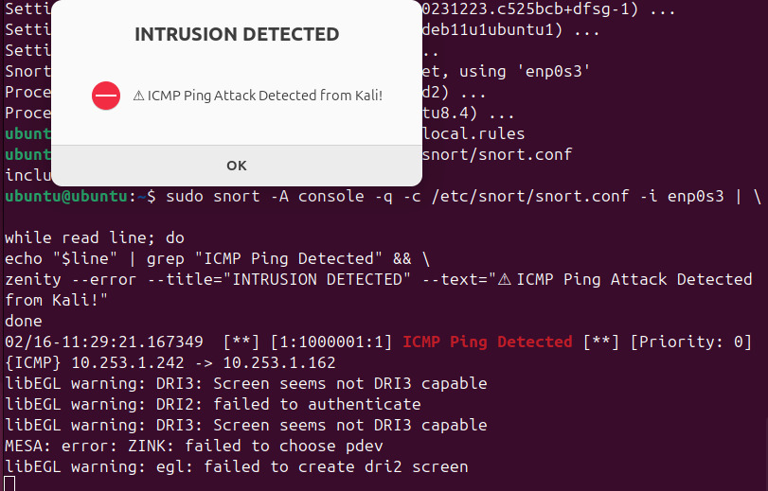

Slide 10
Conclusion
The project demonstrates successful network attack detection using Kali Linux and Snort.
Real-time monitoring and instant alert generation were achieved.
Highlights the importance of continuous network monitoring for security.
Popup notifications improve user awareness and response capability.
Provides a base for advanced cybersecurity projects and research.

Slide 11
Future Scope
Detect additional attacks such as port scanning, DoS, and brute-force attempts.
Enable automatic blocking using firewall integration.
Store alerts in a database or centralized logging system.
Create a web dashboard for live monitoring and reporting.
Expand the system for large-scale organizational network protection.

Slide 12
Thank you

