Slide 1

第九組-第3題

Slide 2
題目
Suppose that a weighted, directed graph G = (V, E) has a negative-weight cycle. Give an efficient algorithm to list the vertices of one such cycle. Prove that your algorithm is correct.

Slide 3

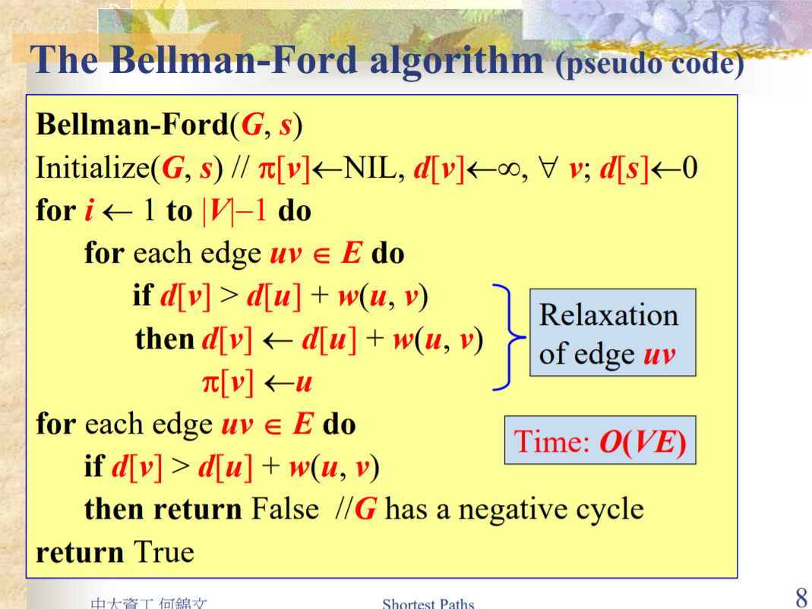

Slide 4
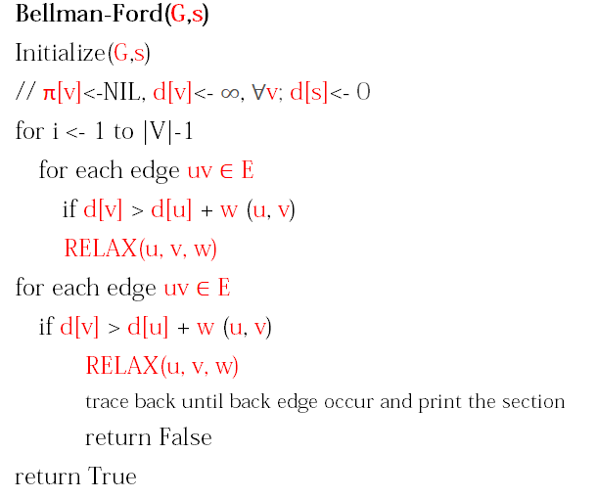
有迴圈
或者可以用dfs但是要計算走的那條路全部weight加起來是不是負的
有負迴圈

Slide 5
THANKS

