Slide 1
HW10-4
第十組

Slide 2
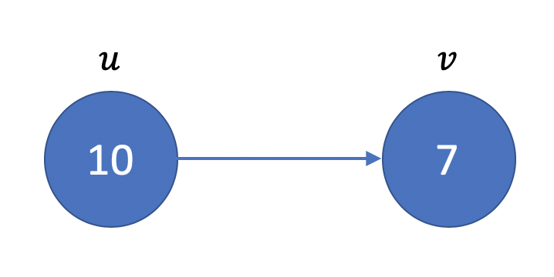
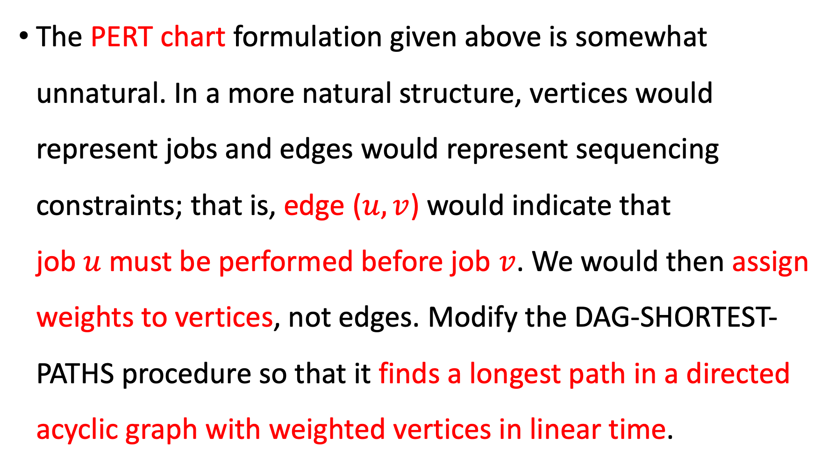
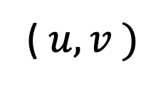
The PERT chart formulation given above is somewhat unnatural. In a more natural structure, vertices would represent jobs and edges would represent sequencing constraints; that is, edge ($u, v$) would indicate that job $u$ must be performed before job $v$. We would then assign weights to vertices, not edges. Modify the DAG-SHORTEST-PATHS procedure so that it finds a longest path in a directed acyclic graph with weighted vertices in linear time.
( $u, v )$

Slide 3







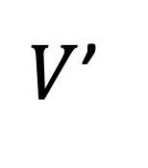

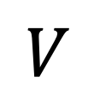
Transform vertices
$$u$$
$$v$$
$$V$$
10
7
$$u$$
$$v$$
$$u′$$
$$u′′$$
$$v′$$
$$v′′$$
$V$’
Notes:
對於每個點的進入處跟離開處成立新的點

Slide 4


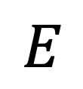

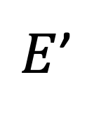

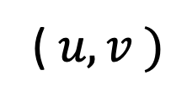



$$E$$
10
( $u, v )$
7
$$u′$$
$$u′′$$
$$v′$$
$$v′′$$
$E$’
$$\left( u^{′}, u^{′′} \right)=w_{u}$$
$$\left( u^{′′}, v^{′}\right)=0$$
$$\left( v^{′}, v^{′′} \right)=w_{v}$$

Slide 5
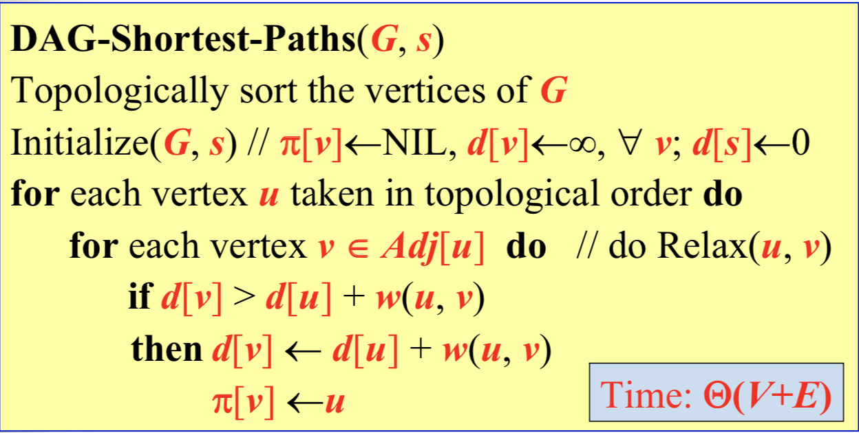

Slide 6
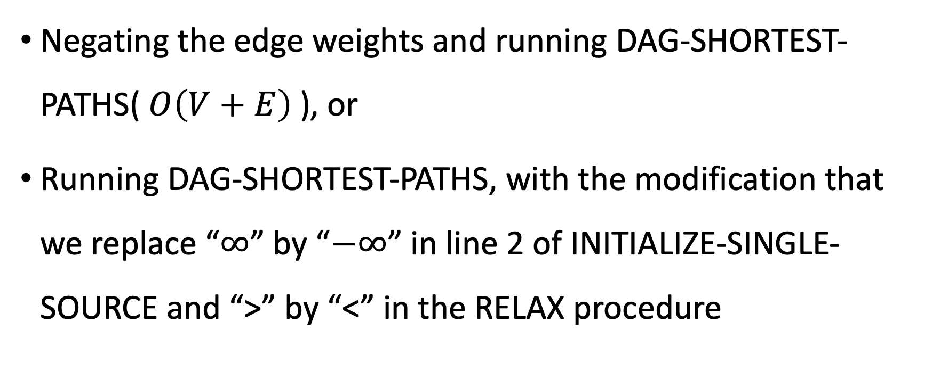
We can find a critical path by either
Negating the edge weights and running DAG-SHORTEST-PATHS( $O\left(V+E\right)$), or
Running DAG-SHORTEST-PATHS, with the modification that we replace “$∞$” by “$−∞$” in line 2 of INITIALIZE-SINGLE-SOURCE and “>” by “<” in the RELAX procedure

