Slide 1
HW10第5題
第一組

Slide 2
題目
Run Dijkstra's algorithm on the directed graph of Figure 24.2, first using vertex s as the source and then using vertex z as the source.
In the style of Figure 24.6 (you can check the textbook P.659 or slide Unit 9 P.19-20), show the d and π values and the vertices in set S after each iteration of the while loop.

Slide 3
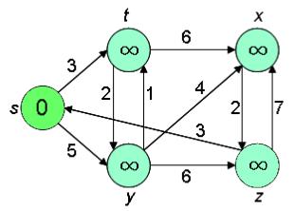
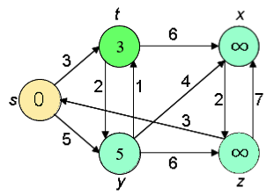
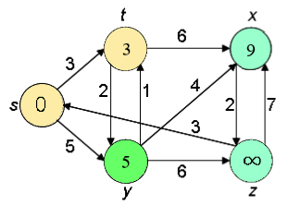
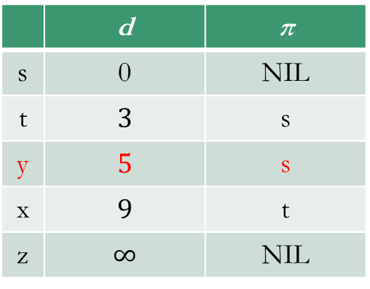
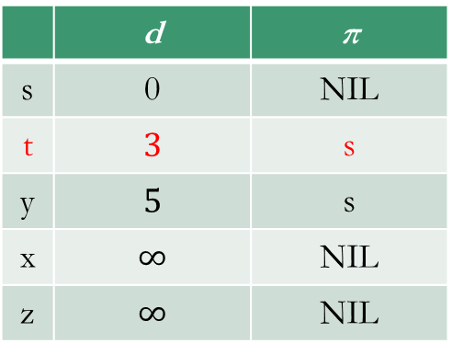
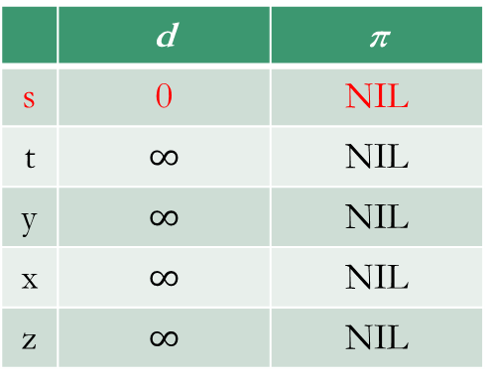
 | d | π
s | 0 | NIL
t | $$∞$$ | NIL
y | $$∞$$ | NIL
x | $$∞$$ | NIL
z | $$∞$$ | NIL
 | d | π
s | 0 | NIL
t | $$3$$ | s
y | $$5$$ | s
x | $$∞$$ | NIL
z | $$∞$$ | NIL
 | d | π
s | 0 | NIL
t | $$3$$ | s
y | $$5$$ | s
x | $$9$$ | t
z | $$∞$$ | NIL

Slide 4
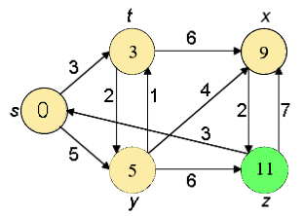
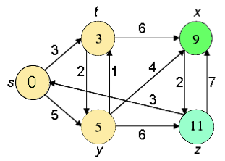
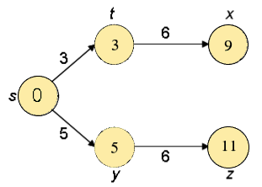
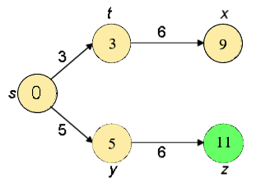
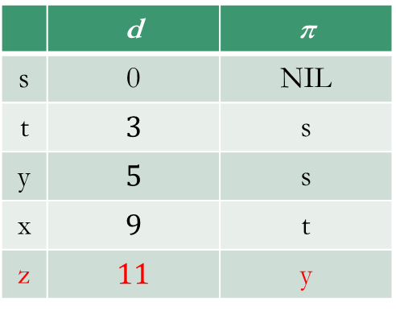
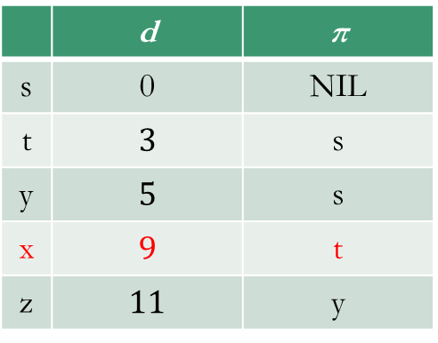
 | d | π
s | 0 | NIL
t | $$3$$ | s
y | $$5$$ | s
x | $$9$$ | t
z | $$11$$ | y
 | d | π
s | 0 | NIL
t | $$3$$ | s
y | $$5$$ | s
x | $$9$$ | t
z | $$11$$ | y

Slide 5
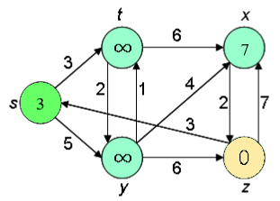
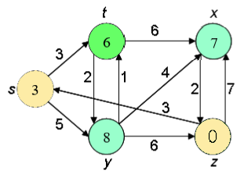
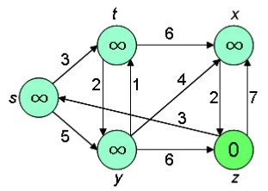
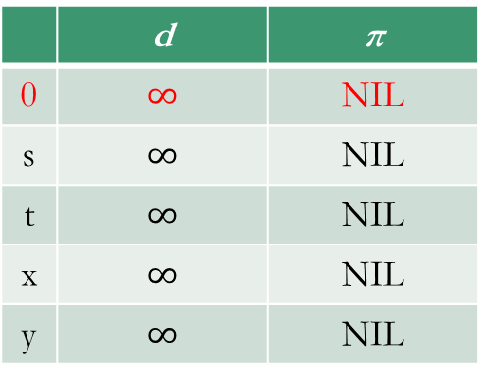
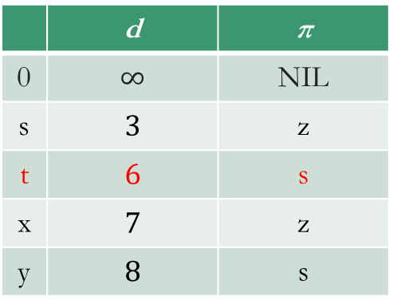
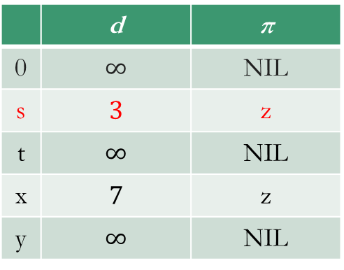
 | d | π
0 | $$∞$$ | NIL
s | $$∞$$ | NIL
t | $$∞$$ | NIL
x | $$∞$$ | NIL
y | $$∞$$ | NIL
 | d | π
0 | $$∞$$ | NIL
s | $$3$$ | z
t | $$∞$$ | NIL
x | $$7$$ | z
y | $$∞$$ | NIL
 | d | π
0 | $$∞$$ | NIL
s | $$3$$ | z
t | $$6$$ | s
x | $$7$$ | z
y | $$8$$ | s

Slide 6
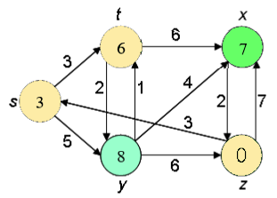
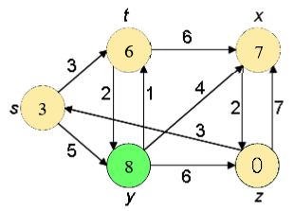
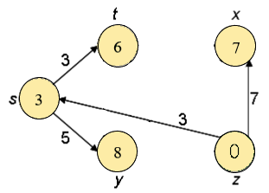
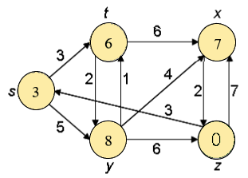
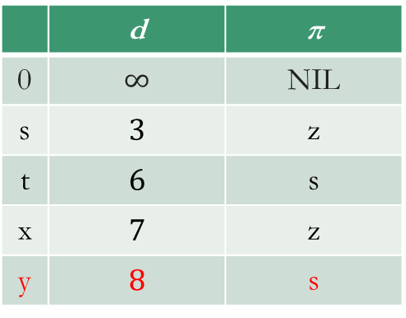
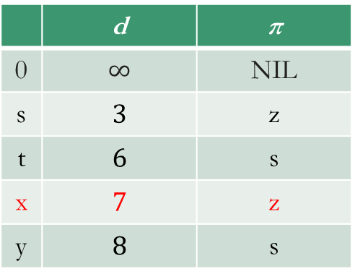
 | d | π
0 | $$∞$$ | NIL
s | $$3$$ | z
t | $$6$$ | s
x | $$7$$ | z
y | $$8$$ | s
 | d | π
0 | $$∞$$ | NIL
s | $$3$$ | z
t | $$6$$ | s
x | $$7$$ | z
y | $$8$$ | s

Slide 7


