Slide 1
HW10 #6
第二組

Slide 2
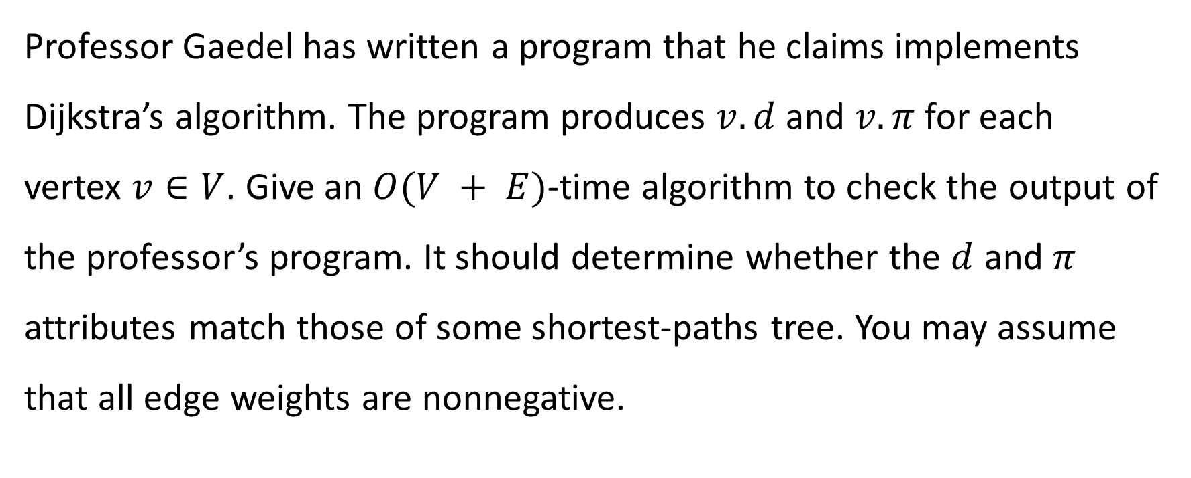
#6 Exercises 24.3-4
Professor Gaedel has written a program that he claims implements Dijkstra’s algorithm. The program produces $v.d$ and $v.π$ for each vertex $v∈V$. Give an $O(V + E)$-time algorithm to check the output of the professor’s program. It should determine whether the $d$ and $π$ attributes match those of some shortest-paths tree. You may assume that all edge weights are nonnegative.

Slide 3

An approach to solve #6
Suppose that $s$ is the source vertex.
Check $s.π=$ NIL and $s.d=0$.
For each $v∈V∖\left\{s\right\}$:
If $v.π≠$ NIL, check $v.d=v.π.d+w\left(v, v.π\right)$.
If $v.π=$ NIL, check $v.d=+∞$.
Do 1-pass of Bellman-Ford and check if the tree changes.
Check if the tree is valid.
Check if the Bellman-Ford converge.

Slide 4
1-pass of Bellman-Ford
is_shortest_paths_tree = true
foreach (u, v) in Edges:
if v.d > u.d + w(u, v):
is_shortest_paths_tree = false
break

Slide 5
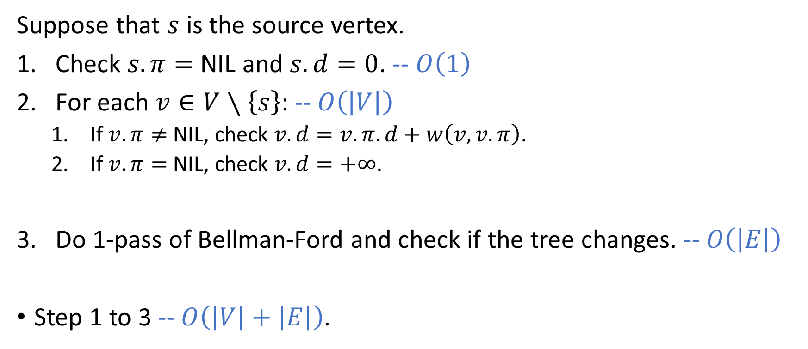
Time complexity
Suppose that $s$ is the source vertex.
Check $s.π=$ NIL and $s.d=0$. -- $O\left(1\right)$
For each $v∈V∖\left\{s\right\}$: -- $O\left(\left|V\right|\right)$
If $v.π≠$ NIL, check $v.d=v.π.d+w\left(v, v.π\right)$.
If $v.π=$ NIL, check $v.d=+∞$.
Do 1-pass of Bellman-Ford and check if the tree changes. -- $O\left(\left|E\right|\right)$
Step 1 to 3 -- $O\left(\left|V\right|+\left|E\right|\right)$.

