Slide 1
Q8
第4組

Slide 2
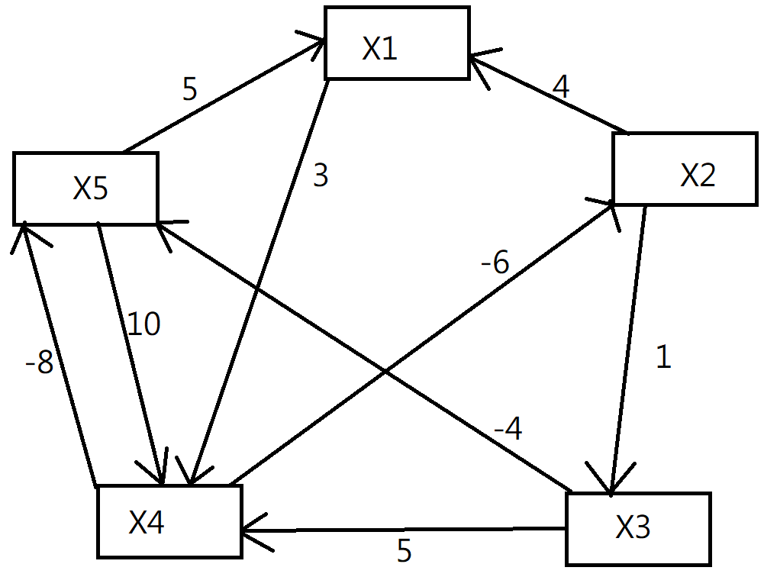
畫成圖

Slide 3
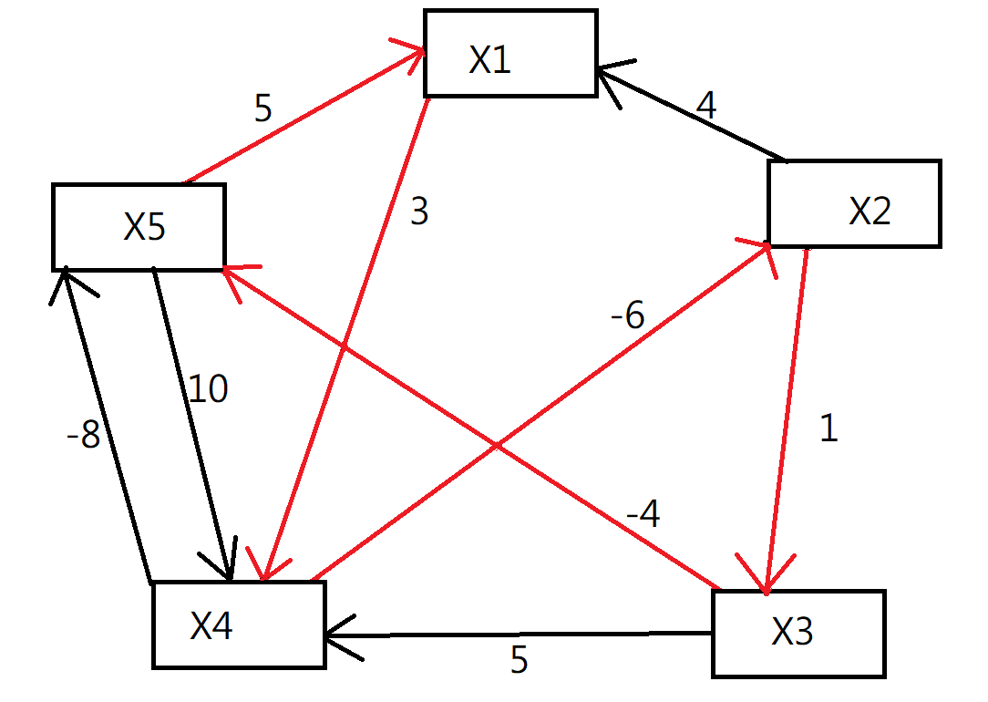
3-6+1-4+5=-1

Slide 4
There is no feasible solution because the constraint graph contains a negative-weight cycle: (v_1, v_4, v_2, v_3, v_5, v_1)has weight :−1

