Slide 1
HW10-第一題
第7組

Slide 2
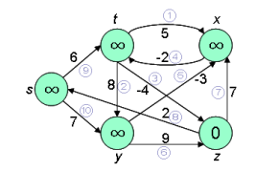
題目
1.Use z as a source, run Bellman-Ford algorithm with order in figure.
2.Change the weight of edge(z,x) to 4 and run Bellman-Ford
algorithm again using s as source.

Slide 3
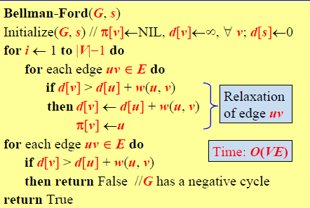
Bellman-Ford algorithm
Initial
V | s | t | x | y | Z
Pi | 0 | 0 | 0 | 0 | 0
d | ∞ | ∞ | ∞ | ∞ | 0

Slide 4
1.Use z as a source, run Bellman-Ford algorithm with order in figure.
i=1
1. X 7. O
2. X 8. O
3. X 9. X
4. X 10. X
5. X
6. X
 | s | t | x | y | Z
Pi | z | 0 | z | 0 | 0
d | 2 | ∞ | 7 | ∞ | 0

Slide 5
1.Use z as a source, run Bellman-Ford algorithm with order in figure.
i=2
1. X 7. X
2. X 8. X
3. X 9. X
4. O 10. O
5. X
6. X
7
2
 | s | t | x | y | Z
Pi | z | x | z | s | 0
d | 2 | 5 | 7 | 9 | 0

Slide 6
1.Use z as a source, run Bellman-Ford algorithm with order in figure.
i=3
1. X 7. X
2. X 8. X
3. X 9. X
4. X 10. X
5. O
6. X
5
7
2
9
 | s | t | x | y | Z
Pi | z | x | y | s | 0
d | 2 | 5 | 6 | 9 | 0

Slide 7
1.Use z as a source, run Bellman-Ford algorithm with order in figure.
i=4
1. X 7. X
2. X 8. X
3. X 9. X
4. O 10. X
5. X
6. X
5
6
2
9
 | s | t | x | y | Z
Pi | z | x | y | s | 0
d | 2 | 4 | 6 | 9 | 0

Slide 8
1.Use z as a source, run Bellman-Ford algorithm with order in figure.
check
1. X 7. X
2. X 8. X
3. X 9. X
4. X 10. X
5. X return true
6. X
4
6
2
9
 | s | t | x | y | Z
Pi | z | x | y | s | 0
d | 2 | 4 | 6 | 9 | 0

Slide 9
2.Change the weight of edge(z,x) to 4 and run Bellman-Ford algorithm again using s as source.
i=1
1. X 7. X
2. X 8. X
3. X 9. O
4. X 10. O
5. X
6. X
0
4
∞
 | s | t | x | y | Z
Pi | 0 | s | 0 | s | 0
d | 0 | 6 | ∞ | 7 | ∞

Slide 10
2.Change the weight of edge(z,x) to 4 and run Bellman-Ford algorithm again using s as source.
i=2
1. O 7. X
2. X 8. X
3. O 9. X
4. X 10. X
5. O
6. X
6
0
4
7
2
 | s | t | x | y | z
Pi | 0 | s | t/y | s | t
d | 0 | 6 | 11/4 | 7 | 2

Slide 11
2.Change the weight of edge(z,x) to 4 and run Bellman-Ford algorithm again using s as source.
i=3
1. X 7. X
2. X 8. X
3. X 9. X
4. O 10. X
5. X
6. X
6
4
0
4
7
2
 | s | t | x | y | z
Pi | 0 | x | y | s | t
d | 0 | 2 | 4 | 7 | 2

Slide 12
2.Change the weight of edge(z,x) to 4 and run Bellman-Ford algorithm again using s as source.
i=4
1. X 7. O
2. X 8. X
3. O 9. X
4. X 10. X
5. X
6. X
2
4
0
4
7
2
 | s | t | x | y | z
Pi | 0 | x | z | s | t
d | 0 | 2 | 2 | 7 | -2

Slide 13
2.Change the weight of edge(z,x) to 4 and run Bellman-Ford algorithm again using s as source.
check
1. X 7. X
2. X 8. X
3. X 9. X
4. O 10. X
5. X return false
6. X exists negative cycle
2
2
0
4
7
-2
 | s | t | x | y | z
Pi | 0 | x | z | s | t
d | 0 | 2 | 2 | 7 | -2

