Slide 1
Week 11-Question 2
第六組

Slide 2
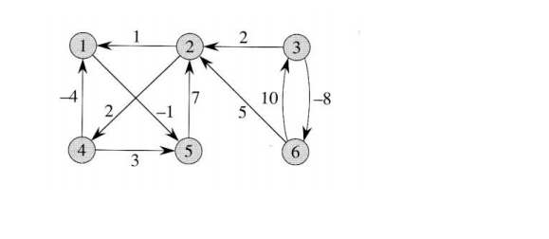
Question
Exercises 25.3-1 Use Johnson's algorithm to find the shortest paths between all pairs of vertices in the graph of Figure 25.2. Show the values of h and ŵ computed by the algorithm.

Slide 3
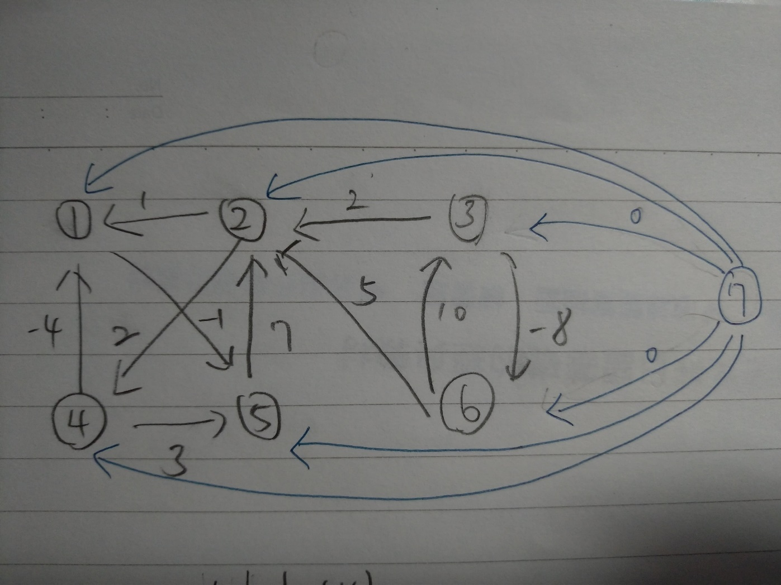
新增一個起點，到各個點權重都是0

Slide 4
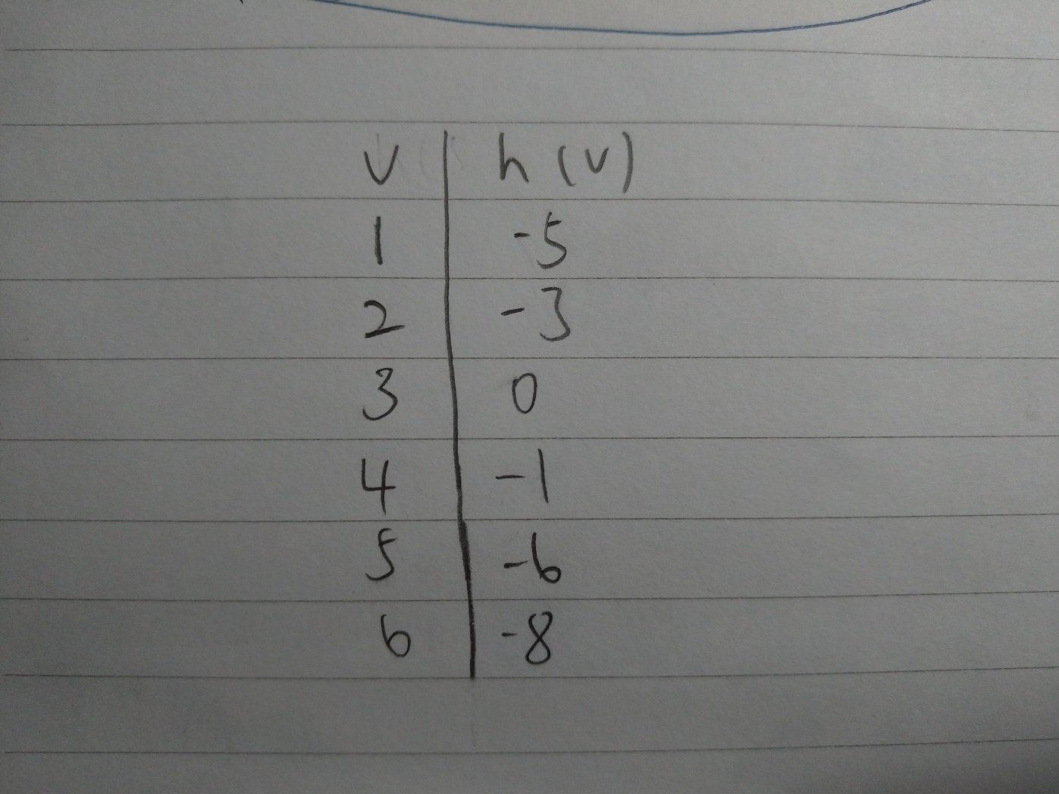
求出h(v)的值

Slide 5
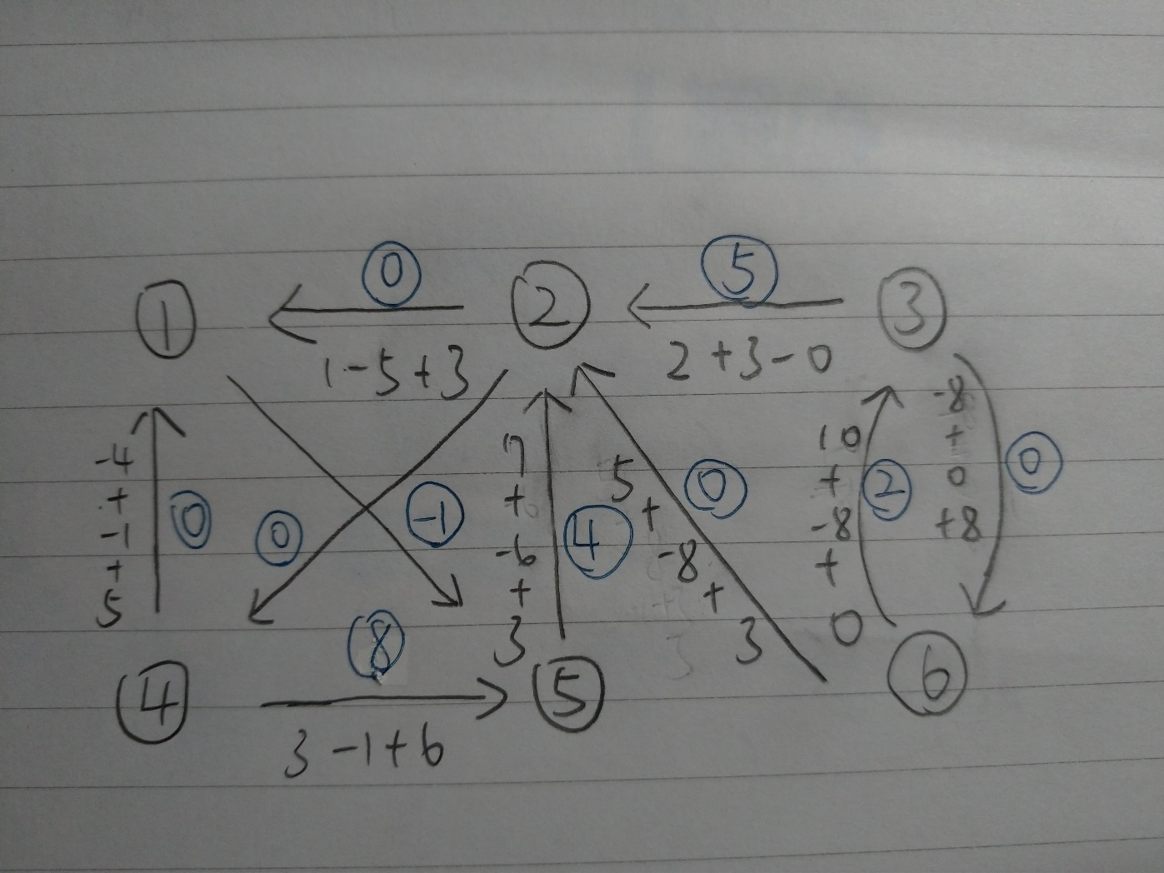
W'(u,v) = W(u,v) + h(u) - h(v)

Slide 6
Answer
V | h(v)
1 | -5
2 | -3
3 | 0
4 | -1
5 | -6
6 | -8
(u,v) | (1,5) | (2,1) | (2,4) | (3,2) | (3,6) | (4,1) | (4,5) | (5,2) | (6,2) | (6,3)
w'(u,v) | 0 | 3 | 0 | 5 | 0 | 0 | 8 | 4 | 0 | 2

Slide 7
answer
0​​​ | ​6 | ∞ | 8 | -1 | ∞
−2 | 0 | ∞ | 2 | -3 | ∞
−5 | −3 | 0 | -1 | -6 | -8
−4 | 2 | ∞ | 0 | -5 | ∞
5 | 7 | ∞ | 9 | 0 | ∞
3 | 5 | 10 | 7 | 2 | 0

