Slide 1
HW11 第三題
第七組

Slide 2
題目
Arbitrage (套利) is the use of discrepancies in currency exchange rates to transform one unit of a currency into more than one unit of the same currency.
For example, suppose that 1 U.S. dollar buys 49 Indian rupees, 1 Indian rupee buys 2 Japanese yen, and 1 Japanese yen buys 0.0107 U.S. dollars. Then, by converting currencies, a trader can start with 1 U.S. dollar and buy 49*2*0.0107 = 1.0486 U.S. dollars, thus turning a profit of 4.86 percent.

Slide 3
題目設定
n currencies c1, c2, … cn
an n * n table R of exchange rates
one unit of currency ci buys R[i, j] units of currency cj .
Give an efficient algorithm to determine whether or not there exists a sequence of currencies such that R[i1, i2]xR[i2, i3]x…xR[ik-1, ik]xR[ik, i1] > 1 . Analyze the running time of your algorithm.
Give an efficient algorithm to print out such a sequence if one exists. Analyze the running time of your algorithm.

Slide 4
題目摘要
A，判斷有沒有存在通過一整圈(從1->k再到1)地交換而可以實現的套利
(頭尾相連)
B，如果存在的話交換路徑為何

Slide 5
The Floyd-Warshall algorithm
只要找到r^{k}[u,u]>1就有解
if k==0, r⁰[u,v]= R[u,v]
r^{k}[u,v]= max｛ r^{(k-1)}[u,v]， r^{(k-1)}[u,k]x r^{(k-1)}[ k,v]｝
r^{(k)}[u,v]=將u幣，經過第k國，轉為v幣
Profit=r[u,v]xR[v,u]-1

Slide 6
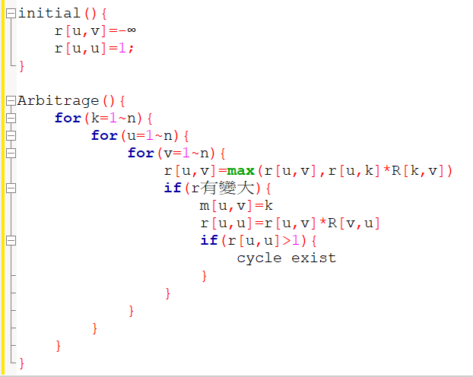
Pseudo Code
複雜度：O(n³)
因為是完全圖，所以用 Bellman-Ford algorithm
O(|V||E|)=O(n*n²)=O(n³)，並不會比較快

Slide 7
Bellman-Ford algorithm
L[u,v]=-log R[u,v]
接著找負迴圈
複雜度=O(|V||E|)=O(|V|*V²)=O(V³)

Slide 8
找出路徑
用m來存路徑
請參考CH9 P.45

Slide 9
Path(u,v){
if(m[u,v]==0){
Cout<<u;
}else{
Path(u,m[u,v])
Path(m[u,v],v)
}
}
主程式裡：
Path(u,u);
Cout<<u;

Slide 10
謝謝

