Slide 1
Algorithms HW12 - 2
第三組

Slide 2
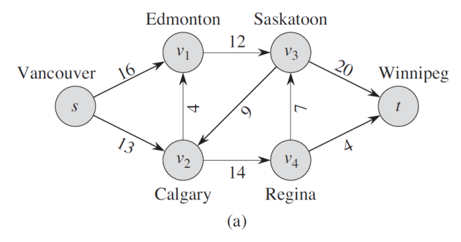
2. Show the execution of the Edmonds-Karp algorithm on the flow network of Figure 26.1(a).

Slide 3
Edmonds-Karp algorithm
利用 Ford-Fulkerson Algorithm 並使用BFS搜尋路徑
S1 : Star with zero flow everywhere
S2 : 以BFS()尋找路徑，且此路徑一定經過「最少的edge」
S3 : 觀察此路徑上每條邊，
找到 minimum capacity，便更新「總flow」
S4 : 以最小minimum capacity 更新Graph上的edge
S5 : 重複S3,S4，直到沒有能夠增加flow 的paths (Augmenting Paths)

Slide 4
Path : s → V1 → V3 → t
minimum capacity : 12
12
16
20
4
7
9
13
4
14

Slide 5
Path : s → V1 → V3 → t
minimum capacity : 12 / maximum flow : 12
12/12
12/20
12/16
4
7
9
13
4
14

Slide 6
Path : s → V2 → V4 → t
minimum capacity : 4
12/12
12/20
12/16
4
7
9
13
4
14

Slide 7
Path : s → V2 → V4 → t
minimum capacity : 4 / maximum flow : 16
12/12
12/20
12/16
4
7
9
4/13
4/4
4/14

Slide 8
Path : s → V2 → V4 → V3 → t
minimum capacity : 7
12/12
12/20
12/16
4
7
9
4/13
4/4
4/14

Slide 9
Path : s → V2 → V4 → V3 → t
minimum capacity : 7 / maximum flow : 23
12/12
19/20
12/16
4
7/7
9
11/13
4/4
11/14

Slide 10
Maximum flow : 23
12/12
19/20
12/16
4
7/7
9
11/13
4/4
11/14

