Slide 1



第一題
Notes:
READ PLEASE!
Before you open this template be sure that you have installed these fonts:
GeosansLight.ttf from: http://www.dafont.com/geo-sans-light.font
New Cicle Semi.ttf from: http://www.dafont.com/new-cicle.font
fontawesome-webfont.ttf from: http://fortawesome.github.io/Font-Awesome
All fonts are free for use in commercial projects!
If you have any problems with this presentation, please contact with me from this page: http://graphicriver.net/user/Bandidos

Slide 2
題目
Show that if an algorithm makes at most a constant number of calls to polynomial time subroutines and performs an additional amount of work that also takes polynomial time, then it runs in polynomial time. Also show that a polynomial number of calls to polynomial-time subroutines may result in an exponential-time algorithm.

Slide 3
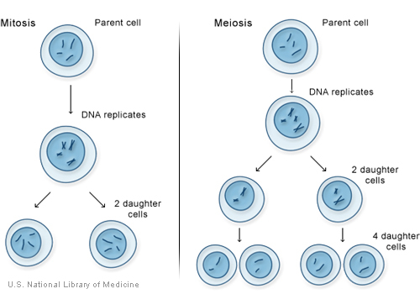
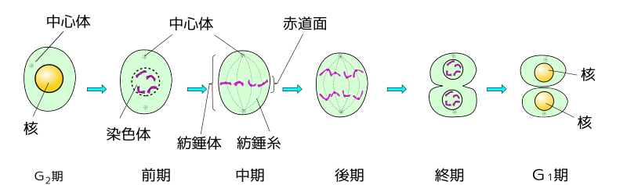
第一小題解法
假設我們寫了 一個細胞分裂的程式
n -> 2n
2n -> 4n
4n -> 8n
.
.
.
總共做
k (at most a constant number)次
additional amount of work that also
takes polynomial time

Slide 4
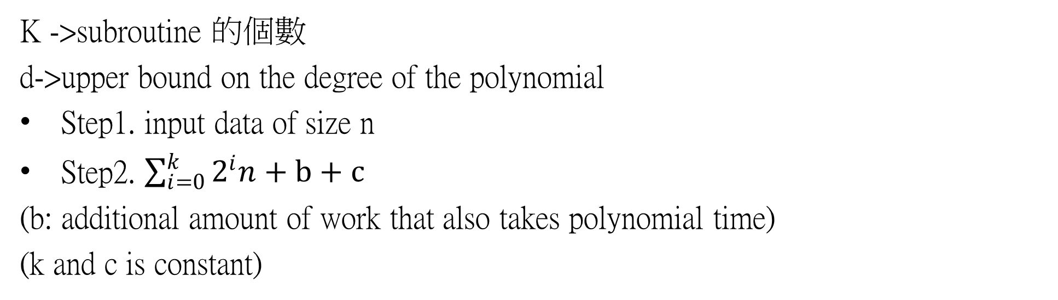
第一小題解法
K ->subroutine 的個數
d->upper bound on the degree of the polynomial
Step1. input data of size n
Step2. $\sum_{i=0}^{k}{2^{i}n}+b+c$
(b: additional amount of work that also takes polynomial time)
(k and c is constant)

Slide 5

第二小題解法
假設我們寫了 一個細胞分裂的程式
n -> 2n
2n -> 4n
4n -> 8n
.
.
.
最$後加起來\sum_{k=1}^{n}{2^{k}}$n
總共做n (polynomial-time)次

Slide 6
謝謝

